Slide 1

SPS Golang workshop
David Alfred Ostrowski PhD. Northwestern University david.ostrowski@northwestern.edu

Slide 2
Overview
Assumptions
Introduction / Basic Concepts
Demo of nominal blockchain written in GoLang
Conclusion

Slide 3
What is Blockchain?
A digital ledger in which transactions are made in bitcoin or another cryptocurrency are recorded chronologically and publicly
A distributed ledger
A public database where new data is stored in a container called a block and are added to an immutable chain with data added in the past
The Napster of record keeping
Networked Excel?

Slide 4
What is blockchain? … just a data structure
It can increase in size
Shared by different clients (P2P)
Not possible to modify data – since cryptographic tools are used
Any modification will be stored in the chain and be public forever
It is structured as a chain of blocks (linked list) where each block has a set of transactions that occurred during a specific period (time-stamped)

Slide 5
Some relevant definitions…
Blockchain- the longest path from the genesis block (root) to the leaf (transaction history)
Block – a data structure used to communicate incremental changes to the local state of the node
Transaction – (think bitcoin) A transaction is a data structure that describes the transfer of bitcoins from spenders to recipients

Slide 6
Benefits
Ownership of data : Ownership of digital, physical records and assets of any kind can be proved
Uniqueness and proof of uniqueness. The uniqueness of a digital, physical record and asset is guaranteed
Immutability- Data stored on a blockchain is accepted as valid and cannot be modified.
Censorship resilient- the existence of censorship like firewalls blocking access to data is not possible

Slide 7
More Benefits
Public transparency and traceability – Anyone can see the content of the transactions and audit them
Trust-less and incorruptible- Blockchain allow us to build trust-less systems using P2P , such that contracts can be encoded without trusted third parties
Cost-efficient- can be reduced since there are no external actors and there exists a unique homogeneous platform for different tasks
Guaranteed continuity- the continuity of the system is guaranteed as far there are nodes running the chain.

Slide 8
Smart Contracts
Smart contracts help you exchange money, property, shares, or anything of value in a transparent, conflict-free way while avoiding the services of a middleman.
An algorithm that can self-execute, self-enforce , self-verify and self-constraint the performance of the contract
Bitcoin the first example

Slide 9
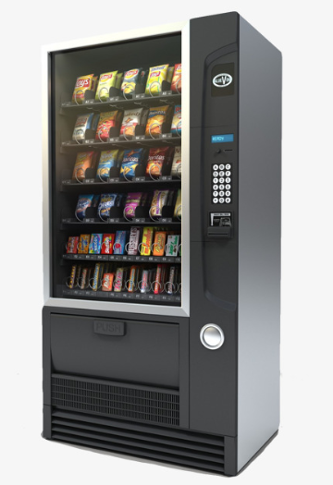
Smart Contracts
Perhaps one of the best analogies to a smart contract is a vending machine
A vending machine is a very straight-forward (albeit mechanical) implementation of a contract
It enforces a very simplistic representation of an agreement – you provide 1.25 in return for a bag of chips etc.

Slide 10
“Smart Contracts” as a tool to automate human interactions
Ordinarily, you would go to a lawyer or a notary, pay them, and wait while you get the document.
With smart contracts, you simply drop a bitcoin into the vending machine (i.e. ledger), and your escrow, driver’s license, or whatever drops into your account.
More so, smart contracts not only define the rules and penalties around an agreement in the same way that a traditional contract does, but also automatically enforce those obligations.

Slide 11
Short list of potential applications of the blockchain
Payment processing and money transfers
Expedite the transfer of funds
Can be settled within a matter of seconds (compared to current banking)
Monitor supply chains
Pinpoint inefficiencies within their supply chains quickly
locate items in real time
View how products performed from a quality-control perspective as they traveled from their place of origin to the retailer.

Slide 12
more
Retail loyalty rewards programs
Token-based system that rewards consumers
Storing these tokens within a blockchain
Incentivize consumers to return to a certain store or chain to do their shopping.
Eliminate the fraud and waste commonly associated with paper- and card-based loyalty rewards programs.
Digital IDs
Give users a way to control their digital identities.
This would allow folks in impoverished regions to get access to financial services, or start their own business, as an example.

Slide 13
more
Digital voting
Blockchain offers the ability to vote digitally
(Eliminate voter fraud)
Transparent
Ease of digital voting w/ immutability
Real estate, land, and auto title transfers
Take paper out of the equation, since paper trails are often a source of confusion. If you're buying or selling land, a house, or a car, you'll need to transfer or receive a title.
Store titles on its network, allowing for a transparent view of this transfer

Slide 14
Paradigm change:
Goal: To lower your uncertainty as related to
economic activity
intermediary
Ebay, amazon,
Alibaba online
banks,
Etc..
You
Good or service
Blockchain
just software
with no middleman
You
Good or service

Slide 15
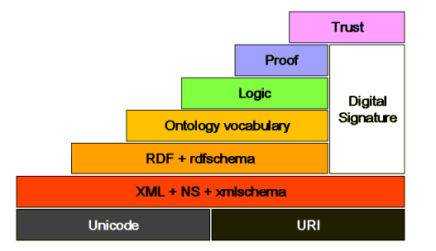
Semantic Web / Linked Data / Blockchain
Wait .. .this is looking a lot about all of the prior concepts in blockchain?

Slide 16
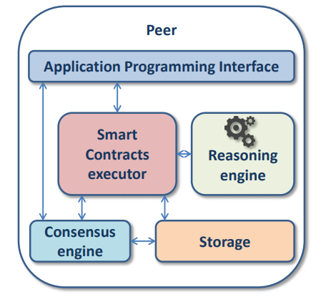
Semantic Blockchain for IOT (sWot) (“semantic web of things”)
Ruta et.al. proposed a novel Service-Oriented Architecture (SOA) based on a semantic blockchain for registration, discovery, selection and payment.
Agents registered in the blockchain are identified by public keys
Each asset can be semantically annotated
Smart Contracts can be semantically enhanced
Semantic-based transactions are tracked and validated by the consensus engine
Semantic transactions are managed in an efficient and safe storage

Slide 17
Geth
Geth - preferred client for Ethereum blockchain – written in Golang.

Slide 18
Code breakdown
package main
import (
"fmt"
"time"
"crypto/sha256"
)

Slide 19
Source code breakdown
type Block struct {
timestamp time.Time
transactions []string
prevhash []byte
Hash []byte
}

Slide 20
Source code breakdown
func main() {
abc := []string{" A sent 50 coins to BC"}
xyz := Blocks(abc, []byte{})
fmt.Println("this is our first Block")
Print(xyz)
pqrs := []string{" PQ sent 230 coins to RS"}
klmn := Blocks(pqrs, xyz.Hash)
fmt.Println("This is our second block")
Print(klmn)
}

Slide 21
Source code breakdown
func Blocks(transactions []string, prevhash []byte) *Block {
currentTime := time.Now()
return &Block{
timestamp: currentTime,
transactions: transactions,
prevhash: prevhash,
Hash: NewHash(currentTime, transactions, prevhash),
}
}
NOTE:
In our real life (public) blockchains this information is extremely “computation-heavy” and as such represents the strength of this technology as you would need all of the computation power of ‘miners’ ( computers who solve cryptographic puzzles which uniquely identify each ‘block’ ) do duplicate a blockchain – this is an insurmountable task

Slide 22
Source code breakdown
func NewHash(time time.Time, transactions[]string, prevhash[]byte) []byte{
input := append(prevhash, time.String()...)
for transactions := range transactions {
input = append(input, string(rune(transactions))...)
}
hash := sha256.Sum256(input)
return hash[:]
}
NOTE:
sha256() function creates an almost-unique, fixed size 256-bit (32-byte) hash. Hash is so called a one way function. This makes it suitable for checking integrity of your data, challenge hash authentication, anti-tamper, digital signatures, blockchain.

Slide 23
Source code breakdown
func NewHash(time time.Time, transactions[]string, prevhash[]byte) []byte{
input := append(prevhash, time.String()...)
for transactions := range transactions {
input = append(input, string(rune(transactions))...)
}
hash := sha256.Sum256(input)
return hash[:]
}
NOTE:
sha256() function creates an almost-unique, fixed size 256-bit (32-byte) hash. Hash is so called a one way function. This makes it suitable for checking integrity of your data, challenge hash authentication, anti-tamper, digital signatures, blockchain.
Sha256 takes a piece of data and convert it into a new, unrecognizable data string of a fixed length.

Slide 24
Source code breakdown
func Transaction(block *Block){
fmt.Println("\tTransactions: ")
for i, transaction := range block.transactions {
fmt.Printf("\t\t%v: %q\n",i, transaction)
}
}

