Slide 1

Golang and Cloud Computing
David Alfred Ostrowski PhD.
Northwestern University david.ostrowski@northwestern.edu

Slide 2
Overview
Prereq / installation / documentation
Introduction to Golang in context of cloud
Applications
Live Coding 1: deployment of applications to google cloud
Live Coding 2: deployment of ‘hello world” cloud functions on GCP
Conclusion

Slide 3
Background / Goals
Examples are demonstrated on the google cloud platform
Please read terms and conditions before using Google Cloud
NOTE : you can use this service with 300.00 initial credit but it can be used rapidly - especially if you are not well versed in the resource utilization
If you have a google account (e.g. gmail) you may be able to get started initially
Best Practice is to “disable” billing for a project after you have completed it.

Slide 4
Documentation
#Install “go”
sudo apt-get update
sudo apt install golang-go
Gihub demo 1 : Deployment of Golang web server to GCP
https://github.com/davidalfredostrowski/DeployGoWebServerToGCP
Youtube demo https://youtu.be/wABKP-xOVGo
Github demo 2: Deployment of Golang function as GCP function
https://github.com/davidalfredostrowski/GoogleCloudFunctionDemo/tree/main
Youtube demo https://youtu.be/tHUrt76t2zE

Slide 5
Prerequisite information
Knowledge of google cloud (GCP)
Exposure to basic UNIX commands (including the rudimentary ‘vi’ editor)
Access to related github repositories
Duplicate recordings (dry run presentations)

Slide 6
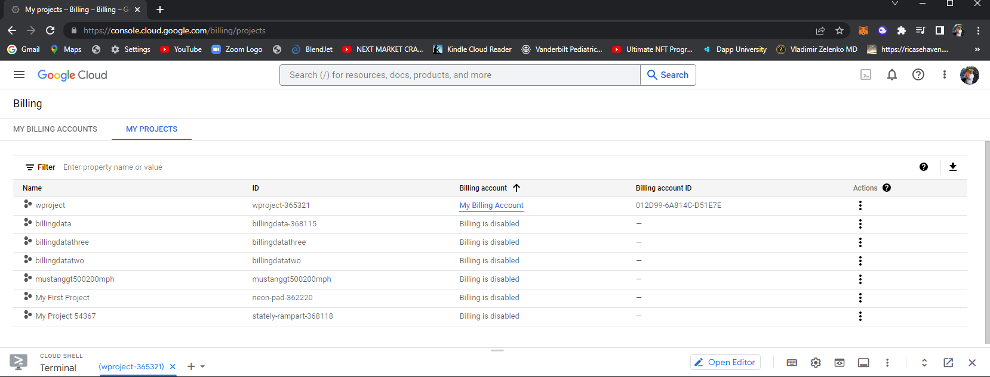
BEST PRACTICE!
Disable all billing

Slide 7
BEST PRACTICE!
Disable all Billing for all project if you
want to stop being billed / charged for
any resources being used
Disable all billing

Slide 8
Golang
Goals @ Google
Productivity
Scalability
Originally developed Golang for Cloud Programming
Server-side
Client-side programming is dominated by Java, JavaScript, or C #
GopherJS
Compile the Golang to pure JavaScript

Slide 9
Golang for Cloud-native development
Go’s concurrency and networking features, and its high degree of portability, make it well-suited for building cloud-native apps.
In fact, Go was used to build several cornerstones of cloud-native computing including Docker, Kubernetes, and Istio.

Slide 10
Comparisons
Speed:
Python code is easy to develop but not fast at run time
The higher speed makes Golang more scalable compared to Python.
Concurrency:
Python only allows one thread to run simultaneously.
In contrast, Golang offers multithreading through the goroutine mechanism.
Golang’s ability to run the program concurrently makes it more scalable than Python.

Slide 11
Golang vs Java
Java is also the language most commonly used for cloud computing. Scalability and concurrency, two effective characteristics of Golang, are essential for cloud computing.
Scalability: Enterprises are growing, and the number of users and queries is increasing, and only a highly scalable language can respond to these changes. How could a programming language be scalable? According to the definition of scalability:
“A scalable computer language is a language that one can write very large programs in (and extend very large programs that have already been written) without feeling an undue amount of pain.”
The simplicity of Golang reduces the system complexity and makes the system highly scalable.

Slide 12
Golang and Java
Concurrency: According to this report, there are best practices to reduce the number of servers using Golang. Concurrency is one of the remarkable features of Golang. The optimized and simultaneous use of computing power and memory utilization by Golang enables an increase in the overall application performance.

Slide 13
Reference Projects
Docker and Kubernetes are written in Go, and that alone is a good reason to learn it
It is also the language used to create Terraform.
Along with AngularJS, Red Hat used it to build its OpenShift Container Platform. Any developer who wishes to contribute to open source projects like Terraform, extend the OpenShift Container Platform or customize their Docker and Kubernetes implementations at the source-code level will need to know Go.

Slide 14

Golang in Context (Right Tool for the Job)
Understand native languages of the most influential tools
Seamless Integration
Understanding native code of the most influential projects

Slide 15
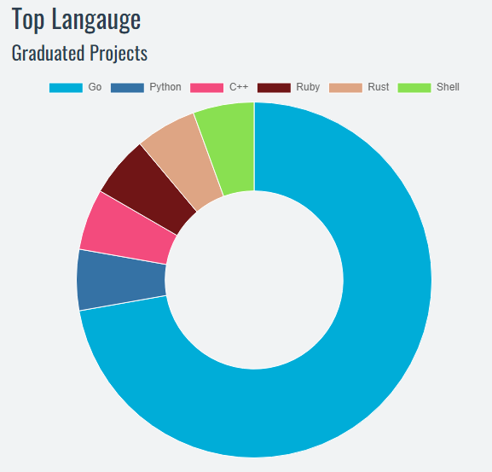
Cloud Native Computing Foundation (CNCF) statistics

Slide 16
Projects: Top two most influential projects in the cloud!
Docker
Linux container manage
Kubernetes
container deployment system

Slide 17
Live code session one: Deploy a web application to the Google cloud (GCP)
package main
import (
"log"
"net/http"
)
func helloGoHandler(w http.ResponseWriter, r *http.Request){
w.Write([]byte("Hello net/http\n"))
}
func main(){
http.HandleFunc("/", helloGoHandler)
log.Fatal(http.ListenAndServe(":8080", nil))
}

Slide 18
Overview of Steps:
Log on to google cloud (http://cloud.google.com)
Create a project
If prior user , select project
gcloud projects list
gcloud config set project <project-id>
“enable” billing (“billing”=> manage billing accounts=> my projects (right side ‘3-dots’)
Open the terminal shell

Slide 19
Main steps
git clone https://github.com/davidalfredostrowski/DeployGoWebServerToGCP
Cd <directory>
gcloud app deploy app.yaml
go run hello.go

Slide 20
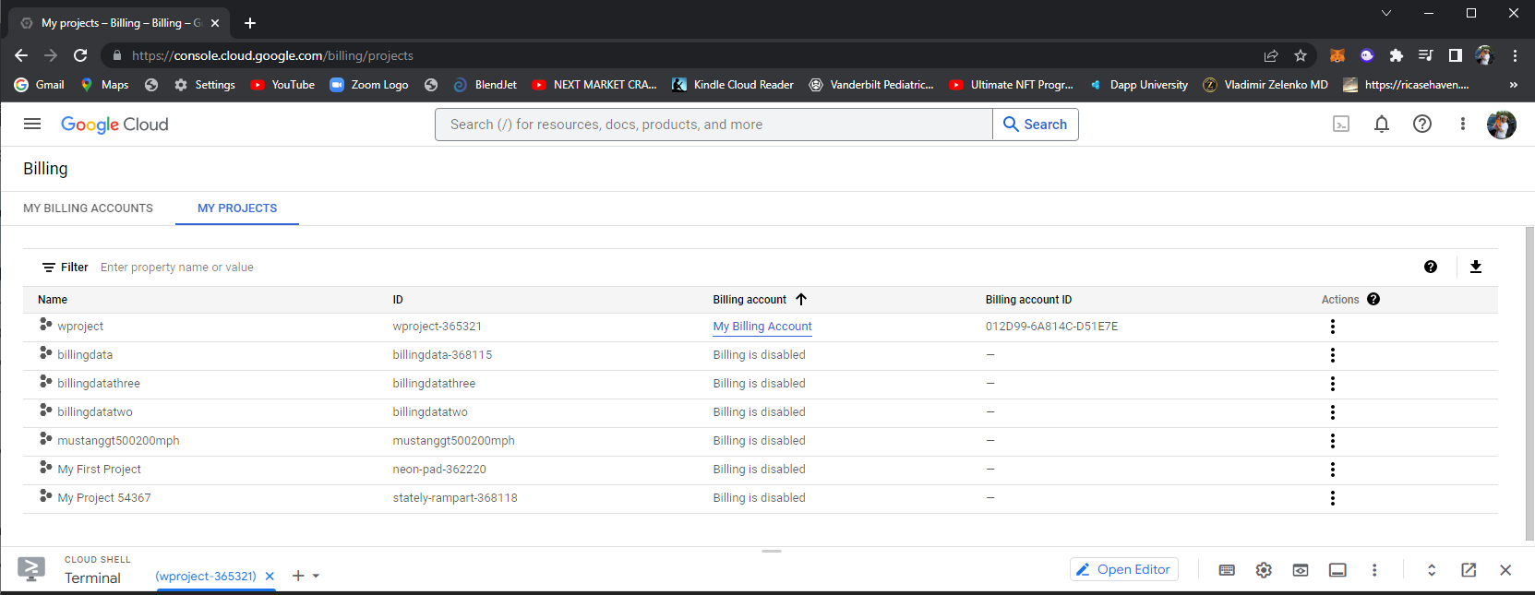

Slide 21
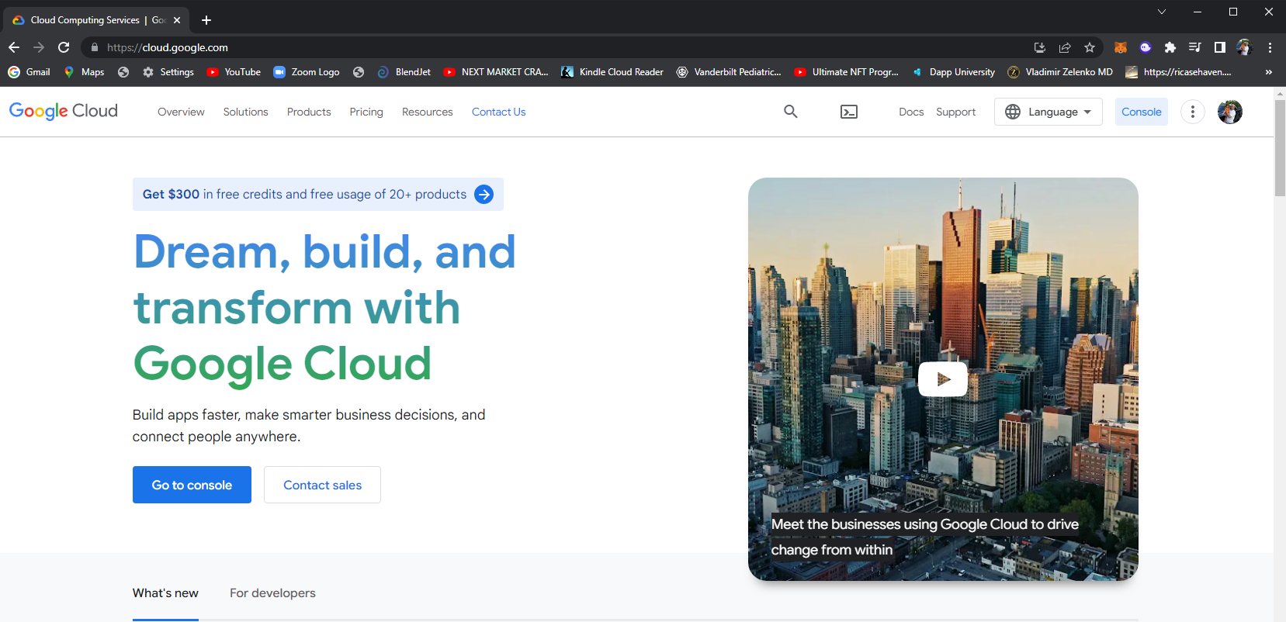

Slide 22
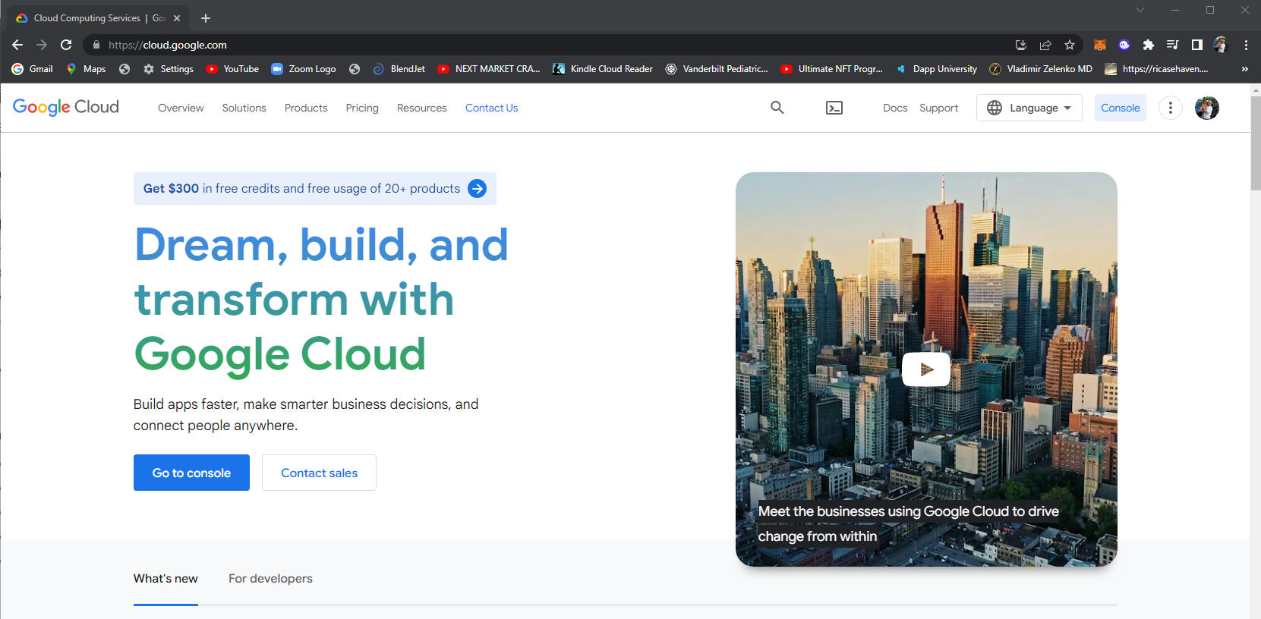

Slide 23
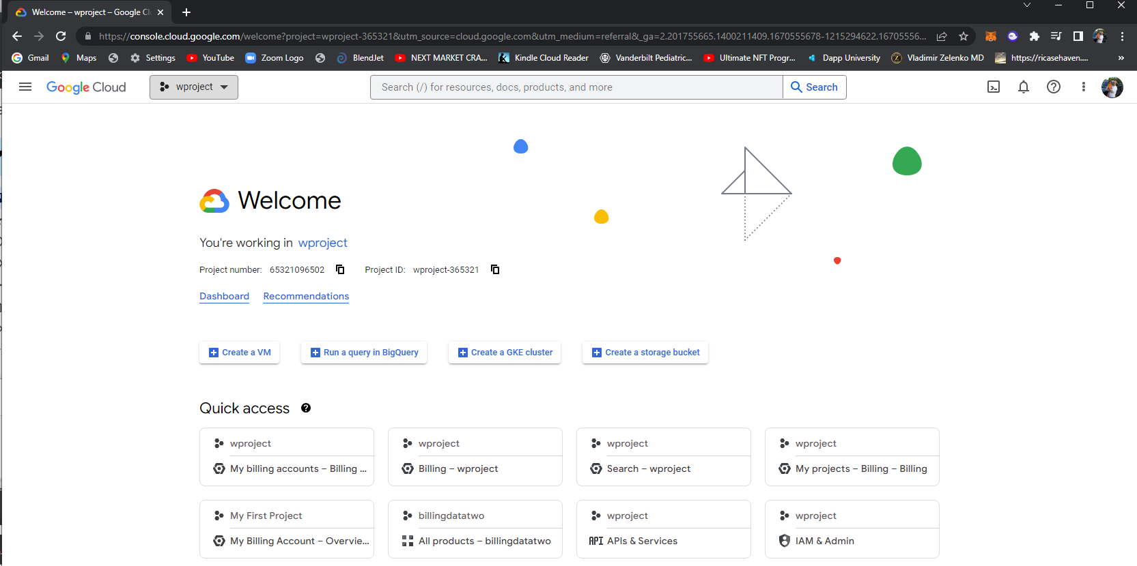

Slide 24
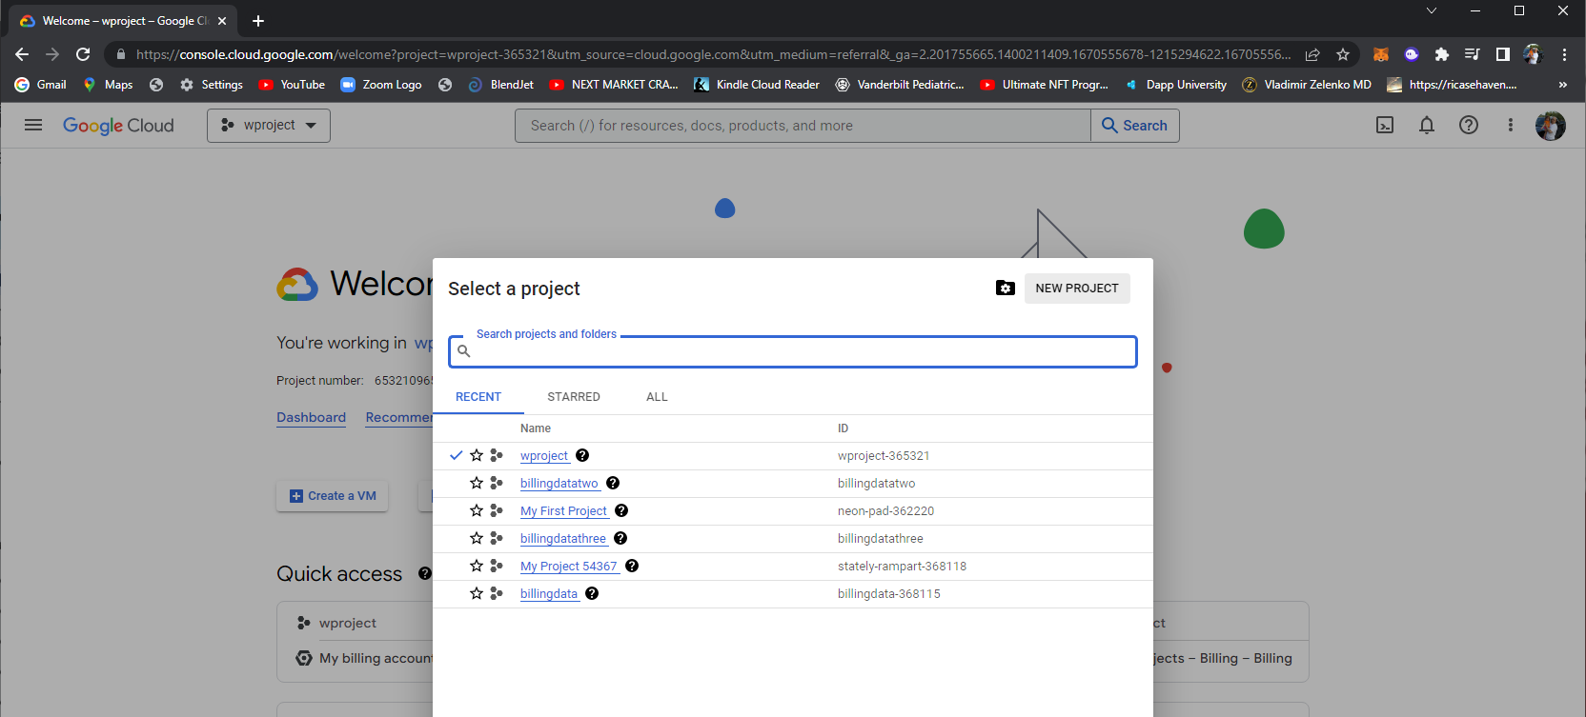

Slide 25
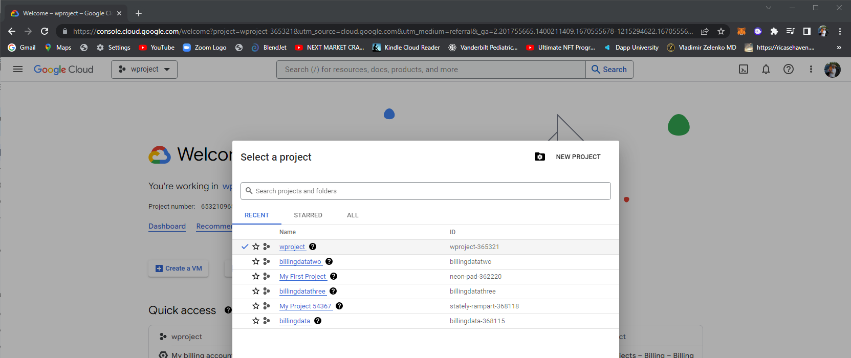

Slide 26
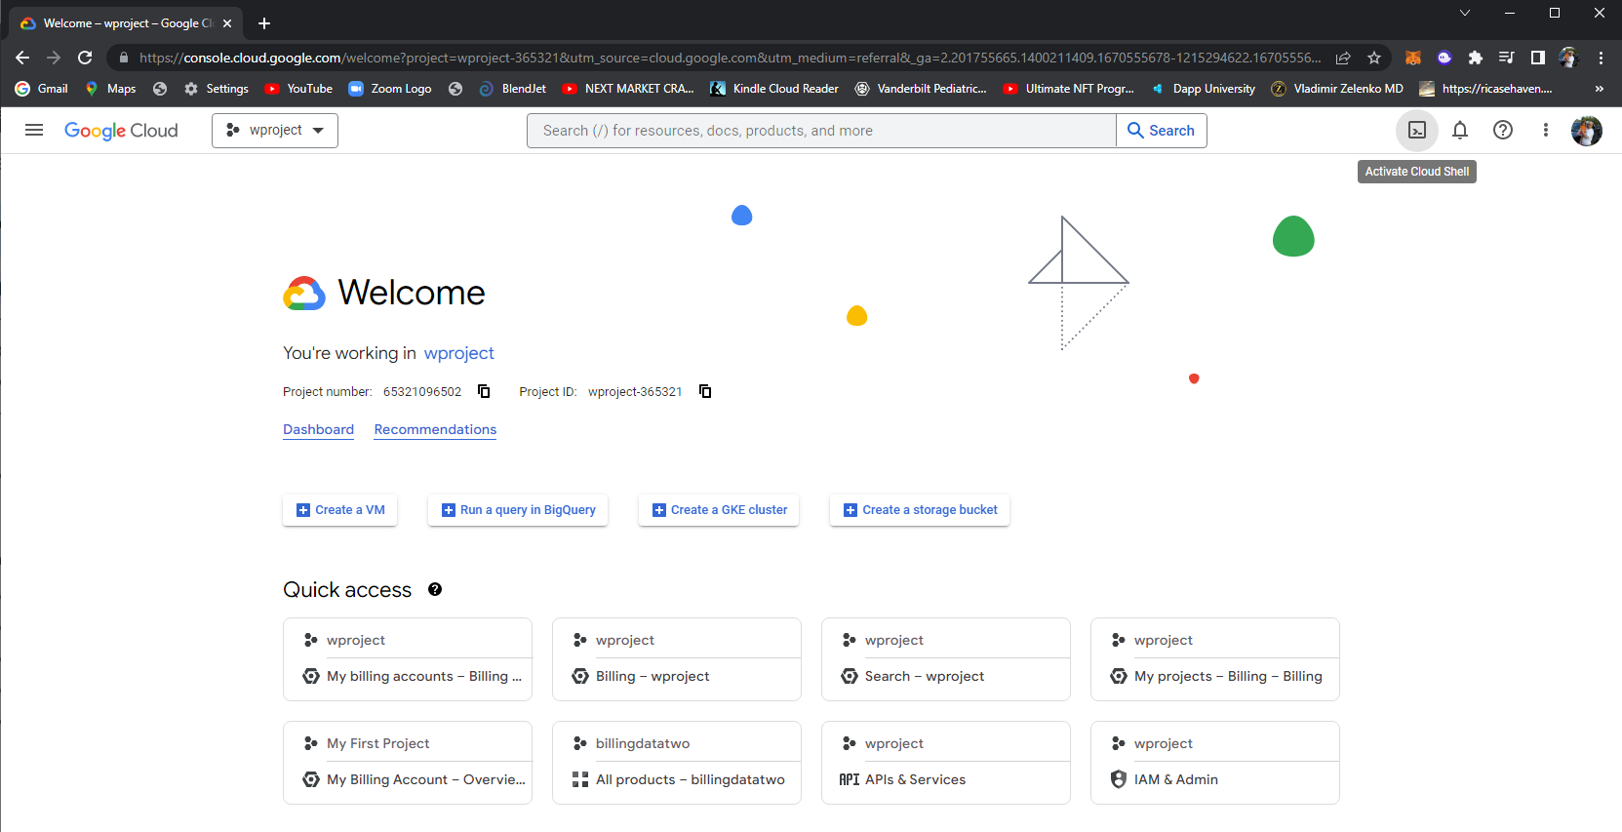

Slide 27
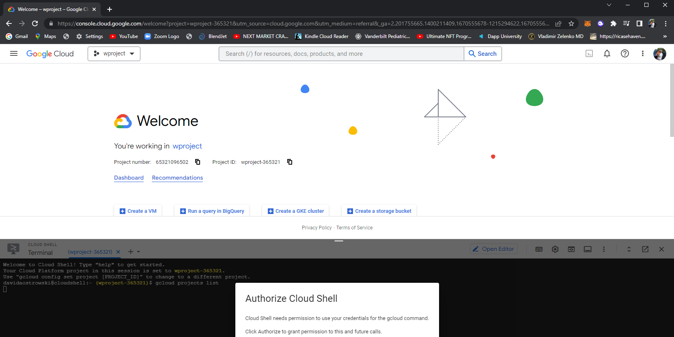

Slide 29
DEMO 1
Set projects / enable billing
Open cloud shell terminal
Install golang (if you do not have it already)
sudo apt-get update
sudo apt install golang-go
git clone https://github.com/davidalfredostrowski/DeployGoWebServerToGCP.git
gcloud app deploy app.yaml
go run hello.go
Access provided url from the deployment response

Slide 30
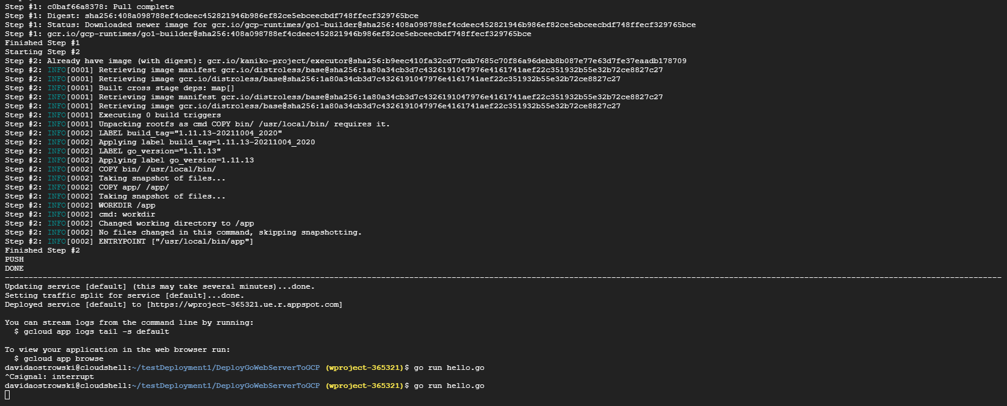

Slide 31
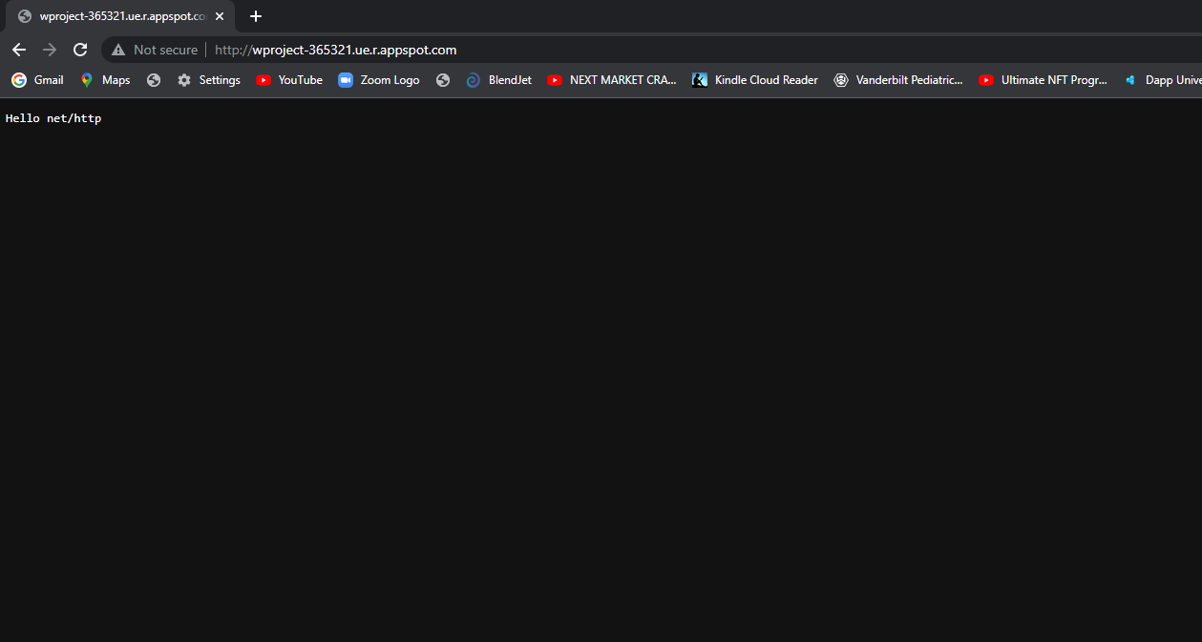

Slide 32
Live code demo two
gcloud services enable cloudfunctions.googleapis.com

Slide 33
Overview of Steps:
Log on to google cloud (http://cloud.google.com)
Create a project
If prior user , select project
gcloud projects list
gcloud config set project <project-id>
“enable” billing (“billing”=> manage billing accounts=> my projects (right side ‘3-dots’)
Open the terminal shell

Slide 34
Main steps
Edit your file
davidaostrowski@cloudshell:~/functionDemo2/hello (billingdatatwo)$ gcloud alpha functions deploy hello --entry-point F --runtime go111 --trigger-http --set-env-vars PROJECT_ID=billingdatatwo
Curl the function to obtain a response
Or put into a browser

Slide 35
Code of the Deployed Function
package hello
import "net/http"
func F(w http.ResponseWriter , r *http.Request) {
msg := []byte("hello world")
w.Write(msg)
}

Slide 36
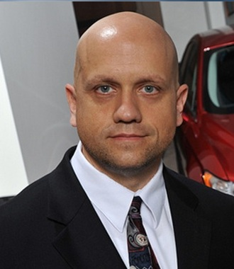
Dziękuję Ci Q/A
david.ostrowski@northwestern.edu
davidaostrowski@gmail.com

