Slide 2
curl -sL https://deb.nodesource.com/setup_14.x -o nodesource_setup.sh
3 sudo bash nodesource_setup.sh
4 sudo apt install nodejs
5 sudo apt install npm
6 sudo apt-get webpack@3.0.0
7 sudo apt-get install webpack@3.0.0
8 npm install webpack@3.0.0
9 npm install webpack-cli@3.0.8 --legacy-peer-deps
10 npm install node-gyp@3.6.2
11 npm install truffle@5.1.39
12 npm install web3
13 npm install create-react-app

Slide 3
1. run through basic install(s)
2. create base (root) project directory
3. from root project directory:
/home/ubuntu/node_modules/.bin/truffle init
This will create contracts
It will include the Migrations.sol
This will create migrations
1_* file
Copy it to make a 2_(deploy) file

Slide 4
My last problem - below was that it needed a parameter in the migration (deploy) file
ubuntu@ip-172-31-15-252:~/packt2/migrations$ cat 2_deploy_contracts.js
var Voting = artifacts.require("./Voting.sol");
module.exports = function(deployer) {
const listOfCandidates = ['Johnny', 'Amber']
deployer.deploy(Voting, listOfCandidates.map(name => web3.utils.asciiToHex(name) ));
};
ubuntu@ip-172-31-15-252:~/packt2/migrations$

Slide 5
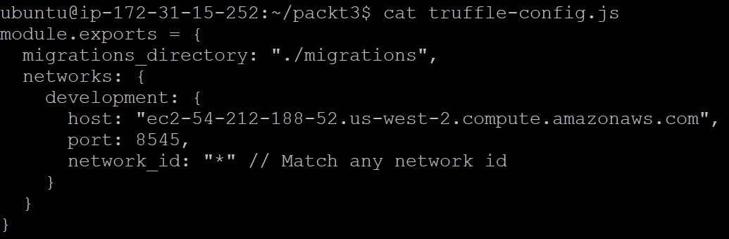

Slide 6
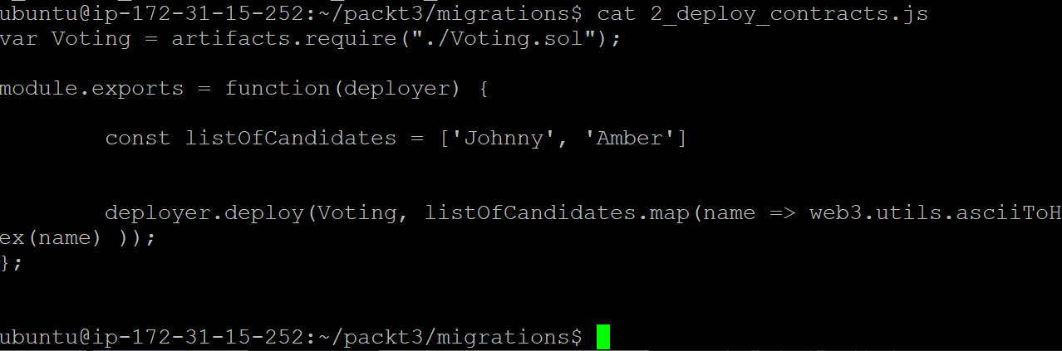

Slide 7
You should now have your two Json files (Voting, Migration)

Slide 8
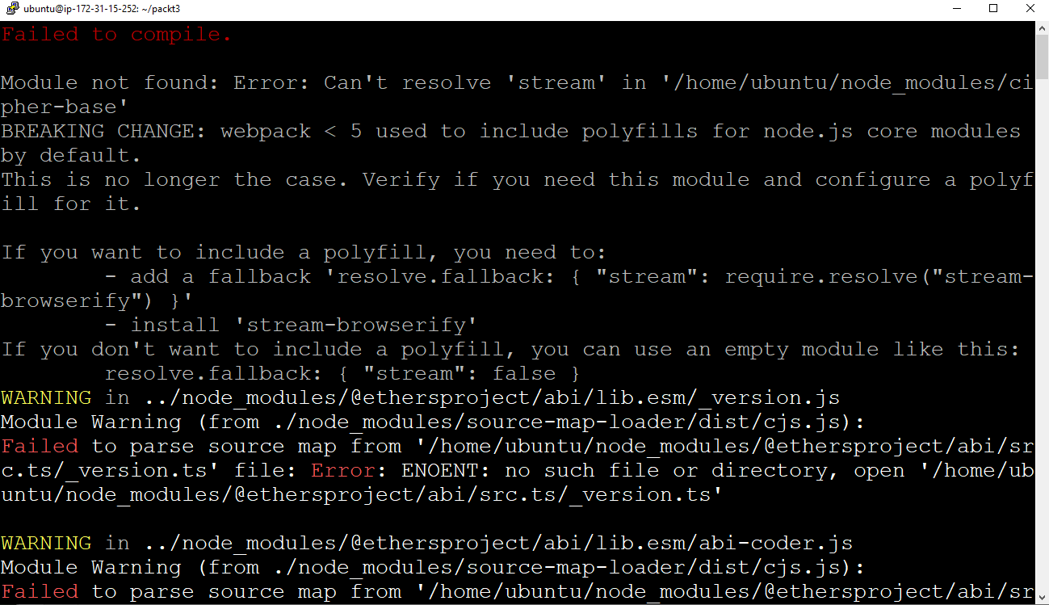

Slide 9
https://www.alchemy.com/blog/how-to-polyfill-node-core-modules-in-webpack-5
https://www.alchemy.com/blog/how-to-polyfill-node-core-modules-in-webpack-5

Slide 11
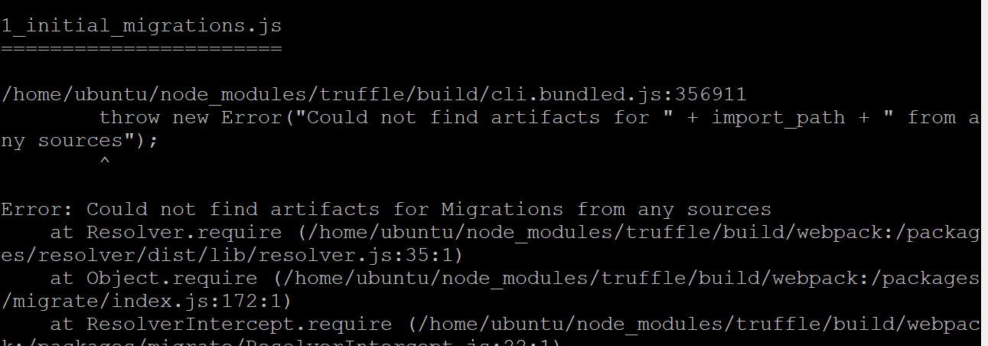
Solution: I need to get an accurage migration / deploy file
Added with the appropriate constructor

