Slide 1
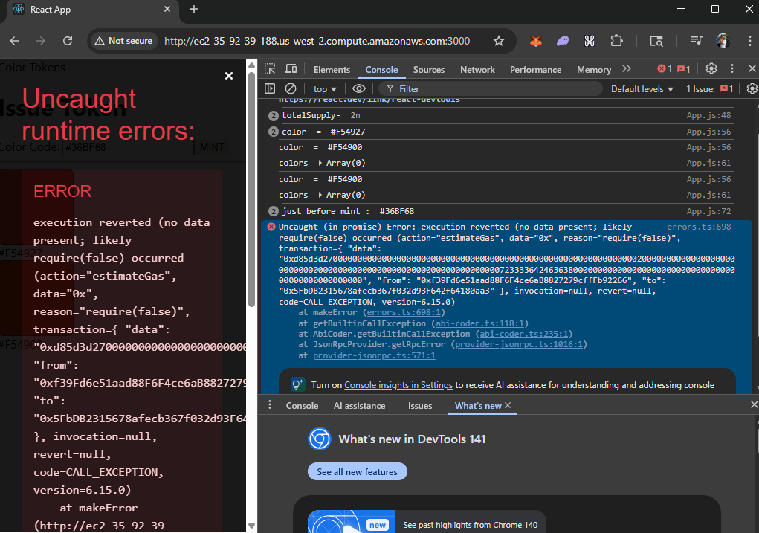

Slide 2
Its working though I cam getting a nasty error……

Slide 3
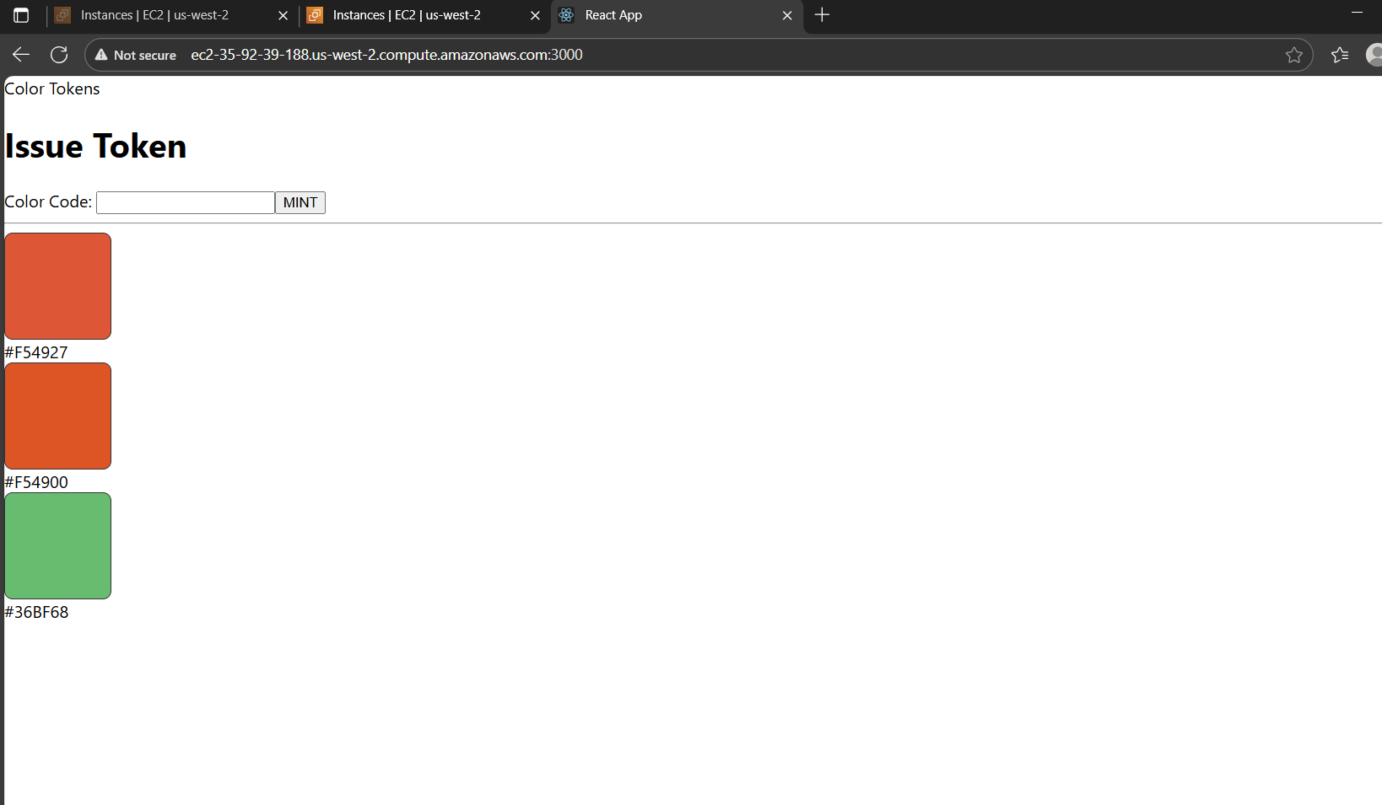

Slide 4
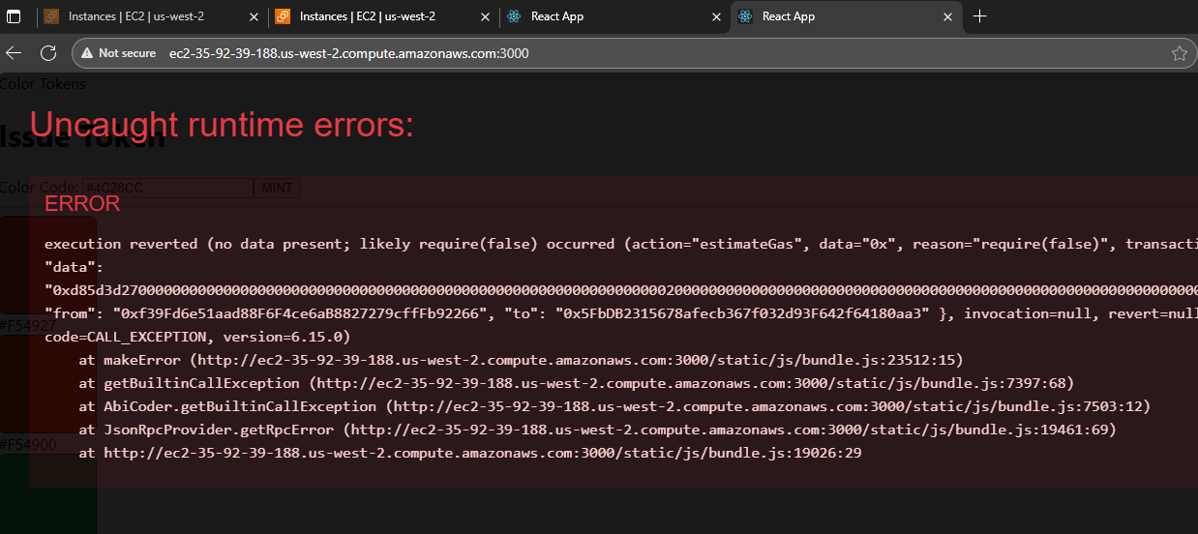

Slide 5
