Slide 2
Fetched 7247 kB in 2s (3970 kB/s)
Reading package lists... Done
E: Could not open lock file /var/lib/dpkg/lock-frontend - open (13: Permission denied)
E: Unable to acquire the dpkg frontend lock (/var/lib/dpkg/lock-frontend), are you root?
mysql> CREATE USER 'root'@'%' IDENTIFIED BY 'junkcrunk22';
Query OK, 0 rows affected (0.01 sec)
mysql> GRANT ALL PRIVILEGES ON *.* TO 'root'@'%' WITH GRANT OPTION;
Query OK, 0 rows affected (0.00 sec)
mysql> FLUSH PRIVILEGES;
Query OK, 0 rows affected (0.01 sec)
ubuntu@ip-172-31-33-160:~$ sudo apt-get install phpmyadmin
when you get the password does not meet policy - rerun it but this time use the 'ignore' option

Slide 3
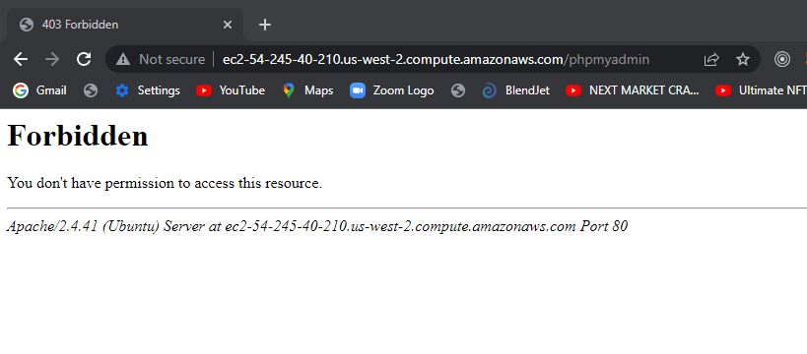

Slide 4
https://www.youtube.com/watch?v=qJjEeIFdoxg

Slide 5
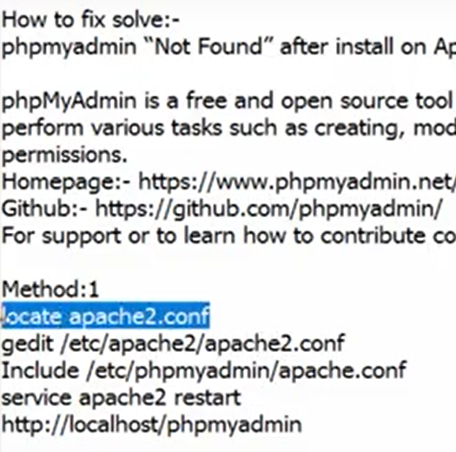

Slide 6
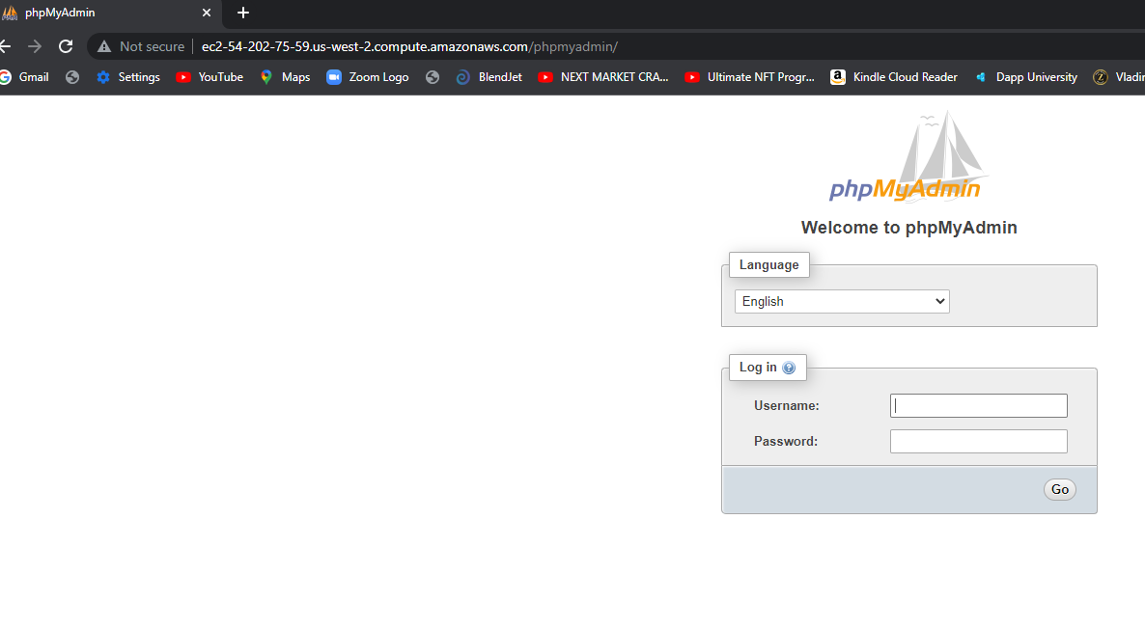

Slide 8
root@ip-172-31-33-160:/etc/phpmyadmin# vi config.inc.php
root@ip-172-31-33-160:/etc/phpmyadmin#

Slide 9
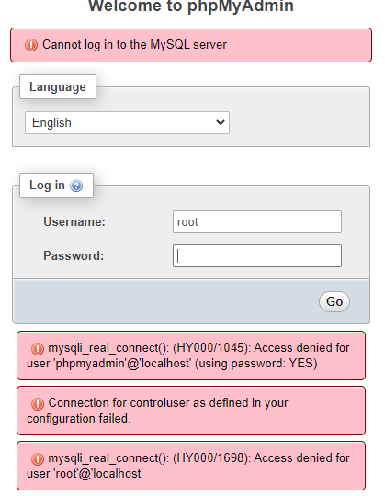

Slide 10
DID not work!
if (empty($dbserver)) $dbserver = 'ec2-54-202-75-59.us-west-2.compute.am
azonaws.com';
/* if (empty($dbserver)) $dbserver = 'localhost';
i*/
$cfg['Servers'][$i]['host'] = $dbserver;
if (!empty($dbport) || $dbserver != 'ec2-54-202-75-59.us-west-2.compute.amaz
onaws.com') {
/* if (!empty($dbport) || $dbserver != 'localhost') {*/
$cfg['Servers'][$i]['connect_type'] = 'tcp';
$cfg['Servers'][$i]['port'] = $dbport;

Slide 11
I can log in with my credentials!
root@ip-172-31-33-160:/usr/share# mysql -u root -p
Enter password:
Welcome to the MySQL monitor. Commands end with ; or \g.
Your MySQL connection id is 25
Server version: 8.0.28-0ubuntu0.20.04.3 (Ubuntu)
Copyright (c) 2000, 2022, Oracle and/or its affiliates.
Oracle is a registered trademark of Oracle Corporation and/or its
affiliates. Other names may be trademarks of their respective
owners.
Type 'help;' or '\h' for help. Type '\c' to clear the current input statement.
mysql>

Slide 12
sudo mysql -p -u root
Enter password:
Welcome to the MySQL monitor. Commands end with ; or \g.
Your MySQL connection id is 8
Server version: 8.0.28-0ubuntu0.20.04.3 (Ubuntu)
Type 'help;' or '\h' for help. Type '\c' to clear the current input statement.
mysql>
mysql> CREATE USER 'pmauser'@'%' IDENTIFIED BY 'junkcrunk22$$';
ERROR 1819 (HY000): Your password does not satisfy the current policy requirements
mysql>
mysql> CREATE USER 'pmauser'@'%' IDENTIFIED BY 'JunkcrunkJunkcrunk22$$';
Query OK, 0 rows affected (0.01 sec)
mysql>
mysql> GRANT ALL PRIVILEGES ON *.* TO 'pmauser'@'%' WITH GRANT OPTION;
Query OK, 0 rows affected (0.00 sec)

Slide 13
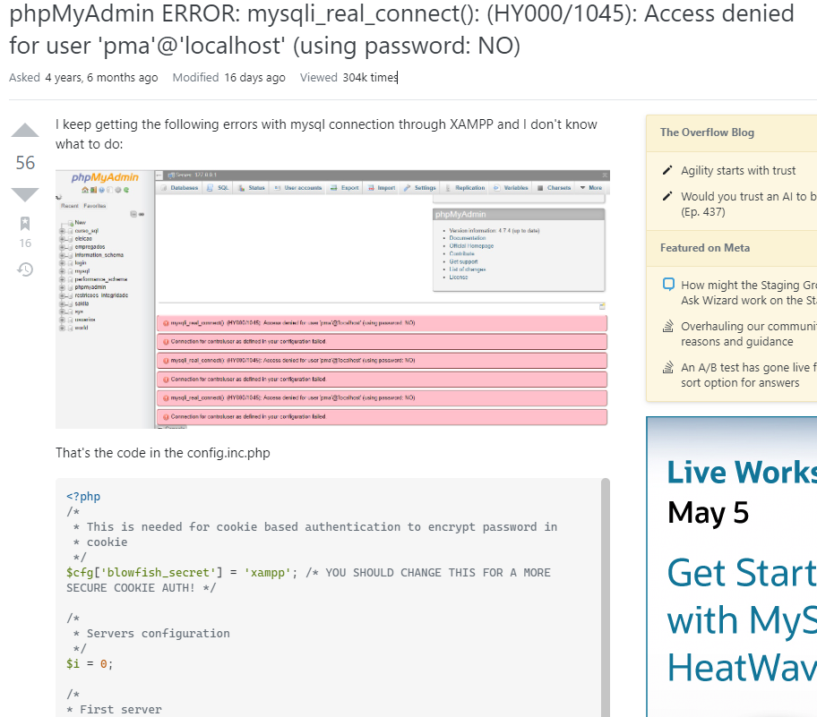

Slide 14
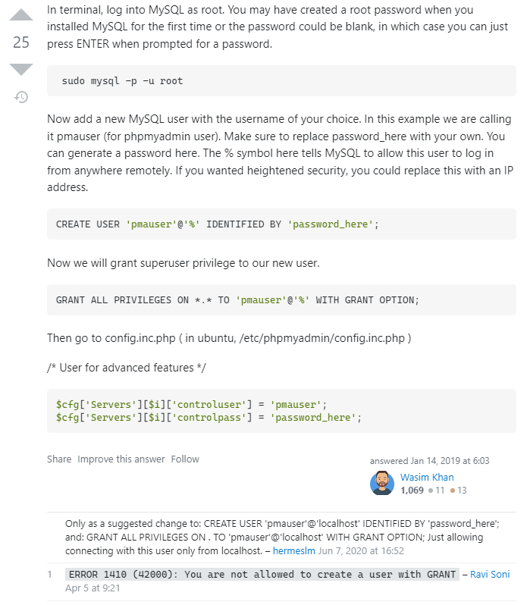

Slide 15
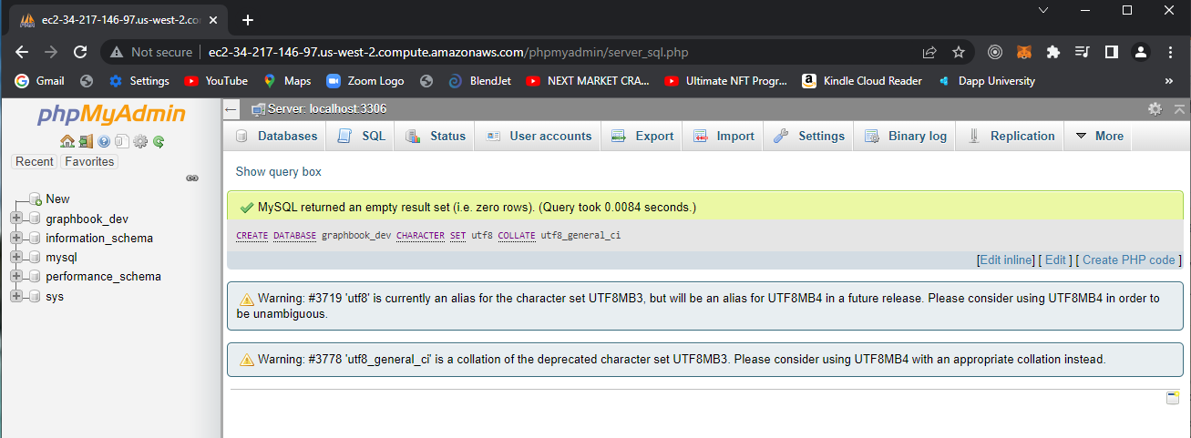

Slide 16
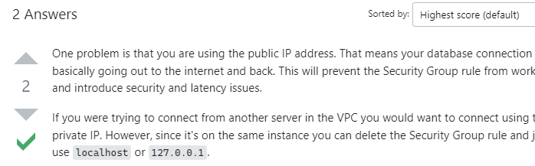
https://stackoverflow.com/questions/38837030/unable-to-connect-to-postgres-on-ec2-econnrefused

Slide 17
const Sequelize = require('sequelize')
const sequelize = new Sequelize('graphbook_dev','pmauser', 'JunkcrunkJunkcrunk22$$', {
host: 'localhost',
port: 3306,
dialect: 'mysql'
});
sequelize.authenticate().then(() => {
console.log("Connection sucessful!");
}).catch((err) => {
console.log(err);
console.log("Error connecting to database!");
});
console.log("Another task");

Slide 18
x.js
ubuntu@ip-172-31-33-160:~/sequelizeStuff$ node index.js
Another task
Executing (default): SELECT 1+1 AS result
Connection sucessful!
ubuntu@ip-172-31-33-160:~/sequelizeStuff$

Slide 19
cat index.js
const Sequelize = require('sequelize')
const sequelize = new Sequelize('graphbook_dev','pmauser', 'JunkcrunkJunkcrunk22$$', {
host: 'localhost',
port: 3306,
dialect: 'mysql'
});
const User = sequelize.define('user', {
username: {
type: Sequelize.DataTypes.STRING
},
password: {
type: Sequelize.DataTypes.STRING
},
age: {
type: Sequelize.DataTypes.STRING,
defaultValue: 21
}

Slide 20
});
User.sync().then((data) =>{
console.log("Table and model synced successfully!");
}).catch((err) => {
console.log("Error syncing the table and model!");});
ubuntu@ip-172-31-33-160:~/sequelizeStuff$ node index.js
Executing (default): CREATE TABLE IF NOT EXISTS `users` (`id` INTEGER NOT NULL auto_increment , `username` VARCHAR(255), `password` VARCHAR(255), `age` VARCHAR(255) DEFAULT 21, `createdAt` DATETIME NOT NULL, `updatedAt` DATETIME NOT NULL, PRIMARY KEY (`id`)) ENGINE=InnoDB;
Executing (default): SHOW INDEX FROM `users`
Table and model synced successfully!
ubuntu@ip-172-31-33-160:~/sequelizeStuff$

Slide 21
