Slide 1
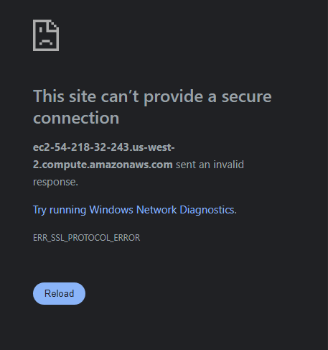

Slide 2
FIX:
Use:
http://ec2-54-218-32-243.us-west-2.compute.amazonaws.com:3000/
Vs
https://ec2-54-218-32-243.us-west-2.compute.amazonaws.com:3000/

