Slide 1

HON207
Cognitive Science
Sequential Sampling Models

Slide 2

Choice RT
Response time is a rare measure in psychology.
Choice vs. simple RT.
Amenable to computational modeling.
Long history
Decision making is a wide field, RT is a useful by-product of decision making.

Slide 3
2AFC
Two-alternative forced choice.
Models most memory research, some categorization research, lexical decision, etc.
Well studied in the choice RT domain.
More than two choices, though?

Slide 4
Sequential Sampling
You need to decide on response A vs B.
Collect a discrete, small piece of evidence that favors A or B (sampling).
Repeat until you have enough evidence (sequential).
Naturally predicts RT (how many samples?) and accuracy (what was the final decision?).

Slide 5
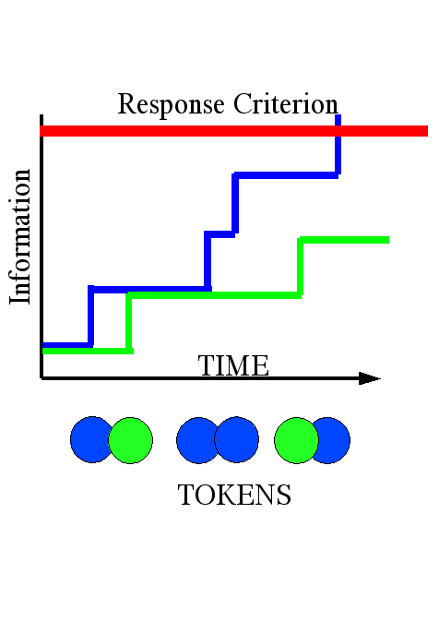
“Drift rate” for blue
“Drift rate” for green
Start Point

Slide 6
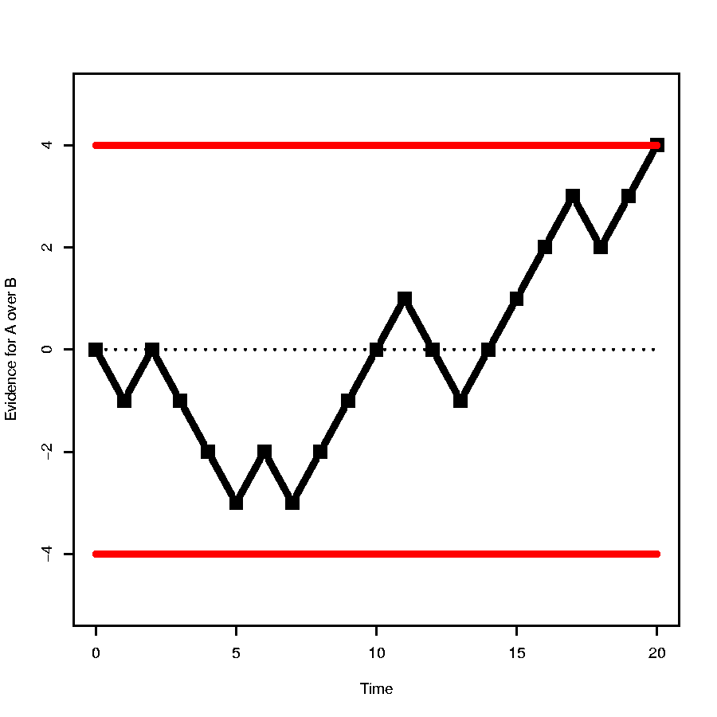
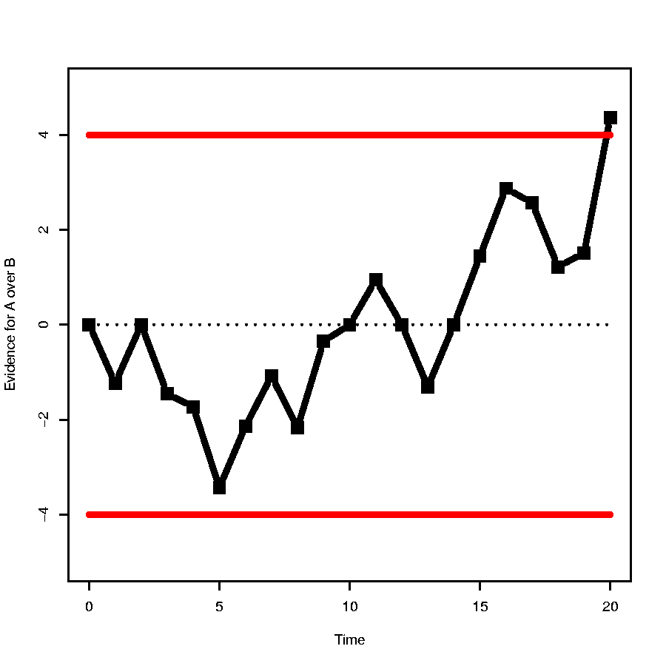
Variations
That was discrete time and discrete state.
Either/both could be continuous.
E.g., random walk models:

Slide 7
Psychology
Links between parameters and psychology.
Speed Accuracy Trade off
BIAS
Faster, but less accurate criteria

Slide 8
Sources of Noise
All good cognitive models include variability.
SS models have variable evidence (discrete or continuous).
Possibly also variable arrival times.
This is not enough:
  RT distributions are identical for correct and error.
Empirically, there are:
  Fast errors in easy conditions with speed emphasis.
  Slow errors in hard conditions with accuracy emphasis.

Slide 9
More Variability
Adding between-trial variability changes error RT distributions.
Variability in bias (start point) -> fast errors:
  “Jump out” errors, where you’re biased to begin with.
Variability in drift rate -> slow errors:
  Slow, unsure responses with high error rates.

Slide 10
Neural Accumulators
Very promising.
Single cell recordings agree.
Slowly bridging the gap from action potentials to behavior.

Slide 11
Analytics
Valuable, for:
  Fitting & parameter estimation.
  Intuition.
  Completeness.
But difficult:
  Requires stochastic diff.eq. theory.
  Mostly Ito calculus (stochastic, hard).
  Nasty, not easily extensible.

Slide 12
Computation (simulation)
Incredibly simple.
Sequential sampling is a natural loop.
Sample random numbers (tokens of evidence) until a criterion is reached!
Repeat many times.
Separate correct & error trials, draw histograms.

Slide 13
E.g. Simple Accumulator.
Two counters, A and B. Initialize at A=0=B. Time=0.
Sample x∈[0,1] random & uniform.
If x<drift rate, A=A+1, else B=B+1.
If A or B > criterion, goto 6.
Time = time+1. Goto 2.
If A>crit, response is A, else response is B.

Slide 14
Computational Variations
Continuous time:
  Step 5: time = time + (random amount)
Continuous evidence:
  Step 3: A=A+(random) or B=B+(random)
Response bias:
  Step 1: A=5 (say) and B=0.
Start point noise:
  Step 1: A=random, B=random.
Drift rate variability:
  Each decision time, chose drift rate randomly.

