Slide 1
Overview and History of Cognitive Science

Slide 2
How do minds work?
What would an answer to this question look like?
  What is a mind?
  What is intelligence?
  How do brains work?
    Neurons
    Brain structure
  What’s the difference between the brain and the mind?

Slide 3
Cognition
Cognition – from Latin base cognitio – “know together”
The collection of mental processes and activities used in perceiving, learning, remembering, thinking, and understanding
  and the act of using those processes
Notes:
Intelligence as a Natural Category- arising from real life
Cognition – from Latin base cognitio – “know together”
The collection of mental processes and activities used in perceiving, learning,
remembering, thinking, and understanding, and the act of using those processes
IQ tests: g – general intelligence, Spearman (1863-1945) or multiple intelligences
The goal of cognitive science: develop a theory of intelligent
Systems?
The goal of artificial intelligence: passing Turing Test?

Slide 4
Cognitive Processes
Learning and Memory
Thinking and Reasoning (Planning, Decision Making, Problem Solving ...)
Language
Vision-Perception
Social Cognition
Dreaming and Consciousness
Notes:
Learning
Memory
Thinking and Reasoning (Planning, Decision Making, Problem Solving ...)
Language
Vision-Perception
Social Cognition
Metacognition
Emotions
Dreaming
Consciousness

Slide 5
So What IS Cognitive Science?
Some possible definitions:
  “The interdisciplinary study of mind and intelligence”
  “Study of cognitive processes involved in the acquisition, representation and use of human knowledge”
  “Scientific study of the mind, the brain, and intelligent behaviour, whether in humans, animals, machines or the abstract”

Slide 6
Disciplines in Cognitive Science
Computer Science- Artificial Intelligence
Neuroscience
Psychology – Cognitive Psychology
Philosophy
Linguistics
Anthropology, Education
Notes:
Philosophy
Neuroscience
Computer Science- Artificial Intelligence
Psychology – Cognitive Psychology
Linguistics
(Anthropology, education)

Slide 7
Paradigms of Cognitive Science
Computational Representational Understanding of Mind
  Mind = mental representation + computational processes
  Computational Theory of Mind
    Duplicating mind by implementing the right program
  Cognitivism, Functionalism
Symbolicism – Connectionism- Dynamicism - Hybrid approaches
Notes:
Computational Representational Understanding of Mind
mind = mental representations + computational processes
cognitivism, functionalism
Computational Theory of Mind: Strong AI (duplicating a mind by implementing the right program)
Embedded, situated cognition, Dynamicism
Physical Symbol Systems
Symbolicism – Connectionism (Parallel Distributed Processing, Artifical Neural Networks)
And hybrid approaches

Slide 8
Methods of Cognitive Science
Computational Modeling (artificial intelligence, computational neuroscience, cognitive psychology)
Experimentation (psychology, linguistics, neuroscience)
Introspection, Argumentation, Formal Logic (philosophy, linguistics)
Mathematical Modeling (cognitive psychology, linguistics, philosophy)
Ethnography (cognitive anthropology)
Notes:
Experimentation (psychology, linguistics, neuroscience)
Computational Modeling (artificial intelligence, computational neuroscience)
Introspection, argumentation, formal logic (philosophy, linguistics)
Ethnography (cognitive anthropology)

Slide 9
Cognitive Modeling
A model is a simplified (usually formal) representation of reality
Cognitive modeling
  Create formal (e.g. mathematical, algorithmic, symbolic) representations of cognitive processes
  Then, use these models to predict or explain behavior associated with those cognitive processes
  Computational modeling: the models usually implemented as computer programs with output corresponding to the predicted behavior
  Example of cognitive process: categorizing objects into groups. Modeling: use decision trees, or neural networks, or rules, etc.

Slide 10
What are Formal Models
Quantitative (mathematical) or Procedural (computer program) implementations of a theory
The formal model attempts to mimic (“fit”) human data from the tasks they are modeling
In Cognitive Psychology, formal models exist for memory, perception, language comprehension, decision-making...
But WHY? What is the point of modeling?

Slide 11
Advantages of Computational Modeling
Push predictive aspects of a theory: more formal, precise and abstract specifications
Avoids ambiguity, vagueness in theory
Forces a more complete specification of the assumptions of a theory
Quantitative as well as qualitative predictions – just like they do in the “real” sciences!
Notes:
Push predictive aspects of a theory: more formal, precise and abstract specifications than verbal models
Computer programs are good experimental participants
Unify several different classes of facts as compared to hypothesis testing

Slide 12
Representation and Computation
Central hypothesis of cognitive science
  thinking can best be understood in terms of representational structures in the mind and computational procedures that operate on those structures.
  much disagreement about the nature of the representations and computations that constitute thinking

Slide 13
The Information-Processing Metaphor
Mind has mental representations analogous to computer data structures, and computational procedures similar to computational algorithms.
Symbolic View: mind contains such mental representations as logical propositions, rules, concepts, images, and analogies, and that it uses mental procedures such as deduction, search, matching, rotating, and retrieval.
Connectionist View: mental representations use neurons and their connections as mechanisms for data structures, and neuron firing and spreading activation as the algorithms – i.e., cognition can be explained by using artificial neural networks

Slide 14
Is cognition information processing?
Church-Turing Thesis
Universal Turing Machine
The information-processing metaphor: data+ algorithms
Notes:
Church-Turing Thesis
Universal Turing Machine
The information-processing metaphor: data+ algorithms
Searle’s Chinese Room Argument

Slide 15
Levels of Analysis: Background
From Marr (1982):
“What does it mean, to see? The plain man’s answer (and Aristotle’s
too) would be, to know what is where by looking. In other words, vision
is the process of discovering from images what is present in the world,
and where it is.
“Vision is therefore, first and foremost, an information-processing task,
But we cannot think of it just as a process. For if we are capably of
knowing what is where in the world, our brains must somehow be capable
of representing this information – in…. The study of vision must therefore
include not only the study of how to extract from images the various
aspects of the world that are useful to us, but also an inquiry into the
nature of the internal representations by which we capture this
information ….”

Slide 16
Levels of Analysis: Background
[ -- Continuing Marr (1982)]:
“This duality – the representation and the processing of information – lies
at the heart of most information-processing tasks and will profoundly shape
Our investigation of the particular problems posed by vision.”
- If one accepts the information-processing approach, how
does one move forward in understanding a complex
information-processing system (e.g. some aspect of
cognition, such as vision)?
~ Marr’s suggestion – Three Levels of Understanding

Slide 17
Levels of analysis (Marr):
Three kinds of questions
computation
  what is the problem?
    inputs, outputs
    what is being computed or maximized?
algorithm
  what are the methods?
    Data representation, “process”
implementation
  what are the mechanisms?
    springs or neurons

Slide 18
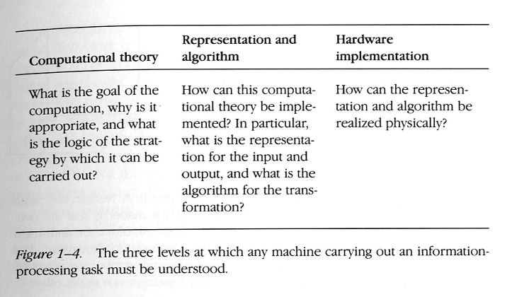
Three Levels (from Marr, 1982):

Slide 19
History of Cognitive Science
The study of mind remained the province of philosophy until the 19th century, when experimental psychology developed.
  Philosophy: rationalism (Plato, Descartes, Kant) vs empiricism (Aristotle, Locke, Hume, Mill)
  Cartesian Dualism – the mind-body problem
experimental psychology became dominated by behaviorism (e.g., J. B. Watson)
  psychology should restrict itself to examining the relation between observable stimuli and observable behavioral responses
  denied the existence of consciousness and mental representations
Notes:
Cognitive Science has a very long past but a relatively short history (Gardner, 1985)
Philosophy: rationalism- all phenomena can be understood-knowledge can be acquired by thinking, proof and innate knowledge (Plato, Descartes, Kant, ...) vs empiricism (Aristotle, Locke, Hume, Mill, ...)- phenomena are to be investigated by careful, objective observation;
We derive all knowledge on senses and experience and on the reflections created on these senses, and the associations of events, objects etc. occurring together
İn experience.
Epistemology- theory of knowledge- its nature, origin (Russell, Frege, Wittgenstein,..)
Nature vs nurture: Innate capacities of the mind-tabula rasa- blank state

Slide 20
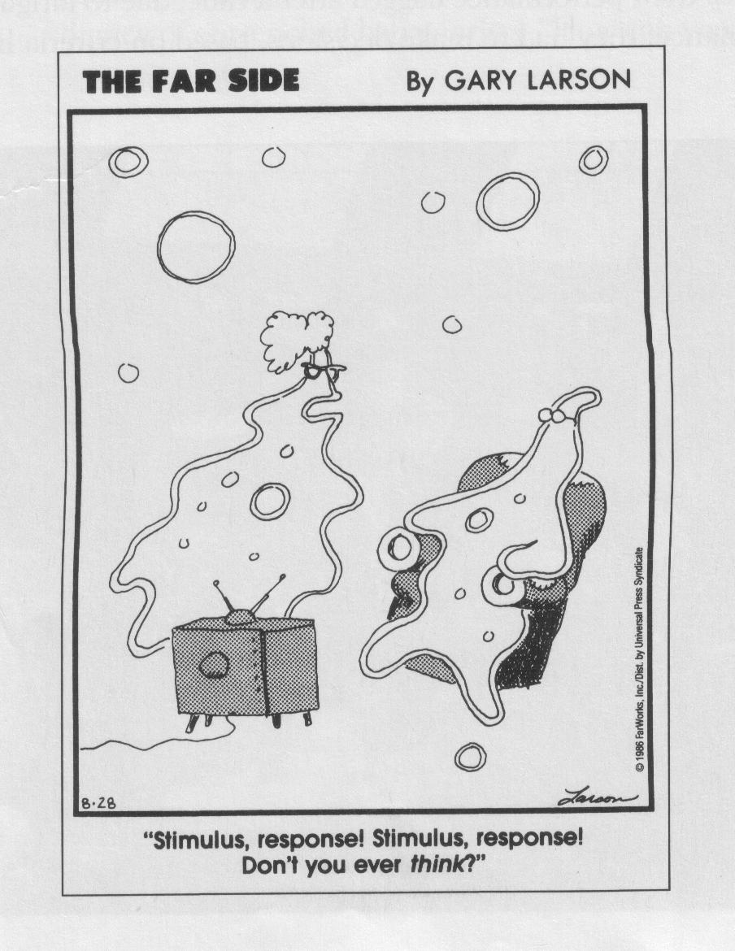
Behaviourism and Cognitive Science

Slide 21
History of Cognitive Science
Linguistics:
  Chomsky: language as a generative system
    rejected behaviorist assumptions about language as a learned habit and proposed instead to explain language comprehension in terms of mental grammars consisting of rules.

Slide 22
History of Cognitive Science
George Miller (1950’s)
  showed that the capacity of human thinking is limited, with short-term memory, for example, limited to around seven items
  proposed that memory limitations can be overcome by recoding information into chunks, mental representations that require mental procedures for encoding and decoding the information.
Notes:
Psychology:
Wundt, Titchener (late 19th century) : study of the conscious mind in lab settings by introspection
James (late 19th century) : bringing insights and intuitions on human mental
Processes, Principles of Psychology..
Ebbinghaus (early 20th century): systematic studies of memory and learning
Linguistics as a systematic discipline about principles of languages
Sapir-Whorf hypothesis: linguistic determinism- language determines
The way we think
Linguistic relativity – distinctions found in a given language will not be
The same as those in any other (1st half of 20th century)
Saussure (early 20th century) langue- system internalized by speakers of a language
Parole – the act of speaking
Behaviourism: (1st half of 20th century) Watson, Skinner, “psyhology as a science of behaviour”..
Artificial Intelligence and Cognitive Psychology (1950s-60s)- The Cognitive Revolution-
The reinstatement of mental processes as the focus of psychology-the computer analogy-
Chomsky- critic of Skinner, language acquisition, language device
Miller- limited capacity of short-term memory
Newell and Simon – simulations of human problem solving
(Miller, Bruner, Minsky, McCarthy, Newell and Simon, Chomsky,...)

Slide 23
History of Cognitive Science
Cognitive Psychology
  First textbook by Neisser in 1967
  Advances in memory models (60s)
Artificial Intelligence
  Alan Turing – Turing machines, Turing Test
  Newell and Simon – Logic Theorist, GPS

Slide 24
Artificial Intelligence
Strong AI (duplicating a mind by implementing the right program) vs Weak AI (machines that act as if they are intelligent)
AI as the study of human intelligence using computer as a tool vs AI as the study of machine intelligence as artificial intelligence
Artificial Intelligence and Cognitive Science: a history of interaction
Notes:
Strong AI (duplicating a mind by implementing the right program) vs Weak AI (machines that act as if they are intelligent)
aI (the study of human intelligence using computer as a tool) vs Ai (the study of machine intelligence as artificial intelligence) (Yeap)
Computer as mind – computer as brain

Slide 25
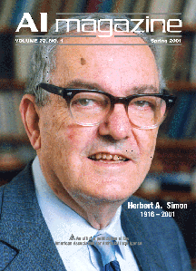
AI and Cognitive Science
"AI can have two purposes. One is to use the power of computers to augment human thinking, just as we use motors to augment human or horse power. Robotics and expert systems are major branches of that. The other is to use a computer's artificial intelligence to understand how humans think. In a humanoid way. If you test your programs not merely by what they can accomplish, but how they accomplish it, they you're really doing cognitive science; you're using AI to understand the human mind."

Slide 26
Types of AI Research: Goals
Simulate human intelligence – as a model of human competence
Simulate human mental processes – as a model of human cognitive processes
Produce intelligent behavior to meet a practical need – whether human-like or not (expert systems, etc.)
Produce a general-purpose intelligent agent (“strong AI”) - nontrivial

