Slide 1
An introduction to R
Honors 207
Cognitive Science
(These Slides were Shamelessly Stolen from
Dr. Pablo Gomez, DePaul University)

Slide 2
What this is
o A short incomplete tour around some of the basic concepts of R as a programming language
o Some hints on how to obtain documentation on the many library functions (packages)

Slide 3
R, S and S-plus
S: an interactive environment for data analysis developed at Bell Laboratories since 1976
1988 - S2: RA Becker, JM Chambers, A Wilks
1992 - S3: JM Chambers, TJ Hastie
1998 - S4: JM Chambers
Exclusively licensed by AT&T/Lucent to Insightful Corporation, Seattle WA. Product name: “S-plus”.
Implementation languages C, Fortran.
See:
http://cm.bell-labs.com/cm/ms/departments/sia/S/history.html

Slide 4
R, S and S-plus
S: an interactive environment for data analysis developed at Bell Laboratories since 1976
R: initially written by Ross Ihaka and Robert Gentleman at Dep. of Statistics of U of Auckland, New Zealand during 1990s.
Since 1997: international “R-core” team of ca. 15 people with access to common CVS archive.
GNU General Public License (GPL)
can be used by anyone for any purpose
contagious
Open Source
quality control!
efficient bug tracking and fixing system supported by the user community

Slide 5
What R does and does not
data handling and storage: numeric, textual
matrix algebra
hash tables and regular expressions
high-level data analytic and statistical functions
classes (“OO”)
graphics
programming language: loops, branching, subroutines
is not a database, but connects to DBMSs
has no graphical user interfaces, but connects to Java, TclTk
language interpreter can be very slow, but allows to call own C/C++ code
no spreadsheet view of data, but connects to Excel/MsOffice
no professional / commercial support

Slide 6
R and statistics
Statistics: most packages deal with statistics and data analysis
State of the art: many statistical researchers provide their methods as R packages

Slide 7
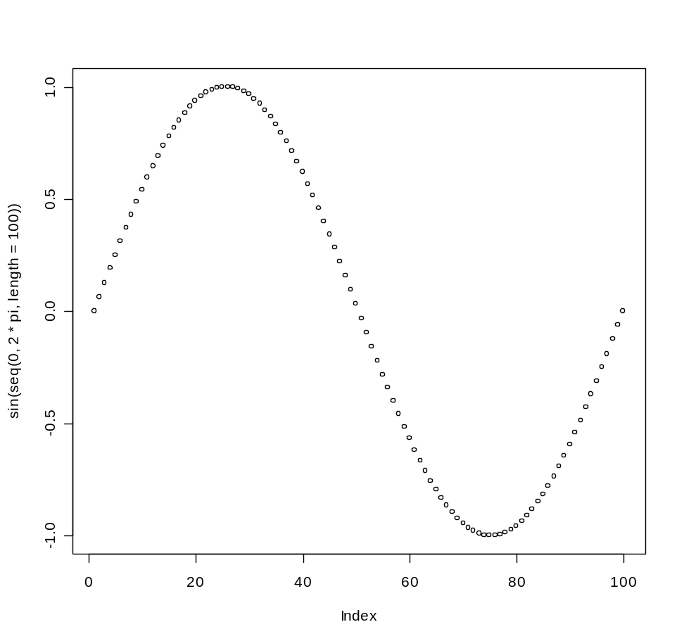
R as a calculator
> log2(32)
[1] 5
> sqrt(2)
[1] 1.414214
> seq(0, 5, length=6)
[1] 0 1 2 3 4 5
> plot(sin(seq(0, 2*pi, length=100)))

Slide 8
variables
> a = 49
> sqrt(a)
[1] 7
> a = "The dog ate my homework"
> sub("dog","cat",a)
[1] "The cat ate my homework“
> a = (1+1==3)
> a
[1] FALSE
numeric
character string
logical

Slide 9
functions and operators
Functions do things with data
“Input”: function arguments (0,1,2,…)
“Output”: function result (exactly one)
Example:
add = function(a,b)
{ result = a+b
return(result) }
Operators:
Short-cut writing for frequently used functions of one or two arguments.
Examples: + - * / ! & | %%

Slide 10
functions and operators
Functions do things with data
“Input”: function arguments (0,1,2,…)
“Output”: function result (exactly one)
Functions may also do other things than returning a result. E.g., plot something on the screen: “side effects”
*Lexical scope and Statistical Computing. R. Gentleman, R. Ihaka, Journal of Computational and Graphical Statistics, 9(3), p. 491-508 (2000).

Slide 11
vectors, matrices and arrays
vector: an ordered collection of data of the same type
> a = c(1,2,3)
> a*2
[1] 2 4 6
Example: we could encode a memory trace as a vector
Other vector types: character strings, logical

Slide 12
vectors, matrices and arrays
matrix: a rectangular table of data of the same type
example: the expression values for 10000 genes for 30 tissue biopsies: a matrix with 10000 rows and 30 columns.
array: 3-,4-,..dimensional matrix
example: the red and green foreground and background values for 20000 spots on 120 chips: a 4 x 20000 x 120 (3D) array.

Slide 13
Lists
vector: an ordered collection of data of the same type.
> a = c(7,5,1)
> a[2]
[1] 5
list: an ordered collection of data of arbitrary types.
> doe = list(name="john",age=28,married=F)
> doe$name
[1] "john“
> doe$age
[1] 28
Typically, vector elements are accessed by their index (an integer), list elements by their name (a character string). But both types support both access methods.

Slide 14
Branching
if (logical expression) {
statements
} else {
alternative statements
}
else branch is optional

Slide 15
Loops
When the same or similar tasks need to be performed multiple times; for all elements of a list; for all columns of an array; etc.
for(i in 1:10) {
print(i*i)
}
i=1
while(i<=10) {
print(i*i)
print(i)
i=i+sqrt(i)
}

Slide 16
regular expressions
A tool for text matching and replacement which is available in similar forms in many programming languages (Perl, Unix shells, Java)
> a = c("CENP-F","Ly-9", "MLN50", "ZNF191", "CLH-17")
> grep("L", a)
[1] 2 3 5
> grep("L", a, value=T)
[1] "Ly-9" "MLN50" "CLH-17"
> grep("^L", a, value=T)
[1] "Ly-9"
> grep("[0-9]", a, value=T)
[1] "Ly-9" "MLN50" "ZNF191" "CLH-17"
> gsub("[0-9]", "X", a)
[1] "CENP-F" "Ly-X" "MLNXX" "ZNFXXX" "CLH-XX"

Slide 17
Storing data
Every R object can be stored into and restored from a file with the commands
“save” and “load”.
This uses the XDR (external data representation) standard of Sun Microsystems and others, and is portable between MS-Windows, Unix, Mac.
> save(x, file=“x.Rdata”)
> load(“x.Rdata”)

Slide 18
Importing and exporting data
There are many ways to get data into R and out of R.
Most programs (e.g. Excel), as well as humans, know how to deal with rectangular tables in the form of tab-delimited text files.
> x = read.delim(“filename.txt”)
also: read.table, read.csv
> write.table(x, file=“x.txt”, sep=“\t”)

Slide 19
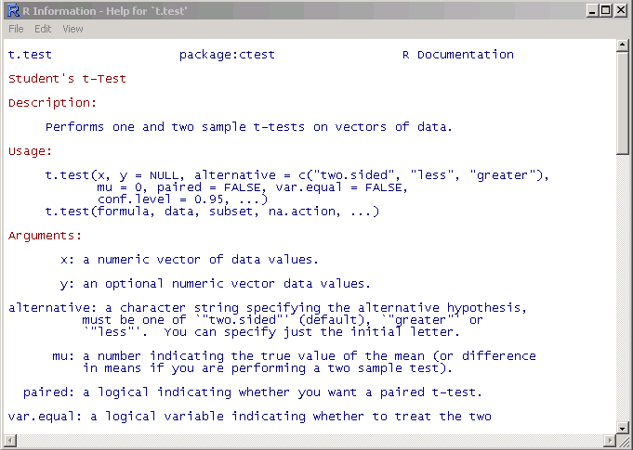
Getting help
Details about a specific command whose name you know (input arguments, options, algorithm, results):
>? t.test
or
>help(t.test)

Slide 20
Web sites
www.r-project.org
cran.r-project.org
www.bioconductor.org
Full text search:
www.r-project.org
or
www.google.com
with ‘… site:.r-project.org’ or other R-specific keywords

