Slide 1
Introduction to Networks
HON207

Slide 2
Graph Theory
In mathematics and computer science, graph theory is the study of graphs, mathematical structures used to model pairwise relations between objects from a certain collection. "Graphs" in this context are not to be confused with "graphs of functions" and other kinds of graphs

Slide 3
Graph Theory
One of the first results in graph theory appeared in Leonhard Euler's paper on Seven Bridges of Königsberg, published in 1736. It is also regarded as one of the first topological results in geometry; that is, it does not depend on any measurements.

Slide 4
The city of Königsberg was set on the Pregel River, and included two large islands which were connected to each other and the mainland by seven bridges. The question is whether it is possible to walk with a route that crosses each bridge exactly once, and return to the starting point. In 1736, Leonhard Euler proved that it was not possible.
Circa 1750, the prosperous and educated townspeople allegedly walked about on Sundays trying to solve the problem.
→
→

Slide 5
Euler’s solution
Euler realized that the problem could be solved in terms of the degrees of the nodes. The degree of a node is the number of edges touching it; in the Königsberg bridge graph, three nodes have degree 3 and one has degree 5. Euler proved that a circuit of the desired form is possible if and only if there are no nodes of odd degree

Slide 6
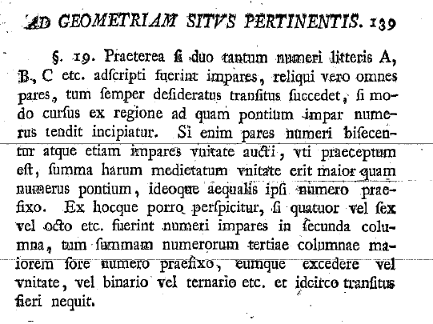
Practice your Latin

Slide 7
Contemporary Graph theory
Applied Graph Theory is related to finding a measurable quantity within the network, for example, for a transportation network, the level of vehicular flow within any portion of it.
Graph theory is also used to study molecules in chemistry and physics, and social networks in social sciences.

Slide 8
What are we going to do?
We will explore some networks and their properties, in particular, their functional forms.

Slide 9
Functional Form
A functional form is a mathematical statement of the relationship between variables in a model

Slide 10
Why?
Developing compact mathematical descriptions of phenomena is an important step in the development of theoretical explanations.
For example:
  Tyco --> Keppler --> Newton

