Slide 1


Slide 2
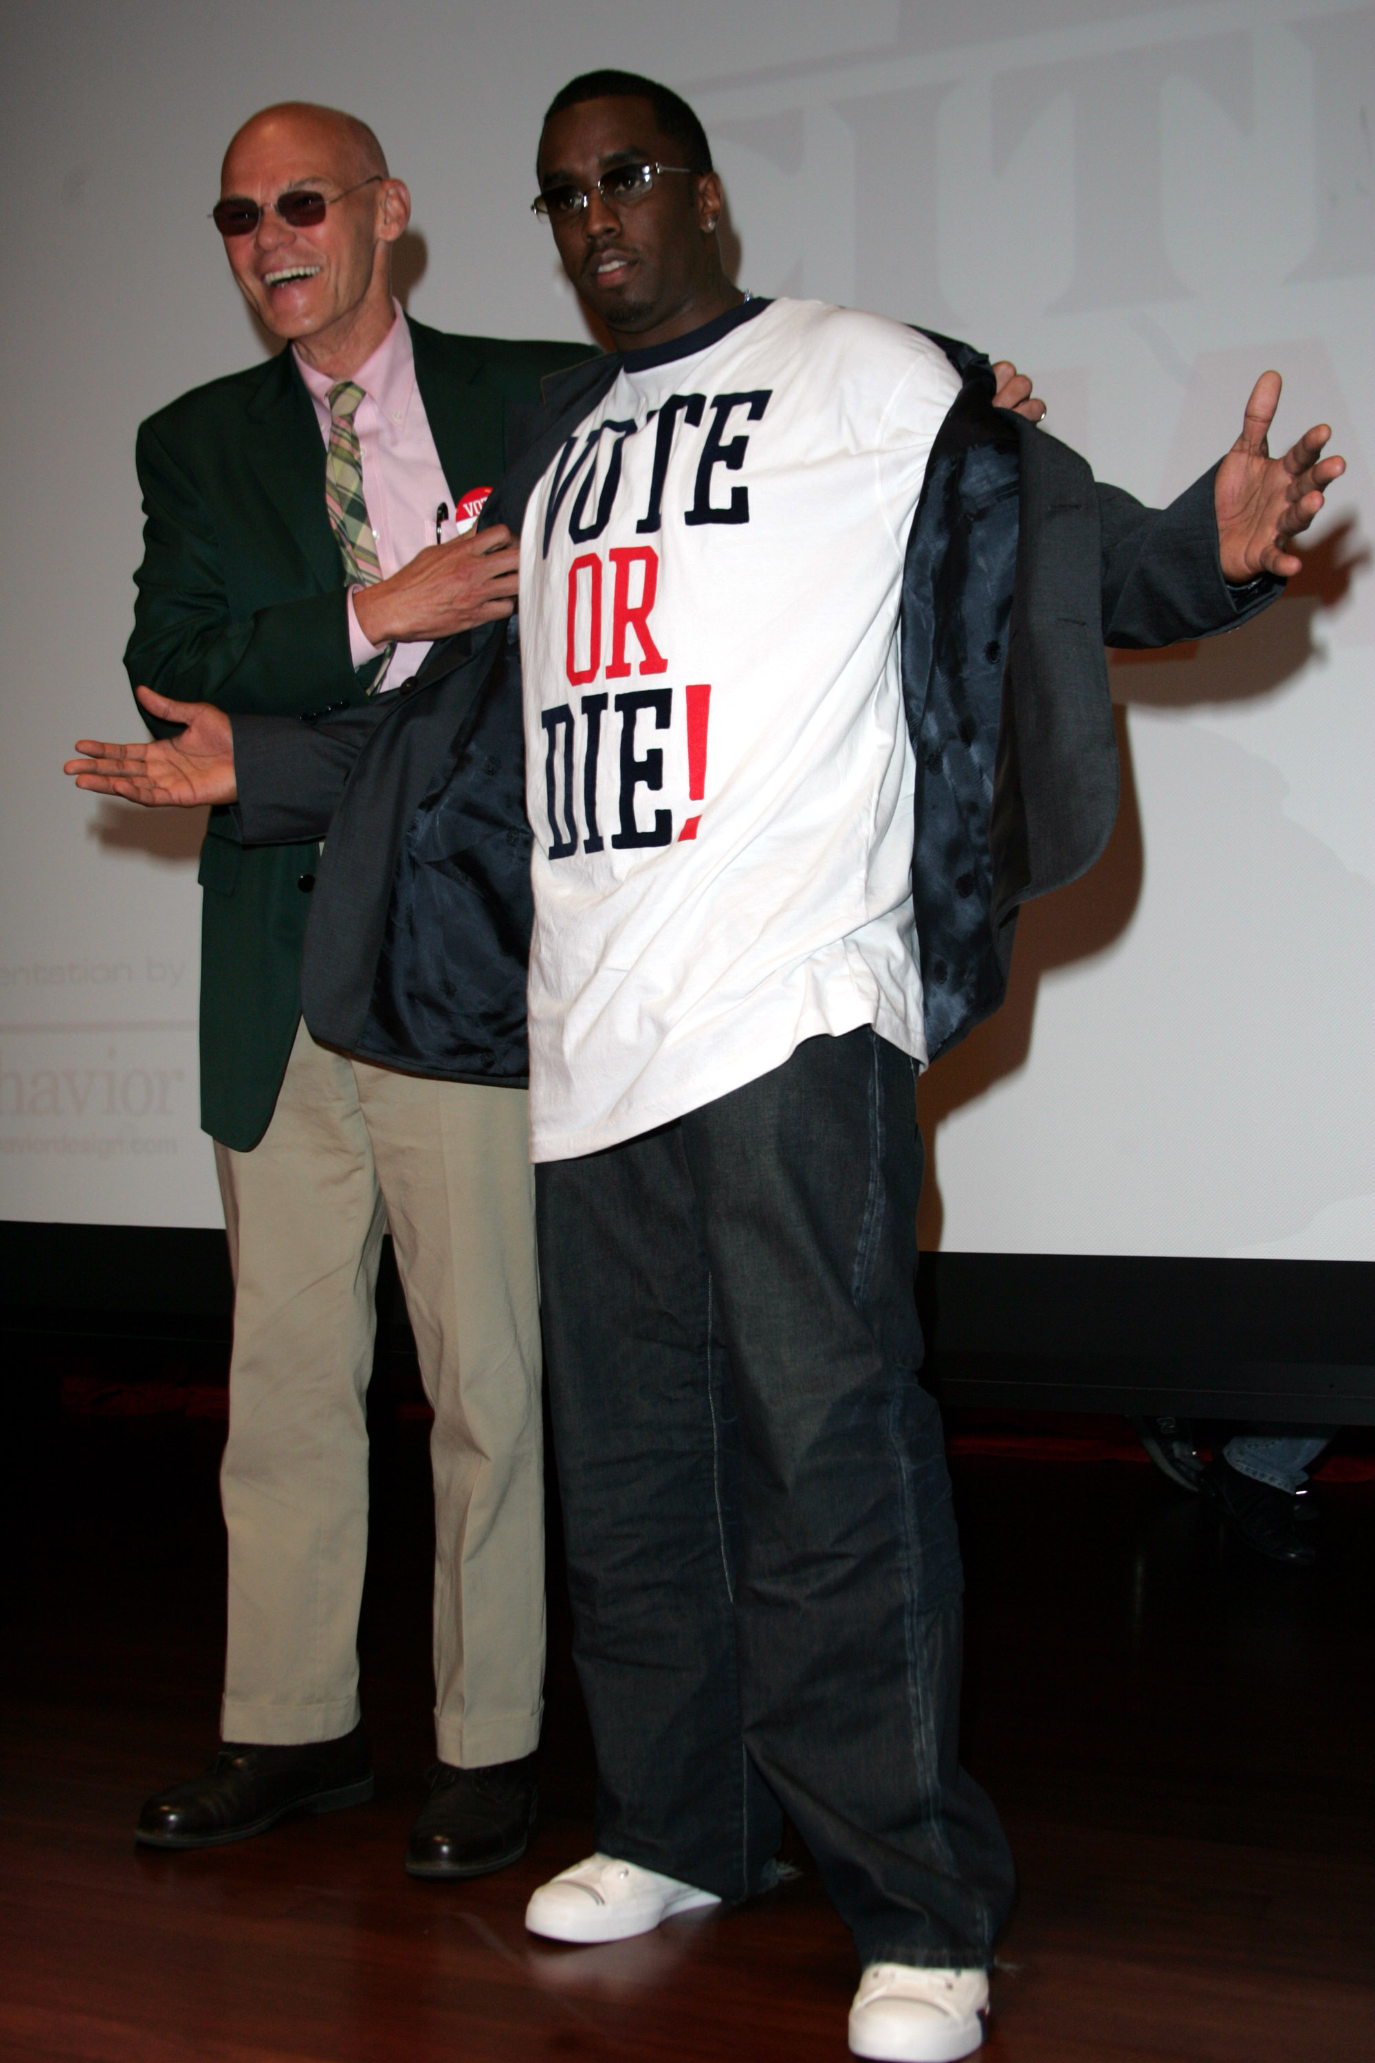
VOTE OR DIE!

Slide 3
Who is actually voting in Presidential elections?
Who has a higher turnout between males and females?
Does anyone one particular age group seem to influence the election more than the others?
Do young people actually exercise their right to vote?

Slide 4
How we gathered the data
Data gathered from 2002 statistical abstract of the US
Used information from the 1980-2000 Presidential elections
Primarily focused on gender, age and geographic tendencies

Slide 5
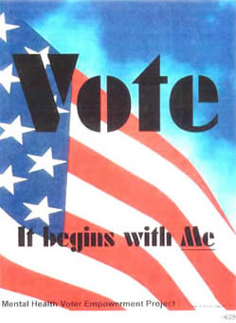

Slide 6
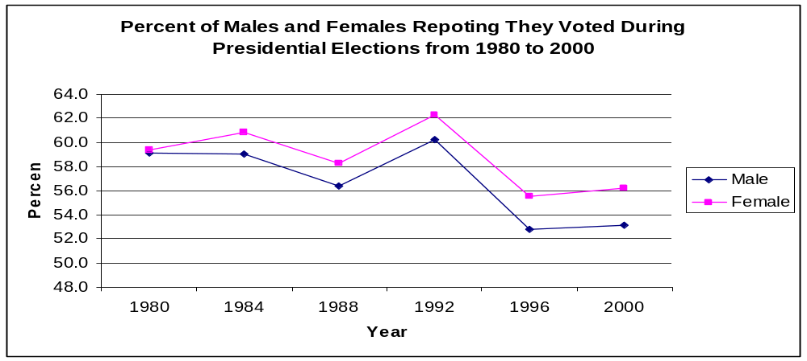
Gender
The graph shows that in every Presidential election since 1980, females have voted more often than males

Slide 7
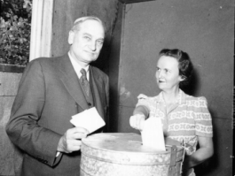

Slide 8
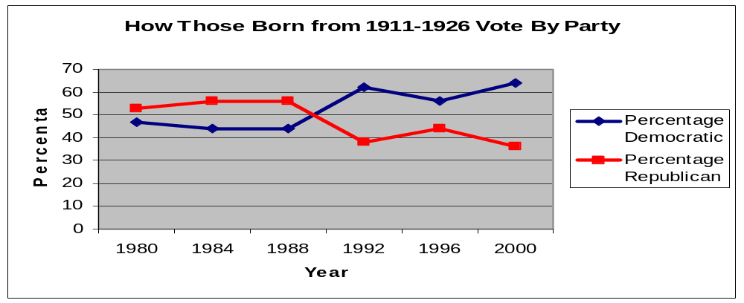
Age Groups
As this age groups has gotten older, they have become more conservative, but it is still hard to predict which party they will vote for because it is not very linear

Slide 9
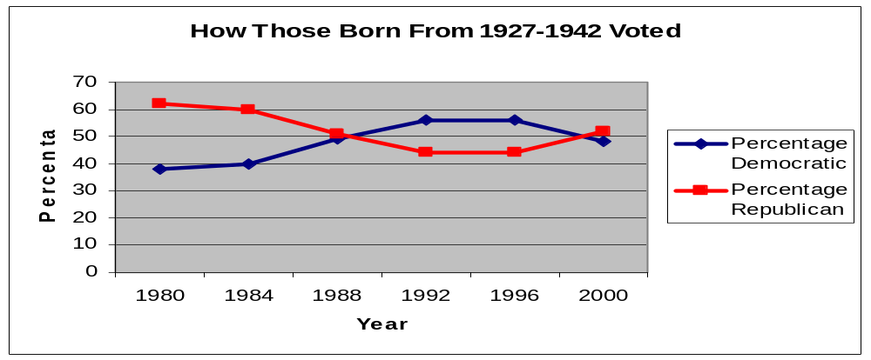
This group was almost evenly divided each election between Republicans and Democrats
Whichever party got a larger percentage of this age group, also when the overall election
There is correlation between this age group and the overall winner, but there is no evidence of causation

Slide 10
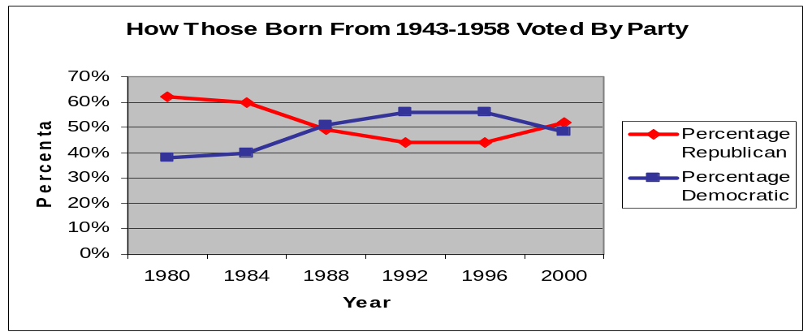
This age group has become less conservative as they have gotten older
This is the hardest age group to predict how they will vote according to linear models, meaning they tend not to vote according to party lines

Slide 11
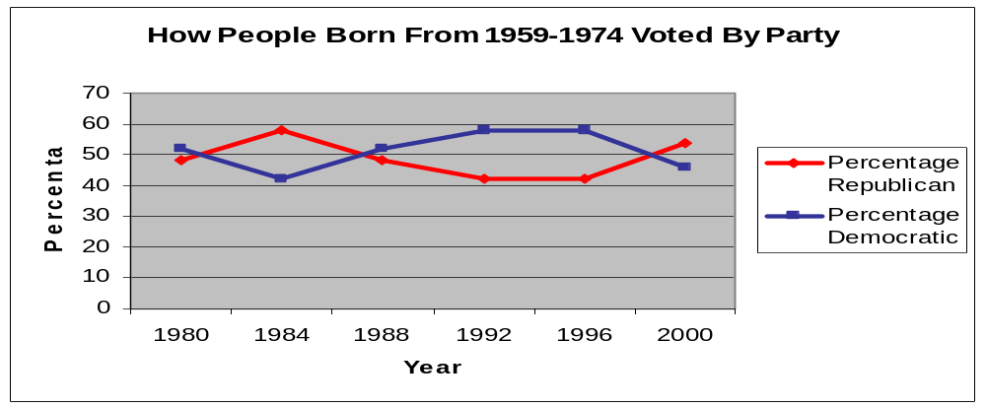
This group has tended to lean more liberal and democratic then most of the other groups, except for those born in 1975 and after, except in the 2000 election
They were the only age group to vote for Dukakis rather than George H. Bush in the 1988 election, and also voted overwhelmingly for Clinton, George W. Bush had a clear majority over Gore, but this could be the cause of Gore losing many of this age group to votes for Ralph Nader

Slide 12
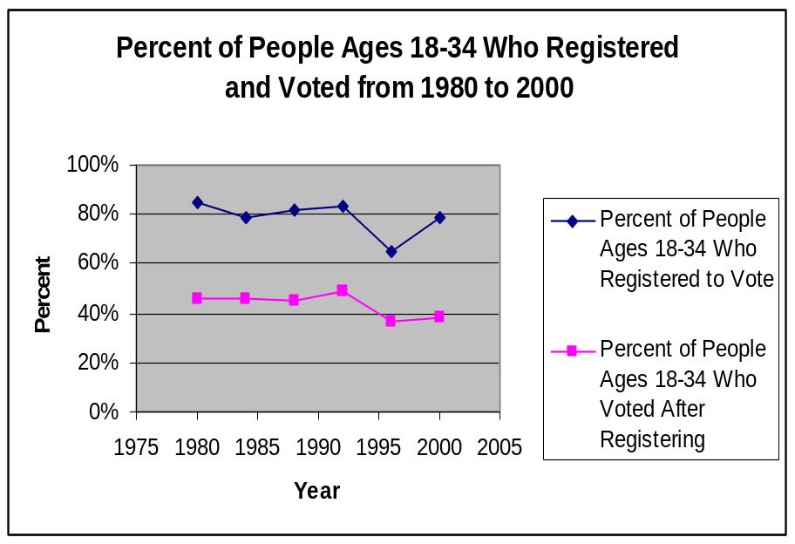
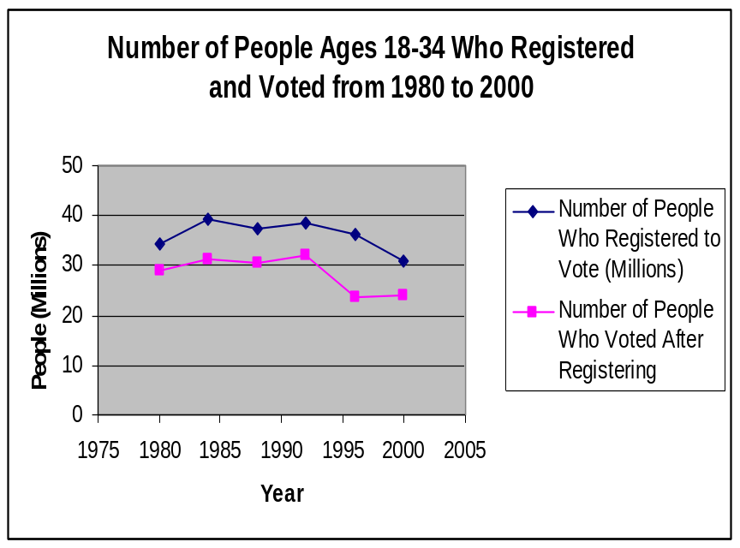
People who registered and used their right to vote.
The percentage of young people registering to vote has decreased within the years. The percent drops even further when it comes to the number of the young people who registered but didn’t vote.

Slide 13
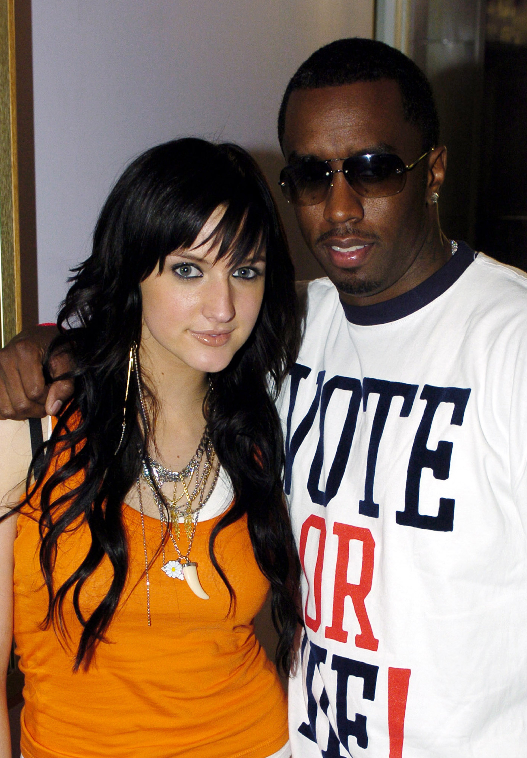

Slide 14
VOTE! Ashlee does….
Actually she probably does not, according to our data, 18-34 year olds are likely to register to vote, but less likely to actually go the polls on Election Day

Slide 15
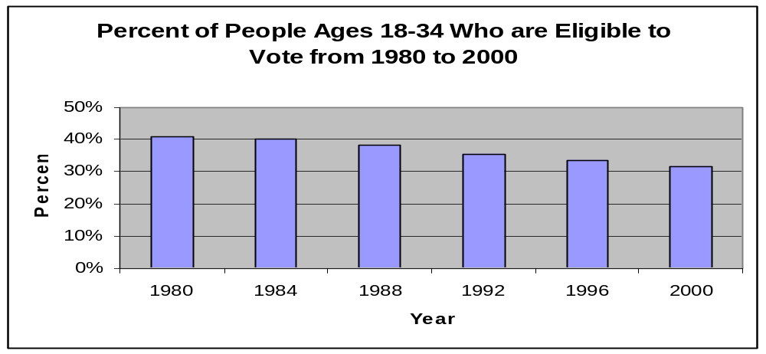
Do people under the age of 34 exercise their voting rights?
The number of people who are eligible to vote has decreased since 1980. The percentages are still high enough to change an outcome in a future election.

Slide 16
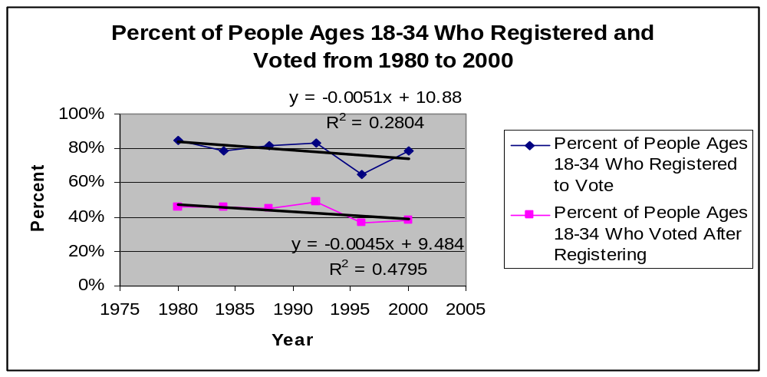
Using the equation of y=-.0051x+10.88, we predict that the percentage of people registering to vote between the ages of 18-34 is 66%
For the percentage of registered voters who actually turned out to vote, we used the equation y=-.0045x+9.484, and made a prediction from this model that 47% of registered voters would turn out to vote

Slide 17
Conclusions
Women tend to have higher turnout then males
It is hard to predict how certain age groups will vote, and the theory that older people tend to get more conservative as they get older is probably not true, because they tend to vote by candidate, not by certain parties
Young people need to actually vote because their numbers are so low it makes it hard for politicians to pay attention to them

Slide 18
There seemed to be correlation, but not causation between how those born between 1927-1942 vote, and the winner of the electoral college. We believe this is the case because this group probably votes in the highest numbers than any other age group
Finally, P. Diddy was probably lying when he said VOTE OR DIE!

