Slide 1

Created By:
Vanessa Hunt and
Katie Baert
Elections

Slide 2
Importance of focusing on certain groups
Age Groups
Political Preferences
Education Level

Slide 3
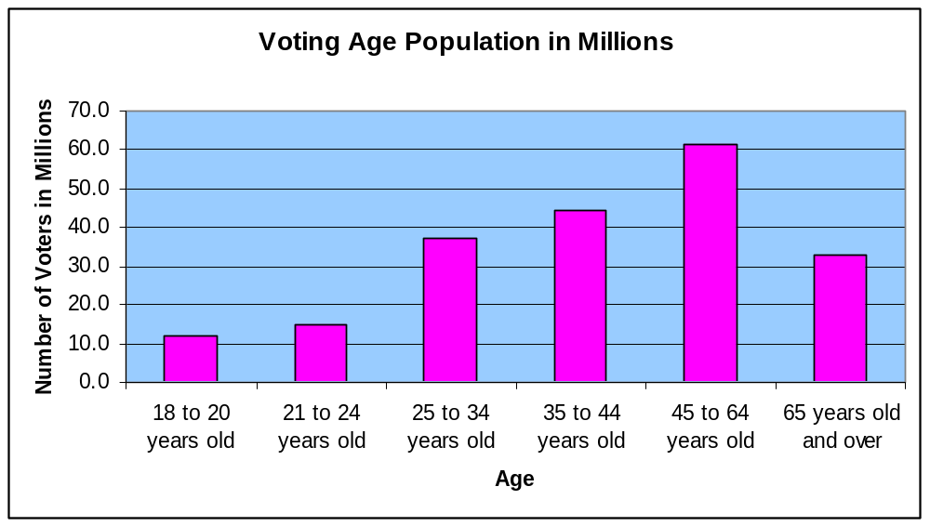
Age Groups

Slide 4


Highest voting turnout: Ages 45-64
Other Groups with high voting turnout: 35-44 and 25-34
Appealing to these age groups should be top priority, but the candidate cannot exclude the other age groups.

Slide 5
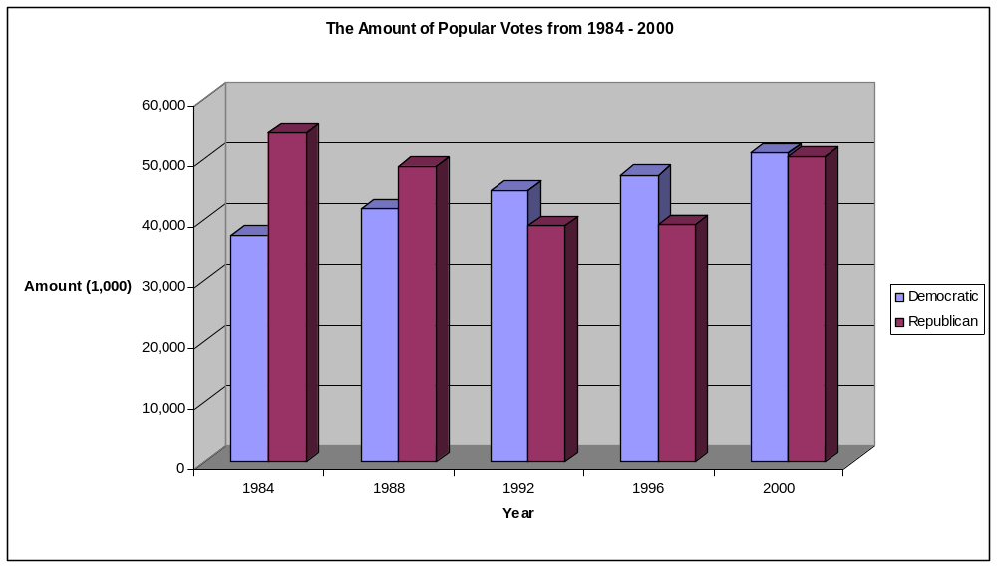
Political Parties

Slide 6

Within a twenty year period, the dominating party has switched back and forth.
The most recent election shows us that one cannot predict which party will win by looking at past elections.

Slide 7
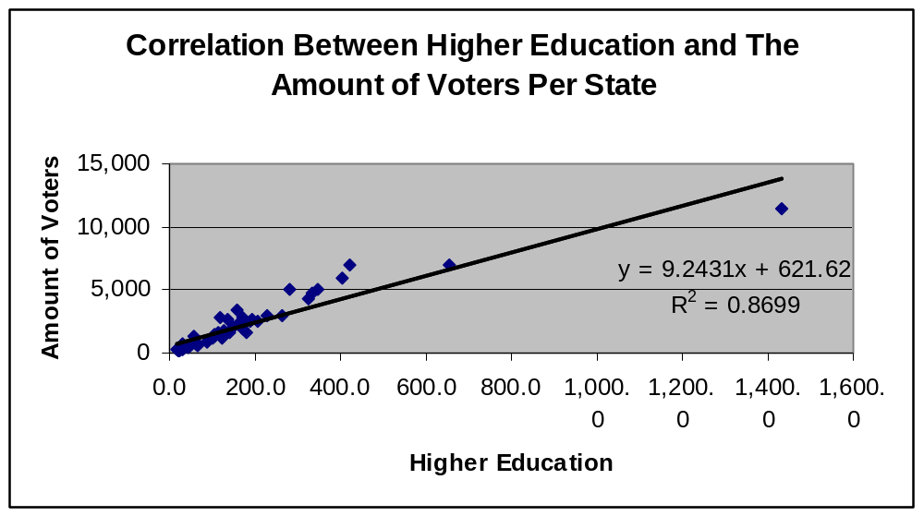
How Education Affects Voters

Slide 8



There is a positive correlation between those enrolled in higher education and the amount of voters in that state.
These two factors are correlated, but they are not dependent upon each other.

Slide 9
Conclusion
It is important for the candidate to appeal to the older populations, as well as the areas that are highly educated.
Also, it is important to appeal to the new potential voters, but not lose the majority.

Slide 10
References
U.S. Census Bureau, Statistical Abstract of the United States: 2002 (122nd Edition)
Washington D.C., 2001. Tables 396, 419, 420, 290.

