Slide 1

Rape in the United States
Michelle Chrul
Mannu Bajwa

Slide 2

Summary of Data
Crime data per state – 2000
Annual Income per State – 2000
Percent obtaining high school diploma per state - 2000

Slide 3
Purpose
To see whether rape is affected by:
  Income
  Level of education received

Slide 4
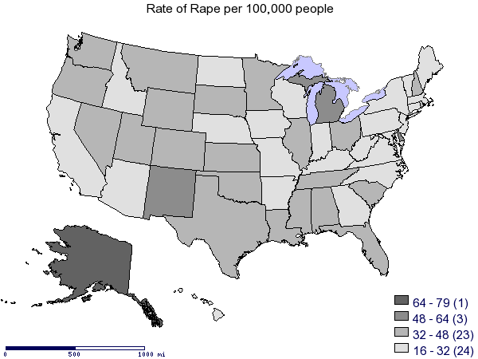
Rapes per 100,000 people

Slide 5
Annual Income
Highest:
  District of Columbia - $52,965
  Connecticut - $45,486
  New York - $45,358
Lowest:
  South Dakota - $24,802
  North Dakota - $24,683
  Montana - $24,272

Slide 6
Education Level
Largest Percent Receiving H.S. Diploma
  Washington – 91.8%
  South Dakota – 91.8%
  Minnesota – 90.8%
Smallest Percent Receiving H.S. Diploma
  Kentucky – 78.7%
  Alabama – 77.5%
  West Virginia – 77.1%

Slide 7
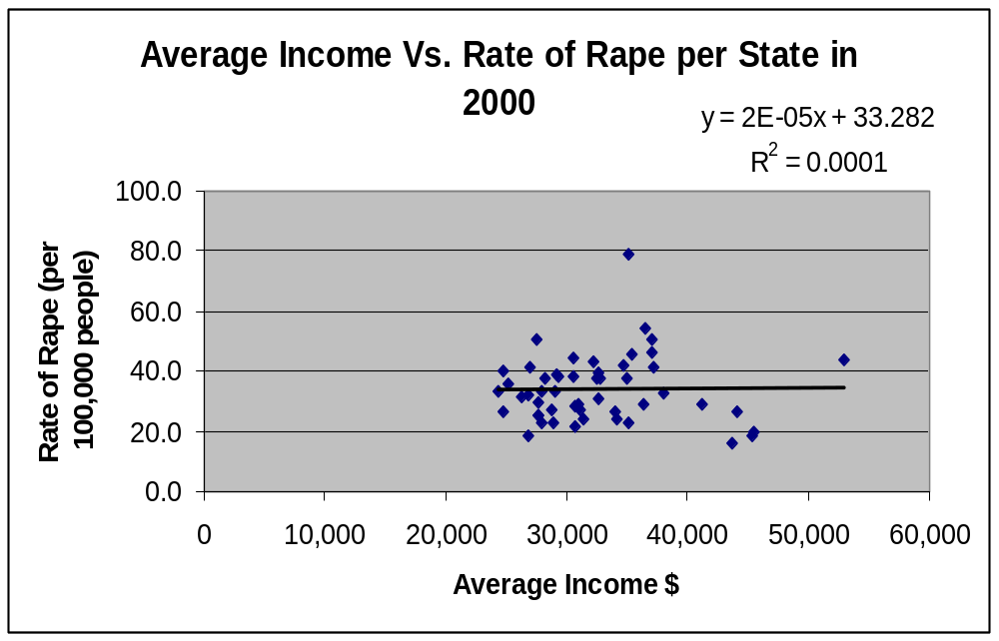
Graph with Outliers

Slide 8
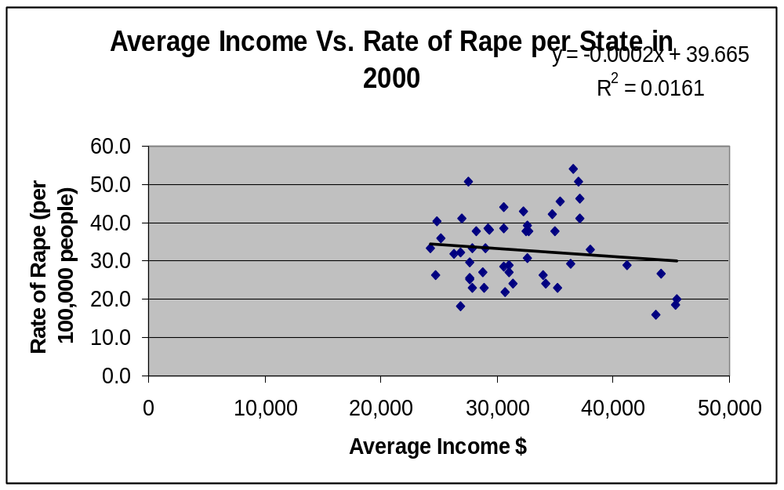
Graph without Outliers

Slide 9
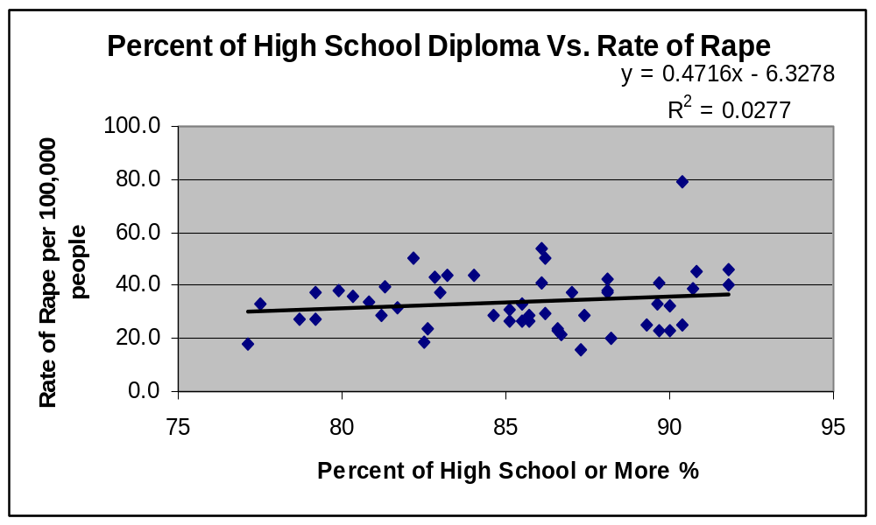
Graph with Outliers

Slide 10
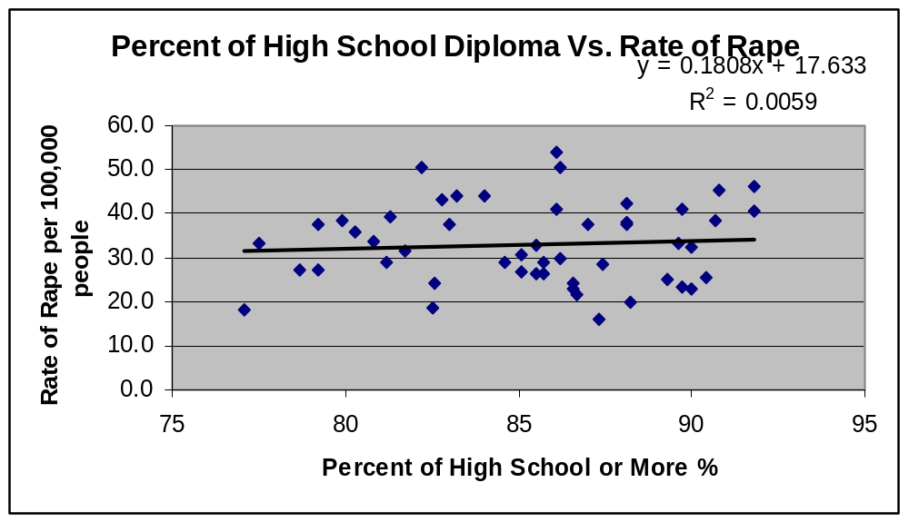
Graph without Outliers

Slide 11
Outliers
Alaska in both cases
Population?
Take a closer look

Slide 12
Conclusion
No relationship
Look for other causes
Look at each state individually

