Slide 1
Flashbulb Memories? Memories for Events Surrounding September 11th
Elizabeth Arnott
David Allbritton
Stephen Borders
DePaul University
Presented at the 45th annual meeting of the
Psychonomic Society, November 2003

Slide 2
Abstract
Questionnaires were administered to 27 DePaul undergraduates concerning their experience of the terrorist attacks of September 11, first on September 12, 2001 and again two months later. Results indicated that the students formed enduring flashbulb memories according to currently held criteria. However, less than half of the propositions recalled about the circumstances one day after the event were accurately reproduced two months later. Consistent with previous findings, participants’ reports decreased in level of detail over time. Confidence was correlated with rehearsal, but no consistent relationship was observed between accuracy and either rehearsal or confidence. Perceived historical significance was associated with the presence of a flashbulb memory, suggesting that the perception of a global level of significance could be important in the development of a flashbulb memory.

Slide 3
Introduction
“Flashbulb Memories”
  In 1977, Brown and Kulik described a phenomenon they termed flashbulb memory.
  They concluded that the personal circumstances surrounding surprising and important events are automatically encoded in memory.
How accurate are they?
  Pillemer (1984) reported approximately 90% of subjects could accurately report their experience
  McCloskey et al., (1988) reported approximately 50% accuracy after 5 years

Slide 4
Factors Related to Accuracy
Rehearsal
  Neisser (1982) noted that accuracy is difficult to verify; Narrative hypothesis
Emotion and surprise
  Finkenauer et al. (1998)
Confidence
  Weaver (1993)
Historical Significance
  Finkenauer et al.

Slide 5
Flashbulb Memory – Operationally Defined
Four “Canonical Questions” are currently used to define a flashbulb memory (from Brown & Kulik’s original six):
  Where?
  Who?
  How?
  What?
A “flashbulb memory” is said to occur when a subject accurately recalls at least 3 of the 4 answers to the canonical questions.

Slide 6
Procedure
27 DePaul students completed a set of questionnaires
They reported their experience of September 11th on September 12, 2001 and again two months later.

Slide 7
Questionnaire
Four “Canonical Questions”
  Where were you? (Where?)
  Who were you with? (Who?)
  From what source did you first hear the news? (How?)
  What were you doing at the time? (What?)

Slide 8
Questionnaire
Additional questions
  When the subject heard of the event
  Emotional Impact
  Personal Significance
  Amount of Rehearsal
  Historical Significance

Slide 9
Coding: Global Accuracy
(on Canonical Questions)
Global Accuracy (accuracy on canonical questions)
  0 = no correspondence between T1 and T2
  1 = partial correspondence between T1 and T2
  2 = full correspondence between T1 and T2

Slide 10
Coding: Global Accuracy
Accuracy coding
  Strict = “2” rating considered accurate
  Lax = “1 or 2” rating considered accurate
Time 2 was only two months after the incident
  Thus, a “strict” rating of accuracy was required on all 4 canonical questions

Slide 11
Propositional Coding
Open-ended questions were propositionally coded (Bovair & Kieras, 1991)
Number of propositions served as a measure of level of detail
Individual propositions were also coded for accuracy:
  0 = not present at Time 2
  1 = partially present at Time 2
  2 = fully present at Time 2
Inter-rater reliability was high (93% agreement)

Slide 12
Are these Memories Accurate? – (Are they Flashbulb Memories?)
Yes.
  78% of the subjects were accurate on all four canonical questions using “lax” criteria
  93% were accurate for 3 of 4 using “lax” criteria; 78% using “strict” criteria
And, no.
  And only 48% of the subjects were accurate on the four canonical questions using “strict” criteria
  Only 45% of the propositions present at Time 1 were present at Time 2.

Slide 13
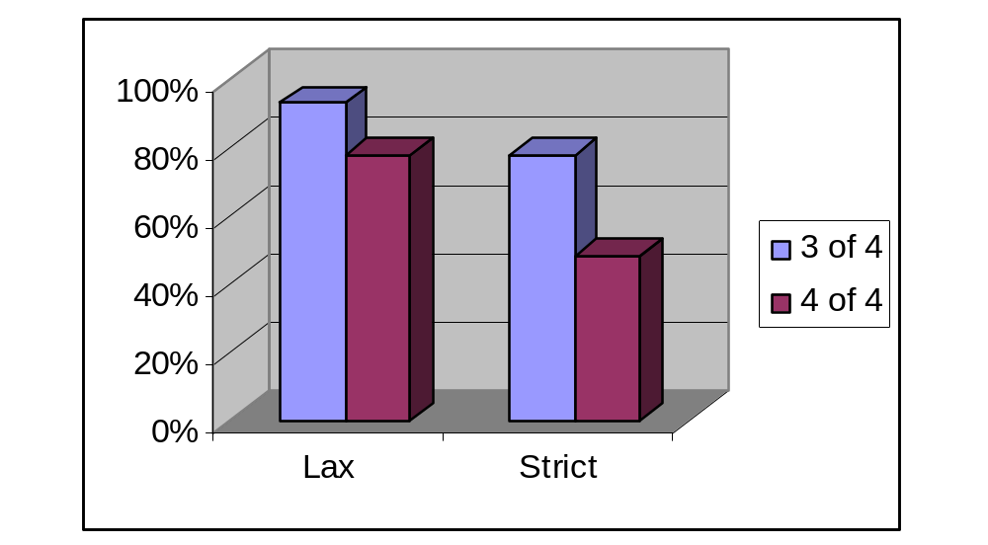
Results –
Memory Accuracy for the 4 Canonical Questions

Slide 14
What is Special about these Memories?
Highly Detailed (Mean = 12.8 propositions)
High Rate of Rehearsal
(Time 1=4.4, Time 2 = 15)
High Emotional Impact and Surprise
(Mean = 7.33, 8.85)*
Moderate Personal Significance
(Mean = 6.85)*
High Historically Significance (Mean = 9.62)*
  *(On 10-point scale where 1= Low; 10 = High)

Slide 15
Flashbulb vs. Non-Flashbulb
Flashbulb memory subjects*:
  Higher ratings of the likelihood of remembering the event in 10 years
  (p = .049; FB = 9.4, non-FB = 8.4)
  Marginally higher ratings of emotional impact
    (p = .074; FB = 8.2, non-FB = 6.5)
  Higher ratings of “historical significance”
    (p = .035; FB = 10, non-FB = 9.2)
* As there was only a two month time delay between Time 1 and Time 2, the “strict criterion” was used to determine which subjects were flashbulb memory subjects for these analyses.

Slide 16
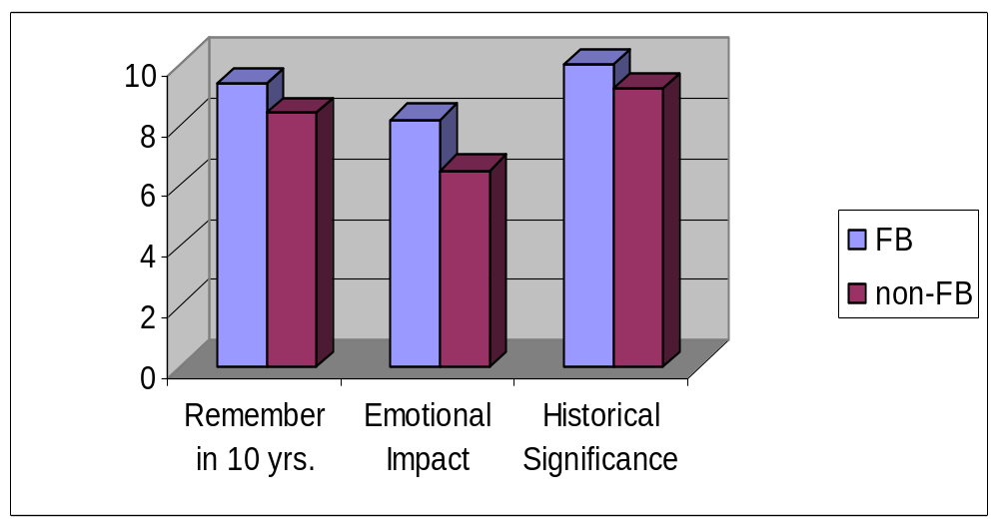
Flashbulb vs. Non-Flashbulb

Slide 17
Do They Change Over Time?
Detail tends to decrease over time
  Detail-level of the responses, as measured by number of propositions given at each Time, decreased between Time 1 and Time 2.
  However this effect was only significant for the What? Canonical question
  (Difference between Time 1 and 2, p = .004)
Amount of Rehearsal increases with time
  (p = .004)

Slide 18
The Role of Rehearsal
Contrary to previous findings accuracy was not significantly correlated with early rehearsal
  Time 1 r = -.005, p = .986
  Time 2 r = .139, p = .508
Those who rehearsed at least once in the first 24 hours recalled more propositions for Time 2 for “What” canonical question.
But, there was little evidence for a role of early rehearsal in our data as a whole.

Slide 19
Confidence
We also found no relationship between accuracy and confidence
  (r = .302, p = .209)
However, confidence was significantly correlated with rehearsal
  (r = .579, p = .038)

Slide 20
Conclusions
Are 9/11 memories flashbulb memories?
  Yes – Using the “3 of 4 correct” criteria for canonical questions
Consistent with previous research:
  Detail decreases with time
  Confidence correlates with rehearsal
  Historical significance ratings higher for FB subjects
Recall data from the day after the event:
  Previous work suggests that FB memories may become “fixed” after a time lapse, therefore having recall data from the day immediately following the event may be an important contribution of the study.

