Slide 1
Psychology
A tool to peer into the minds of others?
Are you ready to begin a demonstration?

Slide 2
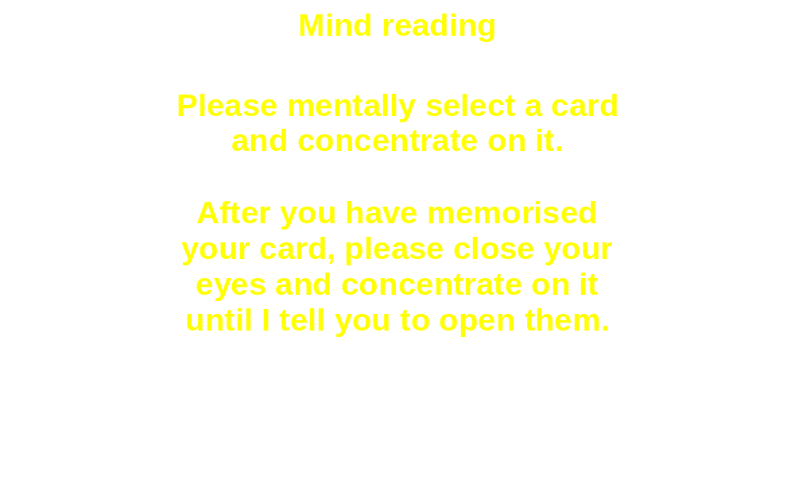


Slide 3
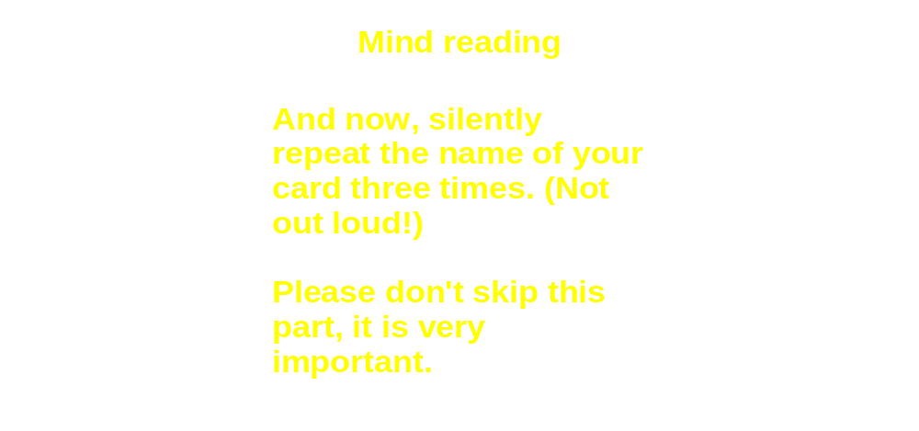

Slide 4
