Slide 1
Psy 105
Introductory Psychology I
David Allbritton
http://www.depaul.edu/~dallbrit

Slide 2
What is Psychology?
The science that studies behavior
and mental processes
Scientific Approach: empirical and skeptical
  1st question: What is the evidence?
  2nd question: What *exactly* is the evidence?
  (this quote from Elizabeth Loftus)

Slide 3
Subfields of Psychology
Cognitive
Biological
Personality
Developmental
Quantitative
Clinical
Counseling
Community
Educational
Social
Industrial/ Organizational

Slide 4
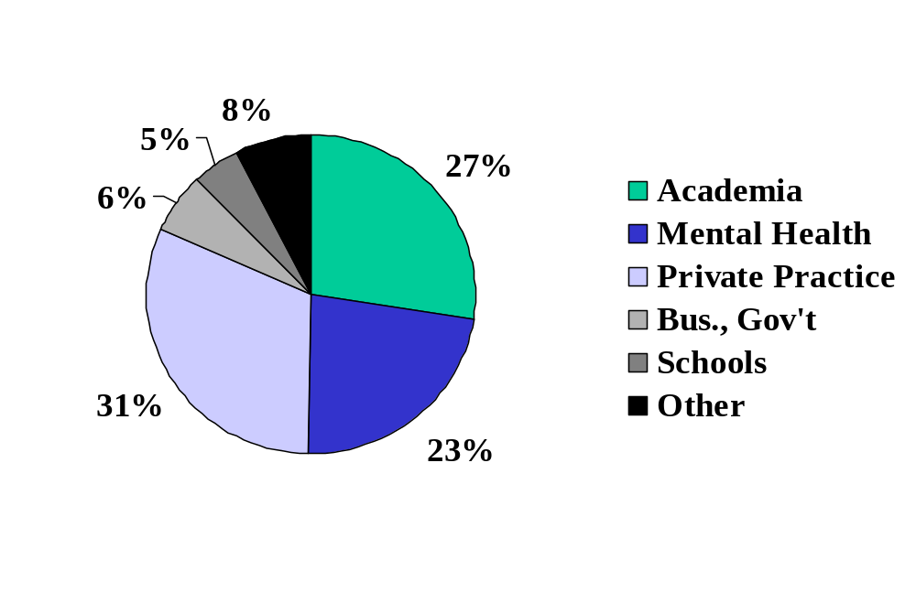
Where Do Psychologists Work?
Source: Data from the 1998 APA Directory Survey

Slide 5
What do Psychology Majors Do?
According to 1992 APA survey:
42% enrolled in graduate school
  28% also worked at the same time
50% were employed full or part time
6% were not employed
What kind of jobs? A wide variety

Slide 6
Approaches to the
Science of Psychology
Biological Approach: Emphasizes activity of the nervous system, especially the brain; the action of hormones and other chemicals; and genetics.
Evolutionary Approach: Emphasizes the ways in which behavior and mental processes are adaptive for survival.

Slide 7
Approaches (cont.)
Psychodynamic Approach: Emphasizes internal conflicts, mostly unconscious, which usually pit sexual or aggressive instincts against environmental obstacles to their expression
Behavioral Approach: Emphasizes learning, especially each person’s experience with rewards and punishments

Slide 8
Approaches (cont.)
Cognitive Approach: Emphasizes mechanisms through which people receive, store, retrieve, and otherwise process information
Humanistic Approach: Emphasizes individual potential for growth and the role of unique perceptions in guiding behavior and mental processes

Slide 9
A Brief History of Psychology
Philosophical roots
  Empiricism: Knowledge comes through experience and observation, not through speculation.
Influence of Darwin’s ideas on development of psychology as a science.
Birth of modern, scientific psychology credited to Wundt in 1879.
First Psychologist to win Nobel Prize (1978)

Slide 10
A brief history: The Big Picture
Early schools of thought
  structuralism
  functionalism
  gestalt
  psychodynamics
Modern paradigms
  behaviorism
  cognitive “revolution”
  biological approaches
  evolutionary psychology

Slide 11
Structuralism
Goals: To study conscious experience and its structure.
Notable Psychologists: Wundt, Titchner
Methods: Experiments; introspection.
Application: “Pure scientific research”
  spurred development of psychological laboratories.

Slide 12
Functionalism
Goals: To study how the mind works to allow an organism to adapt to its environment.
Notable Psychologists: James; Cattell; Thorndike; Dewey
Methods: Naturalistic observations of animal and human behavior.
Applications: Child psychology; educational and industrial psychology; study of individual differences.

Slide 13
Gestalt Psychology
Goals: To describe organization of mental processes.
  “The whole is greater than the sum of its parts.”
Notable Psychologists: Wertheimer; Koffka; Kohler
Methods: Observation of sensory/perceptual phenomena.
Applications: Understanding of visual illusions; laid some groundwork for humanistic and cognitive psychology.

Slide 14
Psychoanalysis
Goals: To explain personality and behavior and develop techniques for treating mental illness.
Notable Psychologists: Freud; Jung; Adler
Methods: Free association under guidance of analyst; clinical insight.
Applications: Development of psychotherapy; emphasis on childhood as important in later personality.

Slide 15
Behaviorism
Goals: To study only observable behavior and explain behavior via learning principles. To make psychology into a “real” science.
Notable Psychologists: Watson; Skinner
Methods: Observation of the relationship between environmental stimuli and behavioral responses. Rigorous application of scientific methods.
Application: Behavior modification; improved teaching methods.

Slide 16
Modern Paradigms in Psychology
Behaviorism
Cognitive “revolution”
Biological approaches
Evolutionary psychology

Slide 17
Recurring Issues and Themes
Nature vs. Nurture
Holism vs. Reductionism
Freedom vs. Determinism
Levels of Analysis
Limited Capacity and “shortcuts”
Evolutionary origins
Failures of the system

Slide 18
Above All, This:
What is the EVIDENCE?
What exactly is the evidence?

