Slide 1
Thinking Critically About Psychology
(or anything else!)‏
What am I being asked to believe or accept?
What evidence is available to support the assertion?
Are there alternative ways of interpreting the evidence?
What additional evidence would help to evaluate the alternatives?
What conclusions are most reasonable?

Slide 2
How do psychologists learn about people?

Slide 3
Goals of the Scientific Method
Describe a phenomenon.
Make predictions about the phenomenon.
Control the phenomenon to ask specific questions about it.
Explain the phenomenon.

Slide 4
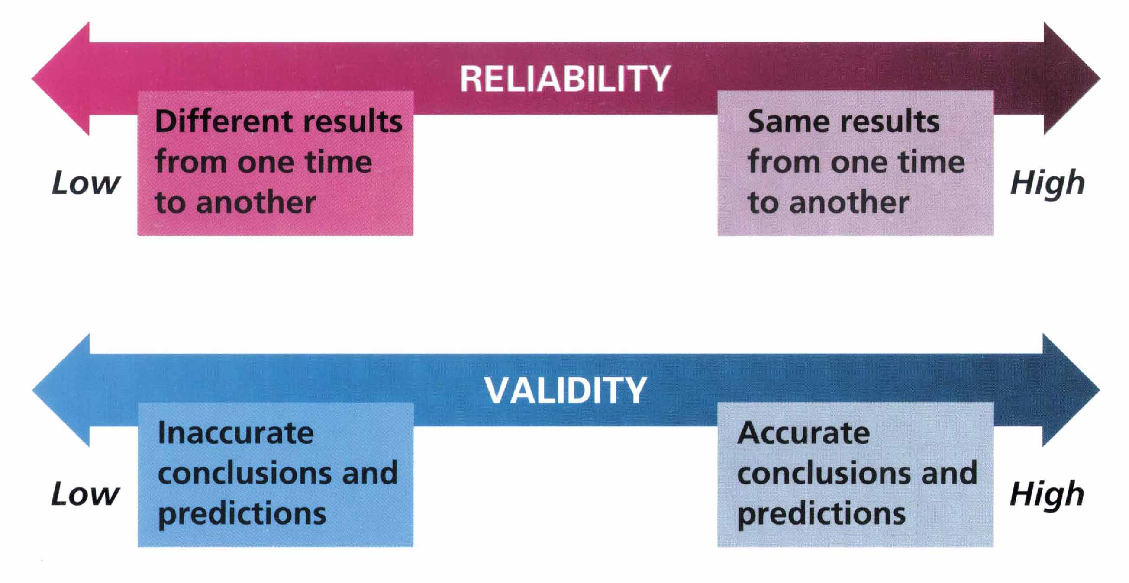
Reliability and Validity
Zick Rubin, Lelitia Anne Peplau, and Peter Salovey, Psychology. Copyright © 1993 by Houghton Mifflin Company. Reprinted by permission

Slide 5
The Scientific Method
Gather Evidence
Formulate a Theory

Slide 6
Methods of Psychological Research

Slide 7
Naturalistic Observations
Features: Observations of humans or animal behavior in the environment in which it typically occurs.
Strengths: Provides descriptive data about behavior presumably uncontaminated by outside influences.
Pitfalls: Observer bias and participant self-consciousness can distort results.

Slide 8
Case Studies
Features: Intensive examination of the behavior and mental processes associated with a specific person or situation.
Strengths: Provide detailed descriptive analysis of new, complex, or rare phenomenon.
Pitfalls: May not provide representative picture of phenomena.

Slide 9
Surveys
Features: Standard set of questions asked of a large number of participants.
Strengths: Gather large amounts of descriptive data relatively quickly and inexpensively.
Pitfalls: Sampling errors, poorly phrased questions, and response biases can distort results.

Slide 10
Experiments
Features: Manipulation of an independent variable and measurement of its effects on a dependent variable.
Strengths: Can establish a cause-effect relationship between independent and dependent variables.
Pitfalls: Confounding variables may prevent valid conclusions.

Slide 11
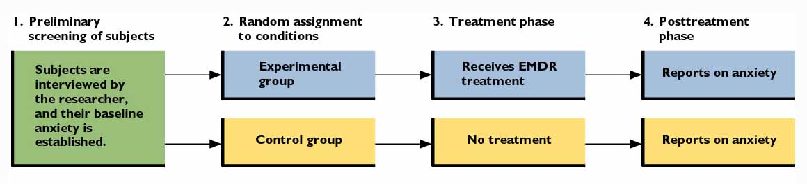
Figure 1.4: A Simple Two Group Experiment
Independent Variable: Whether or not one received the EMDR Treatment
Dependent Variable: Anxiety Level

Slide 12
Potential Problems in Experiments
Confounding variables
Random variables
  Importance of Random Assignment.
Participants’ expectations & the placebo effect.
Experimenter bias
  Often minimized through the use of a Double-Blind Design.

Slide 13
Selecting Human Participants for Research
To whom can the conclusions based on the results of a sample be generalized?
Random vs. biased samples
Importance of having a representative sample.

Slide 14
When scientists announce a significant breakthrough in research, how can you be sure it is “significant”?

Slide 15
Statistical Analysis of
Research Results
Descriptive statistics
Inferential statistics
Correlation as a measure of the direction and strength of the association between two variables of interest.

Slide 16
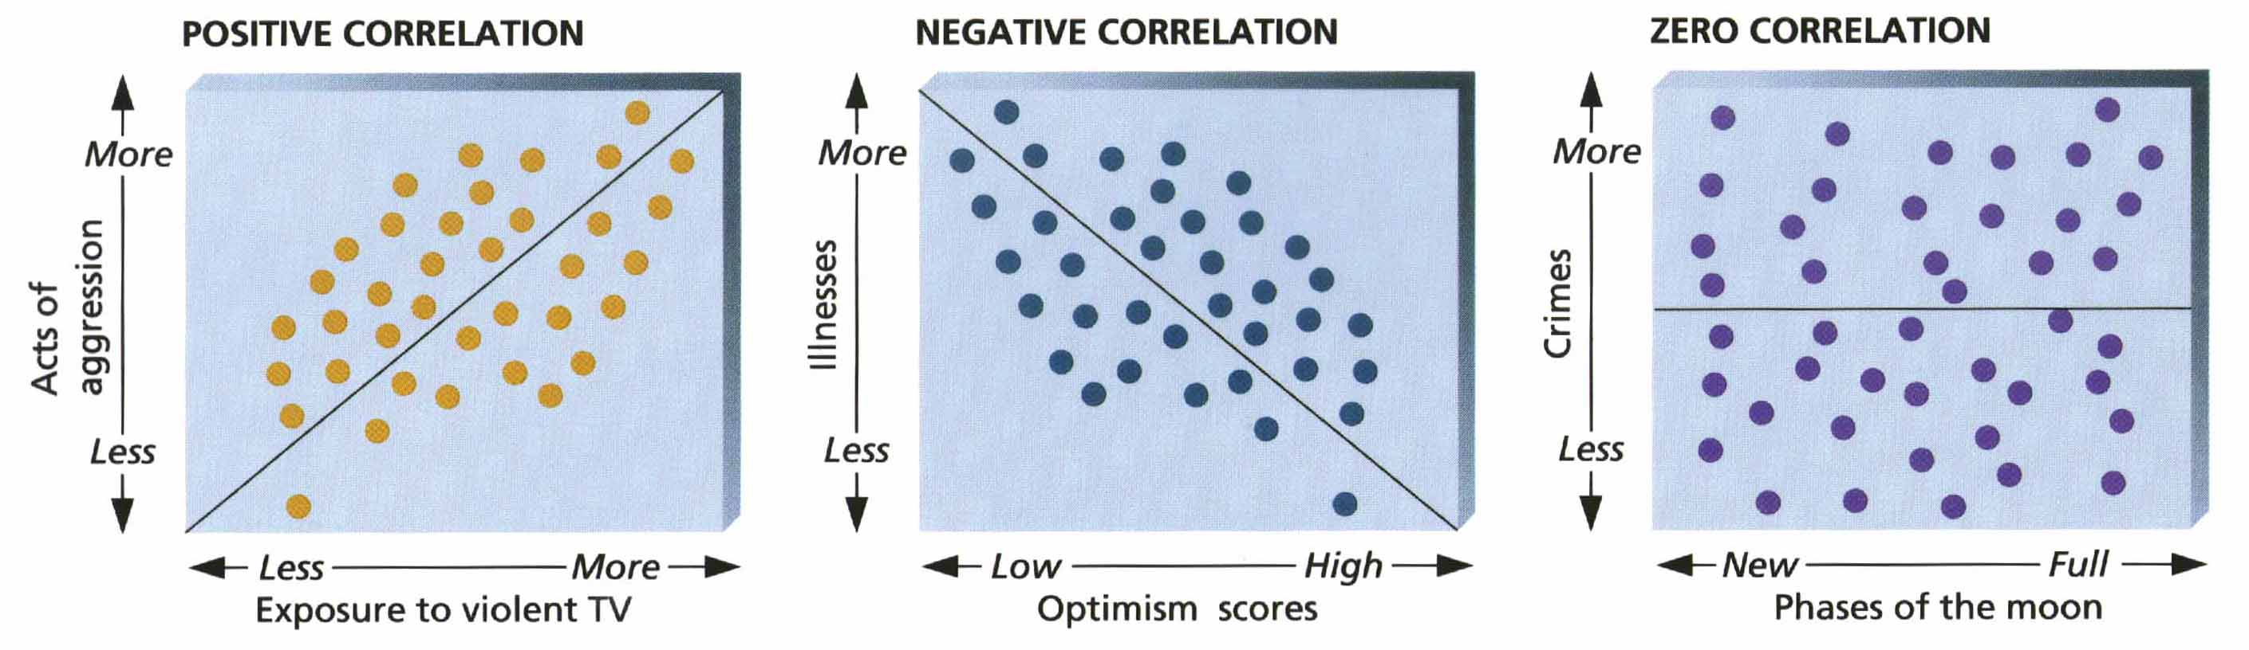
Types of Correlations
Saul Kassin, Psychology. Copyright © 1995 by Houghton Mifflin Company. Reprinted by permission.

Slide 17
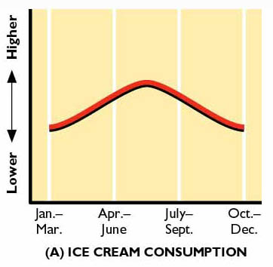

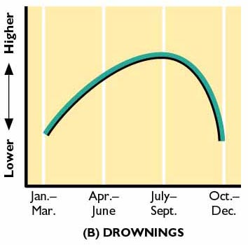
Figure 1.6: Correlation and Causation

Slide 18
From: http://www.venganza.org/about/open-letter/

Slide 19
Do psychologists trick people to get research data?

Slide 20
Ethical Guidelines for Psychologists
Role of the Institutional Review Board (IRB).
All researchers must:
  minimize any discomfort and risk to participant.
  ensure participants will not suffer any long-term negative consequences.
  allow individuals to make informed decisions about their decision to participate in the research.
Ethical obligations extend to animals as well as human participants.

Slide 21
Thinking Critically: Is EMDR an Effective Treatment for Anxiety?
What am I being asked to believe or accept?
What evidence is available to support the assertion?
Are there alternative ways of interpreting the evidence?
What additional evidence would help to evaluate the alternatives?
What conclusions are most reasonable?

Slide 22
Focus on Research: Studying EMDR
What was the researcher’s question?
How did the researcher answer the question?
What did the researcher find?
What do the results mean?
What do we still need to know?

