Slide 1
Learning

Slide 2
What is Learning?
Learning is a relatively permanent change in behavior due to experience.
Learning is important to our ability to adapt to changing environments.

Slide 3
How did Russian dogs teach psychologists about learning?

Slide 4
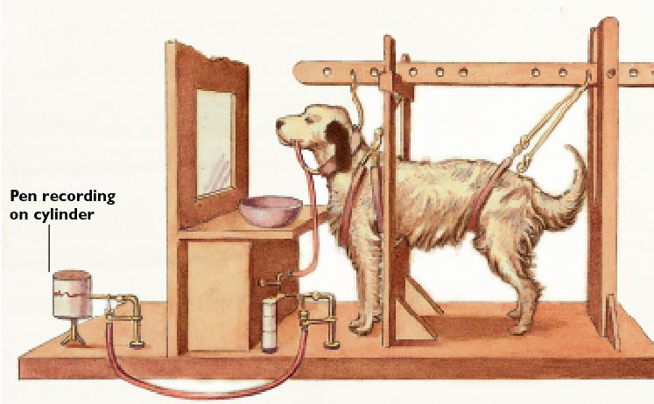
Figure 5.1: Pavlov’s Discovery

Slide 5
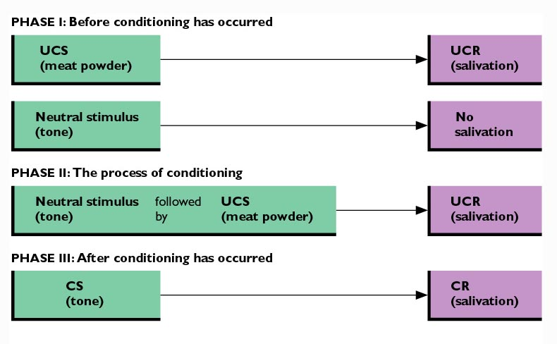
Figure 5.2: Classical Conditioning

Slide 6
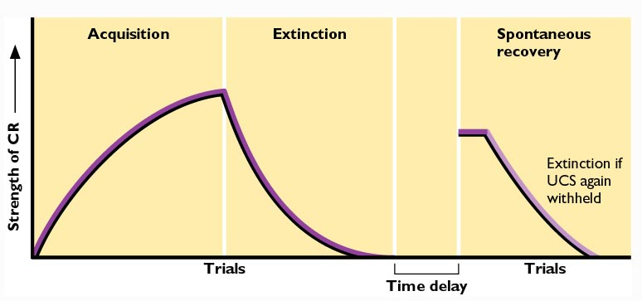
Figure 5.3: Changes Over Time in the Strength of the CR

Slide 7
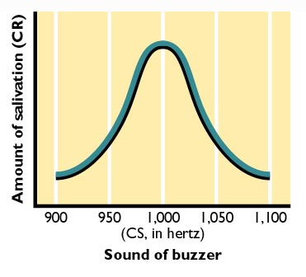
Figure 5.4: Stimulus Generalization

Slide 8
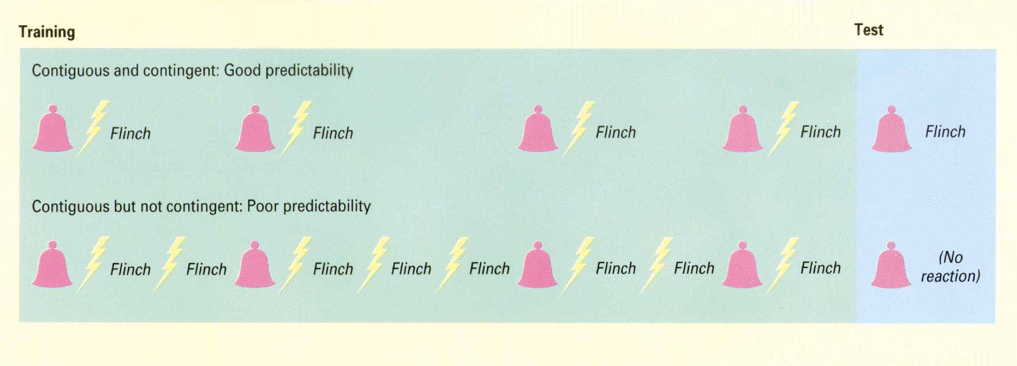
Conditioning, Contiguity, and Predictability
James D. Laird and Nicholas S. Thompson, Psychology. Copyright © 1992 by Houghton Mifflin Company. Reprinted by permission.

Slide 9
Other Factors Influencing the Learning of Conditioned Responses
Timing
Signal Strength
Attention
Second-Order Conditioning
Biopreparedness
  e.g., Conditioned Taste Aversion

Slide 10
Some Applications of
Classical Conditioning
Sometimes plays a role in the development of intense, irrational fears of objects or situations (i.e., phobias).
  Systematic desensitization uses classical conditioning principles to treat such fears.

Slide 11
How do reward and punishment work?
Operant Conditioning

Slide 12
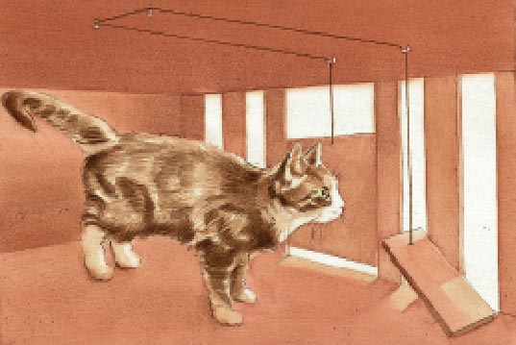
Figure 5.5: Thorndike’s Puzzle Box

Slide 13
Thorndike’s Law of Effect
If a response made to a particular stimulus is followed by satisfaction, that response is more likely to occur the next time the stimulus is present.
  “Instrumental Conditioning”
Skinner extended this idea by saying that an organism learns a response by operating on the environment.
  “Operant Conditioning”
  Skinner’s primary aim was to analyze how behavior is changed by its consequences.

Slide 14
Basic Components of
Operant Conditioning
Operant: A response that has some effect on the world.
Reinforcer: A stimulus event that increases the probability that the operant behavior will occur again.
  Positive Reinforcer: Stimulus that strengthens the response if it follows that response.
  Negative Reinforcer: An unpleasant stimulus that − if removed − strengthens the response that removes the stimulus.

Slide 15
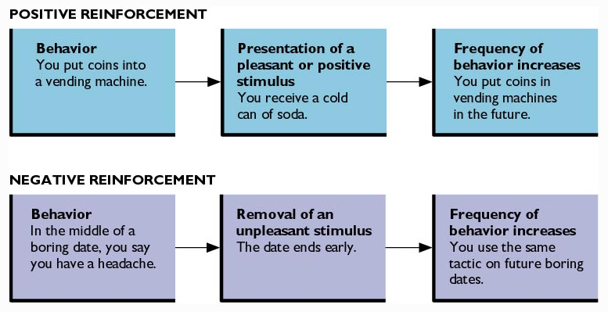
Figure 5.7: Positive and Negative Reinforcement

Slide 16
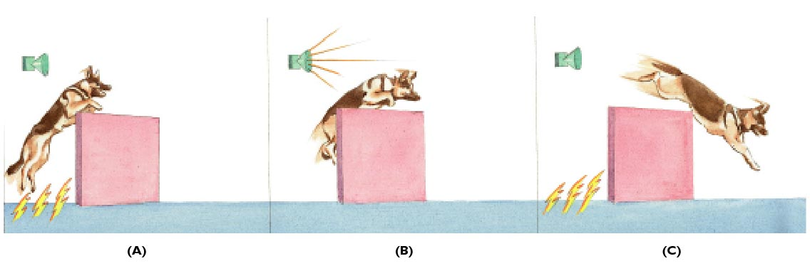
Figure 5.8: Escape and Avoidance Conditioning
Adapted from: The Psychology of Memory and Learning by Hintzman. © 1978 by W.H. Freeman and Company. Used with permission.

Slide 17
Stimulus Discrimination and Generalization
Stimulus Discrimination: Organism learns to make a particular response in the presence of one stimulus but not another.
Stimulus Generalization: Organism performs a response in the presence of a stimulus that is similar to, but not exactly like a stimulus that has signaled reinforcement in the past.

Slide 18
Forming and Strengthening Operant Behavior
Shaping: Process of reinforcing successive approximations to the target behavior.
Types of Reinforcers
  Primary Reinforcers: Events or stimuli that satisfy needs basic to survival.
  Secondary Reinforcers: Rewards that people or animals learn to like.
    sometimes called “conditioned reinforcers.”

Slide 19
Schedules of Reinforcement
Continuous Reinforcement Schedule: Reinforcer is delivered every time a particular response occurs.
Partial or Intermittent Reinforcement Schedule: Reinforcement is given only some of the time.
  Partial reinforcement extinction effect

Slide 20
Partial Reinforcement Schedules
Fixed Ratio (FR): Fixed number of responses required for reinforcement.
Variable Ratio (VR): Number of responses required for reinforcement varies.
Fixed Interval (FI): Fixed set of time must elapse before next opportunity for reinforcement.
Variable Interval (VI): Time interval that must elapse before next opportunity for reinforcement varies.

Slide 21
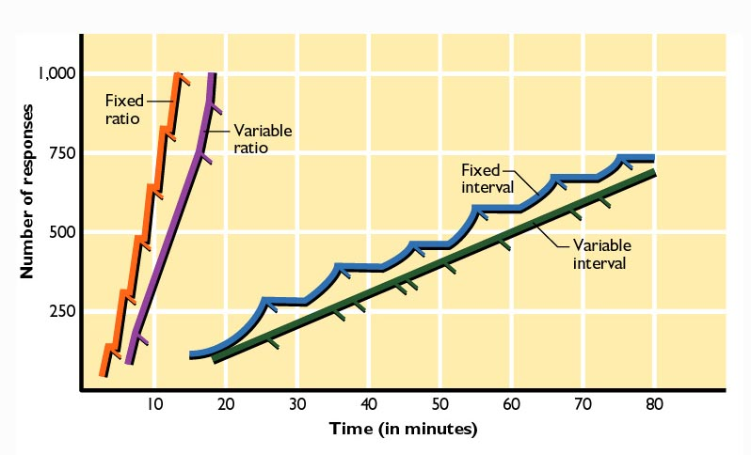
Figure 5.10: Schedules of Reinforcement
Adapted from "Teaching Machines" by B.F. Skinner, Copyright © 1961 by Scientific American, Inc. All rights reserved.

Slide 22
Punishment and Learning
Punishment: The presentation of an aversive stimulus or the removal of a pleasant one following some behavior.
  Results in a decrease in the frequency of a response.
Negative Reinforcement versus Punishment
  Negative Reinforcement: Strengthens behavior.
  Punishment: Weakens behavior.

Slide 23
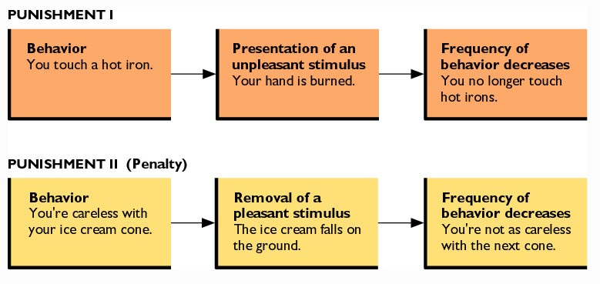
Figure 5.11: Two Kinds of Punishment

Slide 24
Drawbacks of Punishment
Does not “erase” an undesirable habit.
Can produce unwanted side effects.
Can often be ineffective unless it is given immediately after the response and each time the response is made.
Can become aggression, even abuse, when given in anger.
Signals what is inappropriate behavior but does not specify correct alternative behavior.

Slide 25
Guidelines for Effective Punishment
Specify why punishment is being given.
Emphasize that the behavior, not the person, is being punished.
Without being abusive, deliver punishment immediately and noticeably enough to eliminate the undesirable response.
Identify and positively reinforce more appropriate responses.

Slide 26
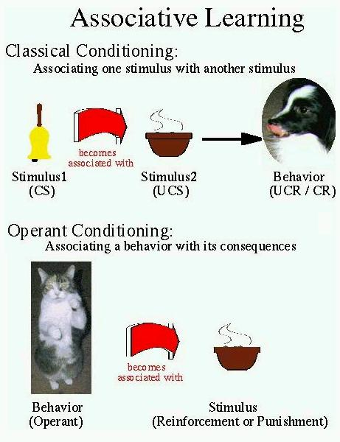
Distinguishing Operant and Classical Conditioning:
A visual aid to help you remember the difference

Slide 27
Can people learn to be helpless?
Learned Helplessness: Tendency to give up any effort to control the environment after experience suggests that no control is possible.

Slide 28
Cognitive Processes in Learning
Challenges to behavioral view of classical and operant conditioning.
  Argued that learning may result from not only from automatic associations but also from mental processes.
  Latent Learning
  Observational Learning

Slide 29
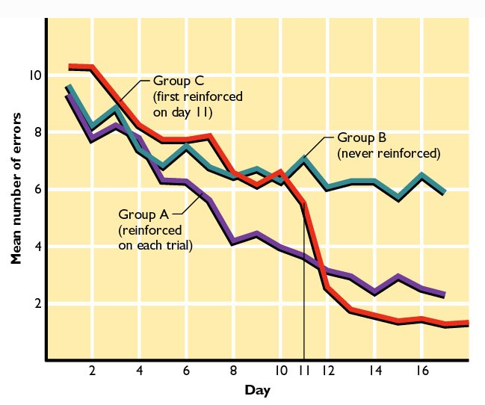
Figure 5.13: Latent Learning

Slide 30
Observational Learning
Learning by watching others.
  Also called social learning.
Learn from watching others who act as models for appropriate behavior.
Vicarious conditioning: Type of observational learning where person is influenced by watching or hearing about consequences of others’ behaviors.

Slide 31
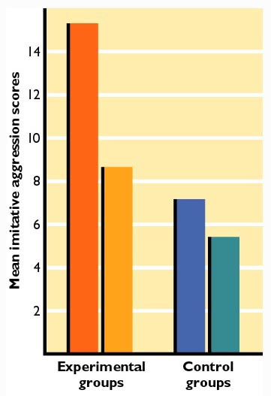
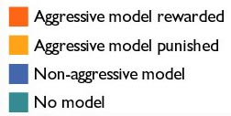
Figure 5.15: Observational Learning
Bandura, A., Ross, D., & Ross, S. A. (1963). Imitation of film-mediated aggressive models. Journal of Abnormal and Social Psychology, 66, 3-11.

Slide 32
What should teachers learn about learning?

Slide 33
Research on Learning to Help People Learn
Cultural differences in classrooms.
Active learning
  Emphasis on the importance of cognitive processes in learning.
Skill learning
  Practice as critical to the mastery of a skill.

