Slide 1
Memory

Slide 2
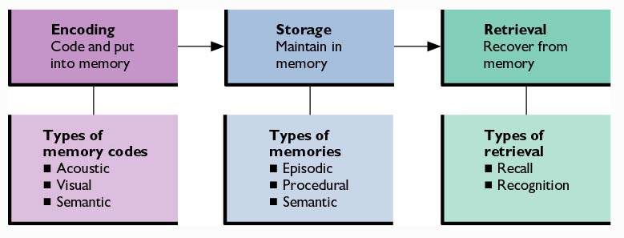
Figure 6.1: Basic Memory Processes

Slide 3
Levels-of-Processing
Model of Memory
Memory depends on the extent to which one encodes and processes information when first received.
  Maintenance Rehearsal: Encode and process information through repetition.
  Elaborative Rehearsal: Encode and process information by relating new material to information already stored in memory.

Slide 4
Other Models of Memory
Transfer-Appropriate Processing Model: Memory depends on how well the encoding process matches up with what is ultimately retrieved.
Parallel Distributed Processing (PDP) Models: New experiences are not only stored but also change one’s overall knowledge base.

Slide 5
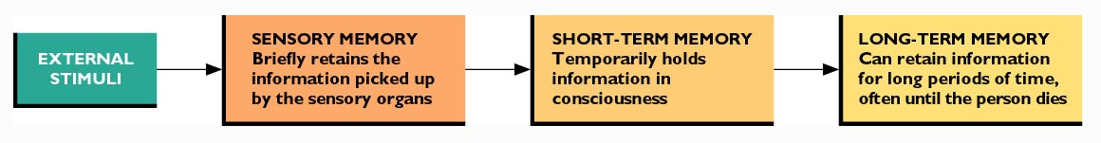
Figure 6.2: Three Stages of Memory

Slide 6
What am I most likely to remember?

Slide 7
Sensory Memory
Major function is to hold information long enough to be processed further.
  Sensory Registers (Icon; echo)
Helps us to experience a constant flow of information, even if that flow is interrupted.
Selective Attention: Mental resources are focused on only part of the stimuli around us.
  Remaining sensory memories fade quickly.

Slide 8
Short-Term Memory (STM)
The part of the memory systems that stores limited amounts of information for up to about 18 seconds unless rehearsed.
Also called working memory because it helps us to do much of our mental work.
Encoding in STM is usually, but not always, auditory.

Slide 9
Test Your Short Term Memory
9 2 5
Now, recall the numbers
8 6 4 2
Now, recall the numbers
3 7 6 5 4
Now, recall the numbers
6 2 7 4 1 8
Now, recall the numbers
0 4 0 1 4 7 3
Now, recall the numbers
1 9 2 2 3 5 3 0
Now, recall the numbers
4 8 6 8 5 4 3 3 2
Now, recall the numbers
2 5 3 1 9 7 1 7 6 8
Now, recall the numbers
8 5 1 2 9 6 1 9 4 5 0
Now, recall the numbers
9 1 8 5 4 6 9 4 2 9 3 7
Now, recall the numbers

Slide 10
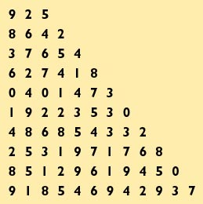
Figure 6.3: Capacity of Short Term Memory
Immediate Memory Span: Maximum number of items one can recall after one presentation
Miller’s (1956) “Magic Number”: 7 plus or minus 2 chunks of information
Power of Chunking
COGNITIVE PSYCHOLOGY: MEMORY, LANGUAGE AND THOUGHT by Howard, Darlene, V., © 1967. Reprinted by permission of Prentice-Hall Inc., Upper Saddle River, NJ.

Slide 11
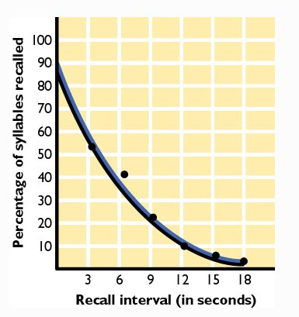
Figure 6.4: Forgetting in Short-Term Memory
Peterson, L. R. & Peterson, M. J. (1959). Short-term retention of individual verbal items. Journal of Experimental Psychology, 59, 193-198.

Slide 12
The Power of Chunking
Try to remember the following letters:
  TH-EDO-GSA-WTH-ECA-T
  Now, recall all of the letters
Let’s try that again:
  THE-DOG-SAW-THE-CAT
  Now, recall all of the letters
They were the same letters, just chunked differently!

Slide 13
Long-Term Memory (LTM)
Part of the memory system whose encoding and storage capabilities are believed to be unlimited.
Placement of information into LTM usually involves semantic encoding.

Slide 14
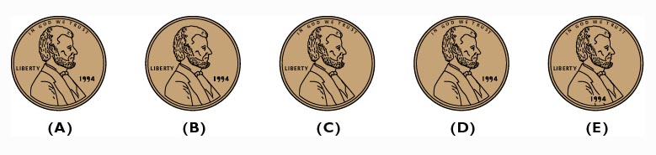
Figure 6.5: Which Is the Correct Image of a U.S. Penny?
From "Long-Term Memory for a Common Object," by R.S. Nickerson and M.J. Adams. Cognitive Psychology, 1979, 11, 287-307. Reprinted by permission of Academic Press.

Slide 15
A Recall Experiment
Study the following list of words for 30 seconds:
Desk, chalk, pencil, chair, paperclip, book, eraser, folder, briefcase, essays

Slide 16
Write down as many of the words from the list as you can, in any order

Slide 17
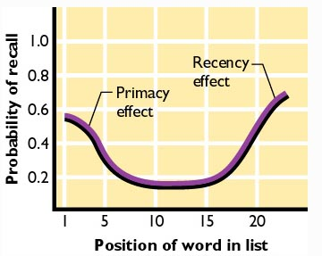
Figure 6.6: A Serial-Position Curve

Slide 18
How do I retrieve stored memories?

Slide 19
Retrieval Cues and
Encoding Specificity
Retrieval Cues: Stimuli that helps one retrieve information from LTM.
Encoding Specificity Principle: Effectiveness of retrieval cues depends on the match between encoding and retrieval.

Slide 20
Context and State Dependence
Context Dependent Memories: Memories that are helped or hindered by similarities or differences between the contexts in which they are learned and recalled.
State Dependent Memories: Memories that are helped or hindered by similarities or differences in a person’s internal state during learning versus recall.
  Mood congruency effects

Slide 21
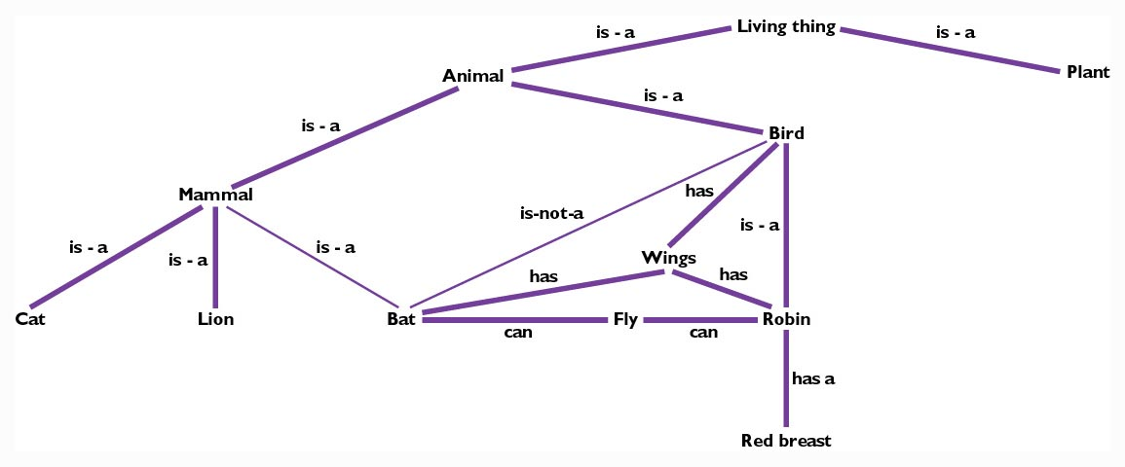
Retrieval Based on How Memory is Organized
Figure 6.8: Semantic Networks

Slide 22
How accurate are my memories?

Slide 23
Constructive Memory
Memories are affected by not only what we perceive, but also by generalized knowledge about the world.
Existing knowledge is used to organize new information as we receive it.
  We fill in gaps in information that we encode and retrieve.

Slide 24
Constructive Memory and Parallel Distributed Processing Models
PDP models suggest how semantic and episodic memories become integrated in constructive memories.
PDP networks can produce spontaneous generalizations.
Problem: catastrophic interference

Slide 25
Schemas in Memory
Schemas: Mental representations of categories of objects, events, and people.
  Example: Restaurant schema
Using general knowledge to fill in the missing pieces of memories for specific events.

Slide 26
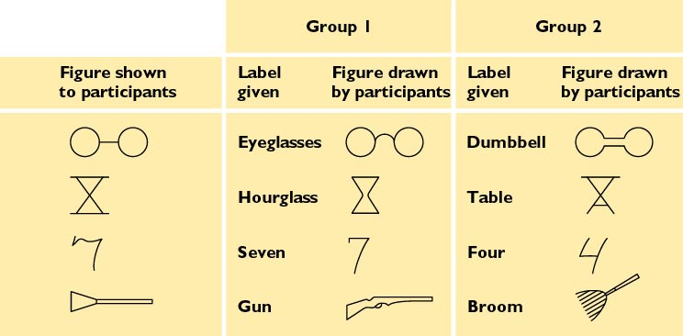
Figure 6.9: The Effect of Schemas on Recall

Slide 27
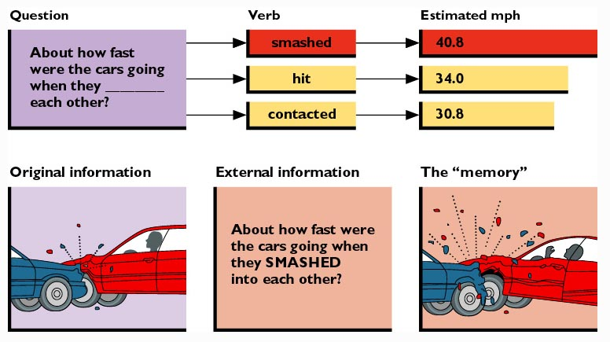
Eyewitness Memory and Post-even Information (Elizabeth Loftus)

Slide 28
Can Traumatic Memories Be Repressed, Then Recovered?
Recovered memory experiences
False Memory Syndrome
  The role of hypnosis
Independent verification
Mechanism: Repression?

Slide 29
Can traumatic events lead to memories that you never forget?
Flashbulb Memories
Where, who, how, what? (“canonical questions)
More accurate?
More detailed?
Less forgetting?

Slide 30
What causes me to forget things?

Slide 31
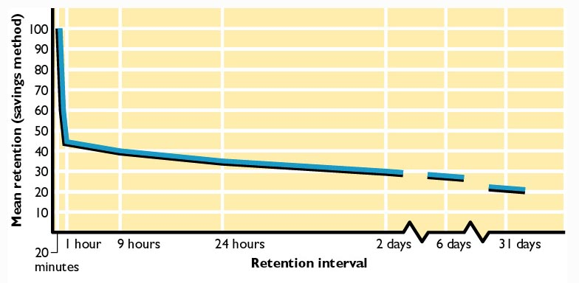
Figure 6.11: Ebbinghaus’s Curve of Forgetting

Slide 32
Why Do We Forget?
Decay: The gradual disappearance of the information from memory.
Interference: Either the storage or retrieval of information is impaired by the presence of other information.
  Proactive Interference: Old information interferes with learning new information.
  Retroactive Interference: New information interferes with recall of old information.

Slide 33
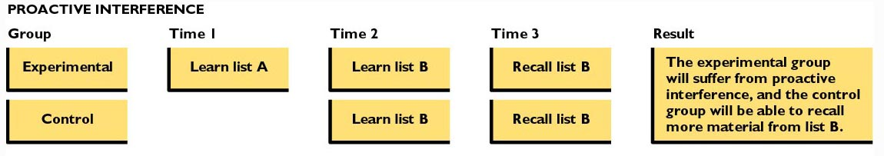
Figure 6.12: Studying Proactive Interference

Slide 34
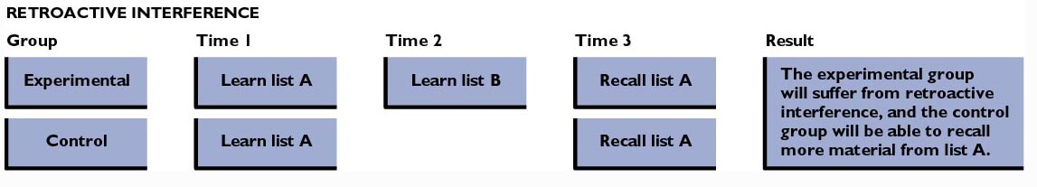
Figure 6.12: Studying Retroactive Interference

Slide 35
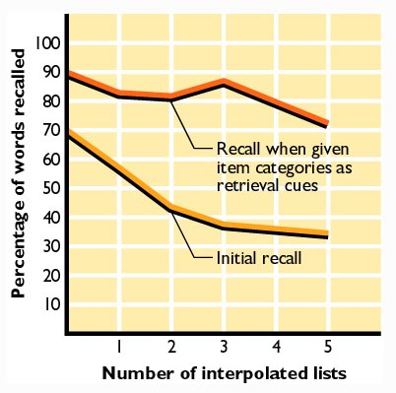
Figure 6.13: Retrieval Failure and Forgetting
Source: Tulving and Psotka, "Retroactive Inhibition in Free Recall: Inaccessibility of Information Available in the Memory Store." Journal of Experimental Psychology, 87, pp. 1-8, 1971. Copyright © 1971 by the American Psychological Association. Adapted with permission.

Slide 36
How does my brain change when I store a memory?

Slide 37
The Biochemistry of Memory
New experiences alter the functioning of existing synapses.
  Long-Term Potentiation: The process of “sensitizing” synapses.
Stimulation from the environment promotes the formation of new synapses.

Slide 38
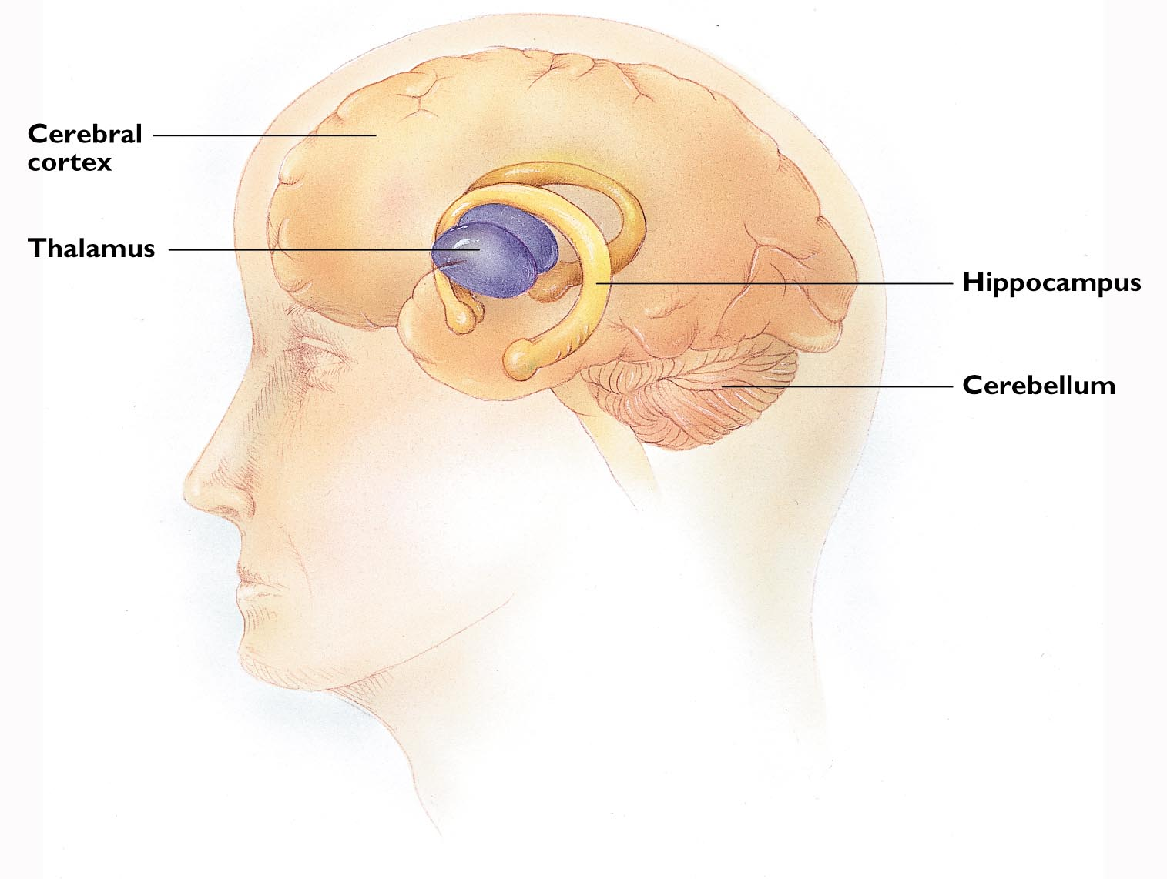
Figure 6.15: Brain Structures Involved in Memory

Slide 39
Impact of Brain Damage on Memory
Anterograde Amnesia: Loss of memory for any event occurring after the injury.
  Often the result of damage to the hippocampus, nearby parts of the cerebral cortex, and the thalamus.
Retrograde Amnesia: Loss of memory for events prior to some brain injury.

Slide 40
How can I remember more information?

Slide 41
Mnemonics
Strategies for putting information into an organized context in order to remember it more easily.
  Verbal organization is basis for many mnemonics.
Method of Loci
Peg-word Method
Vivid imagery and association

Slide 42
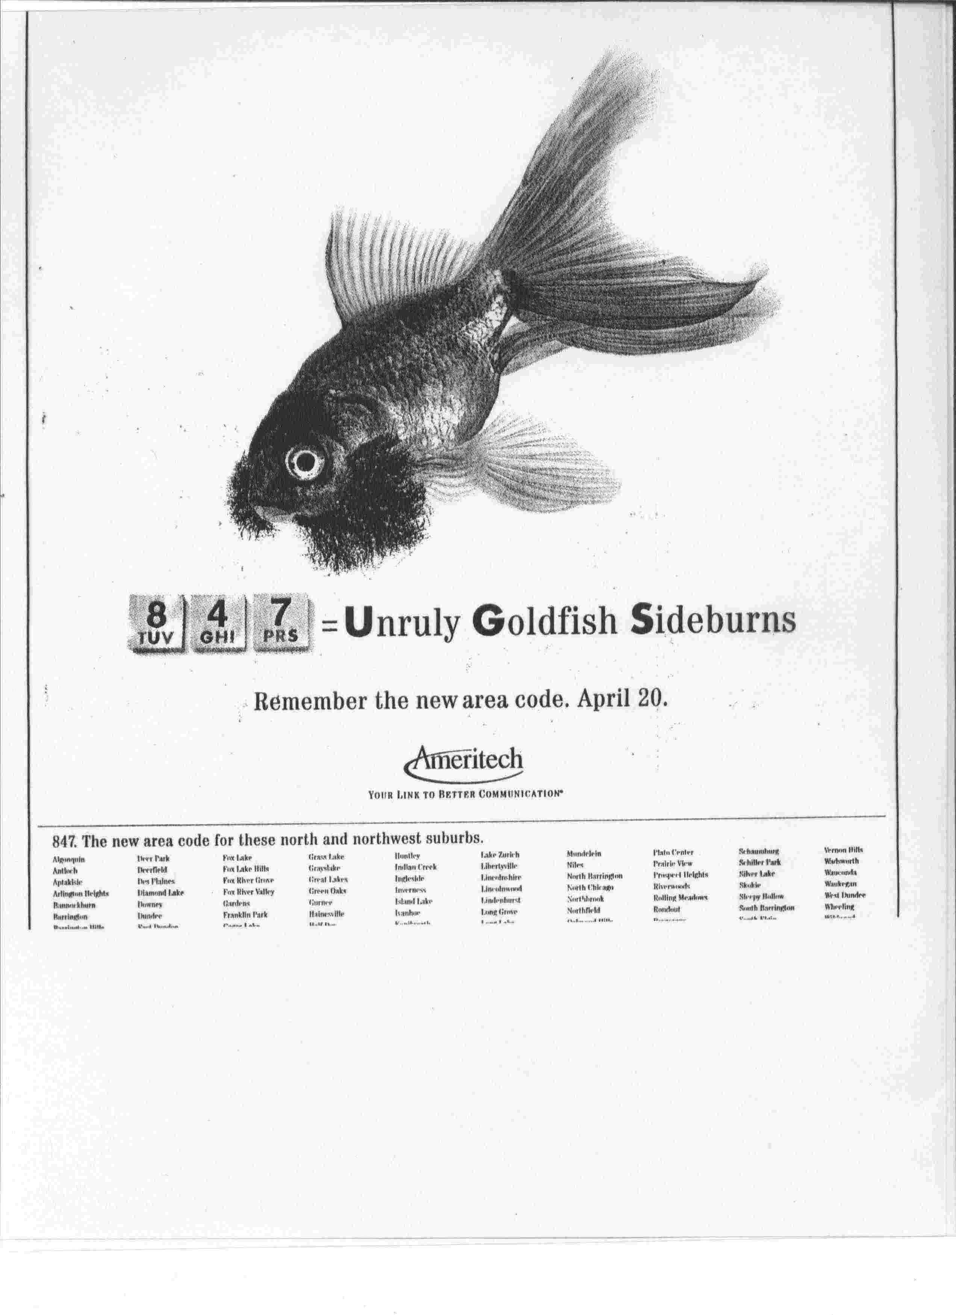

Slide 43
Guidelines for More
Effective Studying
Create an outline or other overall context for learning, rather than just passively reading and rereading the material.
  Maintenance rehearsal alone tends to be ineffective for retaining information over long periods.
Distributed Practice is much more effective than Massed Practice.

Slide 44
More tips
Levels of Processing: use *elaborative* rehearsal
Encoding specificity: match encoding and retrieval
  Study in a similar context (quiet, etc.)
  Study in different orders (multiple cues)
Recency effect: what to go over last-minute

