Slide 1
Intelligence
Psy 105

Slide 2
What Is Intelligence?
Accepted working definition (Sternberg):
  The possession of knowledge.
  The ability to efficiently use that knowledge to reason about the world.
  The ability to use reasoning adaptively in different environments.

Slide 3
A Brief History of Intelligence Tests
Galton, 1869 – Phrenology
Binet (1904): Can French children doing poorly in school be identified?
  Developed a set of intellectual tasks that became model for current intelligence tests.
  Binet’s assumptions:
    Reasoning, thinking, and problem-solving all depend on intelligence.
    Children’s mental abilities increase with age.

Slide 4
A Brief History of Intelligence Tests (cont.)
Stanford-Binet Test:, developed by Terman in 1916 to determine a person’s intelligence quotient, or IQ.
  Based on Binet’s test of intelligence.
  IQ = (Mental Age/Chronological Age) * 100
  Scoring method allow the ranking of people based on their IQ.
  Termites
Goddard (1912) – Setting immigration policy
Yerkes (1917) – Alpha and Beta tests in WWI
Wechsler Adult Intelligence Scale
  Consists of a verbal and performance scale.

Slide 5
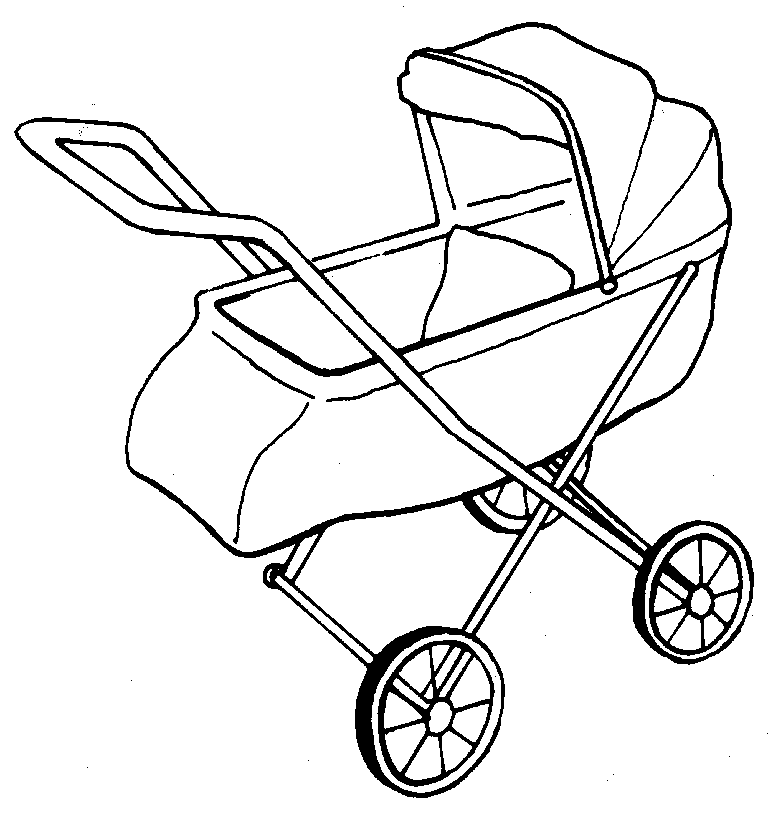
Figure 7.8: Sample Items from the WISC-III
PICTURE COMPLETION
What part is missing from this picture?
Simulated items similar to those in the Wechsler Intelligence Scales for Adults and Children. Copyright 1949, 1955, 1974, 1981, 1990 by The Psychological Corporation. Reproduced by permission. All rights reserved. "Wechsler Intelligence Scale for Children" and "WISC-III" are registered trademarks of The Psychological Corporation.

Slide 6
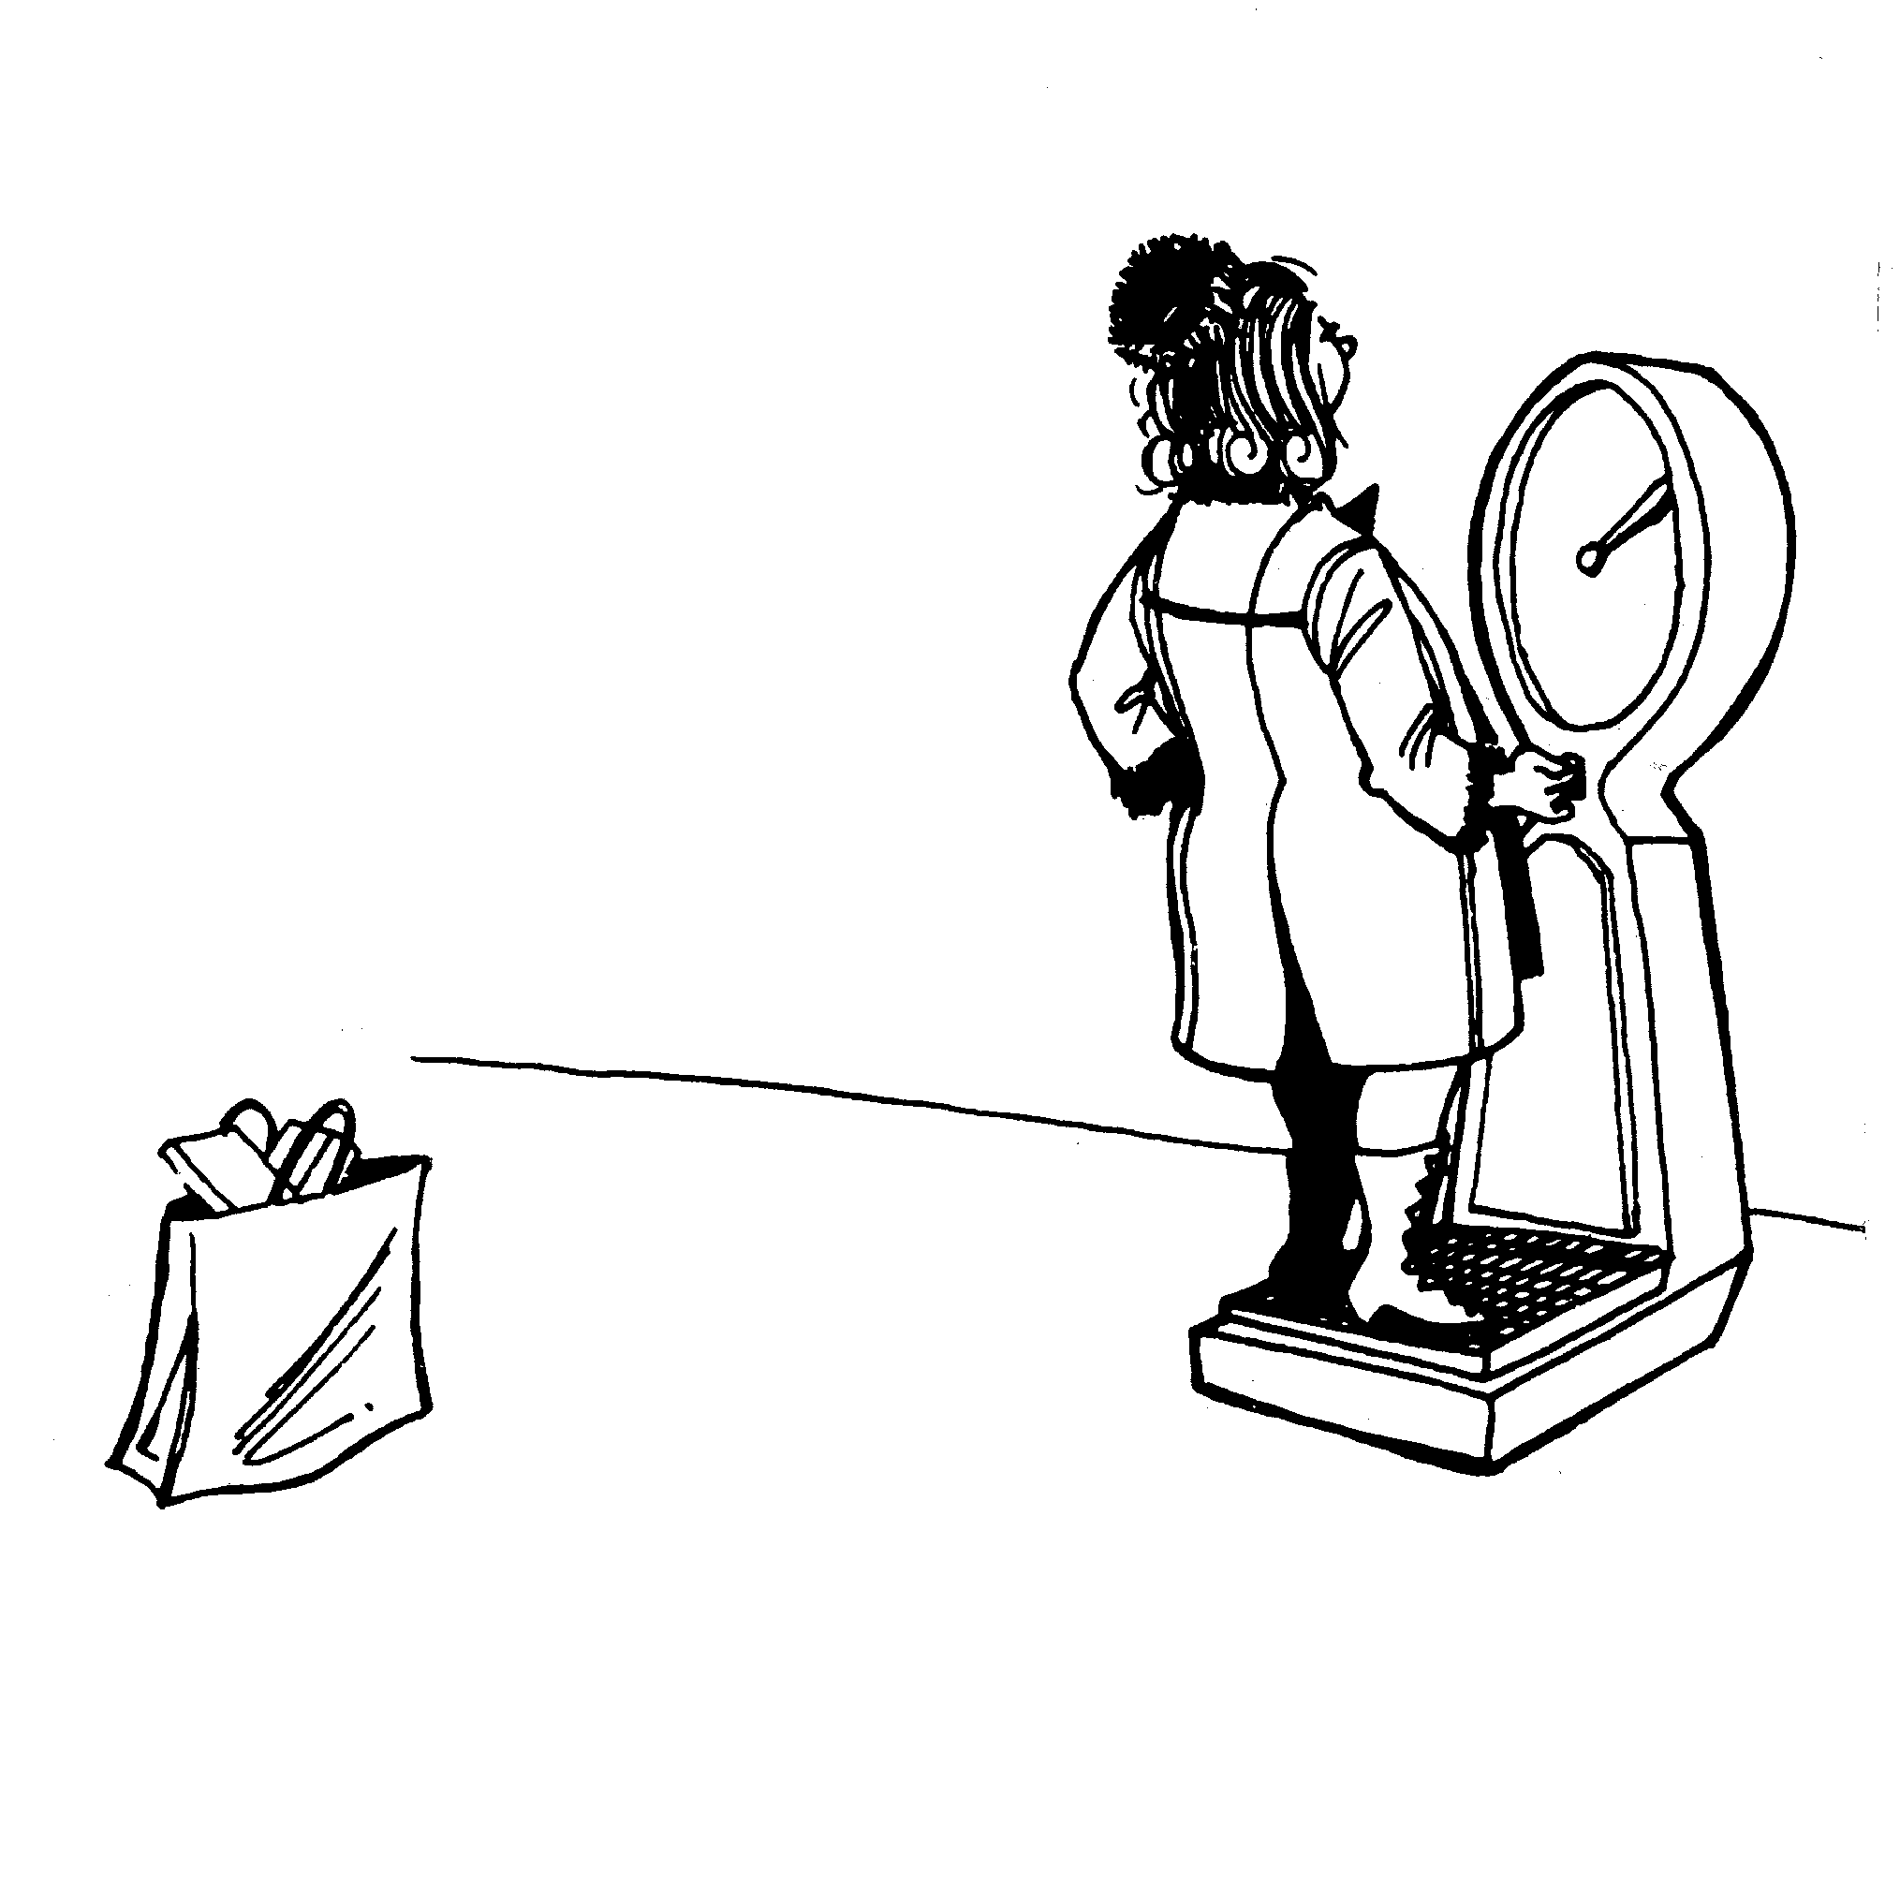
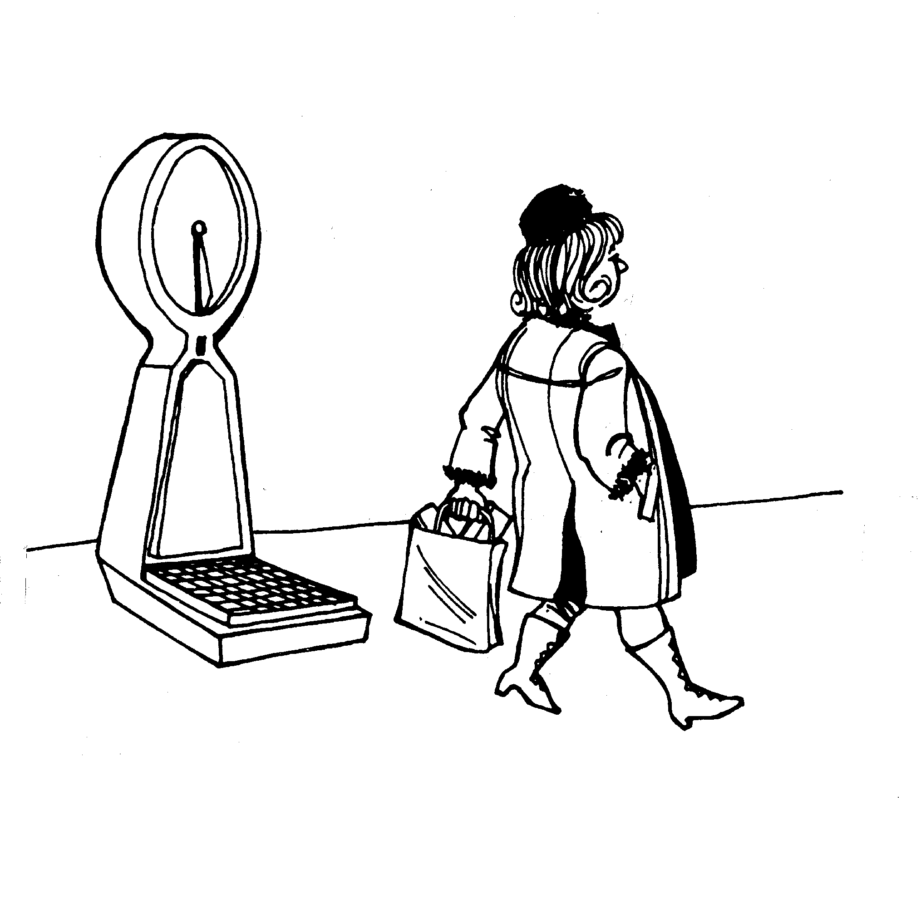
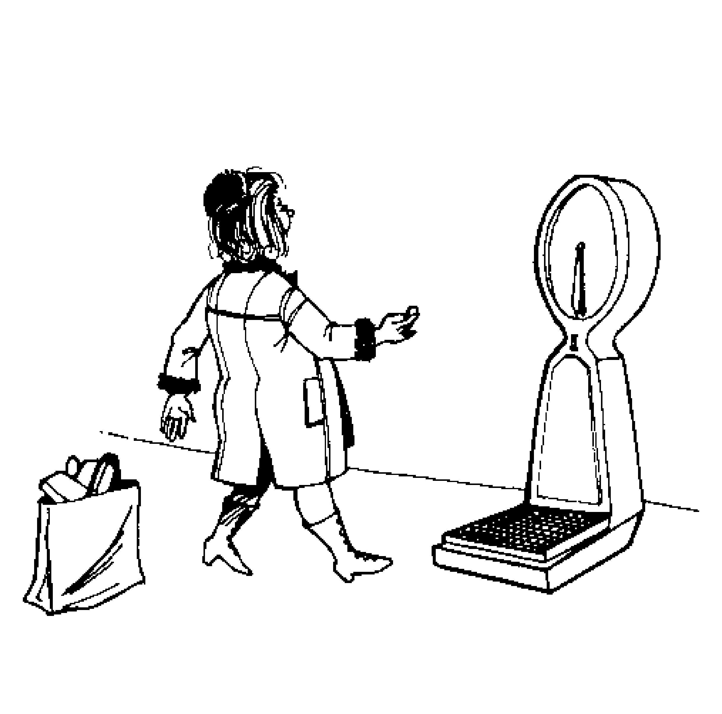
Figure 7.8: Sample Items from the WISC-III
PICTURE ARRANGEMENT
These pictures tell a story, but they are in the wrong order. Put them in the right order so that they tell a story.
Simulated items similar to those in the Wechsler Intelligence Scales for Adults and Children. Copyright 1949, 1955, 1974, 1981, 1990 by The Psychological Corporation. Reproduced by permission. All rights reserved. "Wechsler Intelligence Scale for Children" and "WISC-III" are registered trademarks of The Psychological Corporation.

Slide 7
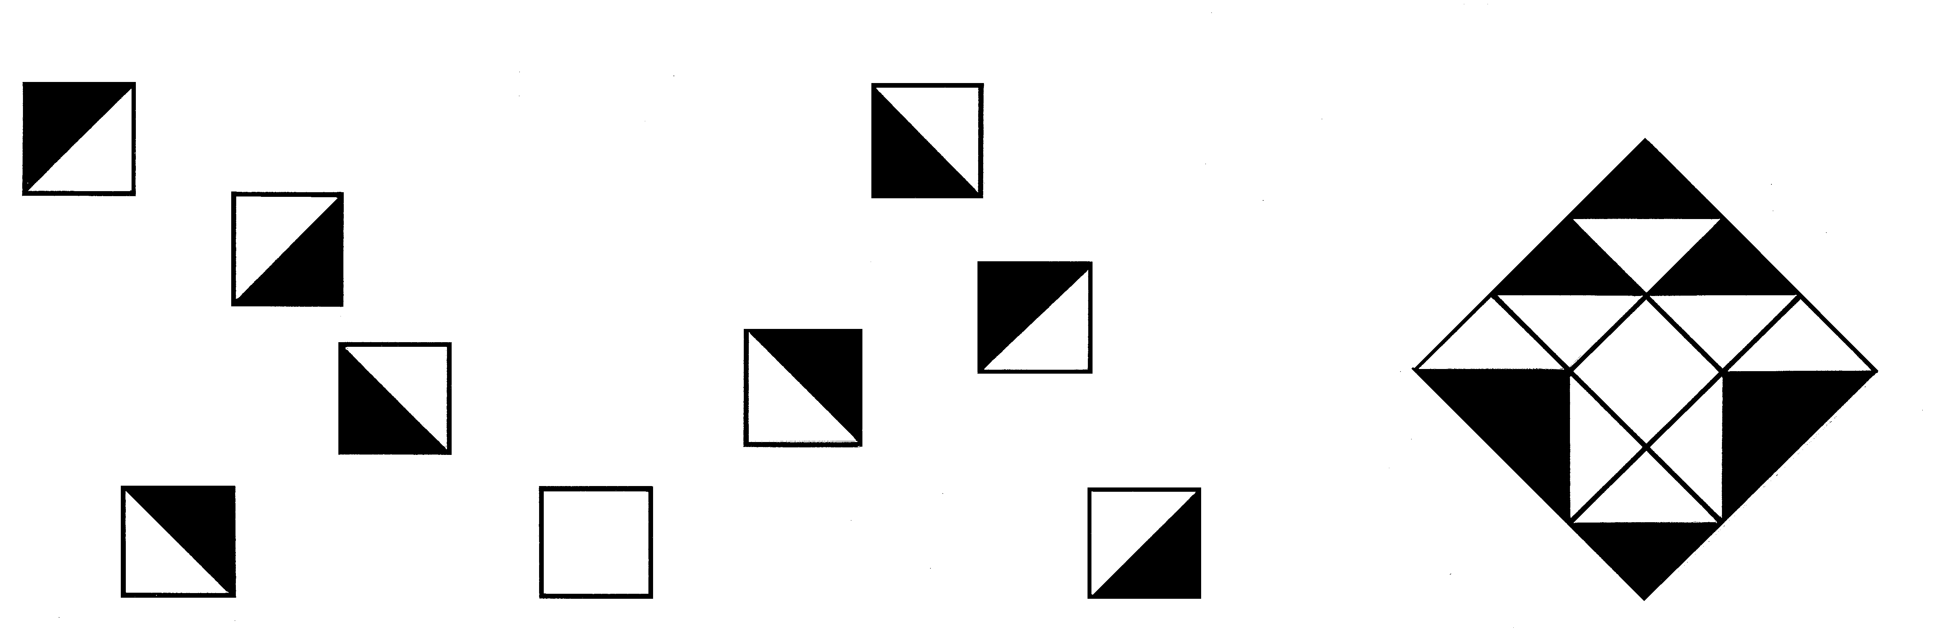
Figure 7.8: Sample Items from the WISC-III
Block Design
Put the blocks together to make this picture.
Simulated items similar to those in the Wechsler Intelligence Scales for Adults and Children. Copyright 1949, 1955, 1974, 1981, 1990 by The Psychological Corporation. Reproduced by permission. All rights reserved. "Wechsler Intelligence Scale for Children" and "WISC-III" are registered trademarks of The Psychological Corporation.

Slide 8
Calculating IQ
For IQ tests today, points earned for each correct answer are summed.
  Total score is compared to scores earned by other people.
  The average score at each age level is assigned the IQ value of 100.
Intelligence Quotient, or IQ score reflects one’s relative standing within a population of one’s age.

Slide 9
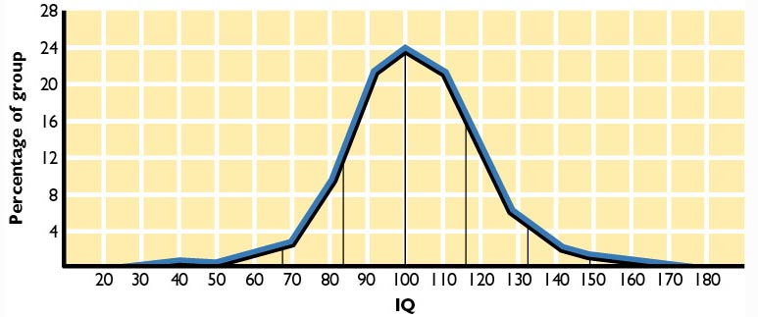
Figure 7.9: Distribution of IQ Scores in the Population

Slide 10
How good are IQ tests?

Slide 11
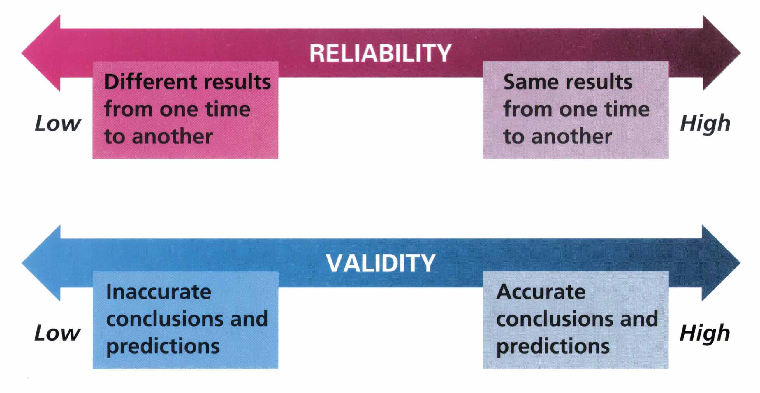
Test Reliability and Validity
Zick Rubin, Lelitia Anne Peplau, and Peter Salovey, Psychology. Copyright © 1993 by Houghton Mifflin Company. Reprinted by permission.

Slide 12
Reliability and Validity of IQ Tests
For teenagers and adults, reliability is high, generally above +.90.
Reasonably good validity for predicting certain criteria.
  But not a perfect measure of how “smart” people are.

Slide 13
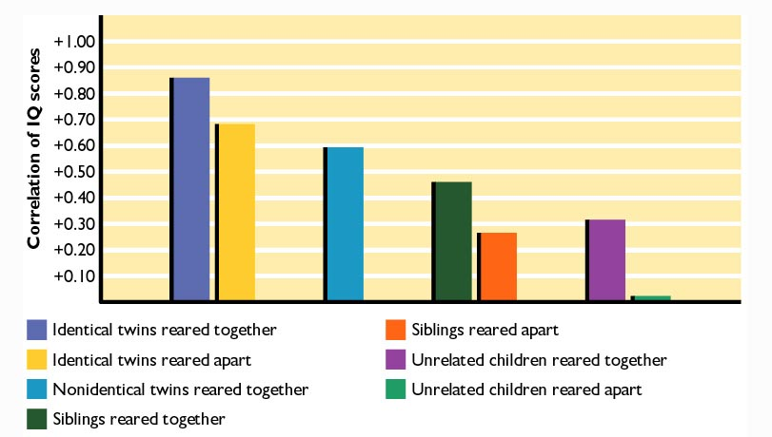
Figure 7.10: Correlations of IQ Scores
Reprinted with permission, Dr. T. Bouchard and from "Familial Studies of Intelligence: A Review," by T. Bouchard et al. From Science, Vol 212, #4498, pp. 1055-1059, May 29, 1981. Copyright © 1981 American Association for the Advancement of Science.

Slide 14
Is IQ all Genetic?
The “Bell Curve”
Fact: There are group differences in IQ
Questions:
  Why are there group differences?
  What are the implications?
  Should we even be asking about it?

Slide 15
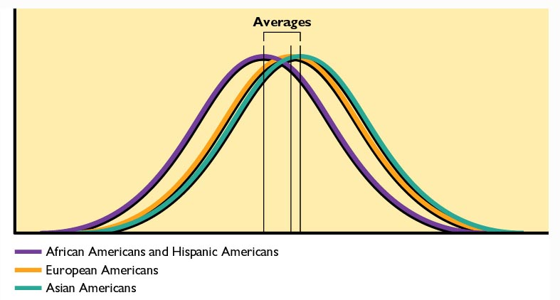
Figure 7.11: A Representation of Ethnic Group Differences in IQ Scores

Slide 16
Why a Relationship Between IQ Scores and Family Income?
Parents’ jobs and status depend on characteristics related to their own intelligence.
Parents’ income affects child’s environment.
Motivational differences between socio-economic levels.
Those with higher IQs may have greater opportunities to earn more money.

Slide 17
A History of the Nature/Nurture Debate
Cyril Burt Scandal
Arthur Jensen (1960s and 1970s) - heredity
Hernstein & Murray “The Bell Curve” 1994
Skeels, 1938; 1966 – environment
Klineberg, 1935 (north and south)

Slide 18
Is there more than one type of intelligence?

Slide 19
Gardner’s Multiple Intelligences
Linguistic: Good vocabulary and reading comprehension.
Logical-mathematical: Skill at arithmetic and certain kinds of reasoning.
Spatial: Understanding relationships between objects.
Musical: Abilities involving rhythm, tempo, and sound identification.

Slide 20
Gardner’s Multiple Intelligences (cont.)
Body-kinesthetic: Skill at dancing, athletics, and eye-hand coordination.
Intrapersonal: Self-understanding.
Interpersonal: Ability to understand and interact with others.
Naturalistic: Ability to see patterns in nature.

Slide 21
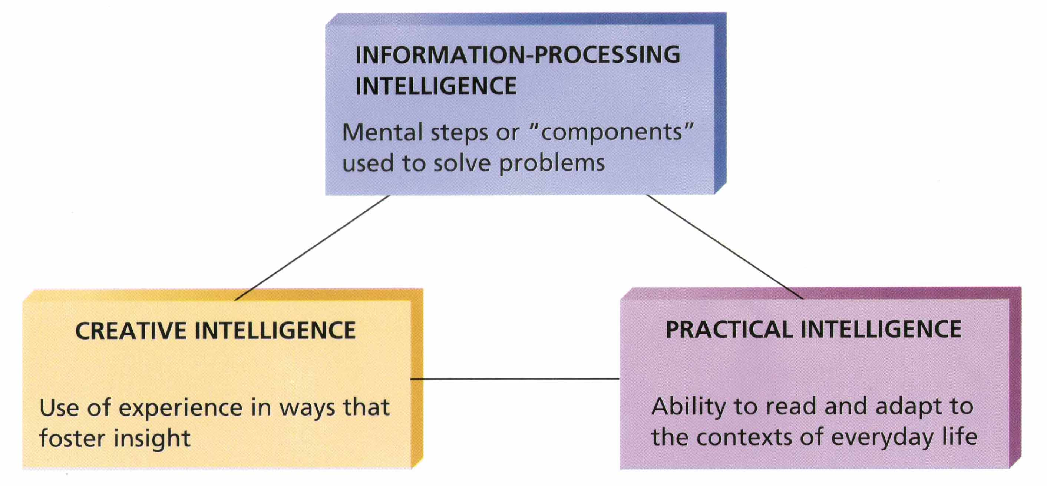
Sternberg’s Triarchic Theory of Intelligence
Saul Kassin, Psychology. Copyright © 1995 by Houghton Mifflin Company. Reprinted by permission.

Slide 22
Unusual Intelligence
Giftedness
  High IQ scores tend to predict success but doesn’t guarantee special distinction in life.
Mental Retardation
  IQs less than about 70 and failure to display the skills at daily living, communication, and other tasks expected at one’s age.

