Slide 1
Human Development
Notes:
1

Slide 2
What does
“genetic influence” mean?

Slide 3
How Does Nature and Nurture Affect Development?
John Locke: Believed childhood experiences have a profound and permanent effect on the individual.
  Newborn as a blank slate, or “tabula rasa.”
Jean-Jacques Rousseau: Argued that children should be allowed to grow as nature commands, with little guidance or pressure from parents.

Slide 4
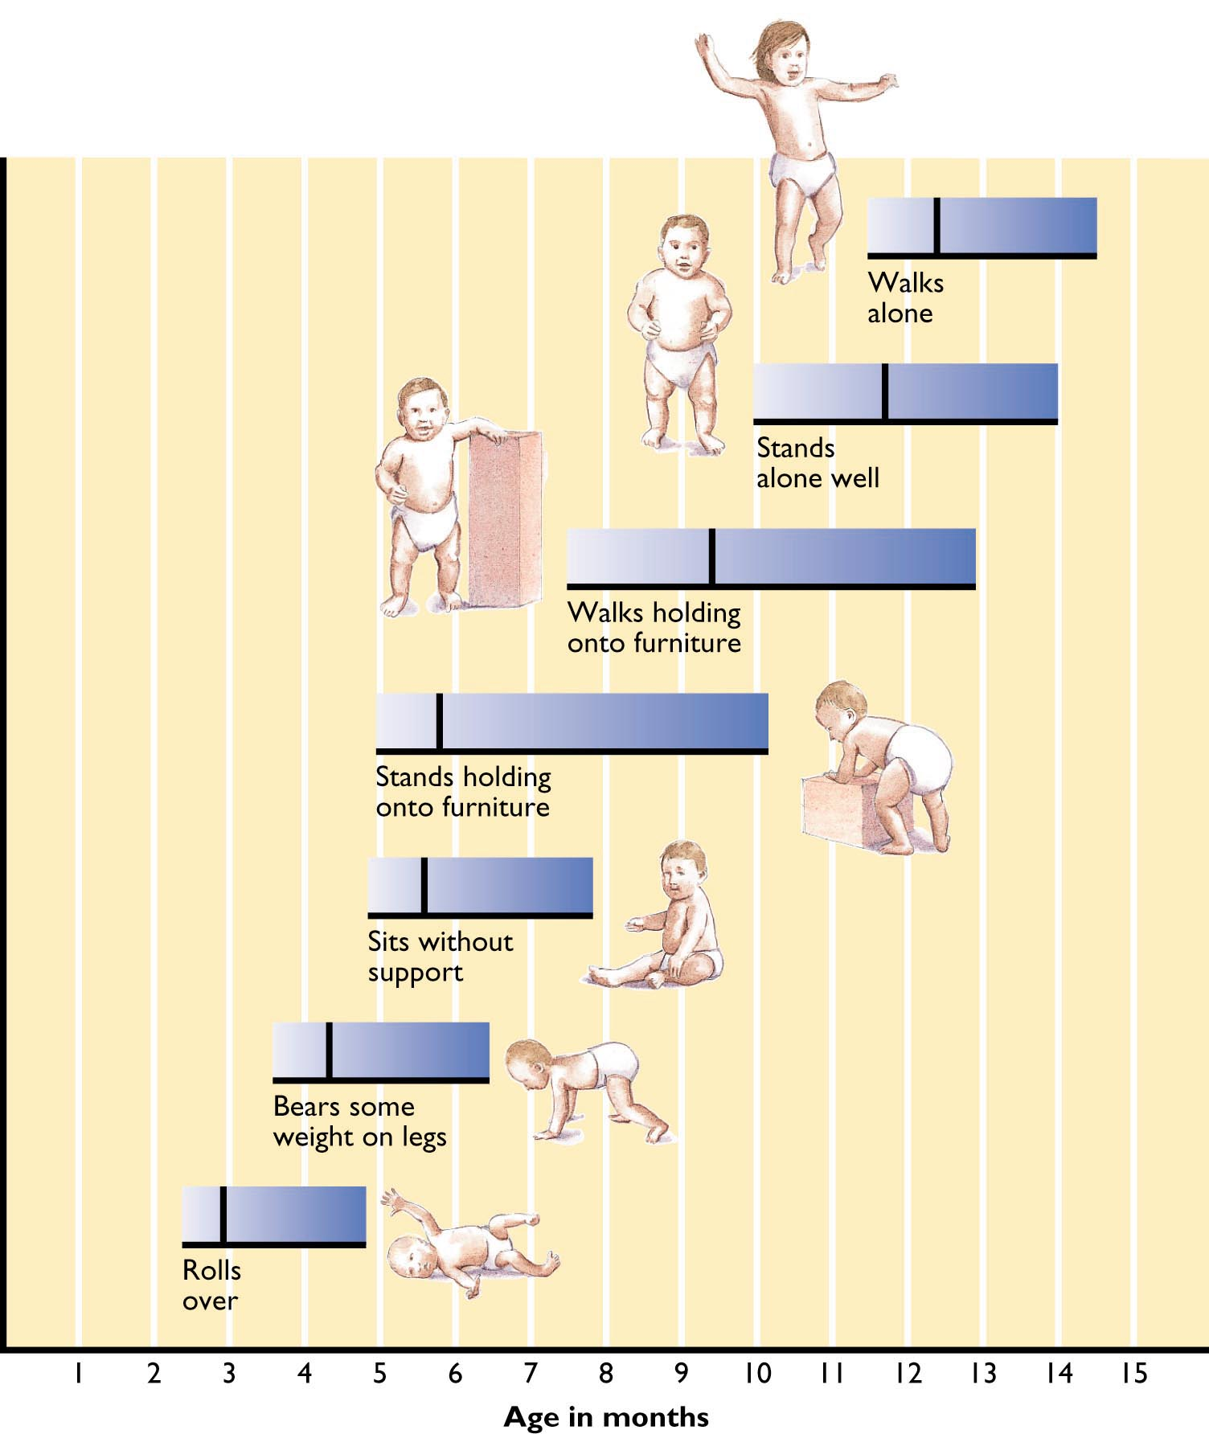
Figure 9.1: Motor Development

Slide 5
Understanding Genetic Influence
Behavioral Geneticists study how genes and the environment influence specific aspects of development.
Nature and nurture contribute jointly to development.
  Operate together to make all people similar in some respects.
  Operate together to make each person unique.

Slide 6
Why should pregnant women stay away from tobacco and alcohol?

Slide 7
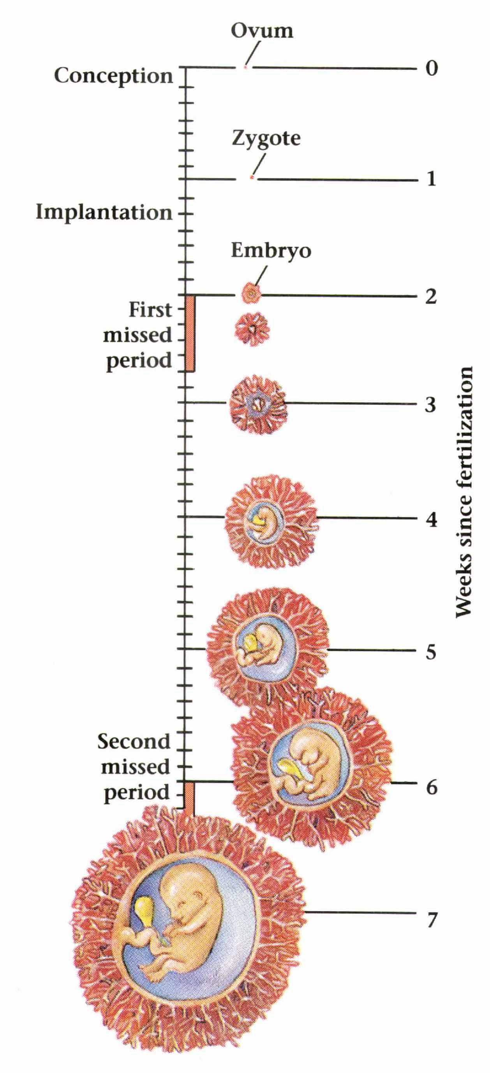
Prenatal Development: The First Weeks
Douglas A. Bernstein, Alison Clarke-Stewart, Edward J. Roy, and Christopher D. Wickens, Psychology, Third Edition. Copyright © 1994 by Houghton Mifflin Company. Reprinted by permission.

Slide 8
Stages of Prenatal Development
Germinal or Zygotic Stage: First two weeks after conception.
  By end of second week, zygote becomes an embryo.
Embryonic Stage
  Heart, nervous system, stomach, esophagus, and ovaries or testes form.
  By two months, embryo looks decidedly human.

Slide 9
Stages of Prenatal Development (cont.)
Fetal Stage: Seven month period until birth.
  Various organs grow and function more efficiently.
  By end of 3rd month, fetus begins to move around.
  In 6th month, eyelids open.
  By end of seventh month, organ systems are functional but still immature.
  In 8th and 9th months, fetus is sensitive to outside sounds and responsive to light and touch.

Slide 10
Prenatal Risks
The placenta protects the developing baby from many potentially harmful substances.
  But, it is imperfect as gases, viruses, nicotine, alcohol, and other drugs can pass through, harming the baby.
Teratogens are harmful substances that invade the womb and result in birth defects.
  Teratogens are especially damaging during the embryonic stage which is a critical stage in prenatal development.

Slide 11
Vision Capabilities of the Newborn
At birth, infant vision is limited by immaturities in both the eye and brain.
Newborns estimated to have 20:300 eyesight.
Infants look longest at what they see best:
  Large patterns with the most elements.
  The most movement.
  The clearest contours.
  The greatest amount of contrast.

Slide 12
Other Senses of the Newborn
At 2-3 days, newborns can hear soft voices and notice differences between tones.
  Special attention paid to speech, especially baby talk.
Certain smells and tastes are liked better than others.
  Within a few days, breast-fed babies prefer odor of own mother to that of another mother.

Slide 13
Reflexes of the Newborn
Babies show involuntary, unlearned reactions, or reflexes, in the first weeks and months after birth.
  Swift, automatic movements in response to external stimuli.
Examples of observed reflexes in infants:
  Grasping reflex.
  Rooting reflex.
  Sucking reflex.

Slide 14
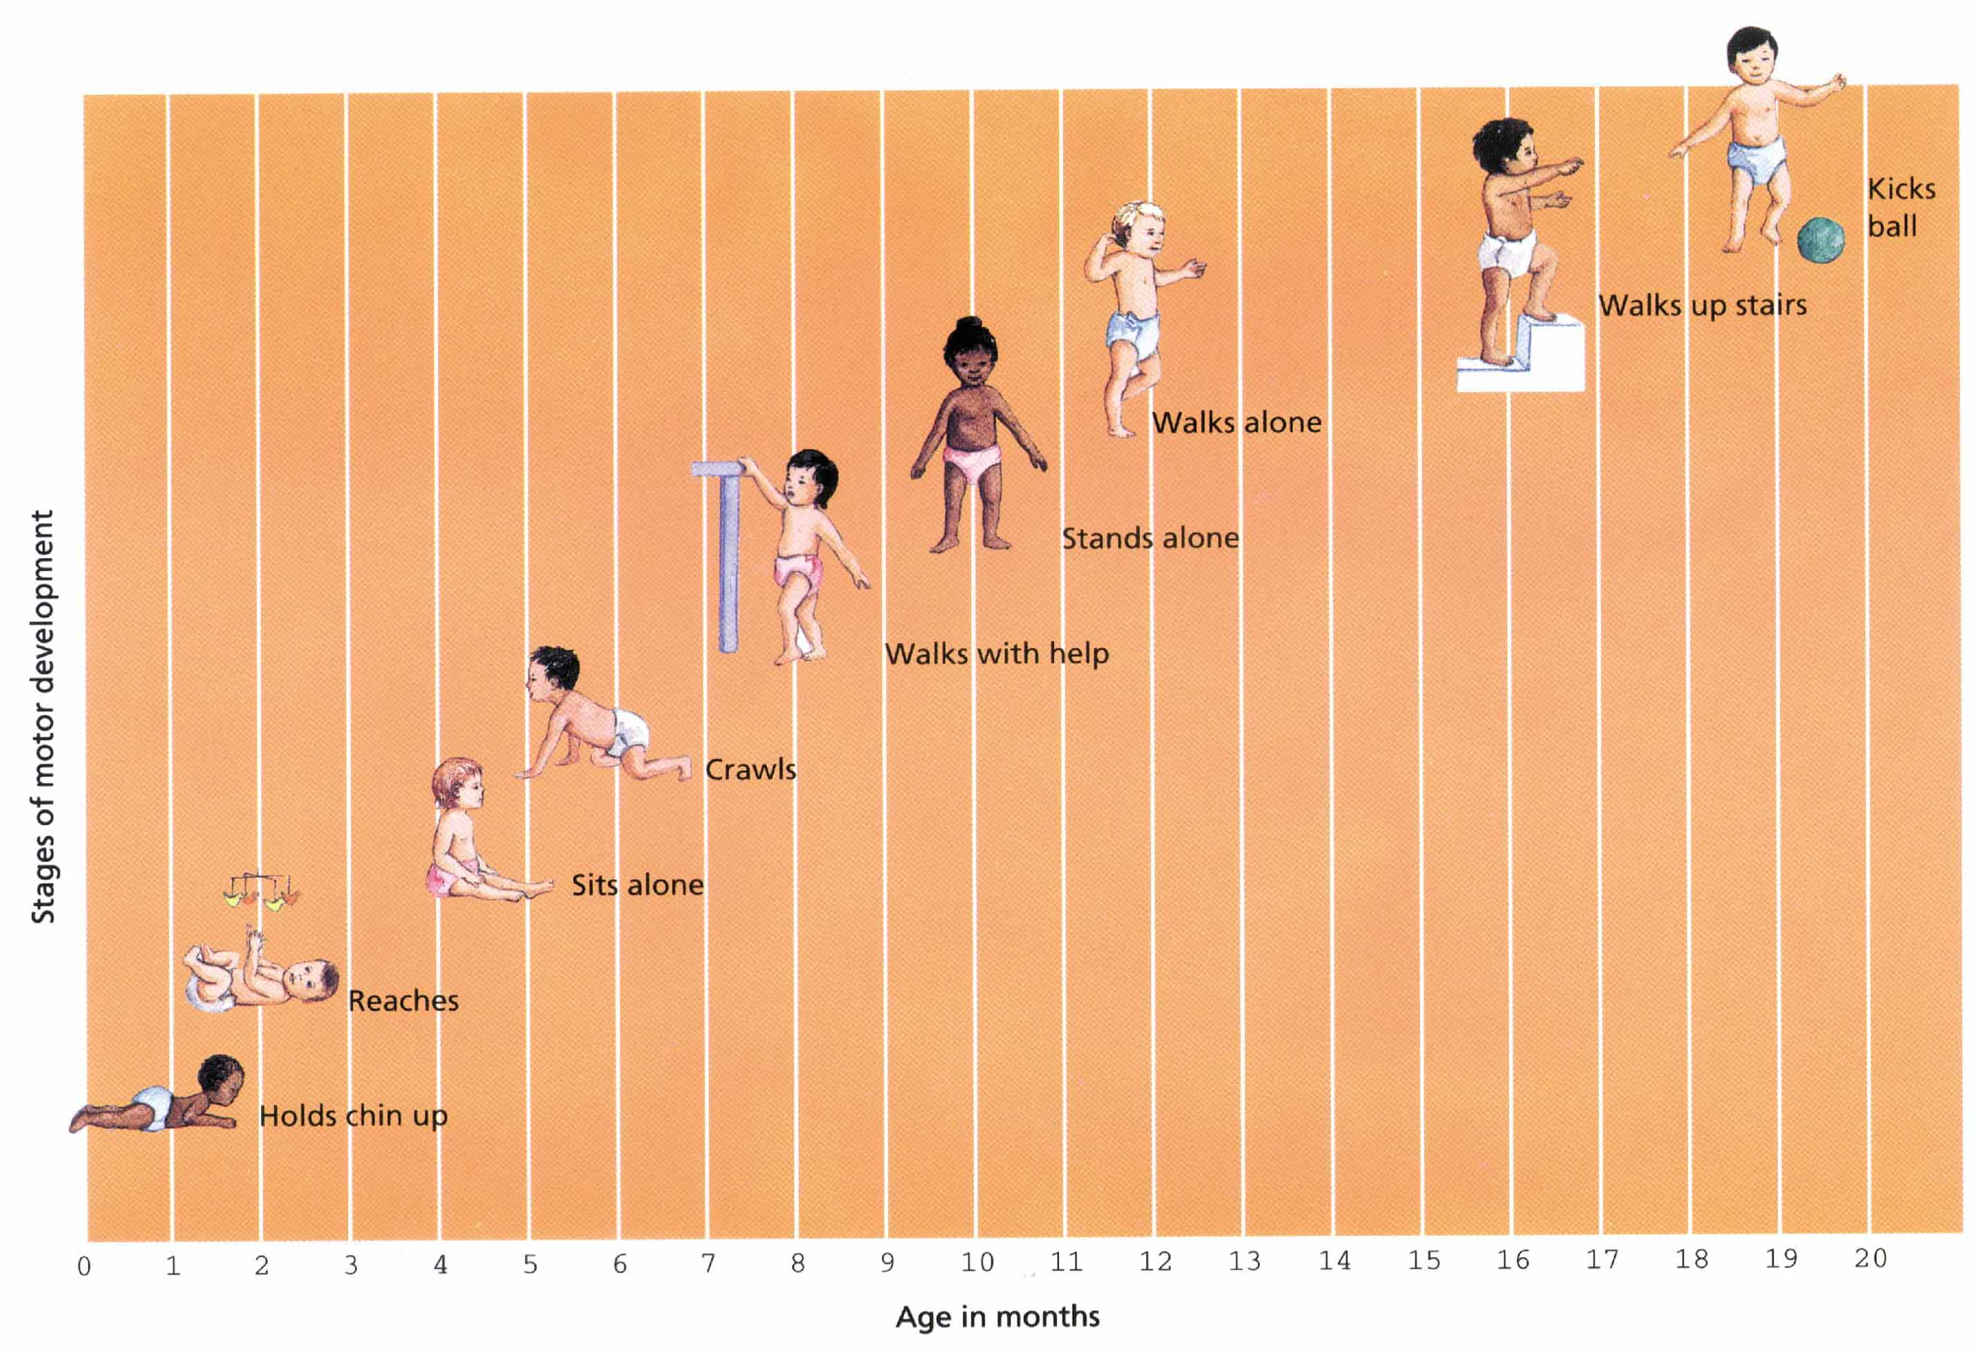
Development of Motor Skills
Zick Rubin, Lelitia Anne Peplau, and Peter Salovey, Psychology. Copyright © 1993 by Houghton Mifflin Company. Reprinted by permission.

Slide 15
How do babies think?

Slide 16
Piaget’s Theory of
Cognitive Development
Cognitive development proceeds in a series of stages or periods.
  Entering each stage involves a qualitative change from the previous stage.
The building blocks of intellectual development are schemas.
  Schemas organize past experiences and provide a framework for understanding future experiences.

Slide 17
Piaget’s Theory of
Cognitive Development (cont.)
Two complimentary processes guide cognitive development:
  Assimilation: The process of trying to fit new objects into existing schemas.
  Accommodation: The process of changing schemas to fit new objects.

Slide 18
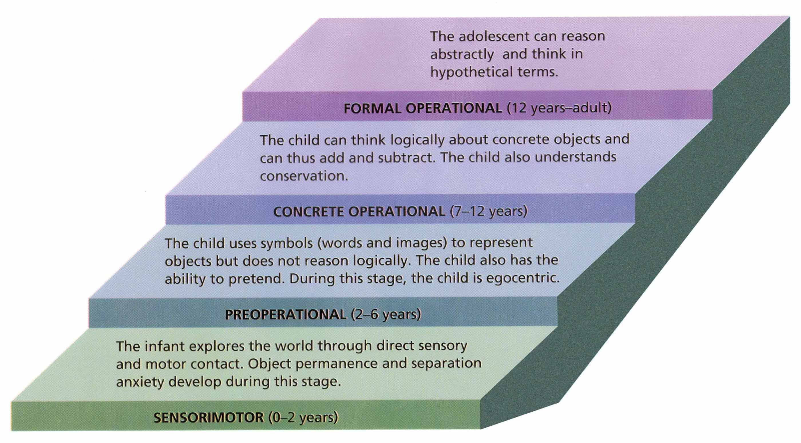
Piaget’s Stages of Cognitive Development
Saul Kassin, Psychology. Copyright © 1995 by Houghton Mifflin Company. Reprinted by permission.

Slide 19
Sensorimotor Development
Piaget:
  Mental activity is confined to schemas about sensory functions and motor skills.
  End of this period is marked by the development of object permanence.
Current View:
  Infants are doing more than just sensing and moving; they are thinking as well.
  Infants develop some mental representations earlier than Piaget suggested.

Slide 20
Preoperational Development
During first half of period, children begin to understand, create, and use symbols to represent things that are not present.
Children do not yet have conservation.
  They do not yet understand logical mental operations such as reversibility and complementarity.

Slide 21
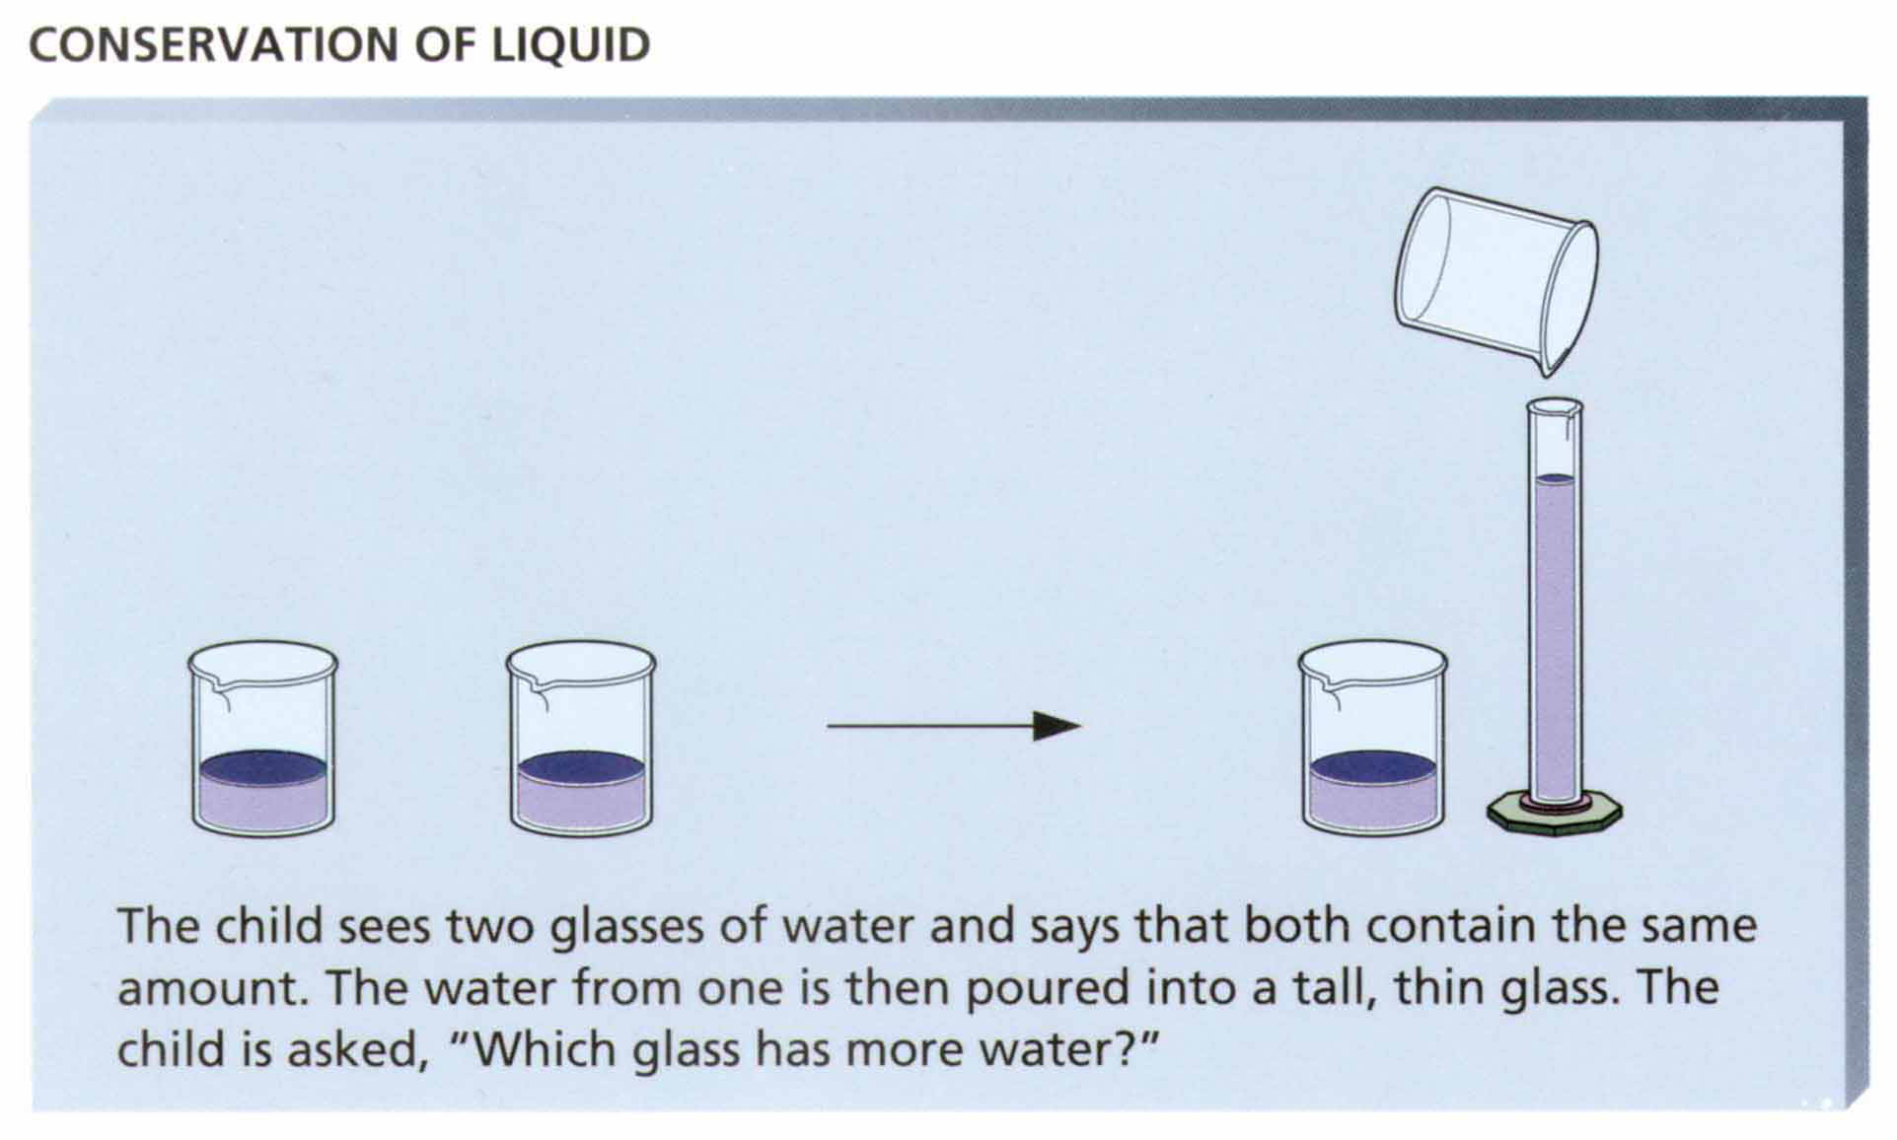
Conservation of Liquid
Saul Kassin, Psychology. Copyright © 1995 by Houghton Mifflin Company. Reprinted by permission.

Slide 22
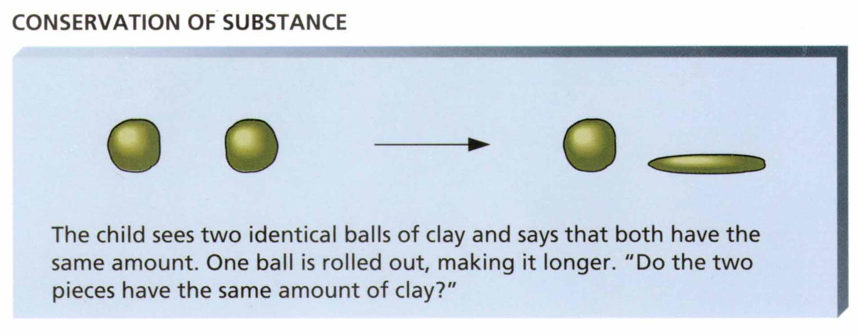
Conservation of Substance
Saul Kassin, Psychology. Copyright © 1995 by Houghton Mifflin Company. Reprinted by permission.

Slide 23
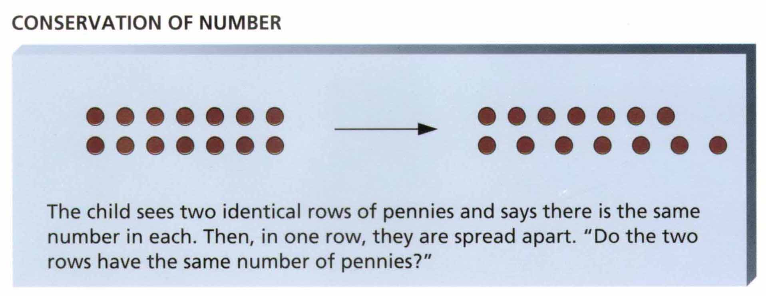
Conservation of Number
Saul Kassin, Psychology. Copyright © 1995 by Houghton Mifflin Company. Reprinted by permission.

Slide 24
Concrete Operational Thought
Thinking is no longer dominated by appearance of things.
Can use simple logic and perform simple mental operations on things.
But, logical operations can only be performed on real, concrete objects.
Can reason only about what is, not what is possible.

Slide 25
Modifying Piaget’s Theory
Changes from one stage to the next are less consistent and global than Piaget suggested.
Children’s knowledge and mental strategies develop at different ages in different areas.
Cognitive development as changing frequencies in children’s use of different ways of thinking, not sudden, permanent shifts from one way of thinking to another.

Slide 26
Information Processing
During Childhood
In contrast to Piaget’s theory, some describe cognitive development in terms of gradual quantitative changes in children’s mental capacities.
As children become older:
  Their information-processing skills become better.
  They develop longer attention spans.
  Their memory storage capacity improves markedly.

Slide 27
Culture and Cognitive Development
Vygotsky focused on the social world of people when explaining cognitive development.
  Viewed the human mind as a product of cultural history.
  Argued that the child’s mind grows through interaction with other minds.
Children’s cognitive abilities are influenced by the scripts they learn for everyday activities as well as the language of their culture.

Slide 28
Individual Variation in Cognitive Development
Both experience and heredity are important factors for understanding cognitive differences among children.
Cognitive development can be impaired if raised in a stimulation-deprived environment.

Slide 29
How do infants become attached to their caregivers?

Slide 30
Infants As Social Beings
During first hour or so after birth, babies are usually awake, gazing at their mother’s face as she gazes back and gives gentle touches.
From an early age, infants are sensitive to people around them.
Infants can communicate their feelings to their parents in subtle ways.
Infants thrive among adults who are attentive and responsive.

Slide 31
Individual Temperament
Temperament: An infant’s individual style and frequency of expressing needs and emotions.
  It is constitutional, biological, and genetically based.
  Reflects nature’s contribution to the beginning of an individual’s personality.
  But, temperament can be affected by one’s prenatal environment.

Slide 32
Temperament Patterns
Easy babies get hungry and sleepy at predictable times, react to new situations cheerfully, and seldom fuss.
Difficult babies are irregular and irritable.
Slow-to-warm-up babies react warily to new situations but eventually come to enjoy them.

Slide 33
Importance of Attachment
Attachment: A deep, affectionate, close, and enduring relationship with the person with whom a baby has shared many experiences.
John Bowlby viewed attachment as important because this tie keeps infants close to their caregivers and, therefore, safe.
Harlow demonstrated the importance of attachment in research involving monkeys.

Slide 34
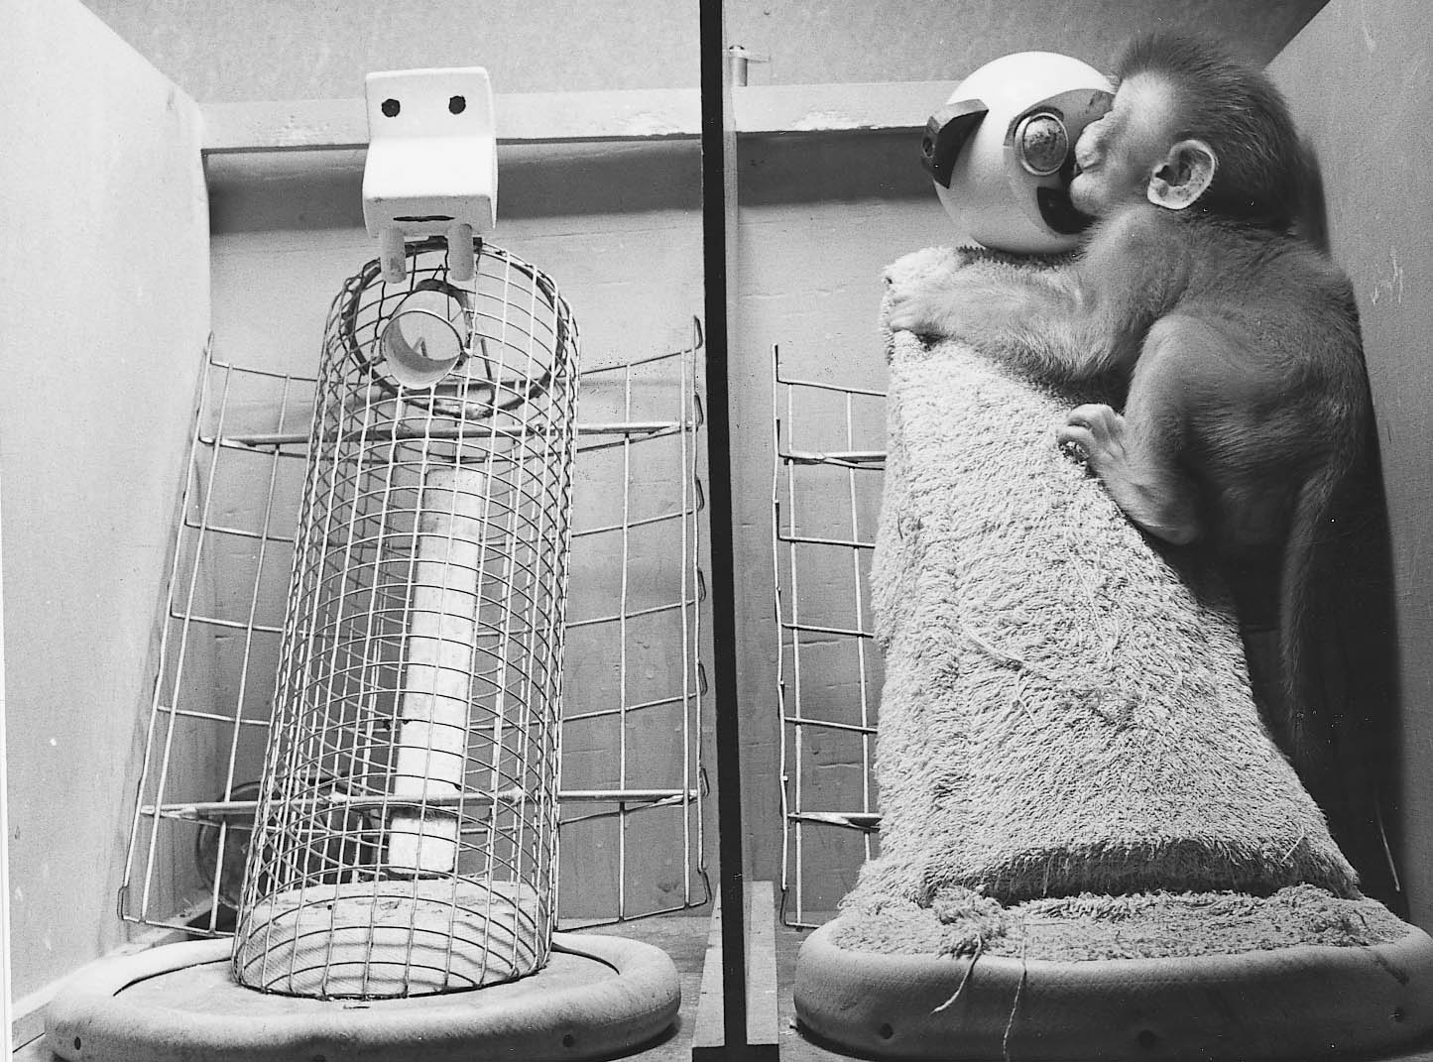
Figure 9.6: Harlow’s Wire and Terrycloth “Mothers”
Harlow Primate Laboratory, University of Wisconsin.

Slide 35
Variations in Attachment
Amount of closeness and contact infant seeks depends to some extent on the infant.
Differences in infant’s attachment studied through the use of the “Strange Situation Test.”
Secure Attachment: Infants urge to be close to mother is balanced by urge to explore the environment.

Slide 36
Types of Insecure Attachment
Avoidant: Infant tends to avoid or ignore mother when she approaches or returns after a brief separation.
Ambivalent: Infant is upset when mother leaves, but acts angry and rejects mother’s efforts at contact after a brief separation.
Disorganized: Infant’s behavior is inconsistent, disturbed, and disturbing.

Slide 37
Erikson’s Psychosocial Stages
Birth - 1 year | Trust vs. Mistrust
1 - 3 years | Autonomy vs. Shame and Doubt
3 - 6 years | Initiative vs. Guilt
6 - 12 years (latency period) | Industry vs. Inferiority
12 - 19 years (adolescence) | Identify vs. Role Confusion
19 - 25 years (early adulthood) | Intimacy vs. Isolation
25 - 50 years (adulthood) | Generativity vs. Stagnation
50 years and older | Ego Integrity vs. Despair

Slide 38
Parenting Styles
Parenting styles found to be related to young children’s social and emotional development.
Three parenting styles among European-American parents:
  Authoritarian: Parents tend to be strict, punishing, and unsympathetic.
  Permissive: Parents give their children complete freedom and provide little discipline.
  Authoritative: Parents fall between these extremes.

Slide 39
Limitations of Parenting Studies
They are based on correlations, which does not prove causation.
How child perceives the discipline they receive may be what is influential.
Correlations between parenting style and children’s behavior not very strong.
Most parenting research has been done with European-American families in the U. S.

Slide 40
Relationship With Peers
From a very early age (even at 1 year), children are interested in the behavior of other children.
Takes time for children to learn to interact with other children.
During school years, peer interaction becomes more complex and structured.
  Friends become important and friendships become long-lasting.
  Realization that feelings, not things, keep friends together.

Slide 41
Social Skills
Social competence and understanding develops over time.
Parents help their children:
  Develop the social skills necessary to sustain responsive interactions with other children.
  Learn to detect and interpret emotional signals from others.

Slide 42
Gender Roles
Gender Roles: The general patterns of work, appearance, and behavior associated with being a man or woman.
Gender roles reflect a mix of nature and nurture.
  Social and cultural training tends to support and amplify any biological predisposition that distinguish boys and girls.

Slide 43
What threatens adolescents’ self-esteem?

Slide 44
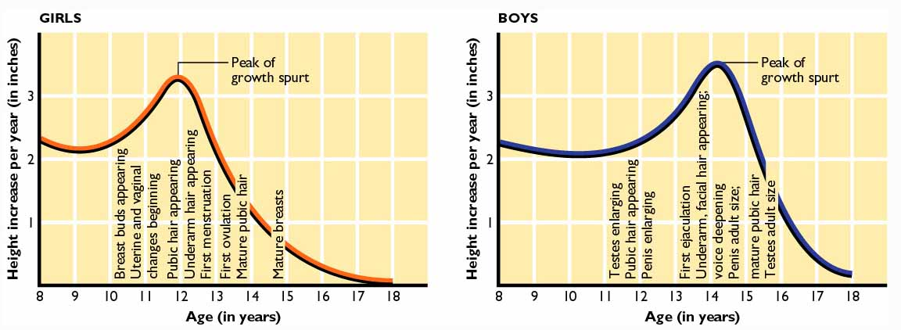
Figure 9.7: Physical Changes in Adolescence

Slide 45
Challenges of Change
Adolescents begin to face challenges to their self-esteem, especially if other stressors occur at the same time.
  Those experiencing more or stronger stressors, have more difficulty adapting to adolescence.
  Self-esteem is related to physical maturity.
Changes and pressures of adolescence often played out at home.

Slide 46
Teens and Sexual Activity
Surveys suggest about 50% have had sexual intercourse by age 16.
Sexually active teens tend to:
  Hold less conventional attitudes and values.
  Smoke, drink alcohol, and use other drugs.
  Have parents who are less educated and who are less likely to exert control over teen or talk openly with them.
Sexuality activity among teens also related to ethnicity.

Slide 47
Problems Associated with Sexuality Activity Among Teens
Decline in school achievement and interest.
Highest rate of sexually transmitted diseases.
  1/5 of all AIDS cases started in adolescence.
Teenage pregnancy
  Nearly 10% of all teenage girls in U.S. get pregnant before they reach the age of 19.
  Problems associated with babies of teenage parents.

Slide 48
Identity and Development of the Self
Developmental changes in how describe self suggest changes in the way one thinks about oneself.
  Preschoolers mention a favorite or habitual activity.
  At 8 or 9 years, identify self by giving facts.
  About age 11, begin to describe self in terms of social relationships, personality traits, and other general, stable psychological characteristics.
As one becomes more self-conscious, one gradually develops a personal identity as an unique individual.

Slide 49
Facing the Identity Crisis
According to Erikson, identity formation is the central task of adolescence.
Challenges to the adolescent’s self-concept precipitates an identity crisis.
  Adolescent must develop an integrated self-image as a unique person.

Slide 50
Abstract Thought and Moral Reasoning
Adolescents develop ability to think and reason about abstract concepts.
  Piaget’s formal operational period of cognitive development.
Adolescents can now engage in hypothetical thinking, including the imagining of logical consequences.

Slide 51
Kohlberg’s Stages of Moral Reasoning
Preconventional Level: Moral choices tend to be selfish in nature.
Conventional Level: Morality consists of following rules and conventions.
Postconventional Level: Moral judgments are based on personal standards or universal principles of justice, equality, and respect for human life.

Slide 52
Limitations of Kohlberg’s Stages
Cross-Cultural Studies
  Stages 1-4 appear universal; Stages 5 and 6 do not always appear.
  Moral judgments in some cultures do not fit into Kohlberg’s stages.
Gender and Morality (Gilligan)
  Men concerned with the abstract, impersonal concept of justice.
  Females concerned with protecting enduring relationships and fulfilling human needs.

Slide 53
What developmental changes occur in adulthood?

Slide 54
Physical Changes
Physical growth continues in early adulthood.
In middle adulthood, physical changes slowly emerge, including loss of sensory sharpness.
Most are well into late adulthood before bodily functions show noticeable impairment.

Slide 55
Cognitive Changes
Important cognitive abilities improve until at least age 60.
Adult thought becomes more complex and adaptive than adolescent thought.
  Thinking becomes more dialectical.
Not until late in adulthood do some intellectual abilities decline in some people.

Slide 56
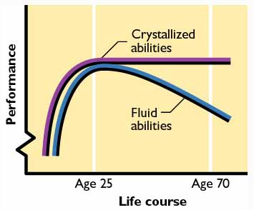
Figure 9.8: Mental Abilities Over the Life Span
Adapted from Baltes, 1994; Willis & Schaie, 1999. Used by permission of Paul B. Baltes.

Slide 57
Social Changes
Early Adulthood: Individuals become concerned with occupational choices as well as issues of love.
  Experiences of parenthood are accompanied by personal, social, and often occupational changes.
Middle Adulthood: People become concerned with producing something that will outlast them, usually through parenthood or job achievements.
  Erikson’s crisis of generativity.
  Around age 40, people go through a midlife transition.

Slide 58
Social Changes in Late Adulthood
Most between 65 and 75 are active and influential politically and socially.
During old age people become generally more inward looking, cautious, and conforming.
Coping skills are increasingly developed to take into account the limits of one’s control.
Relationships found to be more satisfying, supportive, and fulfilling than earlier in life.

Slide 59
Death and Dying
With onset of old age, people become aware that death is approaching.
Some experience a sharp decline in mental functioning, or terminal drop, a few years or a few months before death.
According to Erickson, awareness of impending death brings about the crisis of ego integrity versus despair.

Slide 60
Longevity
Longevity is not related to higher levels of education, income, or occupation.
Longevity is associated with certain personality characteristics such as being curious, conscientious, and not overemphasizing the importance of negative events in life.
Longevity is associated with diet, physical and mental exercise, and a sense of control over one’s life.

