Slide 1
Health, Stress, and Coping

Slide 2
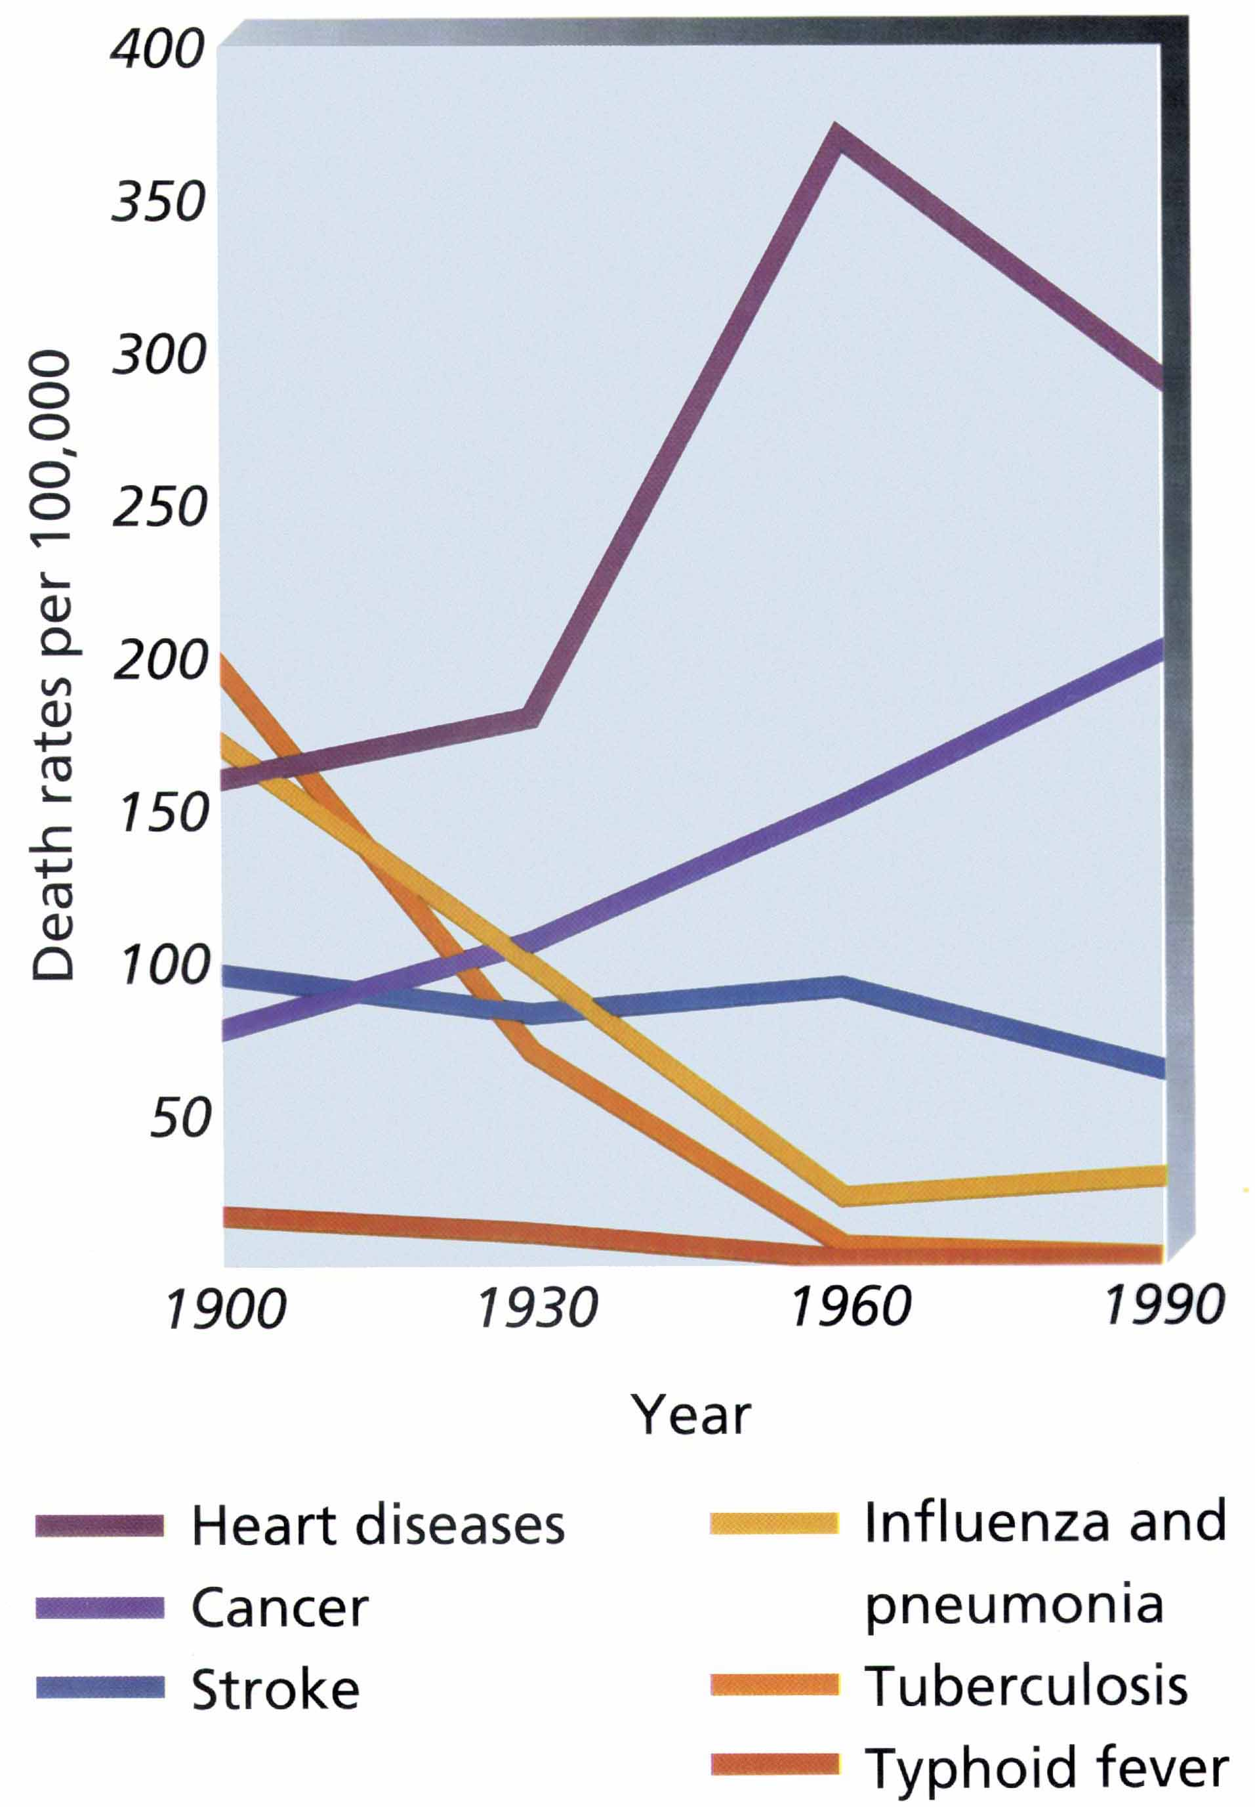
Leading Causes of Death, 1900-1990
Saul Kassin, Psychology. Copyright © 1995 by Houghton Mifflin Company. Reprinted by permission.

Slide 3
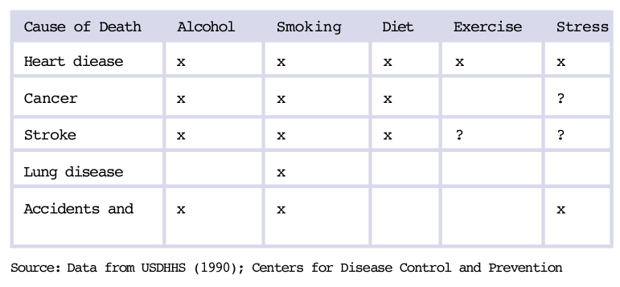
Table 10.1: Lifestyle Behaviors That Affect the Leading Causes of Death in the U.S.
Source: Data from USDHHS (1990).; Centers for Disease Control and Prevention (1999)

Slide 4
Some Goals of Health Psychology
Help people understand the role they can play in controlling their own health and life expectancy.
Discover what causes noncompliance with medical advice and create procedures that encourage greater compliance.
Help people to understand the role played by stress in physical health and illness.

Slide 5
How do psychological stressors affect physical health?

Slide 6
Stress
Stress: The process of adjusting to circumstances that disrupt, or threaten to disrupt, a person’s daily functioning.
  Stress involves a transaction between people and their environments.
Stressors: The events or situations to which people must adjust.
Stress Reactions: Physical, psychological, and behavioral responses to stressors.

Slide 7
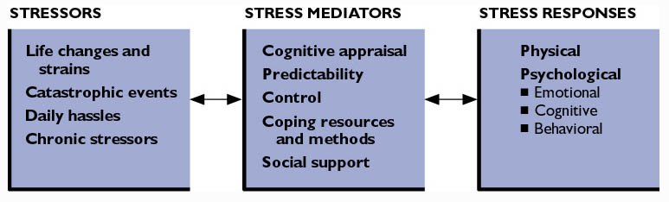
Figure 10.1: The Process of Stress

Slide 8
Psychological Stressors
Psychological Stressors: Any event that forces a person to change or adapt.
Examples:
  Catastrophic events such as natural disasters.
  Life changes and strains such as divorce.
  Chronic stressors such as living near a noisy airport.
  Daily hassles such as commuting in heavy traffic.

Slide 9
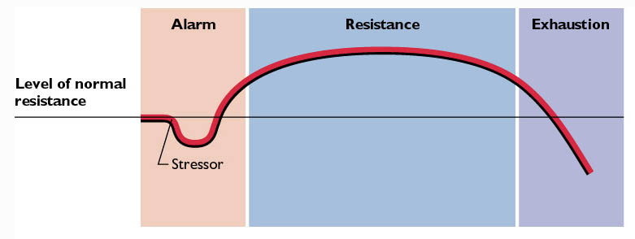
Figure 10.2: The General Adaptation Syndrome
Copyright © 1974 by Hans Selye, M.D. Reprinted by permission of HarperCollins Publishers, Inc.

Slide 10
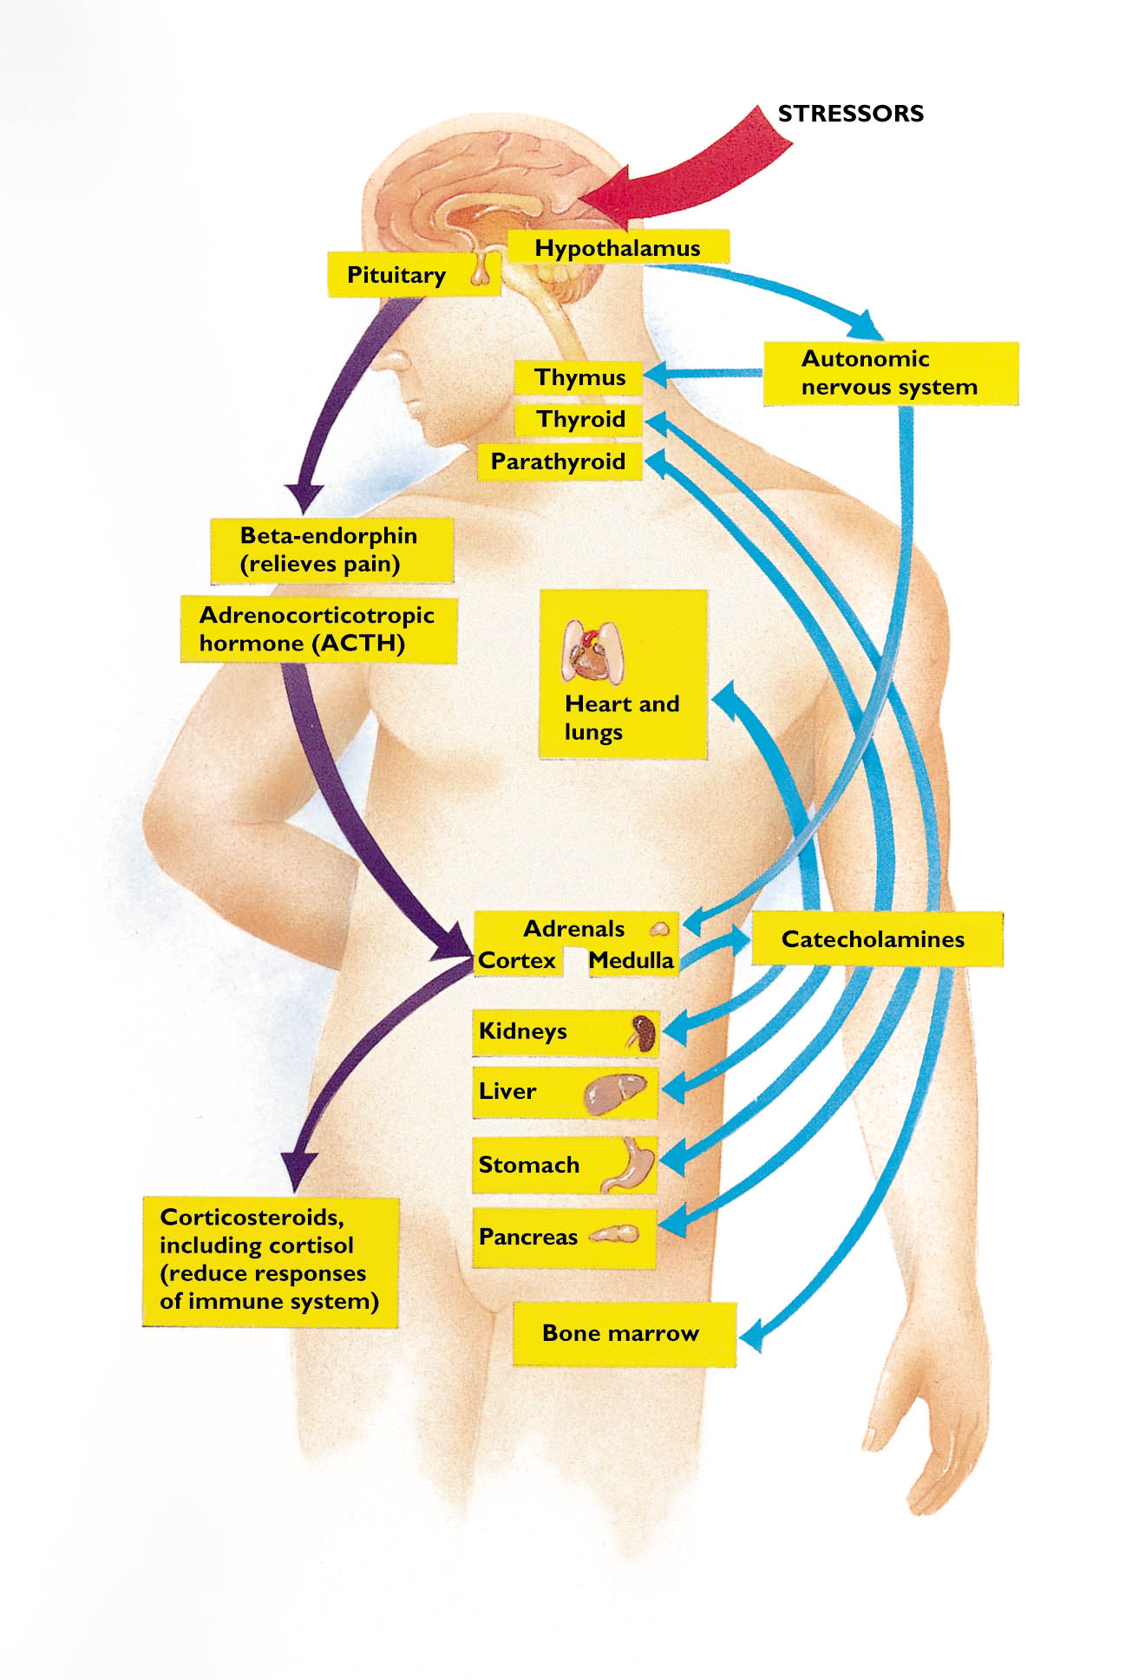
Figure 10.3: Organ Systems Involved in the GAS

Slide 11
Responses to Stress
Physical Stress Responses
Emotional Stress Responses
Cognitive Stress Responses
Behavioral Stress Responses

Slide 12
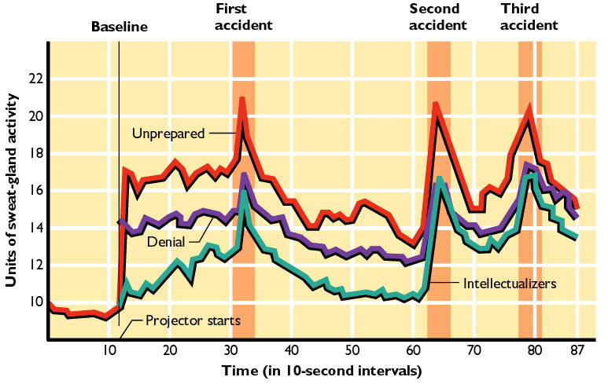
Figure 10.4: Cognition and Stress
Adapted from Lazarus, Opton, Nornikos, and Rankin, Journal of Personality, 33:4. © 1965 by Duke University Press. Reprinted by permission from Blackwell Publishers.

Slide 13
Predictability and Control of Stressor
Predictable stressors tend to have less impact than those that are unpredictable.
  Especially when the stressors are intense and occur for relatively short periods.
Perception of control mediates the effects of stressors.
  The belief that a stressor is controllable can reduce the impact of the stressor.

Slide 14
Table 10.3: Ways of Coping
Problem-focused coping
  Confronting
  Seeking social support
  Planful problem solving
Emotional-focused coping
  Self-controlling
  Distancing
  Positive reappraisal
  Accepting responsibility
  Escape/avoidance (wishful thinking)
Folkman, S., Lazarus, R. S., Gruen, R. J., & DeLongis, A. (1986a). Appraisal, coping, health status, and psychological symptoms. Journal of Personality and Social Psychology, 50, 571-579

Slide 15
Social Support
Quality of social support can influence one’s ability to cope with stress.
  Ability to cope may also determine the quality of social support one receives.
Social support refers not only to relationships with others but also to the recognition that others will care and will help.
Having too much support or the wrong kind of support can be as bad as not having enough support.

Slide 16
Stress & Personality
People with “disease-prone” personalities tend to:
  Persist at mentally avoiding stressors.
  Perceive stressors as long-term, catastrophic threats brought on by self.
  Be pessimistic about ability to overcome stressors or other negative situations.
People with “stress-hardy” or “disease-resistant” personalities tend to have a dispositional optimism.
  The belief or expectation that things will work out positively.

Slide 17
Does Stress Increase the Risk of Heart Disease?
“Type A” behavior
  Aggressiveness
  Competitiveness
  “workaholic”
Cynical Hostility
  Frequent anger
  Distrust
  Resentment
Notes:
5
41

Slide 18
Stress & Gender
Males tend to get angry and/or avoid stressors.
  A “fight-or-flight” pattern.
Females are more likely to help others and to make use of their social support network.
  A “tend and befriend” style.

Slide 19
How does stress affect your immune system?

Slide 20
The Immune System and Illness
The immune system is the body’s first line of defense against invading substances and microorganisms.
Stress can impair or suppress the immune system.
Social support and other stress-mediating factors can help sustain one’s immune system.
  Social support may prevent illness by providing an outlet for the person under stress.

Slide 21
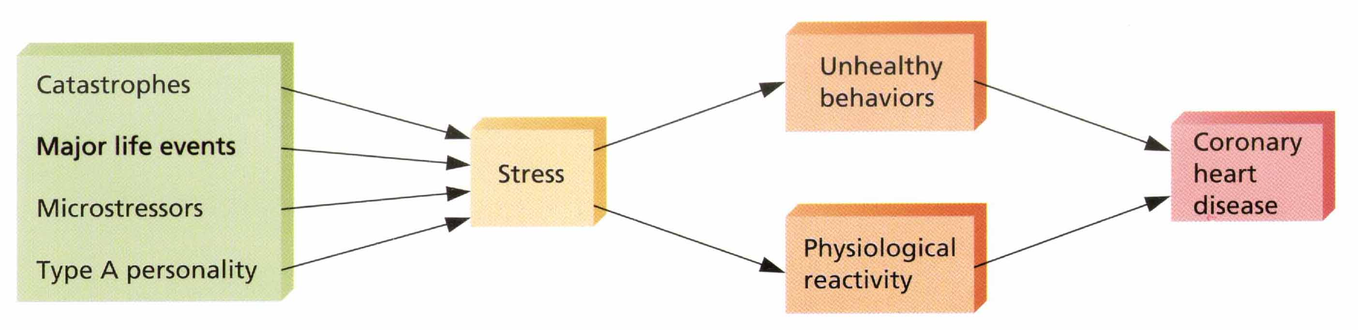
Pathways from Stress to Chronic Health Disease
Douglas A. Bernstein, Alison Clarke-Stewart, Edward J. Roy, and Christopher D. Wickens, Psychology, Fourth Edition. Copyright © 1997 by Houghton Mifflin Company. Reprinted by permission.

Slide 22
Risking Your Life:
Health-Endangering Behaviors
Smoking
Alcohol
Unsafe Sex

Slide 23
Who is most likely to adopt a healthy lifestyle?

Slide 24
Health Beliefs and Health Behaviors
Decisions about health-related behaviors are guided by four main factors:
  A perception of personal threat or susceptibility to contracting a specific illness.
  A perception of the seriousness of the illness and the severity of the consequences of having it.
  The belief that a particular practice will reduce the threat.
  The balance between the perceived costs of starting a health practice and the benefits from this practice.

Slide 25
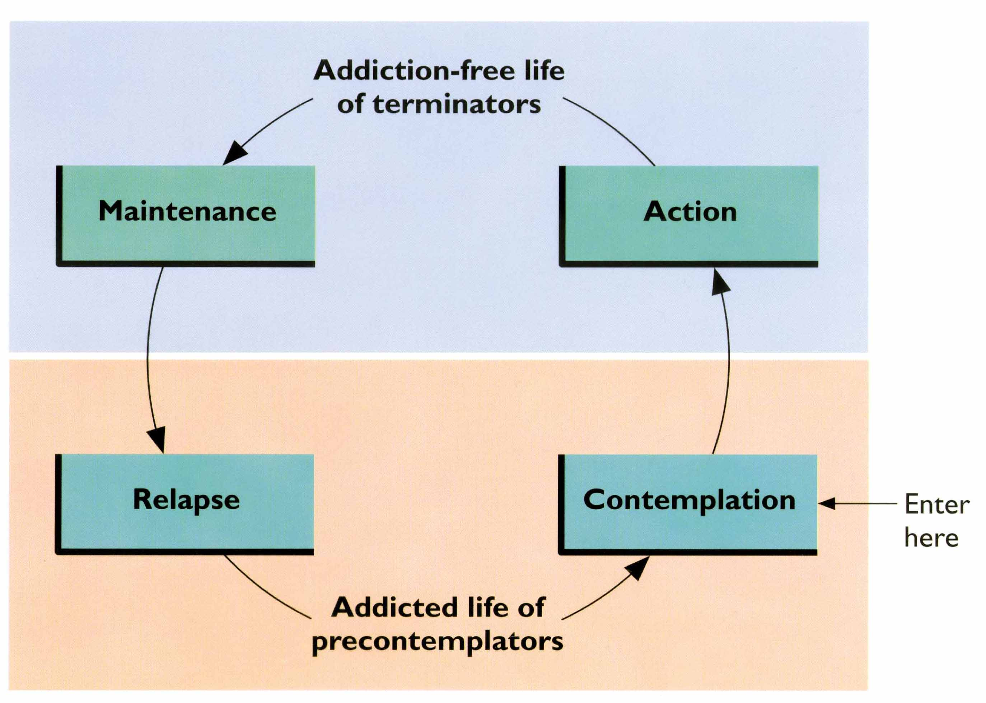
Stages of Readiness to Change Health Behaviors
Prochaska, W., DeClementi, C., and Norcross, J., "In Search of How People Change: Application to Addictive Behaviors," American Psychologist, 47, 1102-1114. Copyright © 1992 by the American Psychological Association. Reprinted by permission.

Slide 26
Stages in Coping with Stress
Assessment
  Identify the sources and effects of stress.
Goal Setting
  List the stressors and stress responses to be addressed.
  Designate which stressors are and are not changeable.
Planning
  List the specific steps to be taken to cope with stress.

Slide 27
Stages in Coping with Stress (cont.)
Action
  Implement coping plans
Evaluation
  Determine the changes in stressors and stress responses that have occurred as a result of coping methods.
Adjustment
  Alter coping methods to improve results, if necessary.

Slide 28
Developing Coping Strategies
Cognitive Coping Strategies: Changing how people interpret stimuli and events, such as through cognitive restructuring.
Emotional Coping Strategies: Seeking and obtaining social support from others.
Behavioral Coping Strategies: Changing behavior to minimize the impact of stressors.
Physical Coping Strategies: Alter physical responses before, during, or after stressors occur.

Slide 29


Slide 30
Stress and Psychological Disorders
Burnout: An increasingly intense pattern of physical, psychological, and behavioral dysfunction in response to a continuous flow of stressors or to chronic stress.
Posttraumatic Stress Disorder (PTSD): A pattern of severe negative reactions following a traumatic event.
  Most common feature is experiencing the trauma through nightmares or vivid memories.

Slide 31
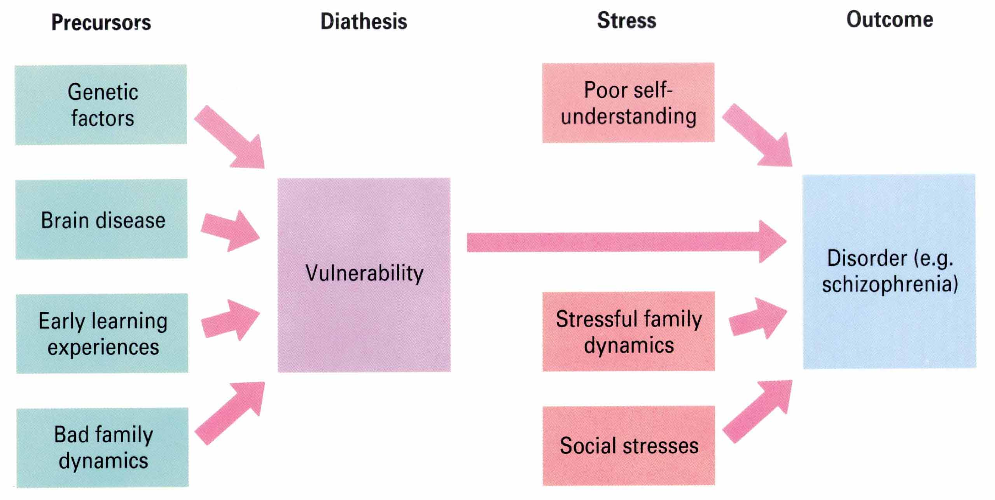
Diathesis-Stress Model
James D. Laird and Nicholas S. Thompson, Psychology. Copyright © 1992 by Houghton Mifflin Company. Reprinted by permission.

Slide 32
Yerkes-Dodson Law
What is the Yerkes-Dodson Law?
The goal is not zero stress

