Slide 1
Personality

Slide 2
Who Are You?
Personality is the unique pattern of enduring psychological and behavioral characteristics by which each person can be compared and contrasted with other people.
The specific questions asked and methods used by personality researchers often depend on which of the four main approaches to personality they take.

Slide 3
Four Main Approaches to Personality
Psychodynamic
Trait
Social-Cognitive
Phenomenological

Slide 4
Sigmund Freud
Was a physician in Vienna during the 1890s treating “neurotic” disorders.
Came to believe in “psychic determinism.”
  The idea that personality and behavior are determined more by psychological factors than by biological conditions or current events.
Proposed that people are partly controlled by the unconscious part of their personality.
  Basis for the psychodynamic approach to personality.

Slide 5
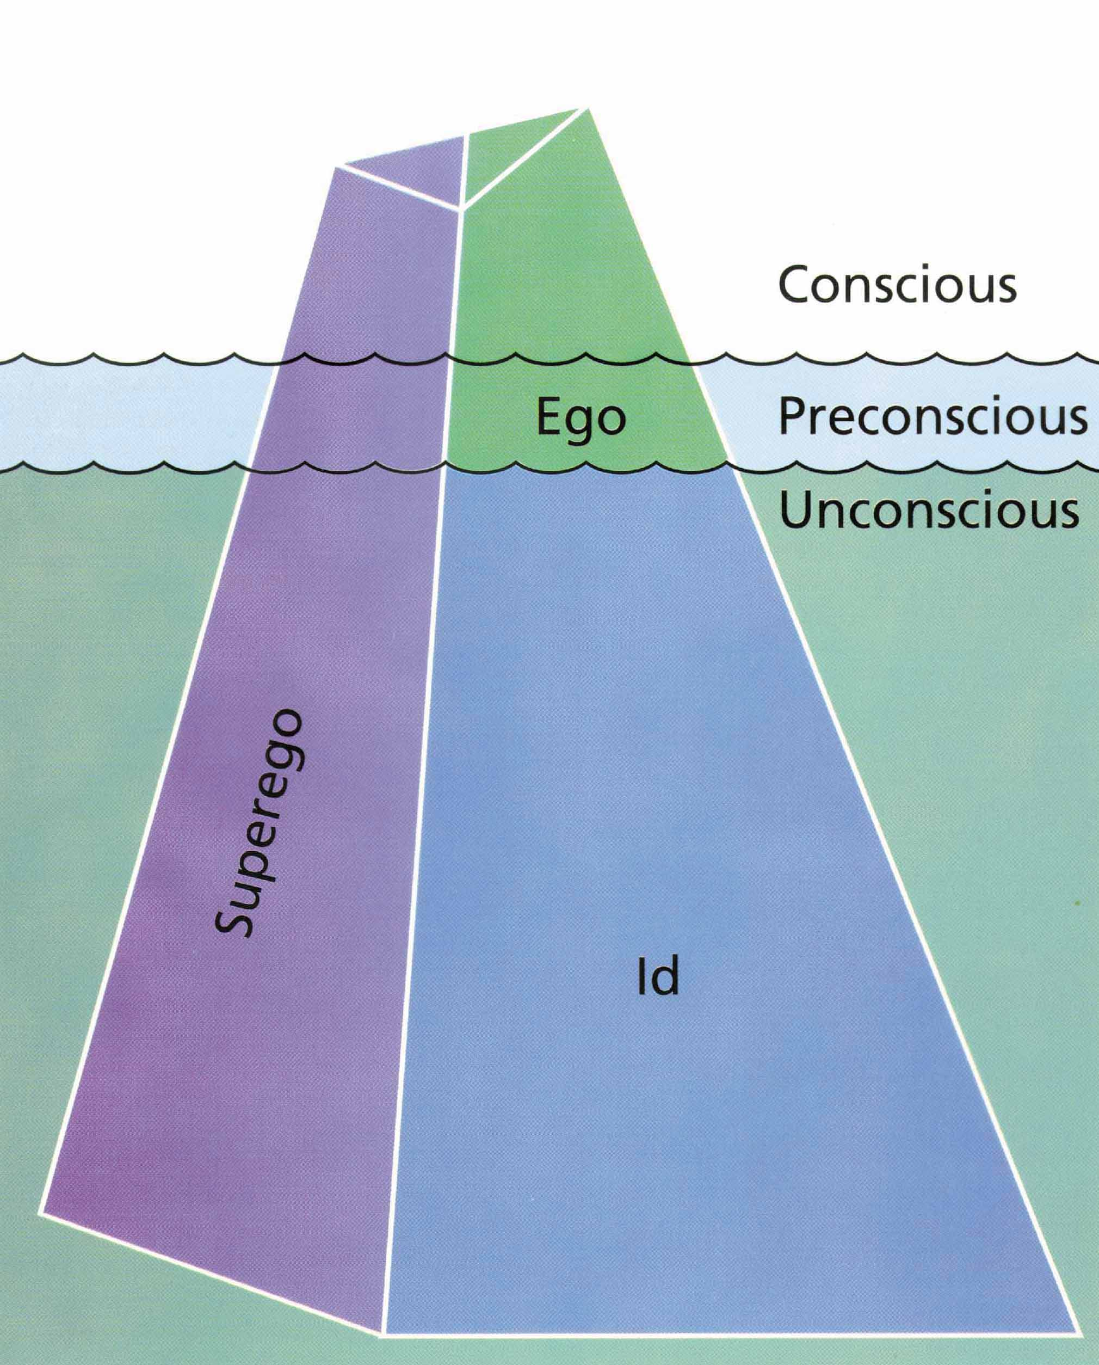
The Structure of Personality According to Freud
Saul Kassin, Psychology. Copyright © 1995 by Houghton Mifflin Company. Reprinted by permission.

Slide 6
Defense Mechanisms
Repression
Rationalization
Projection
Reaction Formation
Sublimation
Displacement
Denial
Compensation

Slide 7
Psychosexual Stages of Personality Development
Oral Stage: Mouth is center of pleasure.
  Personality problems arise when oral needs are either neglected or overindulged.
Anal Stage: Toilet training clashes with instinctual pleasure in having bowel movements at will.
  Child’s ego develops to cope with parental demands for socially appropriate behavior.
  Toilet training that is too harsh or starts to early or too late can lead to anal fixation.

Slide 8
Psychosexual Stages of Personality Development (cont.)
Phallic Stage: Focus of pleasure shifts to the genital region.
  Boys experience the Oedipus complex.
  Girls experience the Electra complex.
Latency Period: Sexual impulses stay in background.
Genital Stage: Sexual impulses reappear at conscious level; genitals again focus of sexual pleasure.
  Quality of relationships and degree of fulfillment are directly affected by how earlier intrapsychic conflicts are resolved.

Slide 9
Neo-Freudian Theorists
Carl Jung: more positive view; “life force”
  Collective Unconscious
  Archetypes
Alfred Adler saw the driving force behind the development of personality as the desire to:
  Overcome infantile feelings of helplessness.
  “Inferiority Complex”

Slide 10
Neo-Freudian Theorists (cont.)
Some saw the attempt to meet social demands once biological needs were met as the main shaper of personality.
  e.g., Erik Erikson
Karen Horney argued that it is men that envy women, not vice versa.
  Men experience “womb envy.”
  Women’s feelings of inferiority due to cultural factors, not “penis envy.”

Slide 11
Contemporary Psychodynamic Theories
Focus is on object relations.
  How people’s perceptions of themselves and others influence their view of and reactions to the world.
  Early relationships between infants and their love objects seen as critically important to development of personality.

Slide 12
Evaluating the
Psychodynamic Approach
Freud’s contributions:
  Most comprehensive and influential theory.
    Ideas led to development of psychodynamic therapies.
  Stimulated development of personality assessment techniques.
Some of Freud’s ideas are supported by research on cognitive processes; but many are not.

Slide 13
Evaluating the
Psychodynamic Approach (cont.)
Problems and weaknesses with Freud’s theory:
  Theory based almost entirely on a cases studies of a few individuals, not representative of people in general: Anecdotal Evidence
  Theory reflected Western cultural values.
  Conclusions may have been distorted by Freud’s personal biases.
  Belief in women’s envy of male anatomy and focus on male psychosexual development questioned.
  Theory is not very scientific.

Slide 14
Trait Theory:
How many personality traits are there?

Slide 15
Assumptions of Trait Approach
Personality traits remain relatively stable and therefore predictable over time.
Personality traits remain relatively stable across situations.
People differ with regard to how much of a particular personality trait they possess.

Slide 16
Allport’s Trait Theory
Central Traits: Traits that organize and control one’s behavior in many different situations and are usually apparent to others.
Secondary Traits: Traits that are more specific to certain situations and control far less behavior.

Slide 17
Eysenck’s Biological Trait Theory
Personality can be described in terms of three main factors or dimensions:
  Introversion-extraversion.
  Emotionality-stability.
  Psychoticism.

Slide 18
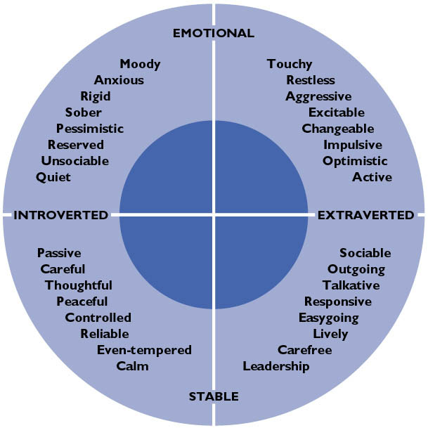
Figure 11.3: Eysenck’s Major Personality Dimensions
From "The Causes and Cures of Neurosis: An Introduction to Modern Behavior Therapy Based on Learning Theory and the Principle of Conditioning" by H.J. Eysenck and S. Rachman. © 1965 by Edits.

Slide 19
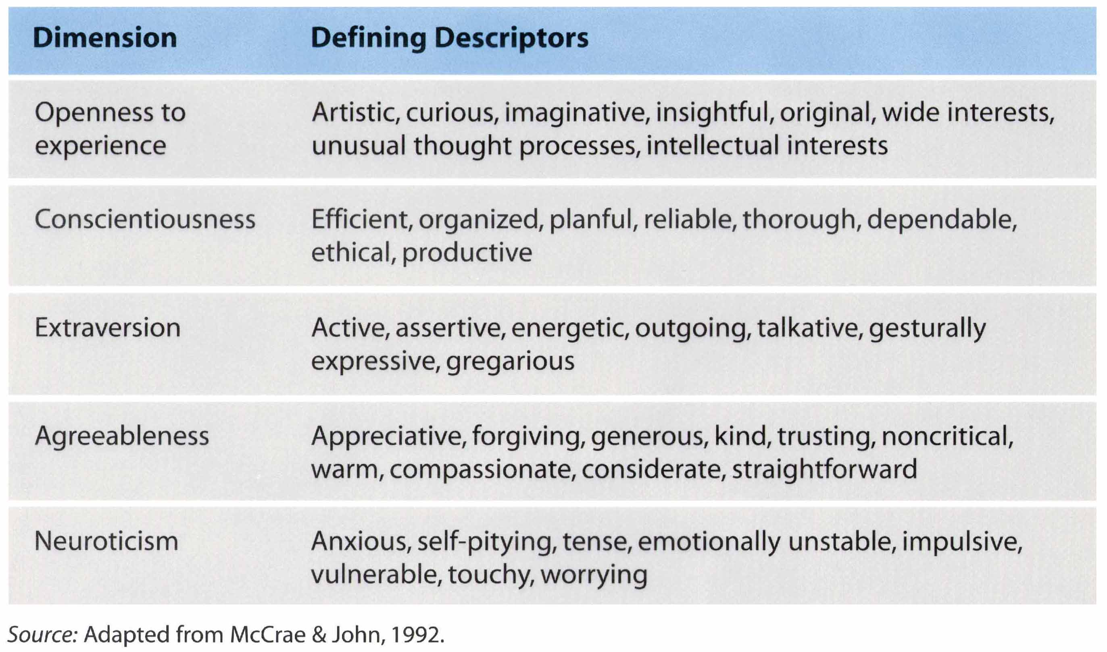
The “Big Five” Model of Personality **Best-supported by Data**
Adapted from "An Introduction to the Five-Factor Model and its Applications" by Robert R. McCrae and Oliver P. John. From Journal of Personality, 60:2, pp. 175-216.

Slide 20
Evaluating the Trait Approach
Trait theories better at describing people than explaining them.
Little said on how traits relate to the thoughts and feelings that precede, accompany, and follow behavior.
Criticized for failing to capture how traits combine to form a complex and dynamic individual.
**Best supported by research – most accepted theory currently.

Slide 21
Do we learn our personality?
(The Social-Cognitive Approach)

Slide 22
Social-Cognitive Approach
Personality is the set of behaviors that people acquire through learning and then display in particular situations.
Emphasis placed on:
  The role of learned patterns of thought in guiding our interactions.
  The fact that much of personality is learned in social situations through interactions with and observations of other people.

Slide 23
Rotter’s Expectancy Theory
Learning creates cognitive expectancies that guide behavior.
Decision to engage in a behavior is determined by:
  What the person expects to happen following the behavior.
  The value the person places on the outcome.
People also develop generalized expectancies about the world.
  e.g., internal vs. external forces determining how life’s rewards and punishments are controlled. (locus of control)

Slide 24
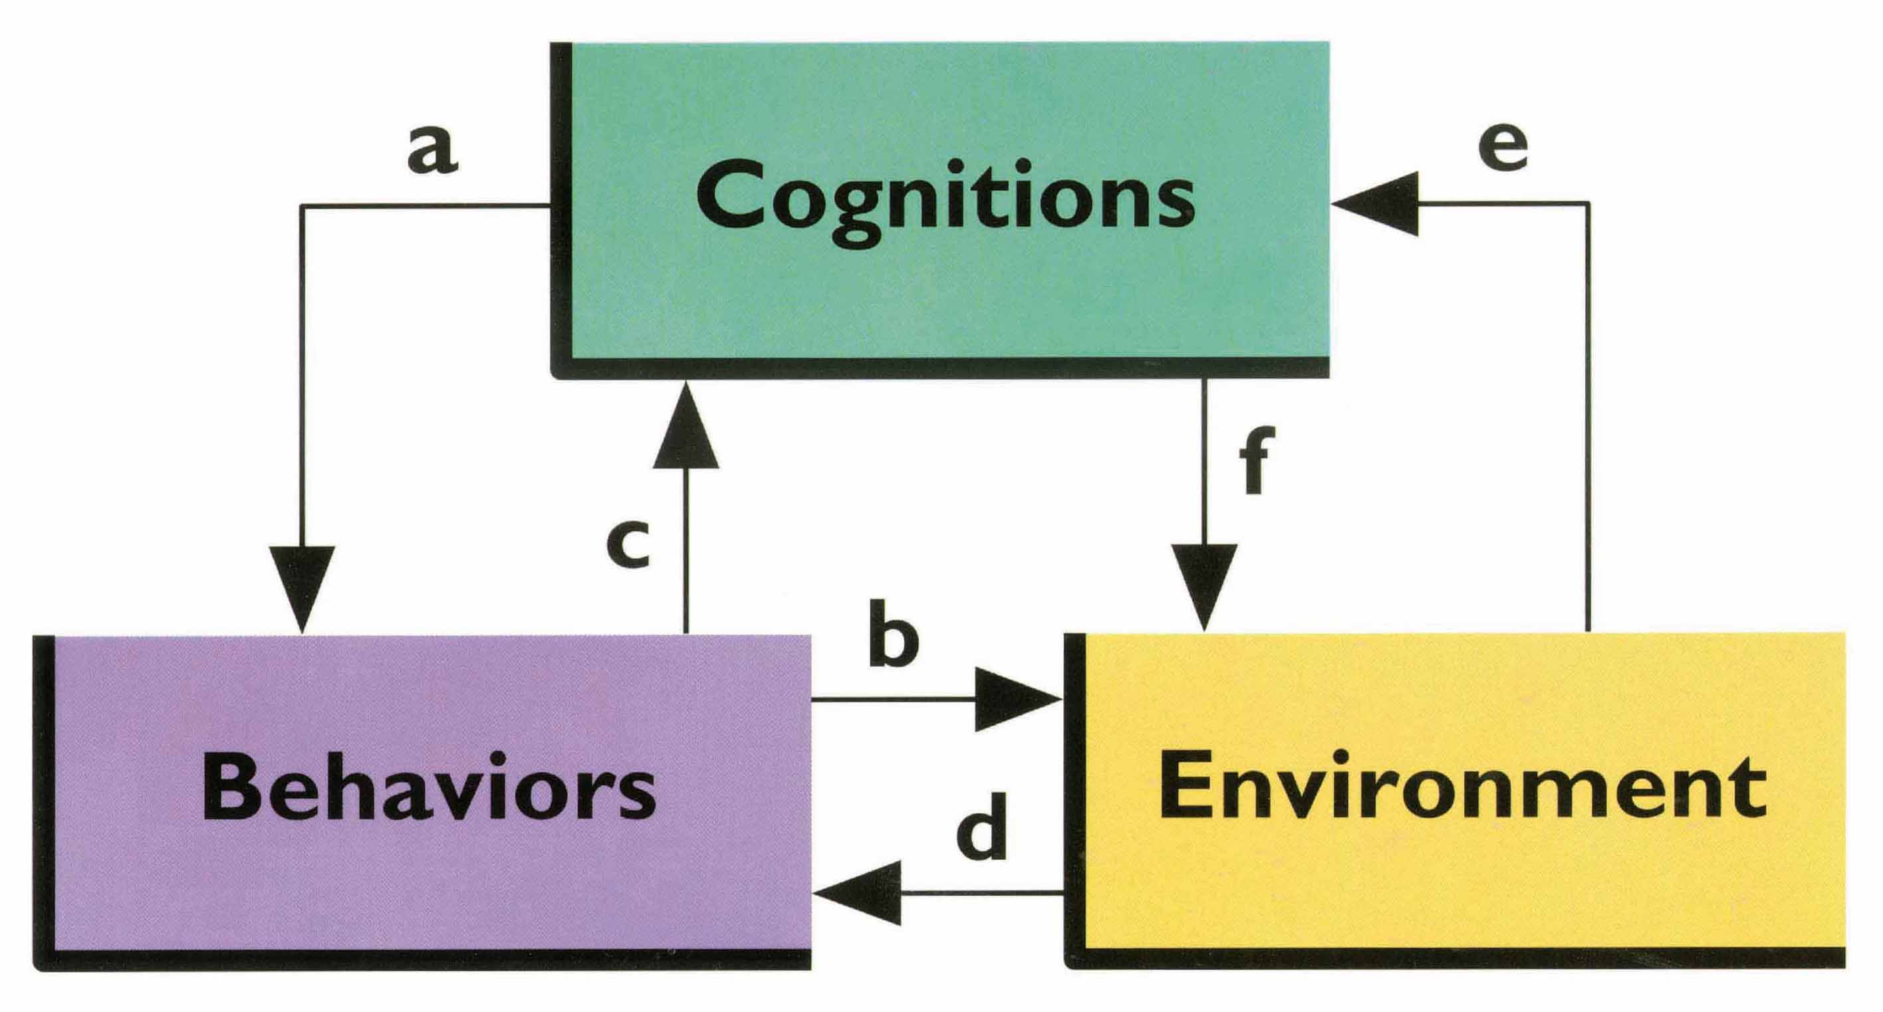
Bandura and Reciprocal Determinism
Reprinted from Journal of Behavior Therapy and Experimental Psychiatry, volume 13, A. Bandura, "Reciprocal Determination" pp. 195-199. Copyright © 1982, with permission from Elsevier Science.

Slide 25
Mischel’s Person-Situation Theory
Person variables:
  Competencies: The thoughts and actions the person can perform.
  Perceptions: How the person perceives the environment.
  Expectations: Person’s self-efficacy.
  Subjective Values: Person’s ideals and goals.
  Self-Regulation and Plans: Person’s standards for self-reward and plans for reaching goals.

Slide 26
Relationship Between Person Variables and Situation Variables
Traits influence behavior only in relevant situations.
**Are they really traits then?**
How is this view of personality directly opposed to trait theories like the Big 5 Theory?

Slide 27
Evaluating the
Social-Cognitive Approach
Expanded applications of classical and operant learning principles.
Principles have lead to development of new therapies for psychological disorders.
Criticisms:
  Has minimized the importance of subjective experience.
  Fails to consider unconscious processes.
  Neglects contribution of emotion to personality.
  Excludes other influences on personality not based on learning such as genetics.

Slide 28
Is everyone basically good?
(The phenomenological approach to personality theory)

Slide 29
Phenomenological Approach
The way people perceive and interpret the world forms their personalities and guides their behavior.
One can understand another person only by perceiving the world through that person’s eyes.
Prime motivator is an innate drive toward personal growth.

Slide 30
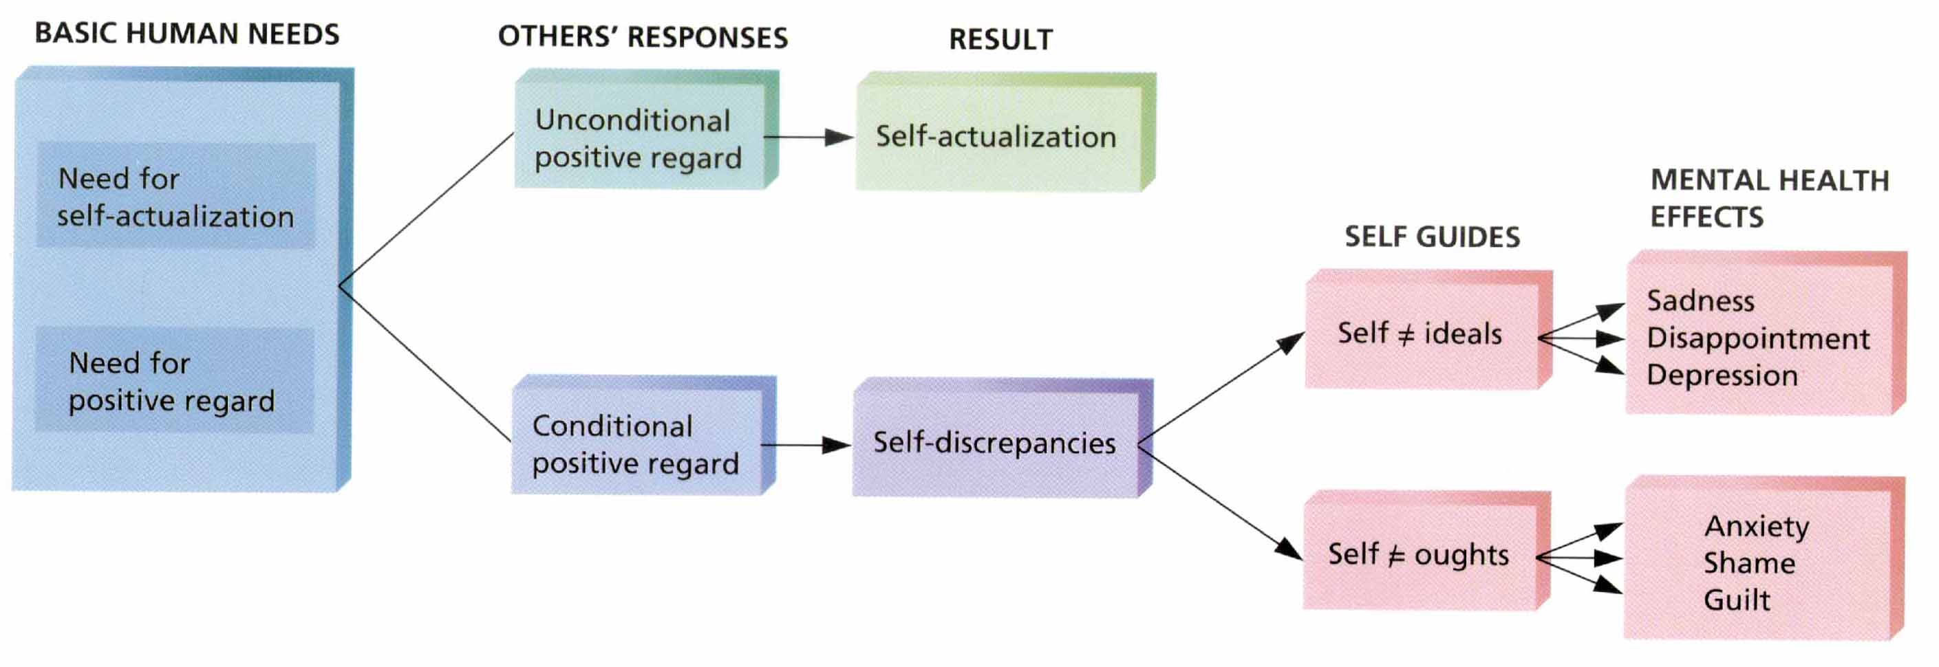
Personality Theory of Carl Rogers
Saul Kassin, Psychology. Copyright © 1995 by Houghton Mifflin Company. Reprinted by permission.

Slide 31
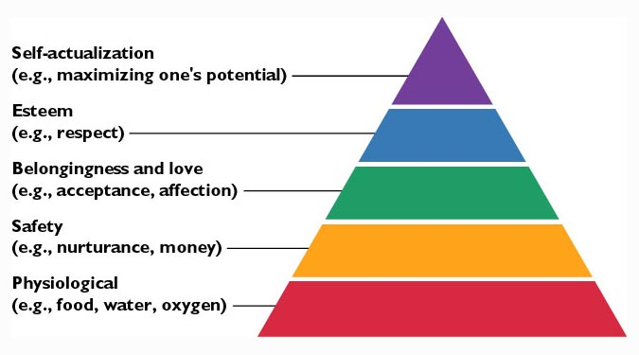
Maslow’s Humanistic Psychology
Source: Adapted from Maslow, 1943

Slide 32
Maslow’s Humanistic Psychology
(cont.)
Most people controlled by a deficiency orientation.
People with a growth orientation do not focus on what is missing, but draw satisfaction from what they have or can do.
  This orientation leads to possibility of having peak experiences.

Slide 33
Evaluating the
Phenomenological Approach
Approach is consistent with the way many people view themselves.
  Central role given to immediate experience and each individual’s uniqueness.
Central to Carl Roger’s client-centered therapy.
Has inspired short-term group experiences, such as sensitivity training and encounter groups.

Slide 34
Evaluating the Phenomenological Approach (cont.)
Criticized for being naïve, romantic, and unrealistic.
  Too little attention on role of other factors in shaping personality.
  View of personality development is too simple.
  Better at describing than explaining personality.
  Concepts are too vague to be tested empirically.
  Not well-supported by empirical evidence.
  View of healthy people as independent and autonomous reflects culture-specific ideals about mental health.

Slide 35
How do psychologists measure personality?

Slide 36
Basic Methods of Assessing and Describing Personality
Observational Methods: direct assessment of behavior.
Interviews: Gather information about personality from person’s own point of view.
Personality Tests: Collect information about personality in a more standardized and economical way than either observations or interviews.

Slide 37
Objective Personality Tests
Characteristics:
  Paper and pencil.
  Quantitatively scored.
Advantages:
  Efficiency.
  Standardization.
Disadvantages:
  Subject to deliberate distortion.

Slide 38
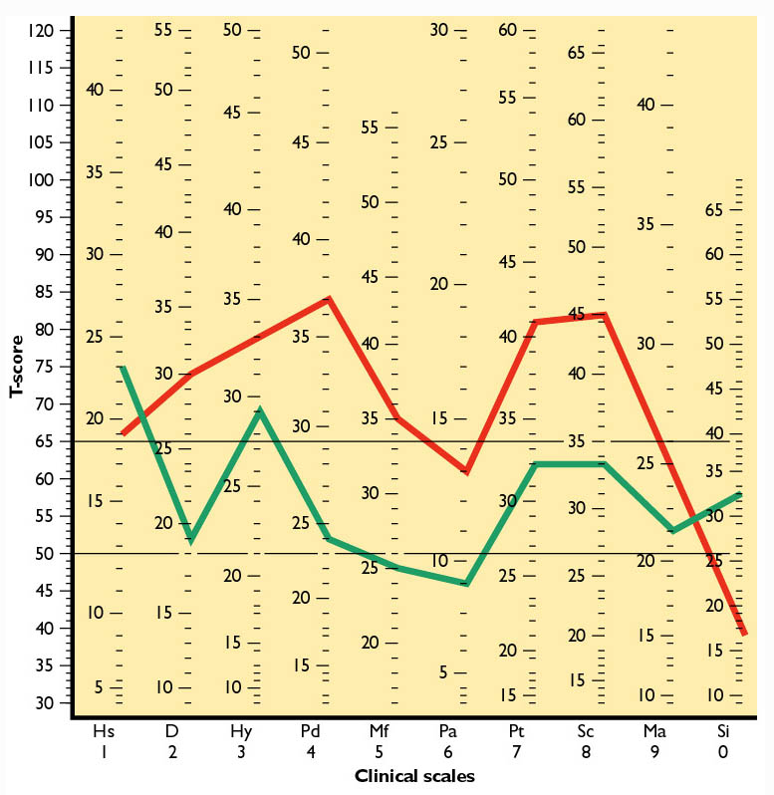
Figure 11.5: Example of an Objective Test: The MMPI-2
Minnesota Multiphasic Personality Inventory-2 (MMPI-2) Profile for Basic Scales. Copyright © 1989 by the Regents of the University of Minnesota. All rights reserved.

Slide 39
Projective Personality Tests
Characteristics:
  Ambiguous stimuli create maximum freedom of response.
  Scoring is relatively subjective.
Advantages:
  “Correct” answers not obvious.
  Designed to tap into unconscious impulses.
  Flexible use.
Disadvantages:
  Reliability and validity lower than those of objective tests.

Slide 40
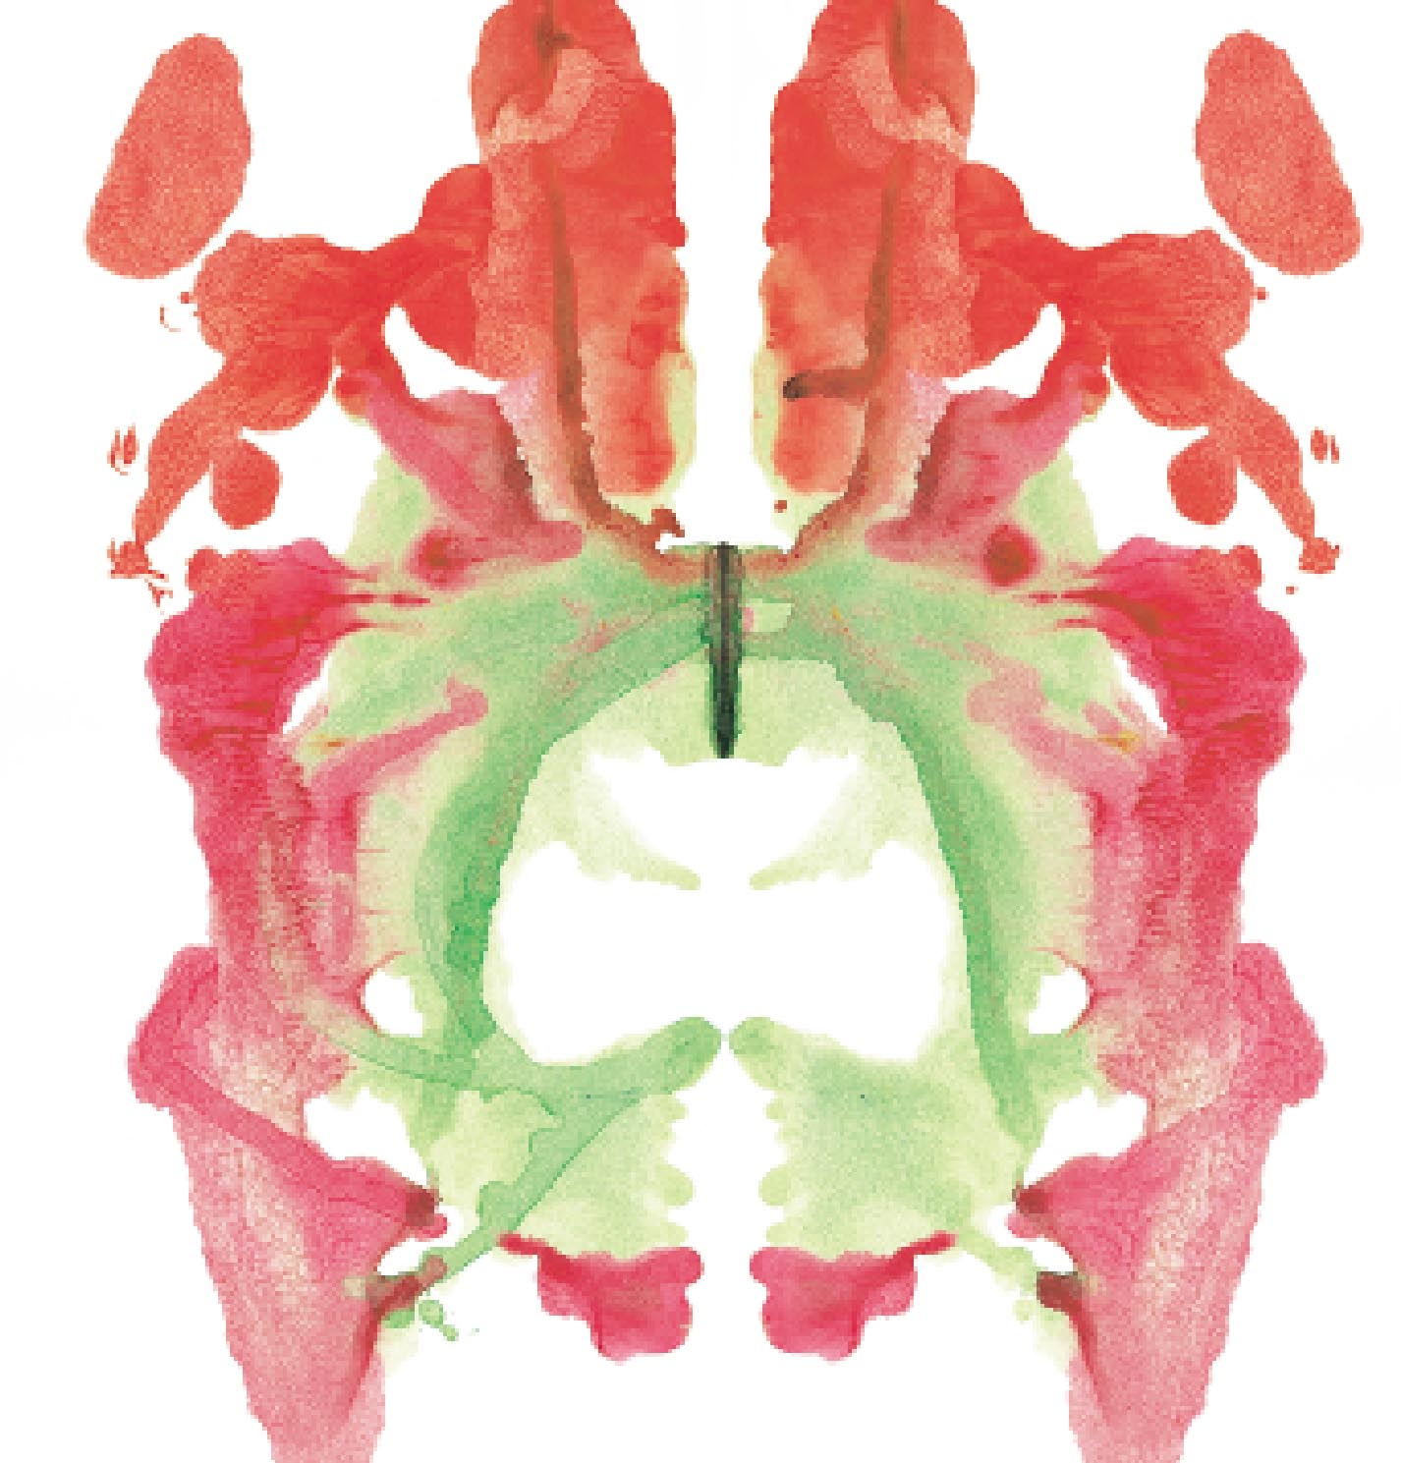
Figure 11.6: Example of a Subjective Test: The Rorschach Inkblot Test

Slide 41
Personality Tests and
Employee Selection
Using objective personality tests in hiring process can help reduce thefts and other disruptive employee behaviors.
Problems:
  Not perfect predictors of behavior.
  Tests seen by some as invasion of privacy.
  Employee concerns on how tests will be interpreted and used in future.

