Slide 1
Project 2d: Experiment Powerpoint Presentation
The following slides provide a template for one possible way you could organize your presentation of your group’s experiment. I suggest that you have at least one slide for each group member to present. You do not have to use the format given in this template – it is just one possibility to help give you ideas.

Slide 2
An Experimental Investigation of One Thing or Another
Orval Faubus
Spiro Agnew

Slide 3
An Experimental Investigation of One Thing or Another
Here is why this is important or how we became interested in it
Here is a clear statement of our hypothesis or hypotheses

Slide 4
Method: Design
Independent Variables
  Thing 1: description of the levels of this IV and how it was operationalized. Or perhaps just a list of the levels, and the person presenting this slide will verbally describe how it was operationalized.
  Thing 2: same information as for thing1
Dependent Variable: name of d.v.
  How operationalized etc.

Slide 5
Method: Materials & Procedure
Description of our materials, and maybe an example
Brief description of what we did – keeping it short and to the point.

Slide 6
Results
One possibility is a list of our predictions, and comparisons of means that tell us whether the predictions were confirmed.
Do not put up a bunch of statistical tests (t or F tests) – just show us the relevant comparison of means and tell us verbally whether it was significant by the test you did.
A better way to do this is to just put up a graph showing the results, and then verbally remind us of your predictions and point to the relevant means on the graph as you tell us whether your predictions were confirmed. See the next slide for an example of a graph you might use for a 2 x 2 design.

Slide 7
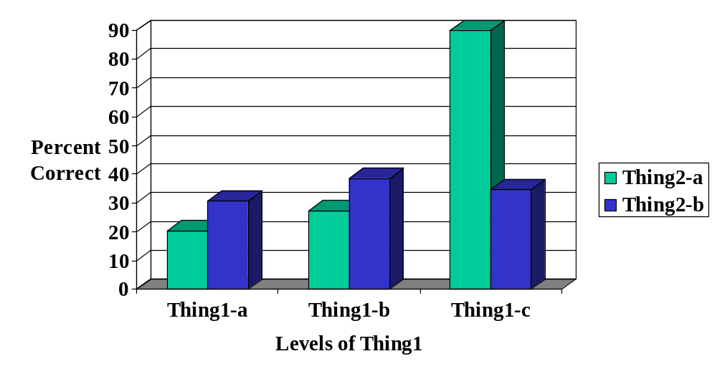
Results

Slide 8
Conclusions
This is like a mini-discussion section
Remind us of what your main finding was
Tell us why it is important or interesting, or tell us what the next question to investigate is, or tell us why you think your results were not as informative as you had hoped.

