Slide 1
Imagery
A Special Form of Representation?

Slide 2
Visual Imagery:
Pictures in the Mind’s Eye?
Definition and Background
Dual Coding Theory (Paivio)
Analog vs. Propositional Representations
Theories of Visual Imagery
  “Picture Theory”
  Quasi-Picture Theory (Kosslyn)
  Propositional Description Theory (Pylyshyn)
Is Imagery Like Perception?

Slide 3
What is Imagery?
Possible Answers
A visual image is a “picture in the mind’s eye.”
“Imagery” simply refers to the subjective experience that accompanies memory when we think about it in certain ways.
An image is a memory representation that resembles perception in significant ways.

Slide 4
Study List
hospital road idea farm
peace order method doubt
teeth radio house force
union steps faith ball
pool girl truth size
hair stress

Slide 5
Test: Recall the Words

Slide 6
Scoring: Total Abstract and Concrete Correctly Recalled
c_hospital c_road a_idea c_farm
a_peace a_order a_method a_doubt
c_teeth c_radio c_house a_force
a_union c_steps a_faith c_ball
c_pool c_girl a_truth a_size
c_hair a_stress

Slide 7
Dual Coding Theory (Paivio)
Information is represented in memory two ways:
  Imaginal Code (visual)
  Verbal Code (propositional)
Evidence:
  Picture-superiority effect
  Better memory for concrete than abstract words

Slide 8
Analog vs. Propositional Representations
Analog representations “mimic the structure of their referents in a more or less direct manner”
  Analog: Vinyl albums
  Non-analog: Compact Disk
Propositions are similar to verbal descriptions

Slide 9
Propositions
Proposition = "smallest unit of knowledge which can be asserted”
Propositions have a truth value
Example: "A big brown dog is in the yard"
propositions:
  A dog is in the yard (in, yard, dog)
  The dog is big (big, dog)
  The dog is brown (brown, dog)

Slide 10
Theories of Visual Imagery
“Picture Theory”
  Images are like the objects they represent
Quasi-Picture Theory (Kosslyn)
  The “Functional Equivalency Hypothesis”
  “2nd order isomorphism”
Propositional Description Theory (Pylyshyn)
  The content of imagery is perceptual, but the format is no different from that used in other cognitive processes.

Slide 11
Evidence for Analog Images
(ways that images behave like perceptions)
Posner, Boies, Eichelman, & Taylor, 1969
The Perky Effect (Perky, 1910)
Mental Rotation (Shepard & Metzler, 1971)
Effects of Image Size (Kosslyn)
Scanning Visual Images (Kosslyn)

Slide 12
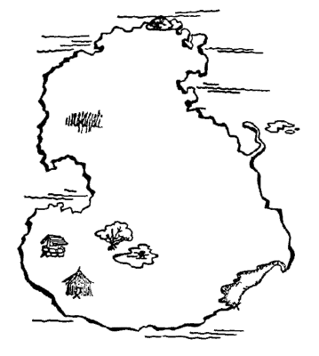
"Mental Travel" (Kosslyn, Ball & Reiser 1978)

Slide 13
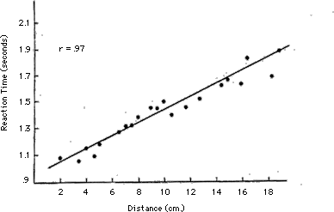
Time to Scan Between Locations

Slide 14
Evidence Against Analog Images
(ways that images behave differently than perceptions)
Mental Rotation, Scanning, and Image Size effects could be due to tacit knowledge and demand characteristics.
Mental images can not be re-interpreted. (Chambers & Reisberg 1985)
  Demonstration: What is this figure?
  (Do not answer out loud)

Slide 15


Slide 16
Re-interpreting Images
Form a mental image of the object you just saw.
Try to see if there is anything else the object could have been – try to re-interpret it.
Now draw the figure.
Then look at your drawing and try to re-interpret it.

Slide 17
Consensus on Visual Images
At least some aspects of visual images are “picture-like” or analog representations
Some aspects of visual images rely on spatial rather than visual representations
  Congenitally blind people show mental rotation effects
Images are in some ways like perceptions

Slide 18
What Does Not Get Imaged?
Intensity (brightness)
Evidence: Reeves (1981) found a Perky effect for a red object imagined on a white background, but not for a white object on a white background.

Slide 19
Echoes in the Mind’s Ear?
Evidence for Auditory Images
What gets imaged and what does not?

Slide 20
Evidence for Auditory Images (Crowder 1989)
Auditory Perception Version:
  Stimuli: tones played by different instruments (different timbres)
  Judging "same" vs "different pitch" was facilitated if the timbre was the same (same instrument)
Imagery Version:
  Tone presented as a sine wave
  Imagine the tone played by a guitar, trumpet, or flute
  Hear a tone played by one of the instruments
  Judge whether same or different tone.
  Imagining the same instrument facilitated judgments.

Slide 21
What Does Not Get Imaged?
(Pitt & Crowder, 1992)
Loudness (intensity)
Same experiment as Crowder (1989) but varying loudness rather than timber
  Perception: Same loudness facilitates the tone judgments
  Imagery: Same loudness does not facilitate the tone judgments

Slide 22
Auditory Imagery: Conclusions
Auditory images are in some ways like auditory perceptions
Auditory images are similar to visual images in that both seem to include information about qualities of the stimulus, but not about the intensity of the stimulus.

Slide 23
Odors in the Mind’s Nose?
Can you imagine what a Rose looks like?
Can you imagine what a Rose smells like?
Olfaction
  A more direct neural pathway than vision or audition
  Odor and memory

Slide 24
Evidence Against Olfactory Images (Schab, 1990)
40 words: 10 related to the odor (apple-cinnamon),
Surprise recall test 24 hours later.
3 conditions at encoding and retrieval:
  odor + imagery
  imagery only
  Neither
Results:

Slide 25
Results (Schab, 1990)
Study and Test
Condition
Recall for
All words
For Semantically Related Words
Odor + Imagery
.19
.27
Imagery Only
.12
.26
Neither
.12
.13

Slide 26
Evidence for Olfactory Images (Lyman & McDaniel, 1990, Experiment 2)
Study: Subjects given a word, told to imagine a picture of it or an odor of it.
Test: odor recognition and picture recognition tests.
Odor imagery at encoding led to better odor recognition; visual imagery at encoding led to better picture recognition:

Slide 27
Recognition Test Performance: d' measure of discriminability
Study Condition
Picture Recognition Test
Odor Recognition Test
Picture Imagery
1.25
1.98
Odor Imagery
0.56
2.51

Slide 28
Recognition Test Performance: d' measure of discriminability
Study Condition
Picture Recognition Test
Odor Recognition Test
Picture Imagery
1.25
1.98
Odor Imagery
0.56
2.51

Slide 29
“The Mind’s Nose”
Djordjevic, Zatorre, Petrides, & Jones-Gotman, 2004
Forced-choice detection of weak odors (“Which is stronger?”)
Odors: lemon, roses
2x2 design, plus no-imagery control:
  Imagery (odor, visual) – between subjects
  Matched detection (match, mismatch) – within subjects
DV: detection accuracy
Notes:
Detection task: given a weak scent of either roses or lemons, and an odorless sample, subjects had to choose “which is stronger”

Slide 30
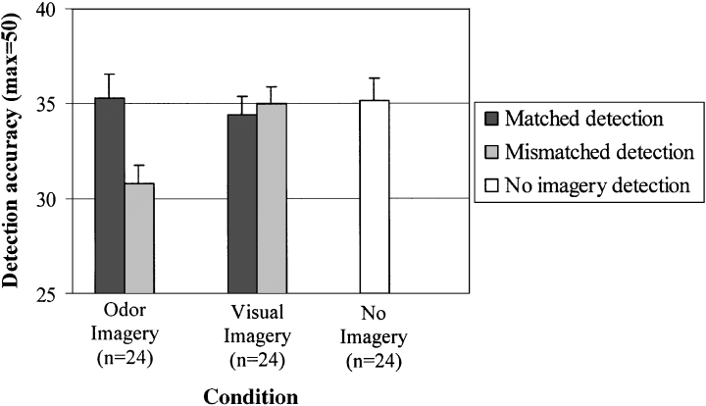
Results
Fig. 1. Accuracy of odor detection in the three imagery conditions. For the odor and visual imagery conditions, results are shown separately for matched and mismatched trials.
From Djordjevic, et al. (2004.) The mind’s nose. Psychological Science 15(3), 143-148).

Slide 31
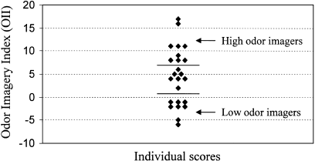
Fig. 2. Individual differences in odor imagery ability. Each diamond represents the Odor Imagery Index (OII) calculated for 1 subject (by subtracting mismatched odor detection from matched odor detection). The graph shows a tertiary split of the sample (n=24) based on the OII. This approach permits classification of participants into "high,""medium," and "low" odor imagers.
From Djordjevic, et al. (2004.) The mind’s nose. Psychological Science 15(3), 143-148).

