Slide 1
Learning
What is Learning?
  Relatively permanent change in behavior that results from experience (behaviorist tradition)
  Can there be learning that does not result in a change in behavior?
Types of Learning
  Associative Learning (simple, passive, external)
  Cognitive Learning (complex, strategic, internal)
Notes:
“relatively permanent..” – the simple definition used by the behaviorists; refers only to behavior and experience, where experience is understood to be interaction with stimuli
*Is this definition adequate? This is the question we will pose today; to the extent that it is inadequate to describe learning, we will be forced to complicate the definition by adding references to internal mental states and processes – cognitive learning.
We will start out with associative learning and try, like the behaviorists did, to explain as much of learning as we can with the simple mechanisms of association. We will then encounter learning phenomena that force us to resort to more complex, cognitive theories.
Behaviorist approaches to learning try to describe learning in terms of only relations between overt behaviors and external stimuli.
Cognitive theories also use hypothesized *internal* states and events – mental representations and mental processes – to explain learning.
How much can we explain without resorting to postulating internal representations and processes? (Wagner’s comment: “in my lab, rats don’t think; they behave according to models.”)
Are there phenomena in learning that force us to make our theories more complicated by hypothesizing internal mental structures and processes?

Slide 2
Associative Learning
Classical Conditioning – associating two stimuli
Operant Conditioning – associating a behavior and its consequences
Notes:
First we will review the basics of classical conditioning, and see how much we can explain with just the simplest notion of associating stimuli that occur together. Then we’ll look at some phenomena within the field of classical conditioning that make it look a lot more “cognitive” and less like simple association
After that, we’ll review the basics of operant conditioning, and hopefully be impressed by just how much we *can* explain with the simple notions of the “law of effect” and simple associations. Then we will explore the limitations of operant conditioning and review some of the early learning studies that first demonstrated those limitations.

Slide 3
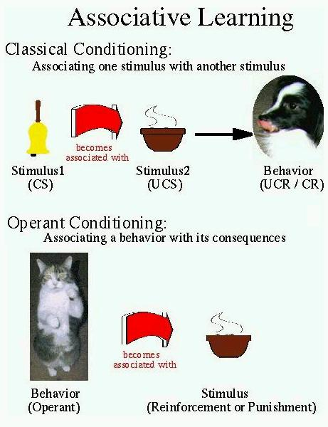

Slide 4
Classical Conditioning
Pavlov’s serendipitous discovery
Associating 2 stimuli
  The first stimulus is “neutral” – does not produce any response
  The second stimulus produces a reflex (unconditioned) response
After the 2 stimuli become associated, both will produce the unconditioned response
Notes:
Pavlov – studying digestion; dogs salivated when the research assistant approached, before receiving food. Was problematic for Pavlov’s measuring salivation response to food. 2 stimuli had become associated: lab assistant approaching & food powder.
Then Pavlov studied the phenomena systematically, associating a tone or bell with the food powder and analyzing the conditions under which it produced salivation.
The steps of classical conditioning and some terminology:

Slide 5
Pavlovian Classical Conditioning
Before Conditioning
UCS
UCR
Neutral Stimulus
No Response
During Conditioning
CS
UCS
UCR
After Conditioning
CS
CR

Slide 6
Pavlovian Classical Conditioning
Before Conditioning
Food (UCS)
Salivation (UCR)
Tone (NS)
No Salivation
During Conditioning
Tone (CS)
Food (UCS)
Salivation (UCR)
After Conditioning
Tone (CS)
Salivation (CR)
Notes:
The CS and UCS become associated; therefore the CS can now produce the same response as the UCS. Note that the NS and CS are the same stimulus before and after learning takes place. Also, the UCR and CR are the same response, again before and after learning respectively.
Examples:
My cat (unlike normal cats) never reacted to the sound of a can opener. Then I bought tuna on sale and had it every day for a week or so. After that, the cat went nuts whenever she heard the can opener. Analyze this story in terms of classical conditioning.
UCS = tuna, UCR = going nuts (begging, whining)
NS = can opener (no reaction)
During learning, CS (can opener) and UCS (tuna) were presented together
After learning, CS = can opener, CR = going nuts.
Can you think of any other examples of behavior that can be explained as examples of classical conditioning?
Practical application: alarms to prevent bed wetting. Blanket sounds an alarm when wet, waking the child up. After a few nights, the child wakes up to go to the bathroom and does not wet the bed. How can you explain how this works in terms of classical conditioning?

Slide 7
Classical Conditioning to Cure Bed-Wetting
Before Conditioning
Alarm (UCS)
Wake up (UCR)
Full Bladder (NS)
No waking up
During Conditioning
Full B. (CS)
Alarm (UCS)
Wake up (UCR)
After Conditioning
Full Bladder (CS)
Wake up (CR)

Slide 8
Further Concepts that Apply to Classical Conditioning
Generalization: CR is given to stimuli that are similar to the CS
Discrimination: CR not given to stimuli that are dissimilar to the CS
Extinction: If the CS is presented repeatedly without being followed by the UCS, the CR will diminish or cease
Spontaneous Recovery: Following extinction, the CR will spontaneously re-appear after a delay
Notes:
Generalization: salivating to tones of different frequencies. In one of the most infamous experiment in the history of psychology: Little Albert *generalized* his fear of white rats to rabbits, other white fuzzy objects.
Discrimination: Albert was not afraid of blocks, other non-fuzzy toys
Extinction: Watson never got around to extinguishing Albert’s fear. How could extinction be used to treat a phobia? (flooding, systematic desensitization)

Slide 9
Classical Conditioning as Simple Associative Learning
Temporal Contiguity was thought to be sufficient – the CS simply needs to occur immediately prior to the UCS for conditioning to take place
Equipotentiality: any two stimuli could be associated through conditioning
Notes:
Research since the time of Pavlov has shown both of these assumptions to be false.
The fact that equipotentiality is false shows that there are *genetic predispositions* to associate certain stimuli and not others. This is a *nativist* modification of what had originally been a thoroughly empiricist theory of learning. Organisms are *not* blank slates waiting for experience to write on; some things are easier to write than others.
The findings that temporal contiguity is not sufficient to produce conditioning, on the other hand, demonstrate the inadequacy of *simple association* as an explanation for classical conditioning, and point to the need for a more *cognitive* explanation – animals appear to not simply be associating the CS with the UCS, but rather they appear to be trying to use the CS to predict what will happen next – a notion that requires our theory of classical conditioning to include *internal mental representations and processes*.

Slide 10
Equipotentiality Falsified
Some stimuli are easier to associate than others
Taste Aversion – only foods become associated with illness, not other stimuli
  Garcia & Koelling, 1966 – the “Sweet, bright, noisy water study”

Slide 11
Garcia & Koelling, 1966
CS = flavor, light, and click (sweet, bright, noisy water)
UCS: 2 conditions
  Group 1: UCS = illness (from X-rays)
  Group 2: UCS = shock
CR = avoidance (not drinking the water)
After conditioning, tested which features of the CS were associated with each UCS
Notes:
Saccharine, light flashes when they drink, click sounds – a compound CS
During training, the rats either were shocked when they drank the sweet bright noisy water, or they were zapped with x-rays so that they later became sick.
After learning, tested to see what components of the compound CS had become associated with the ucs (illness). Would the rats avoid water that had *any* of the 3 features of the CS?

Slide 12
Garcia & Koelling: Results
Both Groups:
CS (sweet, bright, noisy) → CR (avoidance)
Group 1(UCS = shock)
  Sweet water → No avoidance
  Bright noisy water → Avoidance
Group 2 (UCS = illness)
  Sweet water → Avoidance
  Bright noisy water → No avoidance
Notes:
So, the shock was only associated with the light and click; the illness was only associated with the taste. This shows that animals are biologically predisposed to associate some stimuli and not others: illness and foods for example.
Applications of taste aversion:
Makes rats hard to kill – they will only try a poison bait once
Makes it hard for chemotherapy patients to eat – food becomes associated with illness produced by chemo. Solution: associate it with a non-essential food. Works because taste aversion learning happens most readily to novel or unusual foods

Slide 13
Temporal Contiguity is Not Enough
Contingency: The CS must reliably predict the occurrence of the UCS (Rescorla, 1966)
Informativeness: The CS must provide new information for predicting the occurrence of the UCS
Notes:
The CS preceding the UCS in time is not enough for conditioning to take place. The CS must also be:

Slide 14
Contingency (Rescorla, 1966)
UCS = shock (S), UCR = fear
CS = tone (T)
Training: two conditions
  Random Condition: S TS S T TS S T TS
  Contingent Condition: TS TS TS
Results: Rats learned to fear the tone only in the contingent condition, when the tone predicted the shock
Notes:
Random condition: tone and shock presented at random times; some of the time the tone preceded the shock; shock sometimes happened without the tone
Contingent condition:

Slide 15
Informativeness: Blocking
If an organism has already learned that one CS predicts the UCS, that will block the conditioning of a new CS if the new CS does not provide any additional information
Example: Fear conditioning of a tone blocks conditioning of a light

Slide 16
Blocking
Training 1 | Training 2 | Test
-none- | Tone & Light, shock (CR = fear) | Light → Fear
Tone, shock (CR = fear) | Tone & Light, shock (CR = fear) | Light → No Fear
Notes:
Conditioning of the light was blocked when it added no new information about the occurrence of the tone
* Looks like the rats are trying to predict* the shock: forming an internal representation of the situation rather than just associating 2 stimuli

Slide 17
Rescorla-Wagner Model (1972)
A mathematical model of the “strength of association” produced in classical conditioning
Can account for all of the classical conditioning phenomena we have just seen
Uses just one single equation!

Slide 18
Rescorla-Wagner Model
ΔV_{n} = c (V_{max} – V_{n})
V = the strength of association between a CS and a US
ΔV_{n} = the change in the strength of association between the CS and US on a given trial
V_{max} = the asymptote for CS-US association strength after learning
c = rate of conditioning (how fast the association is learned)
Notes:
The actual equation of Rescorla and Wagner is this:
ΔV_{n} = ab (lambda – V_{n})
Where alpha and beta represent the effects of the CS and US respectively, and lambda is the asymptotic conditioning (v-max).
The version I used is a simplification created by Lieberman in his “Learning: Behavior and Cognition” text, 3rd edition.

Slide 19
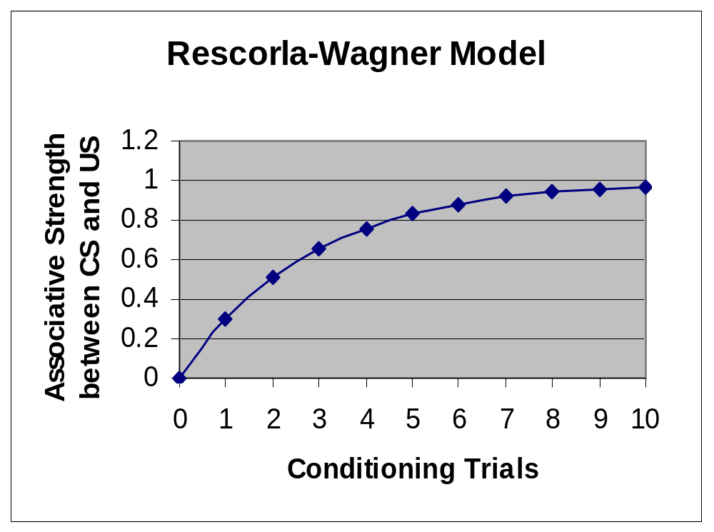
Notes:
Very powerful model; accounts for lots of data. But there are some findings that do not fit the model:
Occasion setting (animals can learn to only associate a CS and US when a third “occasion setting” stimulus is present)
Configural Learning – the model assumes that the associative strength of a compound stimulus is the sum of its component strengths. But rats can learn to respond differently to a compound (a+b) stimulus than they do to each stimulus individually.
CS pre-exposure effect – changes in attention to the CS are not well modeled

Slide 20
Cognitive Interpretation of Classical Conditioning
Classical Conditioning is more than simple association
The concept of information could explain contingency and blocking
They are not just associating stimuli, they are seeking information from one stimulus to predict the occurrence of the other

Slide 21
Operant Conditioning
The law of effect: behaviors that are followed by good things happen more often
Association: Things that occur together become associated
Notes:
How much of behavior and learning can be explained with these 2 simple principles?
Skinner thought all of it can be (even language, for example)

Slide 22
Basics of Operant Conditioning
Operant – freely emitted behavior operating on the organism’s environment; NOT a reflex response
Reinforcement Contingencies – the consequences that follow a behavior
  Reinforcement: increases the frequency of the behavior
  Punishment: decreases frequency of behavior

Slide 23
Reinforcement & Punishment
Positive reinforcement
Negative reinforcement
Positive punishment
Negative punishment
Notes:
Pos reinf: introducing a desirable stimulus
Neg. reinf: removing an aversive stimulus
Pos punishment: introduce an aversive stimulus
Neg. punishment: remove a desirable stimulus
Favorite example: “oh give him the cookie, he wont do it again”
Can you give examples of each?
Pos reinf: take out the trash, roommate says “thanks”
Neg reinf: take out the trash, roommate stops nagging you
Pos punis: yell at you for running up the phone bill
Neg punis: take away phone privileges for running up the bill

Slide 24
Reinforcement Schedules
Continuous vs. Partial
Fixed vs. Variable
Interval vs. Ratio
Examples
  Fixed ratio: vending machine
  Variable ratio: slot machine
  Fixed interval: checking mailbox
  Variable interval: checking email
Notes:
Fixed ratio: vending: ratio=1; video rental (rent 5, get one free) – fixed ratio of 5
With a fixed interval, responses slow down right after reinforcement, then speed up again as the next interval approaches. ** shows planning and anticipation; suggests cognition**
Variable schedules (esp. variable ratio) are more resistant to extinction

Slide 25
Explaining Complex Learning with Operant Conditioning
Secondary reinforcers - association
Shaping – simple learning in small increments
Chaining – small increments plus secondary reinforcement
Language – association and reinforcement (Skinner’s Verbal Behavior, 1957)
Notes:
Secondary reinf – once something (like money) becomes associated with a primary reinforcer (food), it can reinforce behavior too.

Slide 26
Learning that Could not be Explained by Behaviorism
Latent Learning – learning without reinforcement (Tolman & Honzig, 1930)
Observational Learning – learning without behaving or being reinforced (Bandura, 1977)
Overjustification – when rewards decrease the frequency of behavior (but see Eisenberger & Cameron, 1996 for an opposing view)
Language Acquisition – Chomsky’s critique
Notes:
Latent learning: next slide
Observational learning: the Bobo doll experiment. Kids who watched an adult lash out angrily at the bobo doll were then likely to do the same thing (*and in exactly the same way as they had observed*) when left alone with bobo and frustrated by being told they could not play with the good toys (“saving these good toys for the other children”).
No behavior; no reinforcement; learned by just watching. Requires internal representations to explain this learning.
Overjustification: when external rewards can reduce intrinsic motivation.
More recent research however, shows that rewards only hurt motivation in limited circumstances:
Eisenberger, R., & Cameron, J. (1996). Detrimental effects of reward: Reality or myth? American Psychologist, 51(11), 1153-1166.
E&C’s meta-analysis shows *positive* effects of reward on performance. Negative effects appear *only* when the reward is not tied to quality of task performance or task completion.

Slide 27
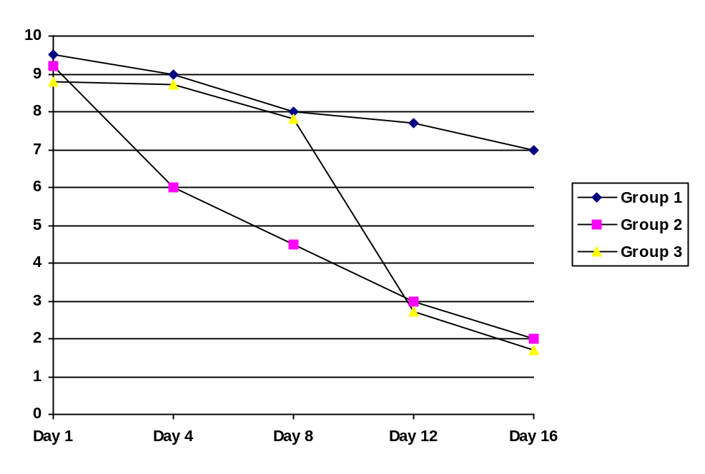
Latent Learning
Tolman & Honzig, 1930
Group 1: never a food reward
Group 2: always a food reward
Group 3: food reward after 10 days
Notes:
Behaviorist perspective would predict that it should take a while for the delayed-reward condition (group 3) to catch up to group 1, since learning can only take place when behavior is reinforced.
The fact that group 3 *immediately* did as well as group 1 once the reward was introduced shows that they *were* learning even before the reinforcement was introduced.
The most natural interpretation was that they were creating a mental representation of the layout of the maze, and when the reinforcement was introduced they were able to use this representation to better run the maze.

Slide 28
Behaviorism Falls Short: Language
Chomsky: “Action in the past” as a property of stimuli is sneaking mental representations in the back door
Association is insufficient to explain language learning: The evidence points to learning RULES
Evidence: Over-regularization (“goed”)
Conclusion: Mere associations between words can not explain language; any adequate theory of meaning must hypothesize internal representations of the rules of language (grammar)
Notes:
There is no objective observable property of stimuli corresponding to “action in the past” that language learners can associate with the past tense.
Over-regularization: kids start out getting it right (went) then switch to getting it wrong (goed) even though they have *never heard anyone say* goed. This shows that they have learned a RULE and applied it.
Chomsky also agued that the *universality* of how language is learned indicates that language learning is at least partially *innate* - not primarily learned through experience, but hard-wired into the brain at birth.

Slide 29
So What was Behaviorism Lacking?
Symbolic Representation – we have internal (mental) representations for things in the external world
Structure – we learn sets of rules for combining symbols (e. g., grammar), not just associations between pairs of symbols
Notes:
Symbolic – we must have these internal representations in our theories to account for things like latent learning, observational learning..
Structure – sentences are not just bags of words, as they would be if learning language were just a matter of forming associations between individual words (symbols). The order and arrangement of the words matters – we learn *rules* when we learn language.
Cognitive theories unabashedly hypothesize internal representations and structures to explain behavior. The simplicity of the behavioral approach has been sacrificed for the sake of explanatory adequacy.

Slide 30
Associative Learning Rises Again?
LSA – Latent Semantic Analysis
  A theory of meaning, and a method for computer analysis of the meanings of texts
  The meaning of a word = all of the words that co-occur with it in a sample of written text (roughly)
  Meaning is just a function of associations of words, not structure (syntax)
  How much of language meaning can LSA account for? A surprisingly large amount.
Notes:
Do we *really* have to assume a sentence is more than a bag of words? (assume that we use knowledge of grammar to understand language)? Recent developments suggest that maybe unstructured associations between words can explain more than we thought.
LSA uses only associative information – how closely each word is associated with every other word in terms of occurring together – to define meaning. *Without* including anything about structure (syntax) in the theory at all, LSA can do a reasonably good job of deciding whether two sentences mean the same thing, or even whether a student’s answer on an essay exam is correct.
Meaning of a word = all the words that co-occur with it; actually the meaning of each word is represented as a vector in a multi-dimensional space that is derived from the co-occurrence frequencies of every word with every other word. If you have 10,000 words in your sample of text, you get a 10,000 x 10,000 matrix of co-occurrence statistics. By using a form of factor analysis, these 10,000 dimensions defining each word are reduced to 100-500 dimensions. The vector of values for a word on these 100 dimensions defines its meaning, and the angle between two vectors defines their similarity of meaning.
The meaning of a sentence is the sum of the vectors for the words. Same thing for a paragraph. Thus, you can get a single vector that represents the meaning of an essay, compare it to the vector that represents the meaning of a model essay (the “right” answer), and see how similar in meaning they are. Automatic grading!
LSA, after being “trained” on a textbook, was able to pass a multiple choice exam!

