Slide 1
Perception
Putting it together

Slide 2
Sensation vs. Perception
A somewhat artificial distinction
Sensation: Analysis
  Extraction of basic perceptual features
Perception: Synthesis
  Identifying meaningful units
Early vs. Late stages in the processing of perceptual information

Slide 3
The parts without the Whole
When sensation seems to happen without perception: Agnosia
Agnosia = “without knowledge”
Seeing the parts but not the whole object
Prosopagnosia: The man who mistook his wife for a hat

Slide 4
Perceiving Objects:
Pattern Recognition
Four “Information Processing” approaches:
Template matching
Feature matching
Prototype matching
Structural descriptions

Slide 5
Template Matching
Objects represented as 2-D arrays of pixels
Retinal image matched to the template
Viewer-centered
Problems:
  Orientation-dependent
  Inefficient?
2 Stages: Alignment, then Matching

Slide 6
Feature Analysis
Objects represented as sets of features
Retinal image used to extract features
Object-centered
Example: Pandemonium (Selfridge, 1959)
  Model of word recognition
  Features -> Letters -> words
  Heirarchical and bottom-up
Neurological “feature detectors”

Slide 7
Hubel & Wiesel (1959, 1963)
Specific cells in cat and monkey visual cortex responded to specific features
  Simple cells
  Complex cells
  Hyper-complex cells

Slide 8
Feature Analysis: Advantages
Some correspondence to neurology (at early levels)
Economical: only 1 representation stored for each object

Slide 9
Feature Analysis: Disadvantages
Not every instance of the pattern has all the features (see prototype theories)
Does not take into account how the features are put together (see structural description theories)
Some features may be obscured from different points of view (see structural description theories again)

Slide 10
Prototype Matching Theories
Prototype = a typical, abstract example
Objects represented as prototypes
Retinal image used to extract features
Object recognition is a function of similarity to the prototype

Slide 11
Prototypes: Advantages
Accounts for the intuition that some features matter more than others
Is more flexible – recognition can proceed even if some features are obscured
Accounts for “prototype effects” – objects more similar to the prototype are easier to recognize

Slide 12
Example of Prototype Effects
Solso & McCarthy (1981)
Identikit faces
Study faces similar to a “prototype”

Slide 13
Studied Faces
75%
50%
75%
Prototype Face
100%

Slide 14
Solso & McCarthy Results
Recognition test
Recognition confidence was a function of number of features shared with prototype
Prototype face was most confidently “recognized” even though it was not studied

Slide 15
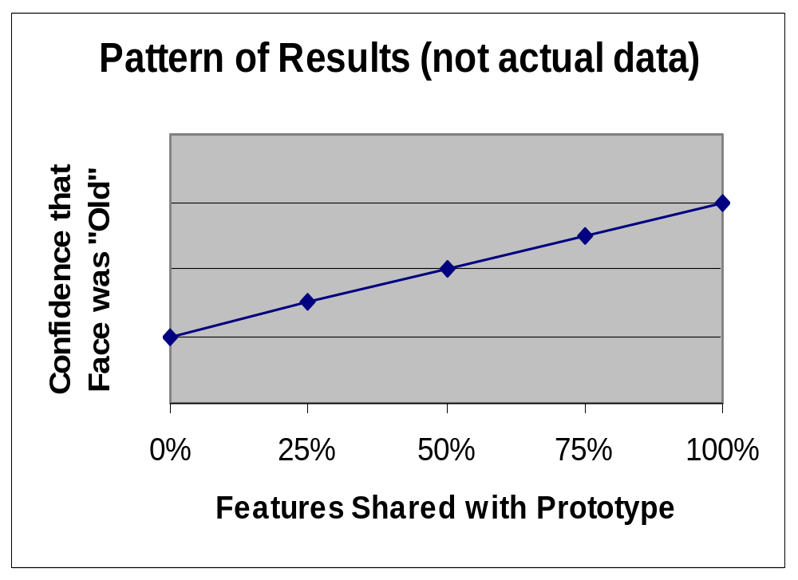
Solso & McCarthy Results

Slide 16
75%
50%
75%
Prototype Face
Perfect Match?
100%
100%

Slide 17
Structural Description Theories
Objects represented as configurations of parts (features plus relations among features)
Retinal image used to extract parts
Object-centered
Example: Biederman’s Structural Description Theory

Slide 18
Structural Description Theory
(Biederman)
Objects are represented as arrangements of parts
The parts are basic geometrical shapes or “Geons”
Object-centered
Evidence: degraded line drawings

Slide 19
Structural Description Theory
Advantages
  Recognizes the importance of the arrangement of the parts
  Parsimonious: Small set of primitive shapes
Disadvantages
  Structure is not always key to recognition: Peach vs. Nectarine
  Which geons? (simplicity vs. explanatory adequacy)

Slide 20
Another Problem…
c
All of these theories are basically “bottom-up”
None can account very well for context effects (top-down)

Slide 21
Top-down and Bottom-up Processing
Bottom-up: Stimulus driven; the default
Top-down: Context-driven or expectation-driven. Examples:
  Word superiority effect (see Coglab)
  McGurk Effect (http://www.media.uio.no/personer/arntm/McGurk_english.html)

Slide 22
The Interactive Activation Model
A connectionist model of word recognition
Incorporates both top-down processing (forward connections) and bottom-up processing (backward connections)
The nodes sum activation
Connections can be excitatory or inhibitory
Run the Model: http://www.socsci.kun.nl/~heuven/jiam/

Slide 23
Gibson’s Ecological Optics: an alternative view
Constructivist models vs. direct perception
Constructivist models
  Stimulus information underdetermines perceptual experience (e.g., depth perception)
  Rules (unconscious inferences) must be applied to the stimulus information to achieve perception
  Top-down processes compensate for the poverty of the stimulus

Slide 24
Direct Perception
All the information is in the stimulus
Most stimuli are not ambiguous
Motion provides information
Invariants – properties of the stimulus that are invariant across changes in viewpoints and can be directly perceived
Entirely stimulus-driven (bottom-up)

Slide 25
Invariants
Center of expansion – always is the point you are moving towards
Texture gradients – always become less course as distance increases

Slide 26
Evidence that Motion is Important:
Center of expansion can induce perception of motion (starfield screen-savers)
Human figures can be recognized from moving points of light

Slide 27
Problems for Direct Perception
There are top-down effects on perception
Depth perception is possible even when motionless
Depth can even be extracted from “random dot” stereograms without motion
  Stereogram of the week: http://www.magiceye.com/3dfun/stwkdisp.shtml

Slide 28
Integrating Visual Perception
Across Space and Time
How do we integrate visual information across space and time?
Not as well as you might think
Across Space: Impossible figures
Across Time: Change blindness

Slide 29
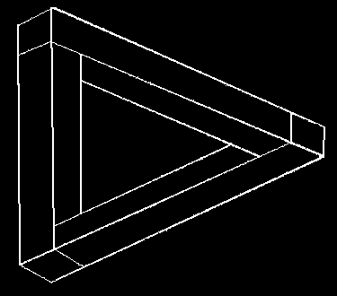
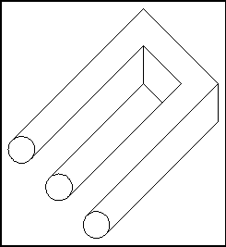
Impossible Figures

Slide 30
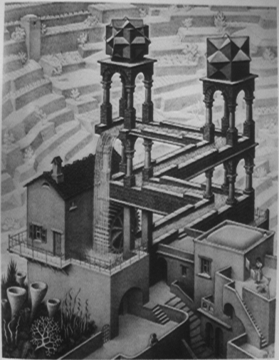
M.C. Escher’s
Impossible Waterfall

Slide 31
Change Blindness
Integrating across time: saccades
Change blindness
  http://www.usd.edu/psyc301/ChangeBlindness.htm
Why did our visual system evolve this way?

Slide 32
Perceptual Illusions
Systematic distortions of reality caused by the way our perceptual system works
Questions to ask as you view them:
  What does this phenomenon tell me about the mechanisms at work in perception?
  Does this illusion result from top-down or bottom-up processes?

Slide 33
Perceptual Illusions: web sites
http://www.rci.rutgers.edu/~cfs/305_html/Gestalt/Illusions.html
http://www.cfar.umd.edu/users/pless/illusions.html
http://www.psych.utoronto.ca/~reingold/courses/resources/cogillusion.html

