Slide 1
Attention
Focus on what matters

Slide 2
What is Attention?
Selection
  Needed to avoid “information overload”
  Related to Limited Capacity
Concentration
  Applying Mental Resources
Control
  Attention’s relation to Automaticity and Action
Notes:
How much can you pay attention to at once? Related issue: sensory storage

Slide 3
Early Studies and Basic Phenomena
Dichotic Listening
Shadowing
  Whether it is a voice or not (Cherry, 1953)
  Whether the speaker is male or female
What does not get through?
  Topic
  Words (Moray 1959)
  Which language it is

Slide 4
Models of Perceptual Attention
(preview)
Selection Models: Bottlenecks
  Early Selection: Filter
  Early Selection: Attenuation
  Late Selection
Capacity Models: Pools of Resources
  Also applicable to complex tasks
Feature Integration Theory: Glue

Slide 5
Early Selection:
Broadbent’s Filter Model
Sensory Channels assumed to have unlimited capacity
There is a bottleneck limiting the information that can get into working memory
A selective filter (attention) allows information from only one channel at a time
Information in the unattended channel is completely blocked

Slide 6
Characteristics of Attention in Broadbent’s Filter Model:
Filter selects information based on physical characteristics only
Filter is all or none
Switching is under conscious control.
Selected information receives deeper perceptual processing and enters working memory

Slide 7
Evidence for the Filter Model
Explains the results of early shadowing studies: the unattended channel is blocked

Slide 8
Evidence Against Filter Model
Cocktail Party phenomenon (Moray, 1959)
Errors in shadowing (Triesman, 1960)
  L: "sitting at a mahogany * three possible"
  R: "Let us look at these * table with her head“
Galvanic Skin Response to unattended channel

Slide 9
Early Selection 2:
Triesman’s Attenuation Model
Messages differ in “subjective loudness”
Attention modulates subjective loudness: attended channel is louder
Individual words have different thresholds of subjective loudness to be noticed
Some concepts have a permanently low threshold (like your name)

Slide 10
Evidence for Attenuation Model
Cocktail Party effect
Contextual errors in shadowing
GSR results (Corteen & Dunn, 1974)
Detecting repetition in dichotic listening
  How big an asynchrony allows detection that the messages are identical?
    4 seconds if attended comes first
    1.5 seconds if unattended comes first

Slide 11
Late Selection Models
(Deutch & Deutch, 1963; Norman, 1968)
Selection occurs late in processing (after information enters STM)
STM is the bottleneck
Attention keeps information from dropping out of STM

Slide 12
Evidence for Late Selection
Listeners can access the meaning of unattended information. Example:
MacKay, 1973:
  Heard "money" or "river" in unattended channel
  shadowed sentence was:
  "they threw the stones towards the bank"
  recognition test for shadowed sentences
  False Alarms to "threw the stones towards the financial institution" only if "money" had been the word in the unattended channel.

Slide 13
Early vs. Late Selection:
Are they distinguishable?
Cocktail Party effect
Contextual errors in shadowing
GSR results
Detecting repetition in dichotic listening
Influence of unattended meaning (MacKay, 1973)
Notes:
Discuss: How would early and late selection theories explain each of these results?

Slide 14
Capacity Models:
Attention as Pools of Resources
Funnel vs. Spotlight
Attention = allocation of cognitive resources
Arousal: increases or decreases the pool of resources
Divided Attention Tasks: can attend to two things at once if neither demands too many resources

Slide 15
Evidence for Resource Models
(Posner & Boies, 1971)
Two tasks
  Primary task: Letter Matching
  Secondary task: Tone Detection
Varied the time the tone was presented
RT to detect the tone was slower just before and just after the 2nd letter
Therefore resources were shifted from the tone detection task to the matching task

Slide 16
Feature Integration Theory:
Attention as Glue
Attention is required to put the pieces together (to combine features into objects)
“What” and “Where” may be separate systems in the brain; attention puts the two back together
Evidence: Conjunction Errors

Slide 17
What letter appears in red on the next slide?
(flash briefly)

Slide 18
A B X E F T G F K S K D J S F S
S T E W T U I G P O I M K L F Q
A X D W S R Y I O P K M N B F R
R S W Q T I L M N V F U G H N B
V F R T Y Z I O K M N B P O I R
M P O E M F P O E I R J P O M V

Slide 20
Conjunction Errors
Snyder (1972) – similar to previous slide
  Identity of a neighboring letter often reported
  Location and shape not combined correctly without attention
Triesman & Gelade (1980)
  Task: detecting “conjunctively defined” targets
  ($ in a field of S and | for example)
  Without prior cuing of where to look, detection was poor
  Attention is needed to detect conjunctions of features

Slide 21
Sample Conjunction Task
On the next slide will be some numbers (black) and letters (in color).
After the slide flashes, write down
1) The numbers
2) The letters and what color they are
There will be two numbers, and the letters will be O, T, or X.

Slide 22
2
8
X
T
O

Slide 24
Results
Did you recombine any features?
(i.e. report seeing a green T or red O etc.)
Triesman & Schmidt (1986) found frequent conjunction errors in this task (about 30% of trials)

Slide 25
Models of Perceptual Attention
(summary)
Selection Models: Bottlenecks
  Early Selection: Filter
  Early Selection: Attenuation
  Late Selection
Capacity Models: Pools of Resources
  Also applicable to complex tasks
Feature Integration Theory: Glue

Slide 26
Attention in Complex Tasks
Attention as executive control
Attention and automaticity

Slide 27
Attention as executive control
In contrast to capacity theories (which see attention as a limitation) considering it as executive control of possibly conflicting multiple goals makes attention instead a source of efficiency
Evidence: Psychological Refractory Period

Slide 28
Psychological Refractory Period
2 stimuli and 2 responses
  Light: press button
  Tone: press foot pedal
Varying SOAs
  At short SOAs, response to task 2 takes longer
Varying stimulus processing difficulty
  Lengthening processing of stimulus 1 slows RT to stimulus 2
  Lengthening processing of stimulus 2 does not slow response to stimulus 2!!

Slide 29
PRP: Surprising Results
Processing
Of Stimulus
Central
Executive
Response
to Stimulus
S1
R1
S2
R2
S1
R1
S2
R2
S1
R1
S2
R2
Notes:
Central Executive: response selection process

Slide 30
Attention and Automaticity
Characteristics of Automatic Processing
  Occurs without intention (Stroop Effect) (Means, Sig.)
  No conscious awareness of the process used
  Does not consume cognitive resources
Characteristics of Controlled Processing
  Requires intention
  Conscious
  Consumes resources
  Requires attention??

Slide 31
Automatic vs. Controlled Search
Unlimited Capacity Parallel Search
  Visual “Pop-out” using individual features
Limited Capacity Search
  No “Pop-out” with conjunctions of features
  Serial or Parallel? (can not tell; Townsend, 1971)

Slide 32
Visual Pop-Out:
RT does not increase with Display Size
Find the blue “S”
Easy:
X T X T
X T S X
T X X X
T T X T
Just as Easy:
X T X T T T X T
X T X X T X T T
T X S T X X T X
X X T X T X T X
T X T T X T X T

Slide 33
No Visual Pop-Out:
RT increases with Display Size
Find the green “T”
Hard:
X T X T
X T T X
T X X X
T T X T
Even Harder:
X T X T T T X T
X T X X T X T T
T X X T X T T X
X X T X T X T X
T X T T X T X T

Slide 34
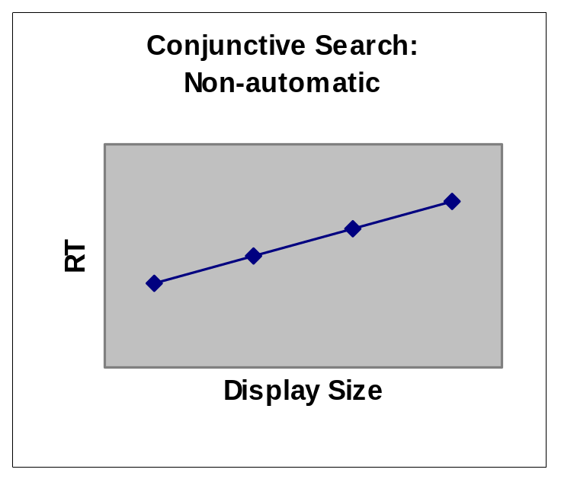
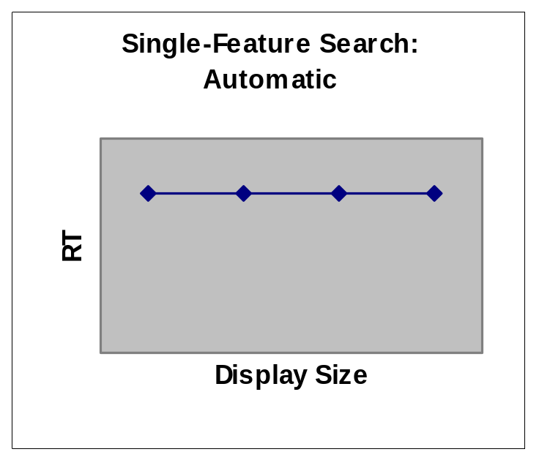
No Pop-out
Pop-out
Requires Attention
Serial or Limited-Capacity
Parallel Processing
Pre-attentive
Parallel Processing
with unlimited capacity

Slide 35
Visual Pop-Out in Conjunctive Search?
Pop-out of more complex features
  http://www.vision.caltech.edu/jensun/what_pops.html. J. Y. Sun & P. Perona. (1996). Vision Research, 379, pp 2515-2529.
  What does the “pop-out” of these kinds of properties tell us about attention and/or perception?

Slide 36
Automatic Processing in Complex Cognitive Tasks
Shiffrin & Schneider, 1977
  Consistent Mapping: led to automaticity
  Inconsistent Mapping: no automaticity even after extensive practice
Conclusions:
  Even complex tasks can become automatic
  Consistent mapping is required for automaticity to develop

Slide 37
Logan’s Instance Theory (for complex tasks)
Some tasks can be solved either by a memory search or by a procedure
(e.g., “What is 12*11”)
A race between the memory search and the procedure
Each instance of the problem encountered makes the memory search faster the next time
Automaticity = when the memory search consistently wins the race

