Slide 1
Memory

Slide 2
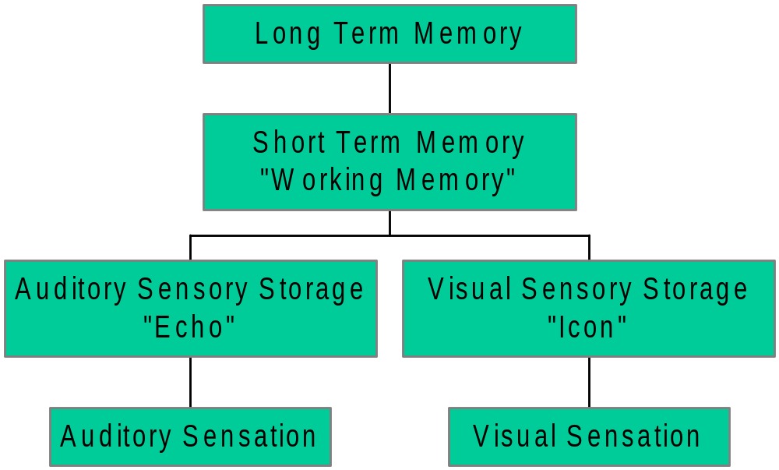
Memory Overview:
Information Processing Model

Slide 3
Sensory Storage
  Capacity: large
  Duration: very brief
  Peripheral
STM
  Capacity: small
  Duration: brief unless rehearsed
  Central
LTM
  Capacity: large
  Duration: indefinitely long
  Central

Slide 4
Memory: Parts (Systems)
At least 3 storage mechanisms, or systems: SS, STM, LTM
Perhaps many subsystems within LTM as well?
Separate Implicit and Explicit systems?

Slide 5
Memory: Processes
Encoding
Storage
Retrieval
Memory can fail at any of these 3 points

Slide 6
Memory: Creating It
(Encoding Tasks)
Intentional
Incidental

Slide 7
Memory: Measuring It
(Retrieval Tasks)
Recognition (direct, explicit)
Recall (direct, explicit)
  Free Recall
  Ordered Recall
  Cued Recall
Priming (indirect, implicit)
  Stem Completion
  Free Association
  Lexical Decision

Slide 8
Sensory Storage: the Icon
Span of apprehension
Sperling’s Partial Report Technique
Implications for Capacity of Sensory Storage
  Unlimited Capacity for Icon
  Rapid Decay
Demonstration: partial, then full report

Slide 9
A G L
U T R
Y K Q

Slide 10
→

Slide 11
B H M
E P W
J L I

Slide 12
→
→
→

Slide 13
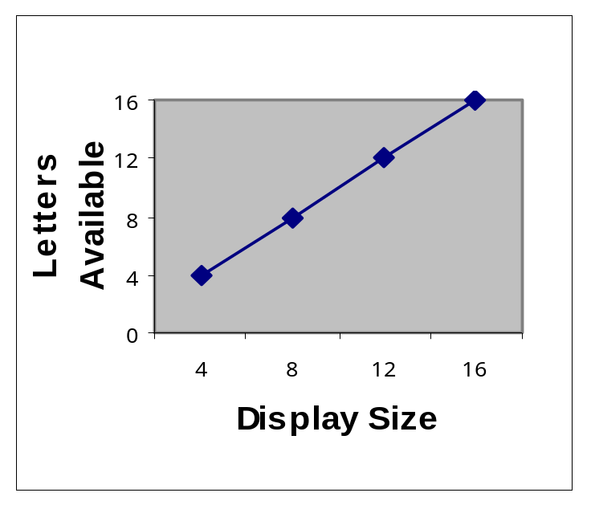
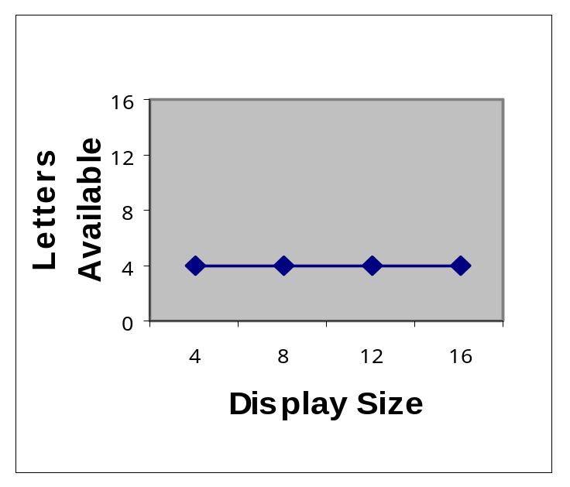
Capacity of the Icon
Pattern of Results with Short Retention Interval
(less than 250 ms)
Partial Report
Full Report

Slide 14
Short-Term Memory
Duration: <18 seconds (without rehearsal)
  Maintenance Rehearsal
  Elaborative Rehearsal
Capacity: 7+-2 (Miller, 1956)
Chunking
  8 6 7 5 3 0 9 3 1 2 vs.
  867 5309 312

Slide 15
Retrieval from STM
Saul Sternberg: Additive Factors
Memory set of 1 to 6 items
Probe item: RT to say “yes” or “no”
Does RT increase as a function of memory set size?
Are you faster to say “yes” than “no”?

Slide 16
Possible Results of Sternberg Task
No
Yes
Parallel
Search
Serial
Exhaustive
Search
Serial
Self-Terminating
Search

Slide 17
Actual Results for
Sternberg Search
Serial Exhaustive Search:
  RT increased by 38 ms per item
  No difference for “yes” vs. “no”
Why not self-terminating? Wouldn’t that be more efficient?

Slide 18
Encoding in STM
Primarily Auditory / Phonological
  Sound-based errors in recall of visually presented letters (Conrad, 1964)
  More words can be recalled if they are short (fast to be pronounced) (Baddeley, Thomson, & Buchanan,1975)
Visual
  Letter matching: AA faster than Aa with ISI of 2 seconds or less (Posner & Keele, 1967)
Semantic
  Release from Proactive Interference (Wickens, 1970)

Slide 19
Forgetting from STM
Displacement or Decay?
Decay: Peterson & Peterson
Displacement: (Waugh & Norman, 1965)
  Immediate memory for digits: What followed the first instance of the digit before the tone?
  Presentation rate: 1/second vs. 4/second
  Accuracy decreases as a function of number of intervening items, but not related to delay

Slide 20
STM as Processing and Storage:
“Working Memory”
Working Memory = the "desktop" or "workbench" of cognitive processes
3 components:
  Central Executive
  2 “Slave” Systems:
    Phonological Loop
      Phonological Store (2 seconds)
      Articulatory Control Process
    Visuo-Spatial Scratchpad

Slide 21
Evidence for the
Working Memory Model
Baddeley & Hitch, 1974
Dual Task:
  Memory Load (0 to 6 letters)
  Reasoning Task (true/false)
Instructions emphasized one task or the other
Did the tasks interfere with each other?

Slide 22
Results (Baddeley & Hitch, 1974)
Memory Load
Letter Recall
Reasoning Time
(seconds)
0 (Baseline)
6.0 (100%)
2.73 to 3.27
2
5.5 to 5.8
3.31
6 with
memory stress
5.0
4.73 *
6 with
equal stress
3.7 *
3.46
Notes:
* = significant difference from baseline

Slide 23
Classic Memory Phenomena
The Forgetting Curve
  Ebbinghaus
The Serial Position Effect
  Primacy
  Recency

Slide 24
The Serial Position Effect
Occurs over both short and long retention intervals
  Memory for US presidents
Greater recency effect for auditory than visual presentation
Suffix Effect – hearing another spoken word after the last item in the list reduces recency

Slide 25
Example of Suffix Effect
I S Q K M P W Y D “go” (with suffix)
U A L N C G F O Z [clap] (no suffix)

Slide 26
Explaining the
Serial Position Effect
LTM, STM
Interference
Temporal Distinctiveness

Slide 27
Long Term Memory
Processing Theories
Systems Theories
Reliability and Strategies

Slide 28
LTM: Processing Theories
Levels of Processing (encoding)
Encoding Specificity (encoding & retrieval)

Slide 29
Levels of Processing
(Craik & Lockhart, 1972)
“Deeper” processing at encoding =
better remembered
Evidence:
  Maintenance rehearsal does not improve recall (Craik & Watkins, 1973)
  Deeper processing increases recall (Rogers, Kuiper, & Kirker, 1977)
    Structural: capital letters?
    Phonemic: rhymes with?
    Semantic: means same as?
    Self-reference: describes you?

Slide 30
Encoding Specificity
Match between encoding and retrieval determines how well remembered
Matching Contexts (Gooden & Badeley, 1975)
Matching Processing
  “Transfer-Appropriate Processing”
  (Morris, Bransford, & Franks, 1977)

Slide 31
Morris, Bransford, & Franks, 1977
Study Task example: “train”
  Shallow: “Rhymes with drain?”
  Deep: fits “The ___ has a silver engine?”
Retrieval Task
  Shallow: “Rhymes with a studied word?”
  Deep: “Is this a studied word?”

Slide 32
Predictions: Levels of Processing and Encoding Specificity
Encoding Task
Shallow Deep
(rhyme) (sentence frame)
Retrieval Task
Poor
Good
Good
Poor
Shallow
(rhyming recog.)
Poor
Poor
Good
Good
Deep
(recognition)

Slide 33
LTM: Systems
Procedural vs. Declarative
Episodic vs. Semantic
Explicit vs. Implicit
Multiple Memory Systems

Slide 34
Semantic Memory
Hierarchical Model (Collins & Quillian 1969, 1972)
  Hierarchical Organization
  Evidence:
    “A canary is a bird” vs.
    “A canary is an animal”
  Problem: typicality effects
    “A canary is a bird” vs.
    “An emu is a bird”
animal
bird
fish
emu
canary

Slide 35
Semantic Memory
Spreading Activation Model
(Collins & Loftus, 1975)
  Modification of Hierarchical Model
  Link length = strength
  of association (inverse)
animal
bird
fish
emu
canary

Slide 36
Semantic Memory: Schemas
Schema = a model of the world that we use to remember and make sense of things.
  an organized unit of knowledge
  embodies typical expectations of situations, events, people
  has slots that can be filled in with default values
Examples:
  Restaurant Script (Schank & Abelson, 1975)
  Stereotypes

Slide 37
Schemas and
Reconstructive Memory
Schemas at encoding: filters
Schemas at retrieval: scaffolds
Reconstructive Memory: Bartlett, 1932
  “War of the Ghosts” story
  Distortions in free recall
Schema plus Correction Model of memory
(Smith & Graesser, 1981)

Slide 38
Episodic Memory
Memory for specific events (place & time)
A surprising effect: Recognition Failure
A mathematical model: SAM
A distinct neural system?
The hippocampus and anterograde amnesia

Slide 39
Recognition Failure:
When recall is superior to recognition
(Tulving & Thomson, 1973; Watkins & Tulving 1975)
study: glue-CHAIR (weakly associated words)
recognition test: desk, top, chair
(Target word is not recognized in the different context.)
cued recall: glue _______
(Chair is recalled when the retrieval cue matches the encoding context.)

Slide 40
SAM – a mathematical model
A “Global Memory Model”
Purposes of a Model
  Make theoretical assumptions explicit
  Fit existing data
  Predict novel findings
A Simplified Description of SAM
A working Demo of SAM (by Ian Neath)
Notes:
Search of Associative Memory

Slide 41
A Neural Mechanism for
Forming Episodic Memories?
Damage to the hippocampus and surrounding areas often results in anterograde amnesia (such as H.M.)
New episodic memories are not formed (recognition and recall)
New “implicit” memories are intact (priming)

Slide 42
Implicit Memory:
A Separate Memory System?
Spared implicit memory in amnesia
“Double-dissociation” of explicit (episodic) memory and implicit memory (priming)
  Manipulations that affect explicit memory (e.g., depth of processing) do not affect implicit memory
  Manipulations that affect implicit memory (e.g., physical similarity) do not affect explicit memory
  Some tasks (e.g., generation effect, Jacoby 1983) have opposite effects on the two types of memory tests

Slide 43
Multiple Memory Systems
Semantic
Episodic
Procedural
“Perceptual Representation Systems” (implicit memory systems)
  Visual Word Form system
  Structural Description System
  Pre-semantic Auditory Subsystem

Slide 44
Alternatives to Multiple Systems
Implicit memory as perceptual bias
(Ratcliff, McKoon, & Allbritton, 1997)
Transfer-appropriate processing as an alternative explanation for dissociations
(Roediger, 1990)
  Data-driven vs. Conceptually Driven Processing
  “Implicit” tasks are typically data-driven
  “Explicit” tasks are typically conceptually driven
  Crossing the two types of processing at encoding and retrieval produced an “encoding specificity” type of pattern of results.

Slide 45
Failures of Memory
Sources of Forgetting
  Decay
  Interference
  Poor retrieval cues (think encoding specificity)
Massed vs. Distributed Practice:
Which is better? Why?
Sources of Distortion
  Schemas
  Post-event information

Slide 46
Eye-witness Memory:
How Reliable is It?
John Dean’s memory and the Nixon tapes
Loftus: The influence of Post-event information
  Remembering things that were not there
  (“How fast when they smashed into each other?”)
  Blending real and post-event information
  (see blue car; asked about green, remember aqua)

Slide 47
Is a Memory Real?
Can you tell?
More Confident? (no)
(Loftus, Donders, Hoffman, & Schooler, 1989)
More Detailed (no)
(Schooler, Gerhard, Loftus, 1986)
More resistant to contradiction? (no)
(Loftus, Korf & Schooler 1989)

Slide 48
Repressed Memories vs.
False Memory Syndrome
Recovered Memory Experiences
The theory of repression
The role of hypnosis
A dangerous assumption:
"The abuse in your life is always as great as the emotional pain you suffer now... If your pain is extreme, the abuse must have been severe, and if you don't remember being abused, you must have repressed it.“
    from Bass & David, The Courage to Heal, 1988

Slide 49
False Recognition & Famous Overnight
(Jacoby, Kelley, & Dywan, 1989; Jacoby, Woloshyn, & Kelley, 1989)
Recognition judgments depend on attributing perceptual fluency to having been studied
A Signal Detection Analysis framework can be used to understand recognition judgments
If perceptual fluency is increased by other means (such as subliminal priming during the test), fluency may be above threshold, leading to false alarms (false memory). Fluency is misattributed to the word’s having been studied.
[Class data from Coglab]
In the “famous overnight” effect, perceptual fluency is misattributed to fame rather than to having been studied.

Slide 50
Meta-memory
But we do sometimes have reliable intuitions about our memory:
  Tip of the Tongue
  Feeling of Knowing judgments
Correlated with recognition performance

Slide 51
Memory Strategies
Mnemonics
  Method of Loci
  Peg-word Method
  Acronyms (unruly goldfish sideburns)
Encoding Specificity
  Context
  Multiple cues
Depth of Processing
  Adequate encoding
  Maintenance vs. elaborative rehearsal

Slide 52
