Slide 1
Language
How can something so difficult
be so easy?

Slide 2
Language
Is complex
Is multi-layered
Requires a huge knowledge base
Is interactive and social
In short, language is hard.
Yet almost everyone becomes an expert.

Slide 3
Language: Overview and Plan
What is Language?
How is it organized? (5 levels)‏
How is it learned?
How does language affect thought?
Is it unique?

Slide 4
What is Language?
A method of communication
A structured relationship between sounds and meanings?
A rule-governed system for using a finite set of symbols to communicate an infinite range of meanings
Characteristics of Language:

Slide 5
Characteristics of Language
Rule-governed (at multiple levels)‏
  “Structure”
  “Grammar”
Symbolic
  Symbols = arbitrary representations that stand for things, actions, ideas
Infinitely Generative
Displacement
Learned

Slide 6
How is Language Organized?
Phonemes
Morphemes
Words
Sentences
Conversations

Slide 7
Phonemes
The sounds of a language
Phoneme = smallest unit that can make a difference in meaning
  Minimal pairs: big / pig
Source and Filter
Place, manner, voicing (VOT)‏
Speech Perception
  Co-articulation and lack of invariants
  Motor Theory vs. Auditory Theory

Slide 8
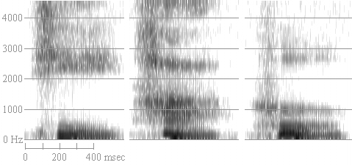
Spectrograms of Vowels
Spectrograms of "hee" "ha" and "who"
From the web pages of Robert Hagiwara, Ph.D.
http://home.cc.umanitoba.ca/~robh/howto.html

Slide 9
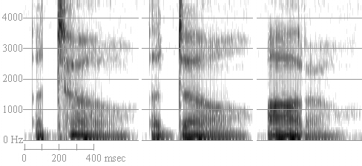
Spectrograms of Consonants
Spectrograms of "a toe", "a doe" and "otto"
From the web pages of Robert Hagiwara, Ph.D.
http://home.cc.umanitoba.ca/~robh/howto.html

Slide 10
Auditory Theory
Motor
Theory
Speech is Special
Speech Perception is a specially evolved module unique to the human brain.
Phonemes are represented as the intended articulatory gestures for producing the sounds
Speech is not Special
Speech Perception relies on the general mammalian auditory system.
Phonemes are represented as sounds

Slide 11
Evidence for the Auditory Theory
Evidence for the Motor Theory
Humans perceive phonemes categorically.
(See class data from Coglab)‏
McGurk Effect.
So do chinchillas. And monkeys. And pigeons.
Non-speech sounds are perceived categorically too.
Phonemic Restoration (discussed later)‏

Slide 12
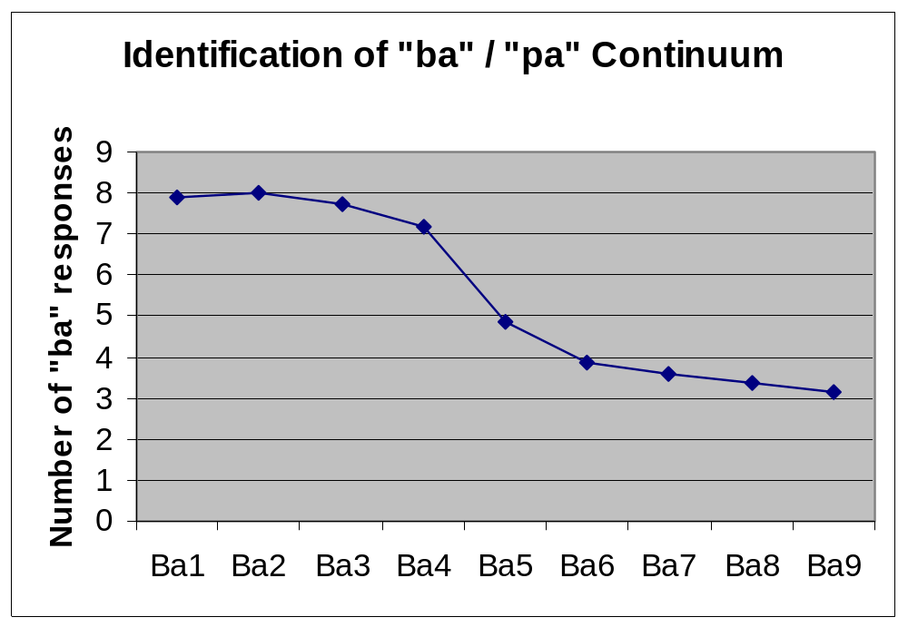
Categorical Perception: Identification
Notes:
2002 class data

Slide 13
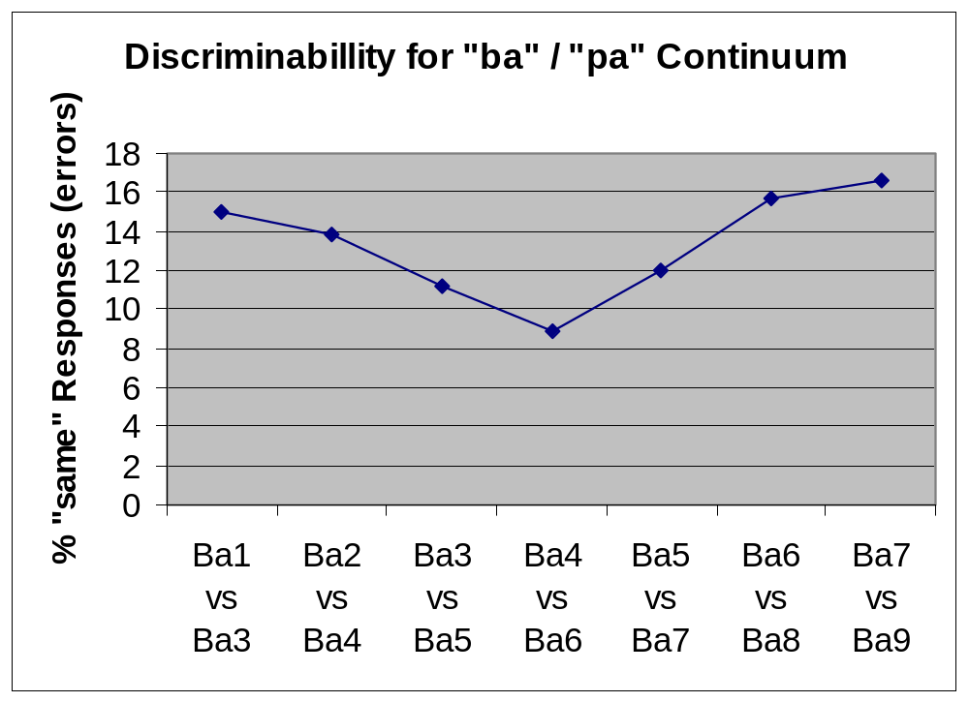
Categorical Perception: Discrimination
Notes:
2002 class data

Slide 14
Morphemes
Morpheme = smallest unit that has a meaning
English examples: bus, “es”, “ed”
ASL morphology: hand shape, movement, location
“Back-formation” of morphemes:
  edit (from editor)‏
  -gate (more of a pseudo-morpheme actually)‏

Slide 15
Words
“We are getting into semantics again. If we use words, there is a very grave danger they will be misinterpreted.” -- H.R. Haldeman
One or more Morphemes that can stand alone
“Lexicon”
Word Recognition
  Empirical effects to be accounted for:
    frequency effects -- more frequent words are identified faster in lexical decision, word identification (naming)
    context effects – (Tulving & Gold, 1963) identification threshold is reduced with increasing amounts of relevant context.
  Models of Word Recognition
    Logogen Model (Morton, 1969)‏
    Interactive Activation Model (McClelland & Rumelhart, 1981)‏

Slide 16
Logogen Model
logogen = adding device for each word. It accumulates evidence until the amount of evidence for that word exceeds a threshold, causing the word to be recognized.
uses a signal detection model for each logogen
context and stimulus information increase a logogen's resting activation
word frequency changes the logogen's threshold
activation only; no inhibition

Slide 17
Interactive Activation Model
A Connectionist model
a node for each feature; a node for each letter; a node for each word
Key differences from the logogen model:
  both excitatory and inhibitory connections --
  structure not defined before-hand
  Parallel, interactive processing

Slide 18
Sentences
Syntax = the set of rules for how words can be combined into phrases and sentences
Descriptive, not Prescriptive
Surface structure vs. deep structure
  "transformational grammar".
    "The boy hit the dog"
    "The dog was hit by the boy"
    "Who hit the dog?"
  Psychological reality of deep structure (Bransford & Franks)‏
    The ants in the kitchen ate the sweet jelly which was on the table.

Slide 19
Conversations
Text and Discourse Comprehension: Putting sentences together into stories
Pragmatics: The rules for using language to communicate in context.

Slide 20
Text Comprehension
Kintsch’s (1988; 1998) Construction-Integration Model
  Information in a text is represented in propositions STM buffer where propositions are initially processed
  Has both top-down and bottom-up influences on comprehension:
    top-down -- goal schema for deciding what is relevant
    bottom-up -- the surface structure of the text -- the actual propositions in the text.
  Situation Model vs. Text-Base representations

Slide 21
Inferences in Text Comprehension
Forward Inferences:
  “The actress had been sitting in the 14th story window. She fell to the sidewalk below.”
  Inference: dead
Backward Inferences:
  “The actress had been sitting in the 14th story window. They found her dead on the sidewalk below.”
  Inference: fell

Slide 22
Pragmatics
Understanding what is meant rather than just what is said (speaker’s meaning vs. utterance meaning).
  “Can you pass the salt?”
  “The cat is on the mat.”
Mutual Knowledge and Common Ground
  Isaacs & Clark, 1987
Grice’s Conversational Maxims

Slide 23
Do the Levels Interact?
“Modularity”
Phonemic Restoration (demonstration)‏
McGurk Effect
Garden-Path Sentences &
Minimal Attachment

Slide 24
Learning Language: It’s Hard!
The task for an infant -- make sense of this stream of sounds: "Zheshiyizhikeaidexiaomao" [463K audio file (.wav)]
sounds -- what are the phonemes? which sounds are relevant?
segmentation -- where are the word boundaries? (Can you identify the word boundaries? Make your best guess, then follow this link to see if you were correct.)
semantics -- once the words are identified, what do they mean?
syntax -- what does the order of the words tell about the meaning?

Slide 25
How is it Learned?
Quickly and Easily
But what is the mechanism?
  Associative Learning & Reinforcement? (Skinner)‏
  Innate “Language Acquisition Device”? (Chomsky)‏
Learning Phonemes: A counter-intuitive process
Learning Words: Built-in Strategies

Slide 26
How does language affect thought?
Whorfian hypothesis (linguistic relativity hypothesis) -- language structures thought (Whorf, 1956).
Strong version of the linguistic relativity hypothesis: Speakers of different languages see the world in different, incompatible ways, because their languages impose different conceptual structures on their experiences. Language determines thought.

Slide 27
Linguistic Relativity: Evidence
For: More “codable” colors are better recognized (Brown & Lenneberg, 1954)‏
Against: Rosch, 1973
  Dani:2 basic color terms: mola and mili
  focal color = the best example of a color category
  Both English and Dani speakers recognized English focal colors better

Slide 28
Linguistic Relativity Hypothesis: The Weak Version
Lanugage influences thinking
Metaphor
  Conceptual Metaphors (Lakoff & Johnson, 1980)‏
    Conduit metaphor for communication (Reddy, 1979)‏
  Different metaphors could lead to different ways of thinking about the world.

Slide 29
Is Language Unique?
Do other species have languages of their own?
Can other species learn human language?

