Slide 1
Tutoring for Conceptual Understanding in Physics
David Allbritton, DePaul Univ.
Sandra Katz & John Connelly,
Univ. of Pittsburgh

Slide 2
Tutoring for Conceptual Understanding
When does conceptual instruction take place in tutorial dialogues? Often it is during “Post-practice Reflection.”
How do tutors distribute their pedagogical strategies across the stages of the tutoring session?
When are dialogues focusing on conceptual instruction most effective?

Slide 3
Background and Motivation
Several ITS’s include activities for students to do after they have solved a practice problem, e.g.:
  stepping through a summary of the student’s solution, with errors highlighted and corrected
  studying optimal or “expert” solutions
  accessing general advice about how to similar problems
What can we learn from human tutoring sessions about how to design effective modules for post-practice reflection?

Slide 4
Questions Addressed
What roles do post-practice discussions play in human tutoring?
What is the relationship between instructional dialogues during and after problem solving?
  To what extent are they connected?
  Are there tutorial strategies that are distributed across these two phases of instruction?
Is it even worthwhile to implement planning engines to support reflective discussions?
  Do post-practice discussions enhance learning?
  If so, what kind(s): enhanced conceptual understanding and/or problem-solving ability?

Slide 5
Overview
Two studies to address these questions
  - Methods and main findings
Implications for the design of automated modules for post-practice reflection
Subsequent and Future work

Slide 6
A Study of Reflective Dialogues in Physics Tutoring
Subjects: 15 students in an introductory college-level physics course were paired with 8 tutors.
Task and environment: Students worked on basic mechanics problems in the Andes ITS (e.g., Gertner & VanLehn, 2000).
  Two types of sessions: “reflection” and “no reflection” (~50/50%)
    At start of each session, subjects were told whether they could continue to discuss the problem after it was solved.
  Student-tutor interaction: “Wizard of Oz” style–separate rooms; messages typed into a “chat” window.
Design:
  pre-test → training (24 Andes problems) → post-test
  post-participation questionnaire
    How did students and their tutors use the opportunity for reflection?
    How did the opportunity for reflection (or lack thereof) influence student/tutor interaction during problem solving?

Slide 7
Dialogue Analysis
Corpus: 164 post-practice dialogues
  1 post-practice dialogue per topic
  often several dialogues per problem
Coded features:
  Initiator: the tutor or the student?
  Information status: Did the reflective dialogue elaborate on a problem-solving dialogue, restate a problem-solving discussion, or raise a new topic?
  Instructional role: What type of learning goals did the dialogue (apparently) attempt to achieve?
Rater reliability (2 coders):
  92% agreement for initiator (kappa = .83), 85% for information status (kappa = .78), and 94% for instructional role (kappa = .77)

Slide 8
Summary of Findings
Post-practice discussions:
Carry out various roles aimed at promoting transfer–that is, the ability to apply concepts and familiar solution strategies to unfamiliar problems, e.g.:
  abstract the concepts and principles that underly correct solutions
  generalize the strategy used in the current solution
  discuss alternative strategies
  present “what if” scenarios that prompt students to “go beyond” the current application of physical principles
Are adapted to the student’s general ability level and performance on the current problem
Are strongly connected to discussions that take place during problem solving
Support transfer, in particular near transfer

Slide 9
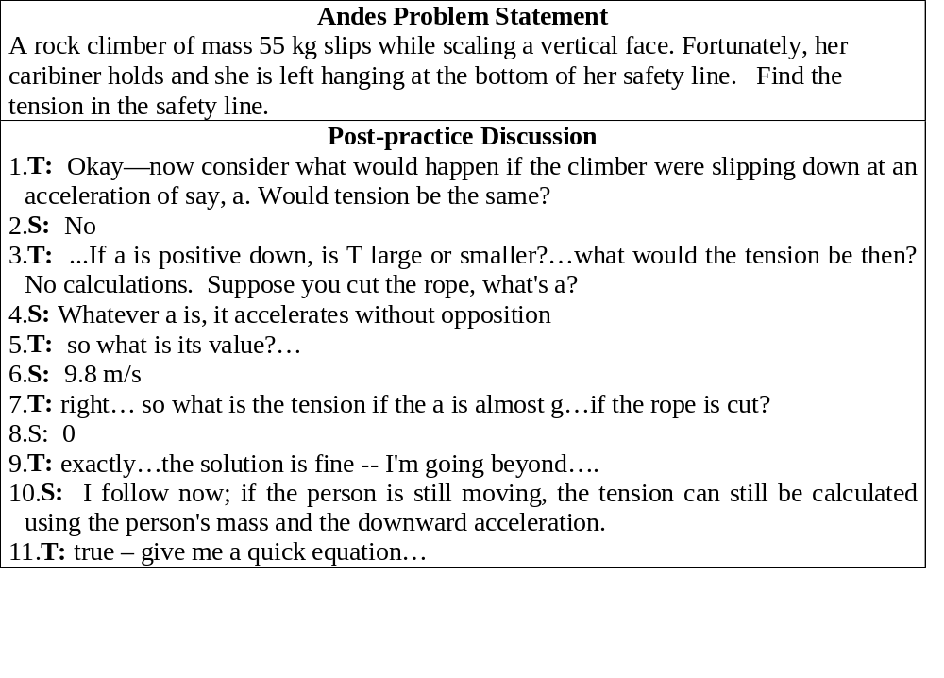
Excerpt from a Reflective Dialogue that “Goes Beyond” a Correct Solution

Slide 10
The Tutor’s Comments on His Goals During Reflection
“I used that opportunity to take the student away from the main question to try to develop an overall intuition or improvement in technical prowess by asking him questions etc.. In general to lead him to discover something about the problem that could be applied with more generality. My student was so focussed on getting to solving problems that he was relying on rote. I was trying to break this habit by forcing contradictions in his reasoning.”

Slide 11
Other Comments on How Students and Tutors Use the Opportunity for Reflection
Students’ Comments
Sometimes my tutor would add a “twist” to the problem—especially if I solved very quickly. Also, I could ask about part of the problem or theory I was unsure of. She asked questions to ensure I knew the “why” of something.
We discussed other ways of solving the problem.
The time was mainly spent on problem solving strategies, sometimes referring to the previous problem, sometimes more general concepts. Often, if I was having trouble with the problem in question my tutor would basically restate the concept in question and made sure I understood it completely before continuing.
Tutors’ Comments
I usually tried to give another example of the problem. Often, the students would ask questions on concepts.
We generally talked specifically about the problem that was just completed. But I do recall conversations dealing with general problem solving techniques and discussing how I may have gone about solving a particular problem.
I usually like to bring up issues and questions as the student is working. I will, however, try to sum up the general physical issues at the end, or reinforce a correction to an earlier misconception.

Slide 12
Some Roles of Reflective Dialogues that Potentially Support Transfer
Conceptual generalization: help the student understand how concepts associated with the current problem apply to various physical situations–e.g., Newton’s Second Law in a static and dynamic situation.
Conceptual specialization: clarify the distinction between related concepts—e.g., the difference between instantaneous, average, and constant acceleration.
Correct misconception: correct a piece of faulty knowledge or a flawed mental model
Strategic generalization: help the student understand that the strategy used in the current problem applies to a whole class of problems—e.g., all conservation of energy problems.
Problem-solving tactics: teach “tricks of the trade” for solving quantitative problems, such as breaking complex problems into more manageable sub-goals, reading the problem statement carefully, and expressing relations symbolically before instantiating variables.

Slide 13
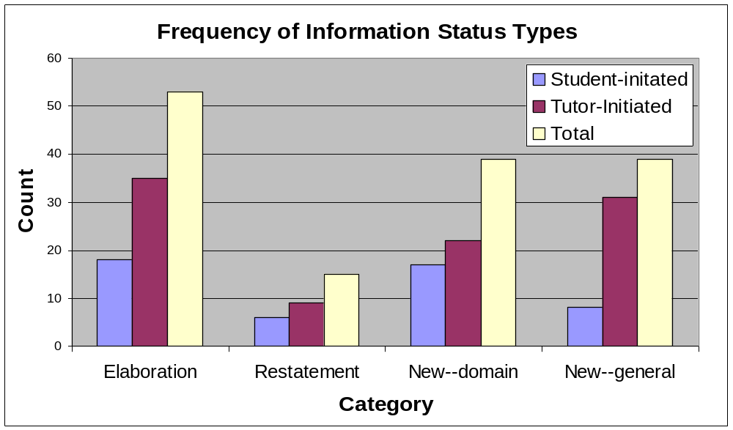
How are reflective dialogues related to problem-solving dialogues?
Most frequently reflective dialogues about physics elaborated on previous discussions, instead of restating them or bringing new topics to the table.
  True of both tutor-initiated and student-initiated dialogues

Slide 14
How are reflective dialogues related to problem-solving dialogues?
Several tutorial strategies are distributed between the two phases of instruction, e.g.:
Overall Instructional Goal:
Address student’s misconception
During problem solving:
Tutor hints at error and lets the solution bring out the contradiction.
During reflection:
Tutor reifies the contradiction brought out in the solution and clarifies the misconceived principle.
Overall Instructional Goal:
Schema abstraction and recognition
During problem solving:
Tutor states that current problem is similar to others that student has solved, at start of session.
During reflection:
(Tutor identifies schema | prompts student to state if she recognized it.) &
Tutor prompts student to specify how schema applied to current problem.

Slide 15
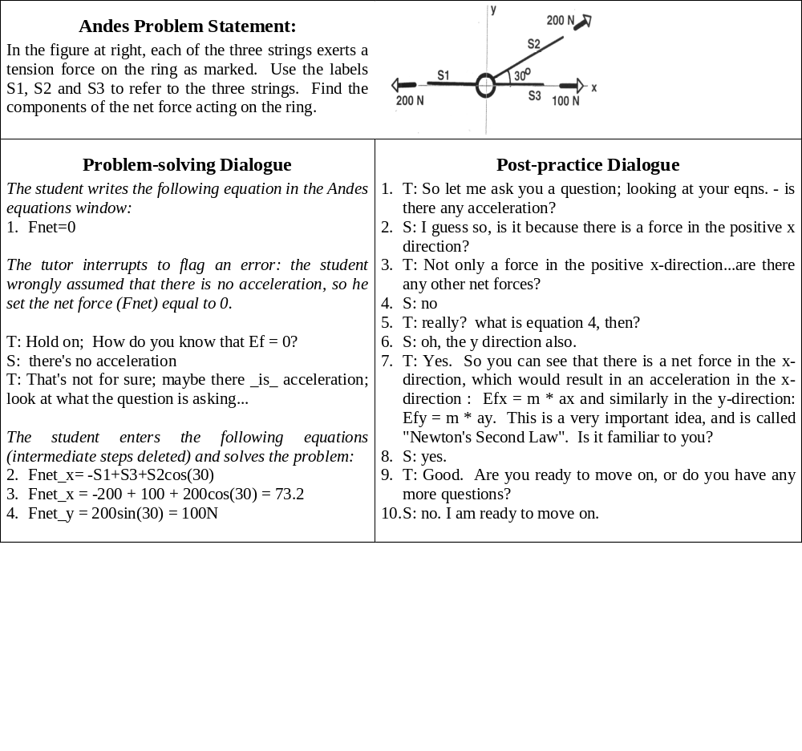
Example of the Flag Misconception→Address Misconception Distributed Strategy

Slide 16
Evidence From This Study That Post-practice Discussions Support Learning
Three measures of learning, with respect to pre-test to post-test gain scores:
  overall gain score
  gain score on conceptual questions
  gain score on quantitative problems (transfer)
Five reflective dialogue variables correlated significantly with overall gain score and quantitative gain score:
  the total number of reflective dialogues that a student and his tutor engaged in (r = .39; r = .37)
  the number of reflective dialogues that elaborated upon problem-solving dialogues (r = .59; r = .59)
  the number of “Old” (elaborated or restated) dialogues (r = .52; r = .48)
  the number of dialogues that performed an abstraction/generalization role (r = .55; r = .52)
  the number of abstraction dialogues that were initiated by the tutor (r = .56; r = .49)
No significant correlation between dialogue features and conceptual gain scores.

Slide 17
Placing the Results in a Larger Framework
These results suggest that post-practice dialogues correlate with learning—in particular, near transfer—especially when they abstract the concepts and strategies associated with the current problem, elaborate or restate problem-solving discussions, and are initiated by the tutor.
These results support previous research on the effectiveness of post-practice reflection.
  “Reflection questions” following worked examples enhanced students’ ability to balance chemistry equations (Lee & Hutchison, 1996).
  Discussions about misconceptions in avionics were more effective when they were distributed between problem solving and post-practice reflection (“debrief”) than when they took place during either phase alone (Katz, O’Donnell, & Kay, 2000).

Slide 18
A Follow-up Study
Two main questions addressed:
  Do students who use Andes and receive reflection questions like the ones that human tutors asked, with feedback, learn more than students who solve Andes problems without reflection questions?
  Is natural-language feedback more effective than canned feedback? Do we need NLP to make reflective modules effective?

Slide 19
An Experiment to Address these Questions
Subjects
  University of Pittsburgh students taking introductory physics
Subject matter
  basic mechanics: kinematics and dynamics (Newton’s laws)
Design
  Pretest ⇒ Intervention ⇒ Post-test
  Tests contained 9 quantitative problems and 27 qualitative questions
Intervention--3 Conditions:
  Treatment 1: Andes problems + Reflection Questions + Canned feedback (15 subjects)
  Treatment 2: Andes problems + Reflection Questions + Human feedback (16 subjects)
  Control: Andes problem-solving only; no reflective debrief (15 subjects)

Slide 20
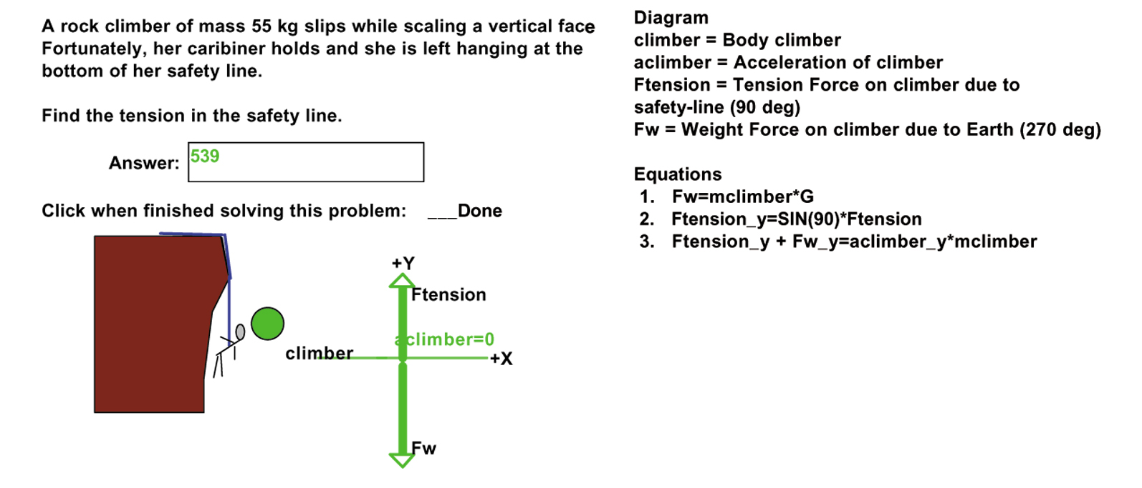
An Example: Andes Problems + Reflection Questions + Canned Feedback
Sample Reflection Question:
Andes: Why does the tension equal the weight in this problem? What would Sir Isaac Newton say?
Student: that is the amount of force being exerted on the bungee
Andes: There is no acceleration (in any direction) since the climber has a constant velocity (of zero). Newton would say since the acceleration in this problem is 0 then that means that there exists no net force. In other words, although forces may act on the object, the sum of all those forces must add up to 0. When we calculate all the forces, we see that there are two forces that act on the system: F_net = T - mg. Since the acceleration is 0, F_net is 0, so T = mg.

Slide 21
Results-1: Comparing Conditions by Overall
Gain Scores
Students learned more with the reflection questions than without.
  Mean overall gain score from pretest to post-test was significantly higher for the two Reflection Question conditions than for the Control condition, F (2,43) = 7.2, p .01.
The difference between the canned and tutored conditions did not approach significance.
Effect of condition on overall gain scores persisted after controlling for initial differences in physics knowledge, which course students were enrolled in (algebra vs. calculus-based physics) and time on task, F (2,37) = 3.3, p < .05.

Slide 22
Results-2: Comparing Conditions by Qualitative and Quantitative Gain Scores
Once again, students learned more with the reflection questions than without, although the effect was only significant for qualitative gain scores.
  Quantitative differences: F (2,43) = 1.6, p = .21.
  Qualitative differences: F (2, 43) = 6.6, p < .05
Differences for quantitative gain scores possibly didn’t approach significance because of the relatively small number of quantitative problems (9), compared with qualitative questions (27).

Slide 23
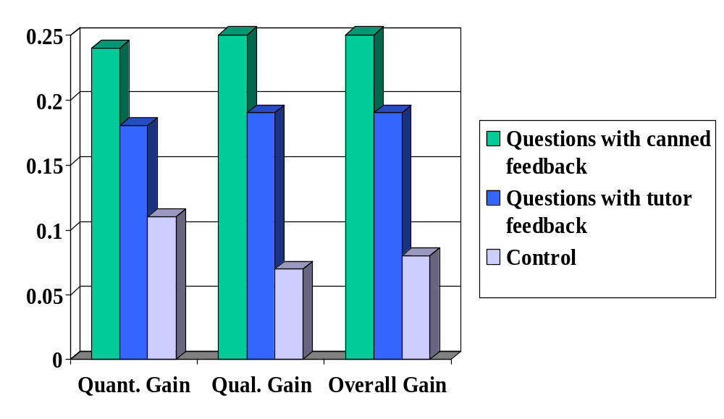
Result Summary: Mean Gain Scores from Pre-test to Post-test by Condition

Slide 24
Overview
Two studies to address these questions
  - Methods and main findings
Implications for the design of automated modules for post-practice reflection
Future work

Slide 25
Implications of These Studies for the Design of Automated Modules for Reflection
Empirical support for reflection
No evidence of a significant difference between canned and natural-language feedback
Adaptive selection of reflection questions and other dialogue content
Human tutors apply distributed strategies for reflection
Incorporate reflective modules in ITS’s!
Canned feedback may be sufficient (needs to be tested further).
Use the student model to tailor reflective dialogues to students’ overall ability and their performance on the current problem.
Plan distributed reflective dialogues. Model them after human tutors’ distributed strategies.

Slide 26

Figure 6: Proposed Model of a 2-Phase Dialogue Planning System
Action Interpreter
Student Model
maps student solution to solution graphs and/or expert model
detects errors
User Interface
Dialogue Interpreter
Error List
2-part Pedagogical Planner
Domain Knowledge Base
solution graphs
declarative knowledge
etc.
Problem-solving planner:
goals
tactics
Post-practice planner:
goals
tactics
2-part plan
2-part Dialogue Planner
Problem-solving dialogue planner:
moves
content
Post-practice dialogue planner:
moves
content
Dialogue moves

Slide 27
Overview
Two studies to address these questions
  - Methods and main findings
Implications for the design of automated modules for post-practice reflection
Subsequent and Future work

Slide 28
Next Steps
Further analysis of the reflective dialogues to identify features of dialogues centered around reflection questions that do/do not support learning
Further specification of distributed tutorial strategies
Research on the staging of “knowledge construction dialogues”:
  What is the optimal way of distributing these discussions? What content should be addressed before, during, and after practice problems?

Slide 29
Planned and Partially Completed Research:
Timing of Conceptual Dialogues
“KCD” – knowledge construction dialogue in ANDES
When are KCD-like dialogues focused on conceptual knowledge most effective? Before, during, or after problem-solving activities?
Eventually: 4 topics per student, 1 per condition:
  No instructional dialogues (baseline)
  Instructional dialogues before problem-solving
  Instructional dialogues during problem-solving
  Instructional dialogues during reflective follow-up

Slide 30
Preliminary New Data
Before vs. During problem solving
New domains:
  mass/energy
  radioactive decay
Examples of KCDs before and during problem-solving in ANDES
Results so far

Slide 31
KCDs: Sample Knowledge Construction Dialogue Excerpt
Tutor: How radioactive is a substance with a high decay constant?
Student: extremely
Tutor: Correct.
What is the relationship between a substance's decay constant and its lifetime?
Student: they are equal
Tutor: That answer seems to be incorrect.
The lifetime is simply the reciprocal of the decay constant (i.e., τ = 1 / λ). So, they are inversely related -- if one is high, the other is low, and vice versa.
Of what length is the lifetime of a highly radioactive substance?
very short

Slide 32
KCD Placement in Before-Practice Condition
cheat sheet
Over time, the number of nuclei of the original substance diminishes as individual nuclei
disintegrate. Recall that we labelled the number of decays n and the number of original, intact
nuclei N. Because every decay destroys one nucleus of this type, the number N is constantly
diminishing. In a given time period, the change DN in the number N of intact nuclei is
ΔN = -n = -λ N Δt
One can calculate the probable number N of remaining nuclei after a time period t, starting with N₀
nuclei at time t=0:
N = N₀ e^{-λ t}
The average time any one nucleus is likely to survive is called its lifetime, symbolized by the Greek
letter tau: t. The lifetime is just the reciprocal of the decay constant:
τ = 1 / λ
and is measured in seconds (in taking the reciprocal of a measure with units decays/atom/second,
bear in mind that decays are measured as number of atoms; therefore, decays/atom cancels out,
leaving the reciprocal of 1/seconds, or simply seconds).
This equation means that the higher the decay constant is (i.e., the more radioactive the substance is), the shorter an average atom of the substance will last before its nucleus disintegrates. Highly radioactive substances don't last long, and long-lasting substances aren't highly radioactive.
(2nd background page)
Continue

Slide 33
KCD Placement in Before-Practice Condition
cheat sheet
Over time, the number of nuclei of the original substance diminishes as individual nuclei
disintegrate. Recall that we labelled the number of decays n and the number of original, intact
nuclei N. Because every decay destroys one nucleus of this type, the number N is constantly
diminishing. In a given time period, the change DN in the number N of intact nuclei is
ΔN = -n = -λ N Δt
One can calculate the probable number N of remaining nuclei after a time period t, starting with N₀
nuclei at time t=0:
N = N₀ e^{-λ t}
The average time any one nucleus is likely to survive is called its lifetime, symbolized by the Greek
letter tau: t. The lifetime is just the reciprocal of the decay constant:
τ = 1 / λ
and is measured in seconds (in taking the reciprocal of a measure with units decays/atom/second,
bear in mind that decays are measured as number of atoms; therefore, decays/atom cancels out,
leaving the reciprocal of 1/seconds, or simply seconds).
This equation means that the higher the decay constant is (i.e., the more radioactive the substance is), the shorter an average atom of the substance will last before its nucleus disintegrates. Highly radioactive substances don't last long, and long-lasting substances aren't highly radioactive.
(transition page
before 2nd KCD)
cheat sheet
Let's further explore the relationship between a substance's decay constant, its lifetime, and its
radioactivity.
Continue
Continue

Slide 34
KCD Placement in Before-Practice Condition
cheat sheet
Over time, the number of nuclei of the original substance diminishes as individual nuclei
disintegrate. Recall that we labelled the number of decays n and the number of original, intact
nuclei N. Because every decay destroys one nucleus of this type, the number N is constantly
diminishing. In a given time period, the change DN in the number N of intact nuclei is
ΔN = -n = -λ N Δt
One can calculate the probable number N of remaining nuclei after a time period t, starting with N₀
nuclei at time t=0:
N = N₀ e^{-λ t}
The average time any one nucleus is likely to survive is called its lifetime, symbolized by the Greek
letter tau: t. The lifetime is just the reciprocal of the decay constant:
τ = 1 / λ
and is measured in seconds (in taking the reciprocal of a measure with units decays/atom/second,
bear in mind that decays are measured as number of atoms; therefore, decays/atom cancels out,
leaving the reciprocal of 1/seconds, or simply seconds).
This equation means that the higher the decay constant is (i.e., the more radioactive the substance is), the shorter an average atom of the substance will last before its nucleus disintegrates. Highly radioactive substances don't last long, and long-lasting substances aren't highly radioactive.
(1st question of
KCD recipe)
cheat sheet
Let's further explore the relationship between a substance's decay constant, its lifetime, and its
radioactivity.
cheat sheet
Tutor: How radioactive is a substance with a high decay constant?
Continue
extremely
Continue
Continue

Slide 35
KCD Placement in Before-Practice Condition
cheat sheet
Over time, the number of nuclei of the original substance diminishes as individual nuclei
disintegrate. Recall that we labelled the number of decays n and the number of original, intact
nuclei N. Because every decay destroys one nucleus of this type, the number N is constantly
diminishing. In a given time period, the change DN in the number N of intact nuclei is
ΔN = -n = -λ N Δt
One can calculate the probable number N of remaining nuclei after a time period t, starting with N₀
nuclei at time t=0:
N = N₀ e^{-λ t}
The average time any one nucleus is likely to survive is called its lifetime, symbolized by the Greek
letter tau: t. The lifetime is just the reciprocal of the decay constant:
τ = 1 / λ
and is measured in seconds (in taking the reciprocal of a measure with units decays/atom/second,
bear in mind that decays are measured as number of atoms; therefore, decays/atom cancels out,
leaving the reciprocal of 1/seconds, or simply seconds).
This equation means that the higher the decay constant is (i.e., the more radioactive the substance is), the shorter an average atom of the substance will last before its nucleus disintegrates. Highly radioactive substances don't last long, and long-lasting substances aren't highly radioactive.
(Tutor response &
2nd question)
cheat sheet
Let's further explore the relationship between a substance's decay constant, its lifetime, and its
radioactivity.
cheat sheet
Tutor: How radioactive is a substance with a high decay constant?
cheat sheet
Tutor: How radioactive is a substance with a high decay constant?
Student: extremely
Tutor: Correct.
What is the relationship between a substance's decay constant and its lifetime?
extremely
Continue
Continue
One is the reciprocal of the other
Continue
Continue

Slide 36
KCD Placement in During-Practice Condition
cheat sheet
Problem: You are given two samples of different unknown substances (labeled A and B). There
are ten million atoms of substance A and one million atoms of substance B. Substance A is found
to be decaying at an average rate of 1925 decays per second, while substance B is found to be
decaying at an average rate of 385 decays per second. How many atoms of the longer-lasting
substance will remain after two hours?
Subgoal #1. Compute the decay constant for each substance. (Answer: λ_{A} = 1.925 * 10⁻⁴ and λ_{B} = 3.85 * 10⁻⁴ decays/atom/second)
Subgoal #2. Determine which will last longer, substance A or substance B. Briefly explain your
answer.
Initial answer:
(Initial answer to
2nd subgoal; user
already worked
on 1st subgoal)
substance B because there’s more
Continue

Slide 37
KCD Placement in During-Practice Condition
cheat sheet
Problem: You are given two samples of different unknown substances (labeled A and B). There
are ten million atoms of substance A and one million atoms of substance B. Substance A is found
to be decaying at an average rate of 1925 decays per second, while substance B is found to be
decaying at an average rate of 385 decays per second. How many atoms of the longer-lasting
substance will remain after two hours?
Subgoal #1. Compute the decay constant for each substance. (Answer: λ_{A} = 1.925 * 10⁻⁴ and λ_{B} = 3.85 * 10⁻⁴ decays/atom/second)
Subgoal #2. Determine which will last longer, substance A or substance B. Briefly explain your
answer.
Initial answer:
(Hint for 2nd
subgoal;
same for all
conditions)
cheat sheet
Problem: You are given two samples of different unknown substances (labeled A and B). There
are ten million atoms of substance A and one million atoms of substance B. Substance A is found
to be decaying at an average rate of 1925 decays per second, while substance B is found to be
decaying at an average rate of 385 decays per second. How many atoms of the longer-lasting
substance will remain after two hours?
Subgoal #1. Compute the decay constant for each substance. (Answer: λ_{A} = 1.925 * 10⁻⁴ and λ_{B} = 3.85 * 10⁻⁴ decays/atom/second)
Subgoal #2. Determine which will last longer, substance A or substance B. Briefly explain your
answer.
Hint: Think about the relationship between a substance's decay constant, its lifetime, and its
radioactivity.
substance B because there’s more
Continue
Continue

Slide 38
KCD Placement in During-Practice Condition
cheat sheet
Problem: You are given two samples of different unknown substances (labeled A and B). There
are ten million atoms of substance A and one million atoms of substance B. Substance A is found
to be decaying at an average rate of 1925 decays per second, while substance B is found to be
decaying at an average rate of 385 decays per second. How many atoms of the longer-lasting
substance will remain after two hours?
Subgoal #1. Compute the decay constant for each substance. (Answer: λ_{A} = 1.925 * 10⁻⁴ and λ_{B} = 3.85 * 10⁻⁴ decays/atom/second)
Subgoal #2. Determine which will last longer, substance A or substance B. Briefly explain your
answer.
Initial answer:
(1st question of
KCD recipe;
incorrect
answer)
cheat sheet
Problem: You are given two samples of different unknown substances (labeled A and B). There
are ten million atoms of substance A and one million atoms of substance B. Substance A is found
to be decaying at an average rate of 1925 decays per second, while substance B is found to be
decaying at an average rate of 385 decays per second. How many atoms of the longer-lasting
substance will remain after two hours?
Subgoal #1. Compute the decay constant for each substance. (Answer: λ_{A} = 1.925 * 10⁻⁴ and λ_{B} = 3.85 * 10⁻⁴ decays/atom/second)
Subgoal #2. Determine which will last longer, substance A or substance B. Briefly explain your
answer.
Hint: Think about the relationship between a substance's decay constant, its lifetime, and its
radioactivity.
cheat sheet
Tutor: How radioactive is a substance with a high decay constant?
not very
Continue
substance B because there’s more
Continue
Continue

Slide 39
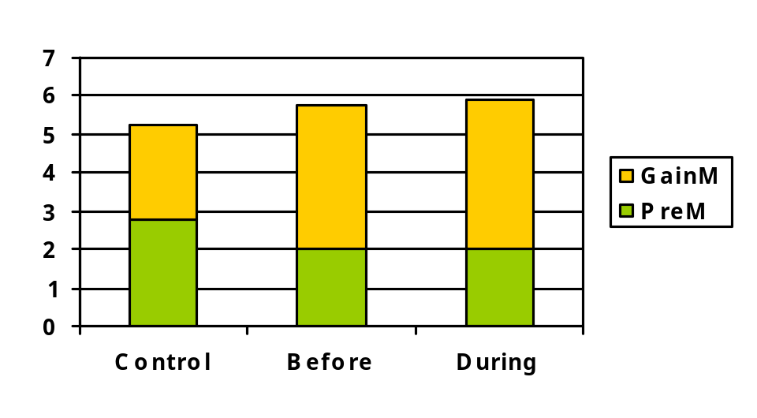
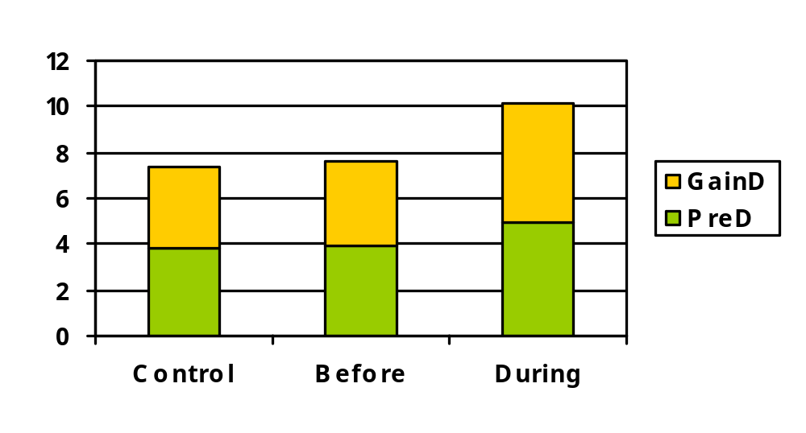
Results so Far
Figure 2: Gains on Mass-Energy Questions Figure 3: Gains on Radioactive Decay Questions
Trend for greater gains with KCDs than Control, but n.s.
Differences from previous study that found benefits of conceptual dialogues:
  Different topics
  Single session, rather than multiple sessions (and less time)
  NL generation of dialogs by ANDES vs. human-generated
Notes:
Andes’ NL processing was pretty accurate, but still up to 5% or 10% errors of classification of student responses.

Slide 40
Conclusion
Goals:
Transfer and Conceptual Understanding
What works?
Need for evidence-based best practices
Where to allocate our resources?
Can something “cheap” get good learning results?
  Canned feedback
  Self-explanation
  LSA

