Slide 1
Passive acoustic results

Slide 2
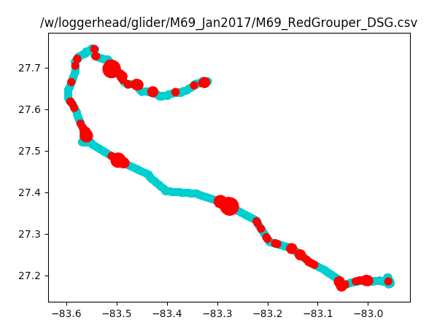
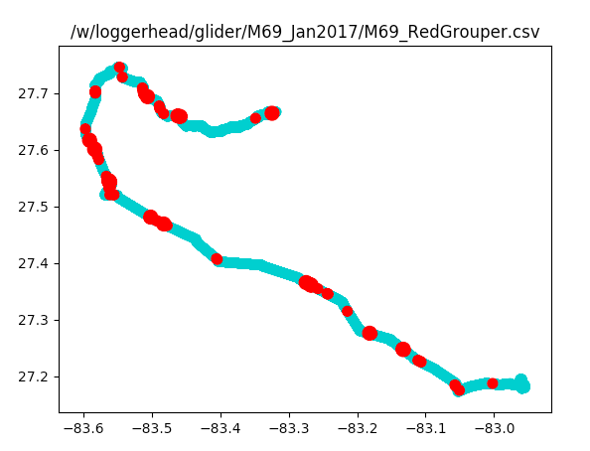
M69 – Jan 2017
Aft Recorder (1min/5min): Detected 255 Red Grouper Sounds
Dorsal Recorder (1 min/ 4 min): Detected 135 Red Grouper Sounds

Slide 3
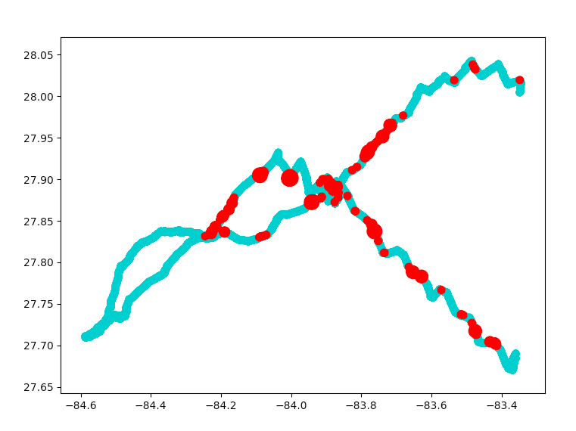
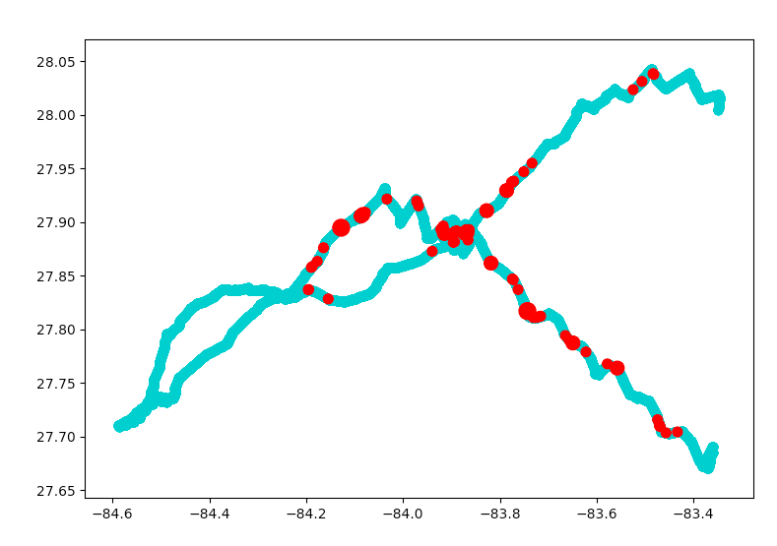
M70 – Feb 2017
Aft Recorder: Detected 230 Red Grouper Sounds
Dorsal Recorder: Detected 85 Red Grouper Sounds
1 minute every 10 minutes

Slide 4
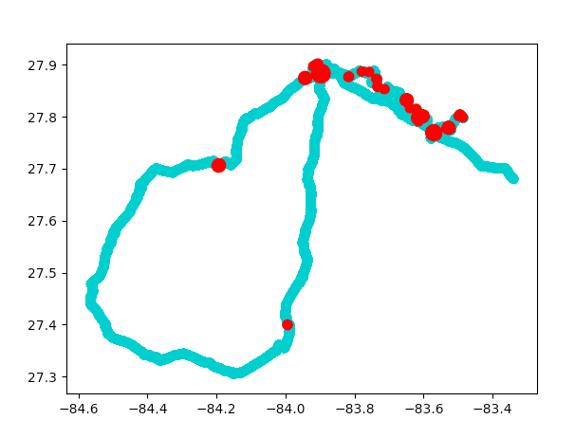
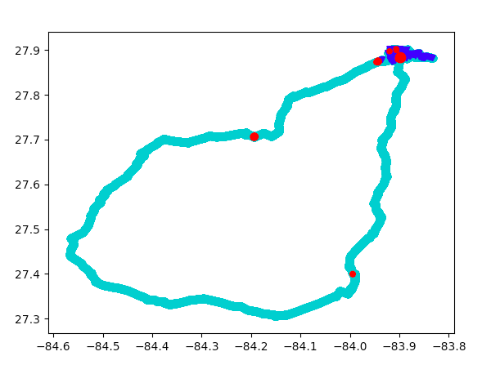
M72 – June 2017
Dorsal Recorder: Detected 72 Red Grouper Sounds
Overlaid with Vemco Detections (blue)
Note—time series available for Vemco was shorter, so beginning of glider deployment not shown

Slide 5
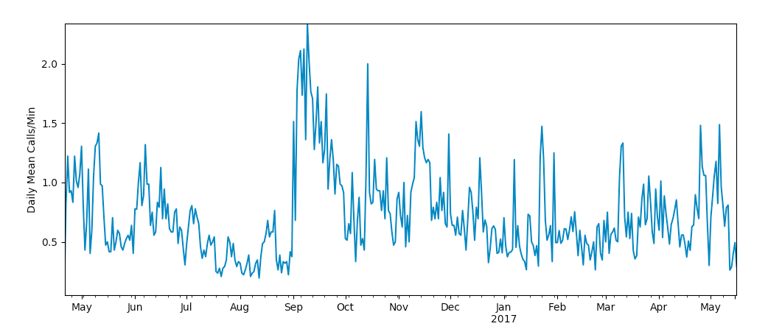
Yearlong time series of red grouper sound production at Vemco site

Slide 6
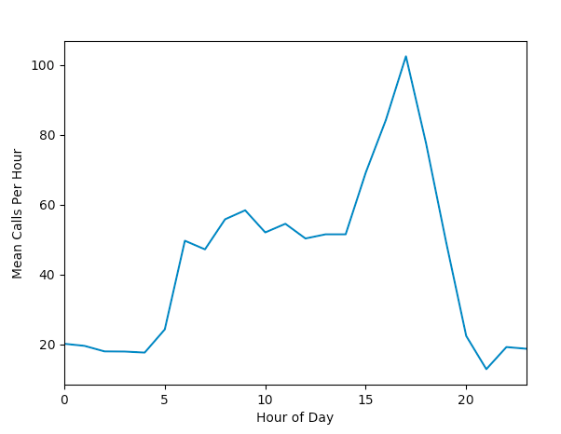
Red grouper mean calls per hour (ET)

