Slide 1

No Proxy
Request / Response
Publish / Subscribe
Requires a hole in the firewall for every client
Site A
Site B
Client
Remote Server
Client
Client
Client
Hash(MSG)

Slide 2
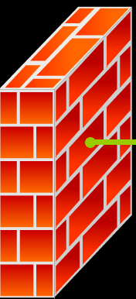
Proxy
Request / Response
Publish / Subscribe
Requires only one open port in the firewall
Site A
Site B
Client
Client
Remote Server
Proxy
Client
Client
Client

