Slide 1
DameGender
Towards an international and free dataset
about name, gender and frequency
(David Arroyo Menéndez)
davidam@gmail.com

Slide 2
Equality of gender is the fifth objective of sustainable development for
United Nations

Slide 3
This equality can be reached by measuring and analyzing data and making good politics with the results.

Slide 4
Many gender studies count males and females based on their names, for instance, research papers, job positions, streets, etc.

Slide 5
The traditional research method is to use commercial APIs with proprietary data without idea about how the data was collected. genderapi, genderize, namsor, nameapi, ...

Slide 6
DameGender approach about Open Data is based collecting Open Datasets regarding name, gender and frequency from many statistical institutions.

Slide 7
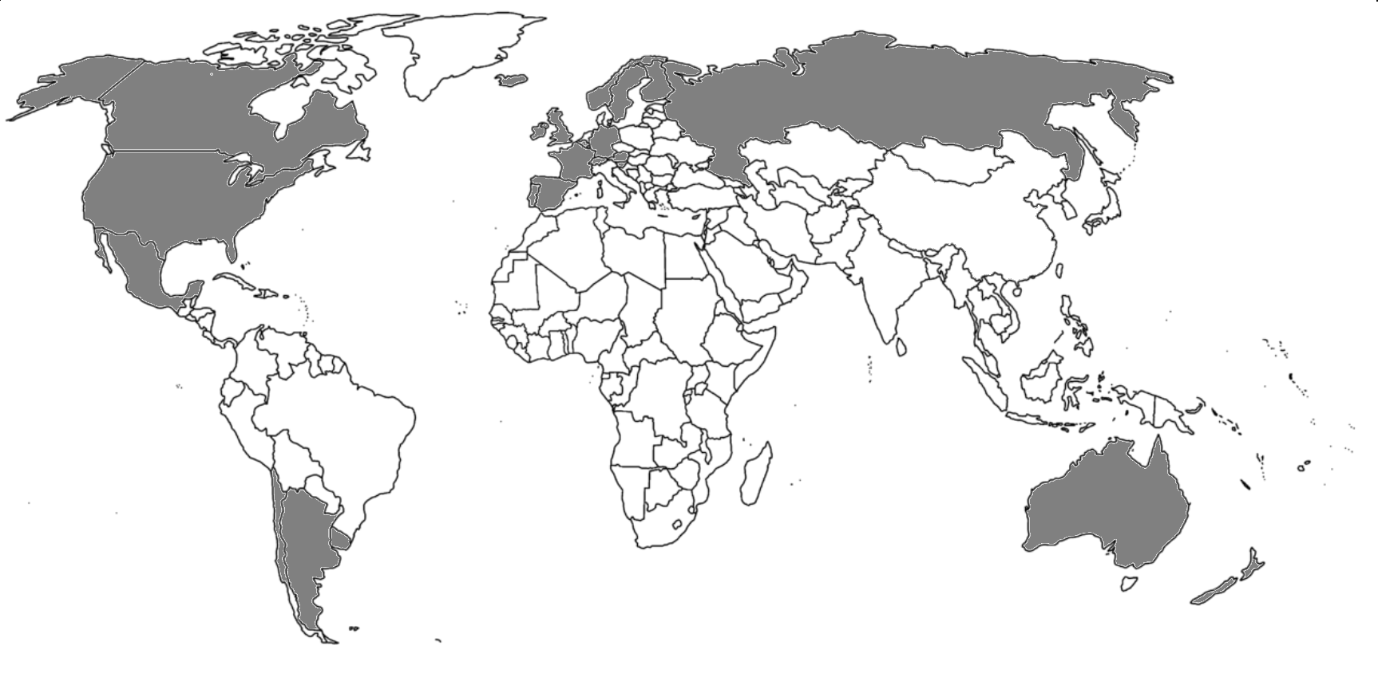
Take a look about our mapamundi!

Slide 8
Take a look about our accuracies!
Dataset Test | Damegender Accuracy
Scientists Wikipedia | 0.93
FIFA soccer | 0.93
WTA tenis | 0.91
National Leagues | 0.91
Baby Names New York | 0.98
Conseil Garonne | 0.97
Paul Sebo | 0.88
Lucia Santamaria | 0.88

Slide 9
Comparing Damegender Free Dataset in number of names
Free Dataset | Number of males | Number of females
USA census (SSA) | 91320 | 91320
Namdict (genderguesser) | 48821 | 48821
NLTK | 2943 | 5001
DameGender | 257925 | 304553

Slide 10
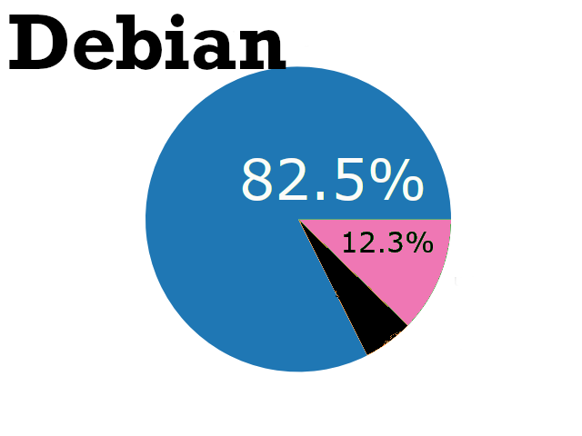
Counting males and females in Debian GNU/Linux
$ python3 csv2gender.py files/debian.csv –first_name_position=0 --title="Debian maintainers grouped by gender"
--dataset="inter" --outcsv="files/debian.gender.csv" --outimg="files/debian.gender.png"

Slide 11
DameGender will allow to measure gender gap to students and academics interested on the phenomenon without costs and on a reproducible way and more people will be contributing to fix the gender gap.

Slide 12
Thanks!!

