Slide 1
Scikit
Aplying Machine Learning
David Arroyo Menéndez

Slide 2

Scikit

Slide 3
Classification

Slide 4
Classification: SGD
We want predict a category and we’ve labeled data with <100k samples
$ python3 plot_sgd_iris.py
$ python3 sgd.py

Slide 5
Classification: Kernel approximation
We want predict a category and we’ve labeled data with <100k samples
and SGD is not working
$ python3 kernel-approximation.py

Slide 6
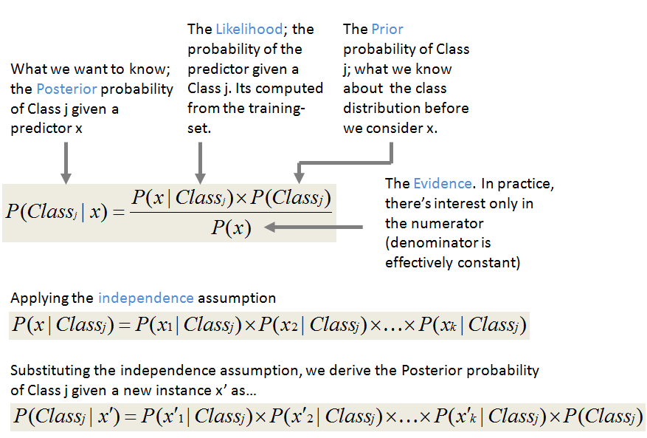
Classification: Naive Bayes

Slide 7
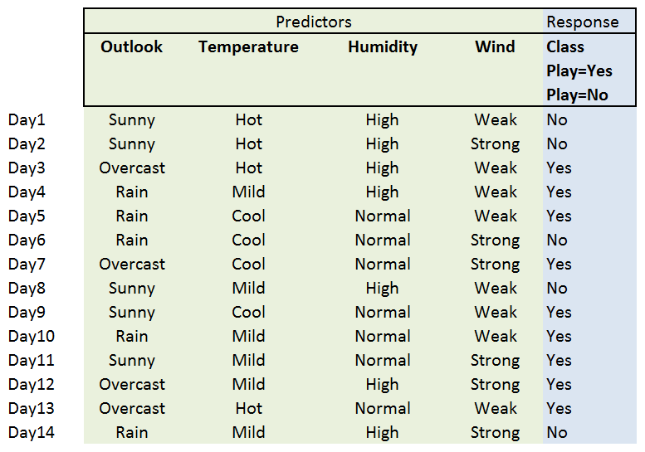
Classification: Naive Bayes

Slide 8
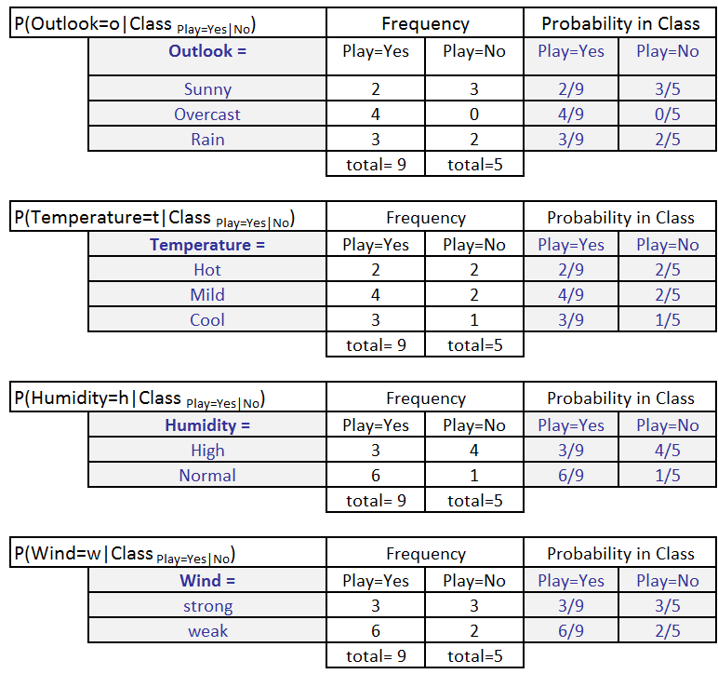
Classification: Naive Bayes

Slide 9
Classification: Naive Bayes
$ python3 gaussiannb.py
$ python3 bernoullinb.py
$ python3 multinomialnb.py
$ python3 nltk/sexmachine.py

Slide 10
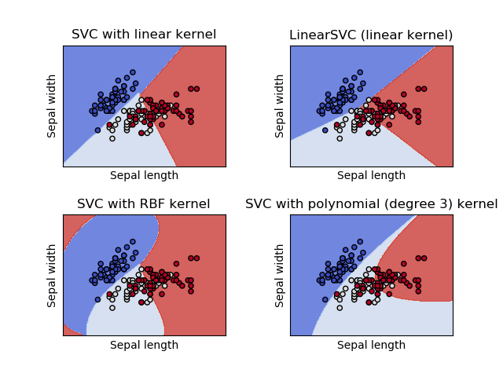
Classification: SVC
We want predict a category and we’ve labeled data with <100k samples

Slide 11
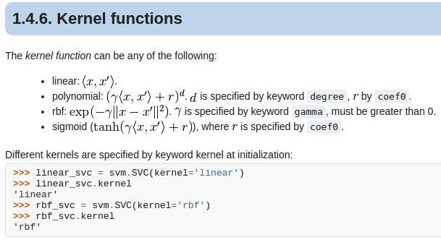
Classification: SVC
What is a kernel?

Slide 12
Classification: SVC
We want predict a category and we’ve labeled data with <100k samples
$ python3 svc-example.py

Slide 13
Classification: Trees
ID3: The algorithm creates a multiway tree, finding for each node (i.e. in a greedy manner) the categorical feature that will yield the largest information gain for categorical targets. Trees are grown to their maximum size and then a pruning step is usually applied to improve the ability of the tree to generalise to unseen data.
C4.5: is the successor to ID3 and removed the restriction that features must be categorical by dynamically defining a discrete attribute (based on numerical variables) that partitions the continuous attribute value into a discrete set of intervals.
CART: is very similar to C4.5, but it differs in that it supports numerical target variables (regression) and does not compute rule sets.

Slide 14
Classification: Trees (II)
$ python3 plot_iris1.py
$ python3 plot_unveil_tree_structure.py
$ python3 plot_classifier_comparison.py
http://scikit-learn.org/stable/modules/generated/sklearn.tree.DecisionTreeClassifier.html#sklearn.tree.DecisionTreeClassifier

Slide 15
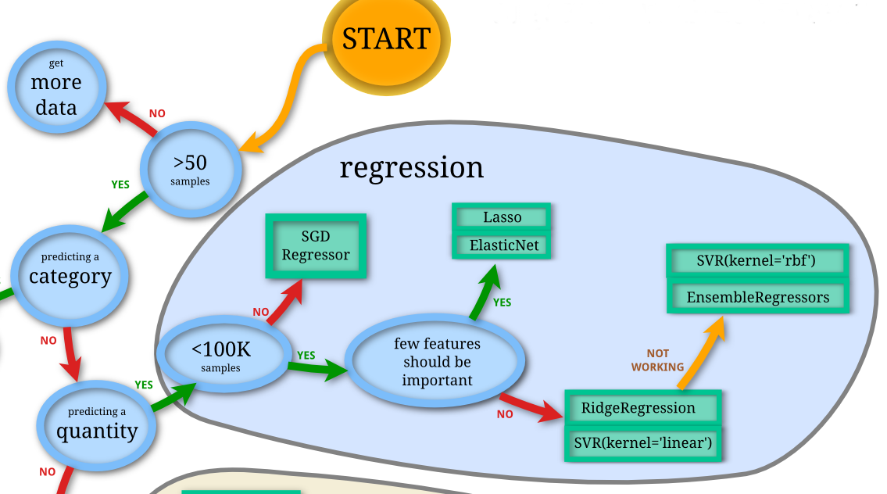
Regression

Slide 16
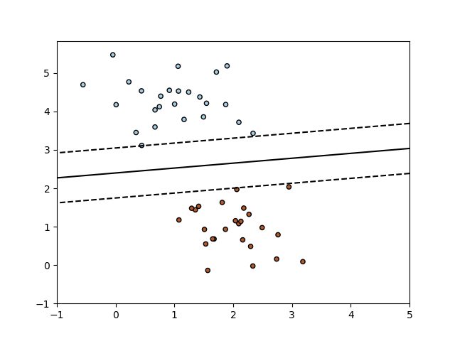
SGD Regressor
The class SGDClassifier implements a plain stochastic gradient descent learning routine which supports different loss functions and penalties for classification.

Slide 17
SGD Regressor
As other classifiers, SGD has to be fitted with two arrays: an array X of size [n_samples, n_features] holding the training samples, and an array Y of size [n_samples] holding the target values (class labels) for the training samples:
$ python3 plot_sgd_iris.py
$ python3 sgd.py

Slide 18
Lasso
Linear Model trained with L1 prior as regularizer (aka the Lasso)
The optimization objective for Lasso is:
(1 / (2 * n_samples)) * ||y - Xw||^2_2 + alpha * ||w||_1
Technically the Lasso model is optimizing the same objective function as the Elastic Net with l1_ratio=1.0 (no L2 penalty).
$ python3 plot_lasso_and_elasticnet.py
$ python3 plot_multi_task_lasso_support.py

Slide 19
Kernel Ridge
Kernel ridge regression (KRR) [M2012] combines Ridge Regression (linear least squares with l2-norm regularization) with the kernel trick. It thus learns a linear function in the space induced by the respective kernel and the data. For non-linear kernels, this corresponds to a non-linear function in the original space.
$ python3 plot_kernel_ridge_regression.py

Slide 20
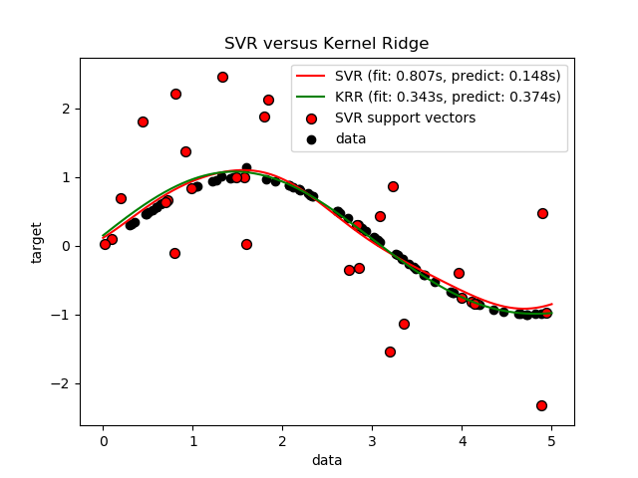
SVR: Support Vector Regression
The free parameters in the model are C and epsilon.
$ python3 svr-example.py

Slide 21
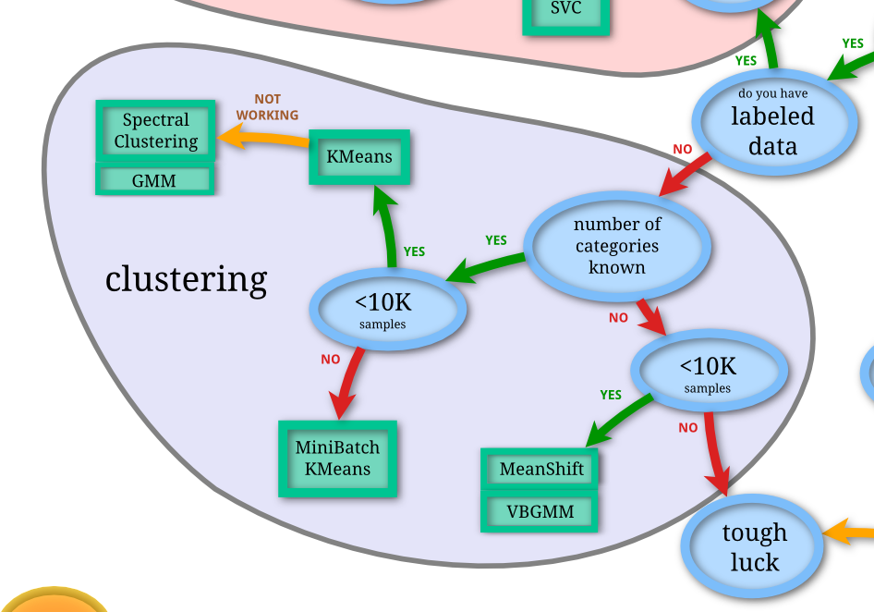
Clustering

Slide 22
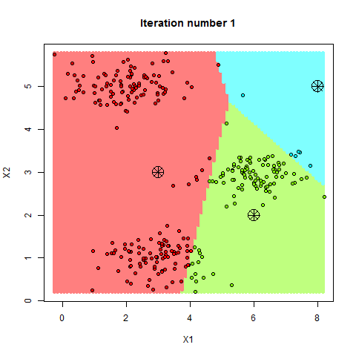
Kmeans

Slide 23
Kmeans
Subdivide the space making regions from reference points called centroides
$ python3 plot_kmeans_assumptions.py
$ python3 plot_cluster_iris.py

Slide 24
GMM
A typical finite-dimensional mixture model is a hierarchical model consisting of the following components:
N random variables that are observed, each distributed according to a mixture of K components, with the components belonging to the same parametric family of distributions (e.g., all normal, all Zipfian, etc.) but with different parameters
N random latent variables specifying the identity of the mixture component of each observation, each distributed according to a K-dimensional categorical distribution
A set of K mixture weights, which are probabilities that sum to 1.
A set of K parameters, each specifying the parameter of the corresponding mixture component. In many cases, each "parameter" is actually a set of parameters. For example, if the mixture components are Gaussian distributions, there will be a mean and variance for each component. If the mixture components are categorical distributions (e.g., when each observation is a token from a finite alphabet of size V), there will be a vector of V probabilities summing to 1.
$ python3 plot_gmm_covariances.py

Slide 25
Spectral Clustering
Make use of the spectrum (eigenvalues) of the similarity matrix of the data to perform dimensionality reduction before clustering in fewer dimensions
$ python3 plot_cluster_comparison.py

Slide 26
Mean Shift
Mean shift is a non-parametric feature-space analysis technique for locating the maxima of a density function, a so-called mode-seeking algorithm.
$ python3 plot_mean_shift.py

Slide 27
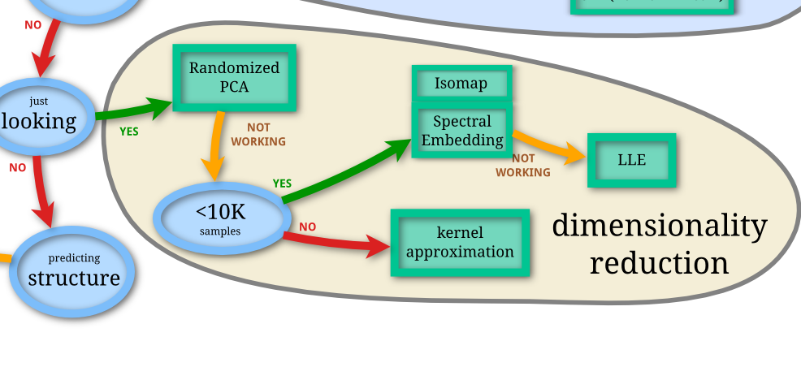
Dimensionality Reduction
The general task of pattern analysis is to find and study general types of relations (for example clusters, rankings, principal components, correlations, classifications) in datasets

Slide 28
Randomized PCA
PCA is mostly used as a tool in exploratory data analysis and for making predictive models. It's often used to visualize genetic distance and relatedness between populations. PCA can be done by eigenvalue decomposition of a data covariance (or correlation) matrix or singular value decomposition of a data matrix, usually after mean centering
$ python3 pca-example.py
$ python3 scikit-plot-pca.py
$ python3 plot_pca_iris.py
$ python3 incremental-pca.py

Slide 29
Kernel Approximation
The general task of pattern analysis is to find and study general types of relations (for example clusters, rankings, principal components, correlations, classifications) in datasets.
For many algorithms that solve these tasks, the data in raw representation have to be explicitly transformed into feature vector representations via a user-specified feature map: in contrast, kernel methods require only a user-specified kernel, i.e., a similarity function over pairs of data points in raw representation.
$ python3 kernel-approximation.py

Slide 30
LLE and Spectral Embedding
$ python3 plot_lle_digits.py
$ python3 plot_spectral_grid.py
Spectral embedding for non-linear dimensionality reduction.
Forms an affinity matrix given by the specified function and applies spectral decomposition to the corresponding graph laplacian. The resulting transformation is given by the value of the eigenvectors for each data point.

Slide 31
Isomap
Isomap Embedding
Non-linear dimensionality reduction through Isometric Mapping
$ python3 plot_compare_methods.py

Slide 32
Scikit Image
$ python3 plot_marching_cubes.py
$ python3

Slide 33
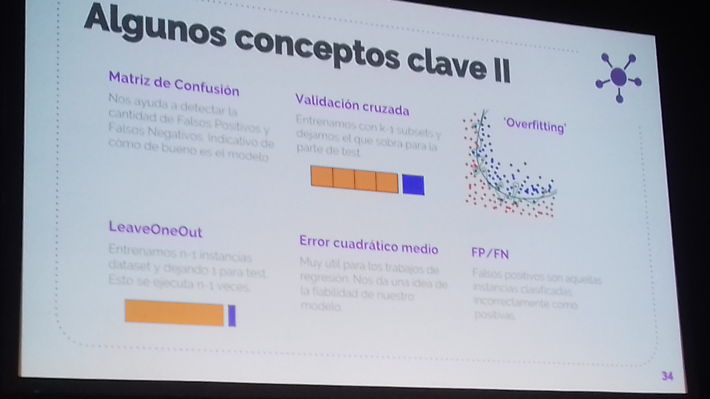
Conceptos Clave

Slide 34
Matriz de Confusión
Each row of the matrix represents the instances in a predicted class while each column represents the instances in an actual class
$ python3 plot_confusion_matrix.py

Slide 35
LeaveOneOut
$ python3 leaveoneout.py
$ python3 leavepout.py

Slide 36
Validación Cruzada
$ python3 crossvalidation.py
$ python3 repeatedkfold.py

Slide 37
Overfitting
$ python3 nooverfitting.py

Slide 38
Outliers
Son valores atípicos que se salen del doble de la desviación típica, por ejemplo.
$ python3 numpy/reject-outliers.py
$ python3 scikit/plot_outlier_detection_housing.pyo

