Slide 1
Static web generators and Python
David Arroyo Menéndez
d.arroyome@alumnos.urjc.es

Slide 2
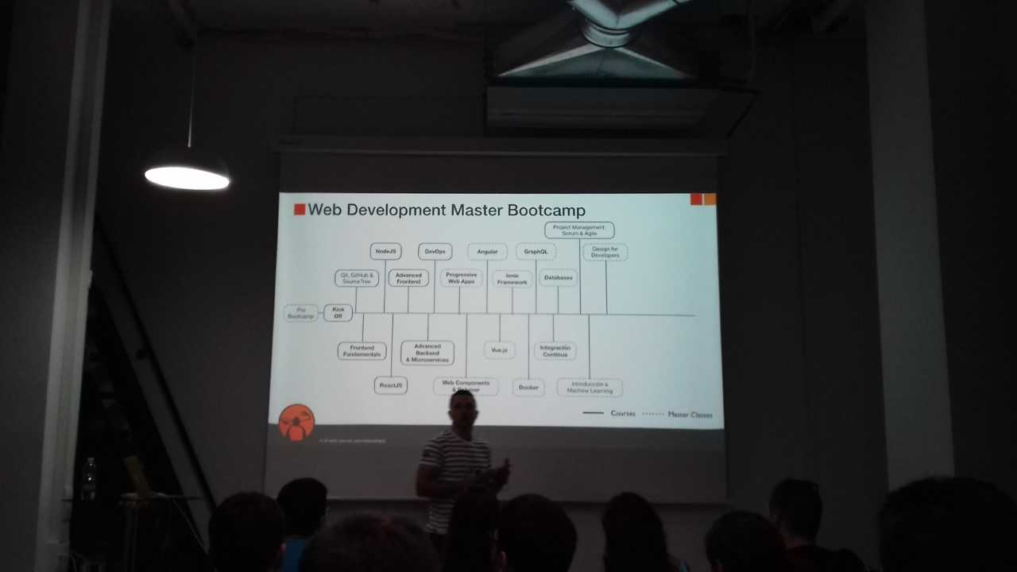
So you want make web publishing

Slide 3
No money! No time! Only HTML!
Do you remember the real problems?
Reuse text to avoid mistakes
HTML sometimes is complex to be read and write by a single human. Divide and simplify your HTML to conquer.
Another humans wants publish in your site

Slide 4
Four approaches to static web publishing
Only templates
Only simple text format.
Using a standard framework
Using a full static page generator

Slide 5
Only templates: a pythonic way
class CGImethod(object):
def __init__(self, title):
self.title = title
def __call__(self, fn):
def wrapped_fn(*args):
print("Content-Type: text/html\n\n")
print("<HTML>")
print("<HEAD><TITLE>{}</TITLE></HEAD>".format(self.title))
print("<BODY>")
try:
fn(*args)
except Exception as e:
print(e)
print("</BODY></HTML>")
return wrapped_fn
@CGImethod("Hello with Decorator")
def say_hello():
print('<h1>Hello from CGI-Land</h1>')
say_hello()
@CGImethod("Hello with Decorator")
def say_hello2():
print('<h1>Hello from CGI-Land</h1>\n' '<p>and paragraph</p>')
class CGImethod(object):
def __init__(self, title):
self.title = title
def __call__(self, fn):
def wrapped_fn(*args):
print("Content-Type: text/html\n\n")
print("<HTML>")
print("<HEAD><TITLE>{}</TITLE></HEAD>".format(self.title))
print("<BODY>")
try:
fn(*args)
except Exception as e:
print(e)
print("</BODY></HTML>")
return wrapped_fn
@CGImethod("Hello with Decorator")
def say_hello():
print('<h1>Hello from CGI-Land</h1>')
say_hello()
@CGImethod("Hello with Decorator")
def say_hello2():
print('<h1>Hello from CGI-Land</h1>\n' '<p>and paragraph</p>')

Slide 6
Only templates: a pythonic way (II)
Advantages:
Full control over source
Disvantages
HTML is more complex than a structured wiki format, such as, markdown or orgmode.

Slide 7
Only simple text format
MARKDOWN
$ git clone https://github.com/trentm/python-markdown2.git
$ cd python-markdown2/bin
$ ./markdown2 ../README.md > /tmp/README.html
ORGMODE
org-html-export-to-html
WORG is a orgmode git wiki

Slide 8
Build from your framework
FLASK
$ git clone https://github.com/davidam/libremanuals.github.io
$ cd libremanuals.github.io/source
$ python3 libremanuals.py # launch the server
$ ./update-libremanuals.sh # create the static pages
Advantages
Solved standard web programming troubles such as i18n or templating
Disvantages
You must learn the framework in the core to extend the framework

Slide 9
Enjoy a full static page generator
PELICAN
$ make html
pelican /home/davidam/tmp/content -o /home/davidam/tmp/output -s /home/davidam/tmp/pelicanconf.py
Done: Processed 2 articles, 0 drafts, 0 pages, 0 hidden pages and 0 draft pages in 0.08 seconds.
$
Advantages
All problems generating static pages is solved
Commands to publish in standard sites (ssh, ftp, dropbox, github, etc.)
Support to orgmode, or markdown in a templating system
Disvantages
You must learn config, plugins and commands
You are not the real programmer
There are different options: pelican, jekyll, …
When you learn the code you are not learning a standard

