Slide 1
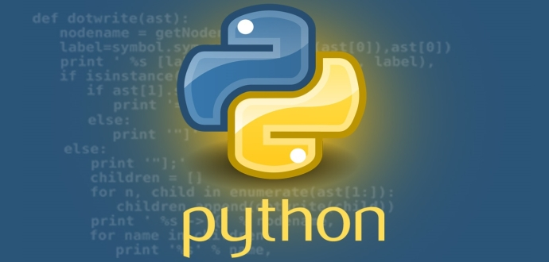
Python Course
David Arroyo Menéndez
2021

Slide 2
Index
1. VirtualEnvs
2. Pytest
3. Basics (I): Sintaxis and Control Structures
4. Basics (II): datastructures (list, dict, set, tuple)
5. JSON and YAML
6. Request
7. PEP8
8. BBDD

Slide 3
VirtualEnv
$ mkdir /tmp/venv
$ python3 -m venv /tmp/venv
$ cd /tmp/venv
$ source bin/activate
$ pip3 install damelibraries

Slide 4
Basics: Sintaxis and Control Structures
$ git clone https://github.com/davidam/damebasics
$ cd damebasics/damebasics
$ pytest-3 test/test_control_structures.py

Slide 5
Basics: Sintaxis and Control Structures
$ pytest-3 test/test_lists.py
$ pytest-3 test/test_set.py

Slide 6
JSON and YAML
$ pip3 install damejson
$ pytest-3 test/test_damejson.py

Slide 7
Requests
$ pip3 install damescraping
$ pytest-3 test/test_request.py

Slide 8
PEP8
https://www.python.org/dev/peps/pep-0008/

Slide 9
BBDD
$ pip3 install damedb
$ pytest-3 tests

Slide 10
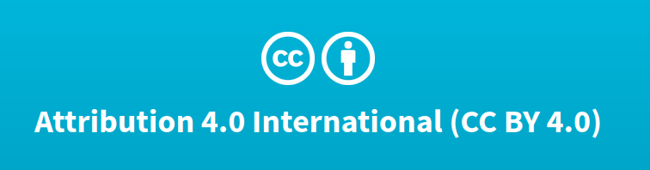
License
Thanks for your attention
© David Arroyo Menéndez. 2021

