Slide 1
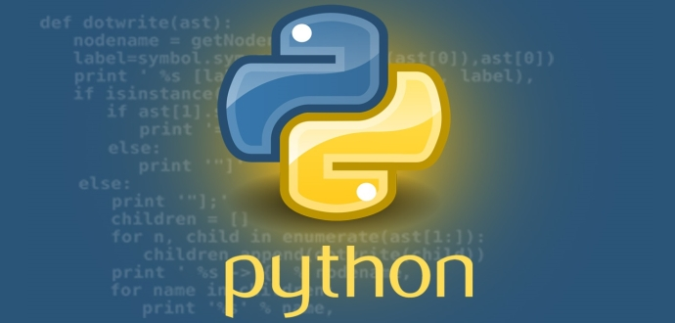
Python
David Arroyo Menéndez
Abril 2018

Slide 2
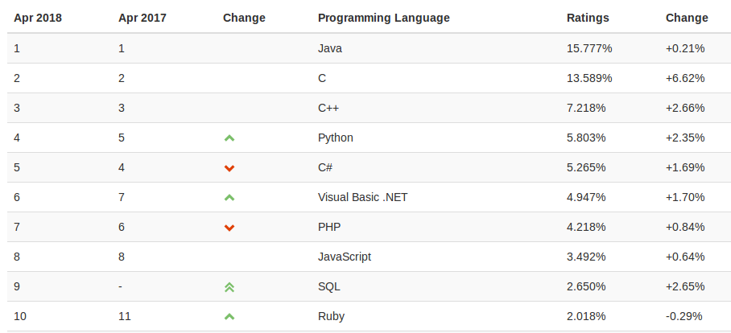
Top Most Popular Languages (2018)

Slide 3
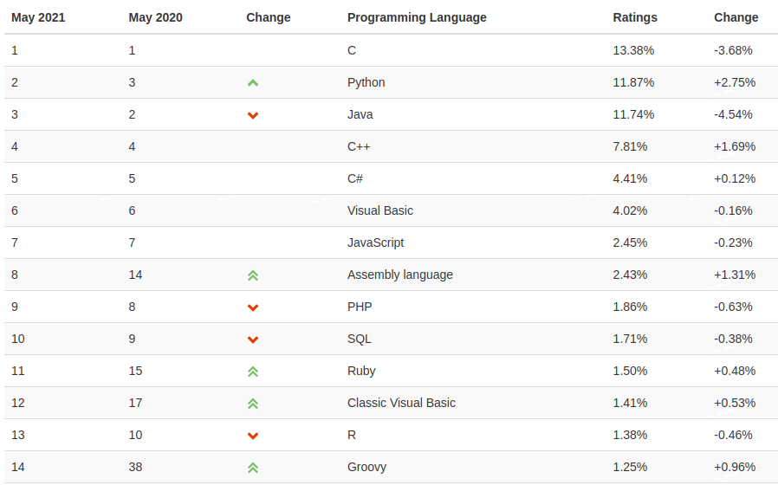
Top Most Popular Languages (2021)

Slide 4
Deciding for a programming language
Mathematical features: poo, functional, imperative, …
Industries to be winner: sys admins, web developers, science, operating systems, guis, …
Interpreter / Compiler
It must be useful to me

Slide 5
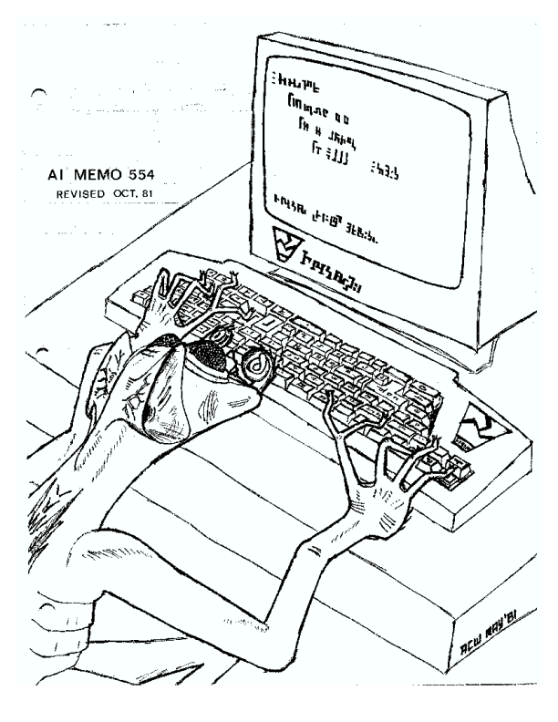
A tale about scripting languages

Slide 6
Lisp says
I hate compile programs for the machine, I will invent the interpreter.
I will organize the the programming with classes and objects and we will invent the guis
I love the philosophy about the mind, I will invent the artificial intelligence

Slide 7
TCL said
The programming languages in the future will be scripting programming languages.
We will write TK to reach this objective.
http://ieeexplore.ieee.org/abstract/document/660187/?reload=true

Slide 8
Stallman said
Why you should not use Tcl
Richard Stallman, GNU Project
As interest builds in extensible application programs and tools, and
some programmers are tempted to use Tcl, we should not forget the
lessons learned from the first widely used extensible text
editor--Emacs.
The principal lesson of Emacs is that a language for extensions should
not be a mere "extension language". It should be a real programming
language, designed for writing and maintaining substantial programs.
Because people will want to do that!
Extensions are often large, complex programs in their own right,
and the people who write them deserve the same facilities
that other programmers rely on.
The programming languages in the future will be scripting programming languages.
https://wiki.tcl.tk/16730

Slide 9
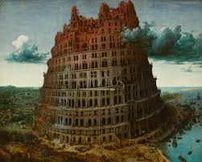
The scripting programming languages wars is served

Slide 10

PHP said
I will be an elephant and
I will govern in the web programming

Slide 11

GNU Bash said
I will be a shell and
I will automate small task
for the system administrators

Slide 12

GNU R said
I will be consonant (erre que erre) and
I will be the language of the statistics

Slide 13

Ruby said
I want earn all rubies in the world
With my rails,
I will earn the innovation in the web programming
And later all world!!!

Slide 14
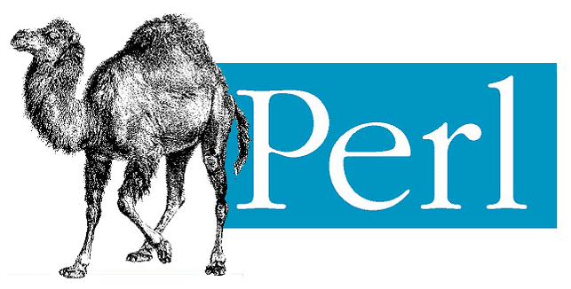
Perl said
I want earn all perls in the world
I will start administering unix systems,
And later all world!!!

Slide 15

Python said
I live in the desert I have poison against
animals near to me

Slide 16
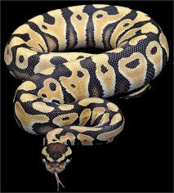
Python is the most popular scripting programming language today
You can use google trends or other statistics
to measure popularity in specific areas

Slide 17
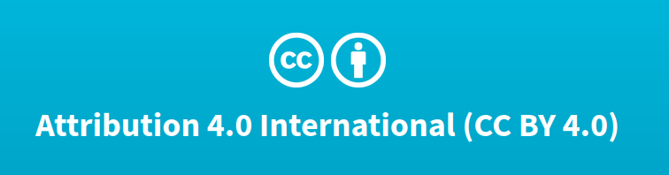
License
Thanks for your attention
© David Arroyo Menéndez. 2021

