Slide 1
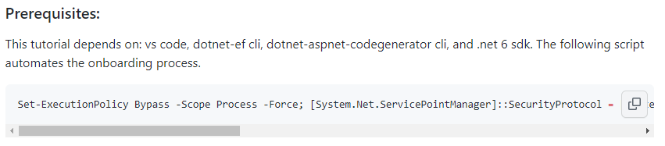
Onboarding Automation
Chocolatey
VS Code
.NET 6 SDK
EF CLI
Code Generator CLI
Navigate to github.com/davidamdev/MVC-EzE-T
Copy onboarding automation script from the “Prerequisites” section
Open PowerShell as Administrator
Paste onboarding automation script into PowerShell terminal
And wait…

Slide 2
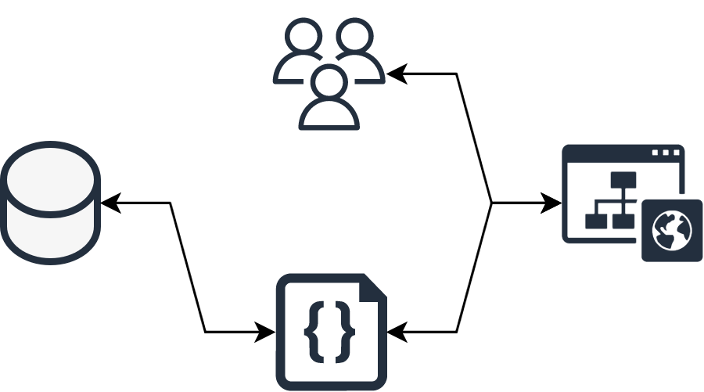
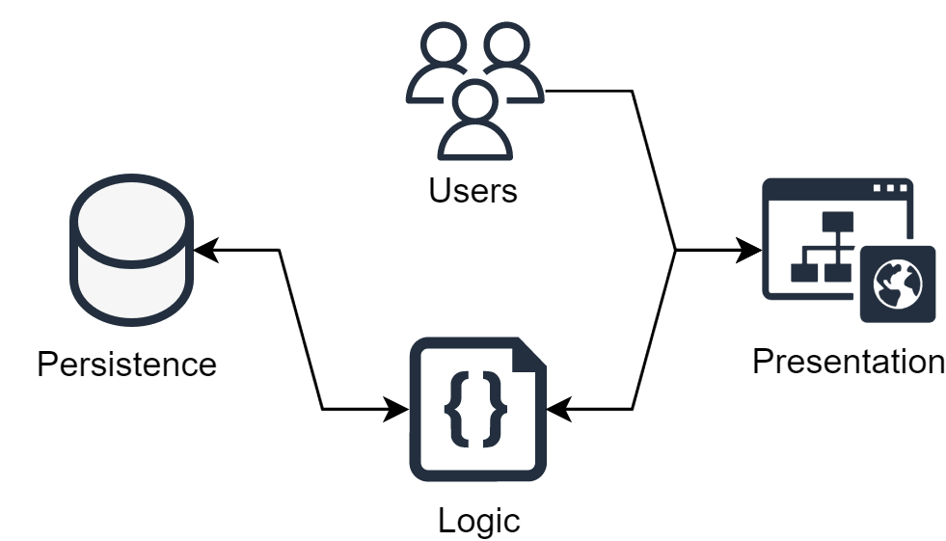
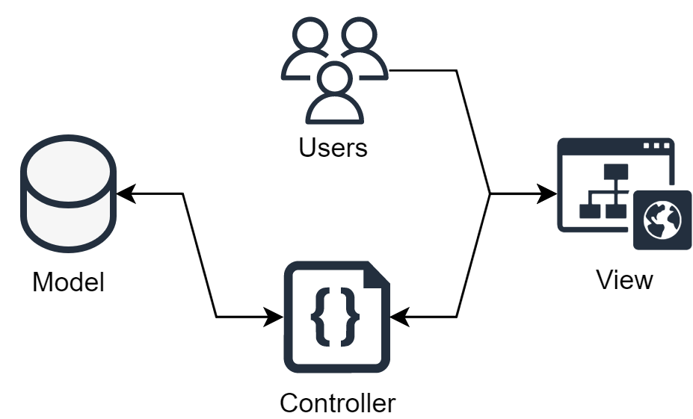
Model View Controller

Slide 3
Steps
Create a new project
Install dependencies
Create a class
Connect database
Scaffolding

