Slide 1

amenda
Chen Wei is the founder of a lean 30-person tech startup, PivotStack Pte Ltd. His law firm drafted a suite of employment contracts 18 months ago. Because the startup moves fast and Chen wants to manage headcount tightly, the law firm included two clauses on his instruction:
A "maximum engagement age" clause — specifying that employment automatically terminates upon the employee reaching age 62, without further notice.
A "no-grievance" clause — stating that employees waive the right to raise internal disputes regarding termination decisions

Slide 2
amenda
These contracts are sitting in the law firm's file, ready to be sent out to three new hires next week.

Slide 3
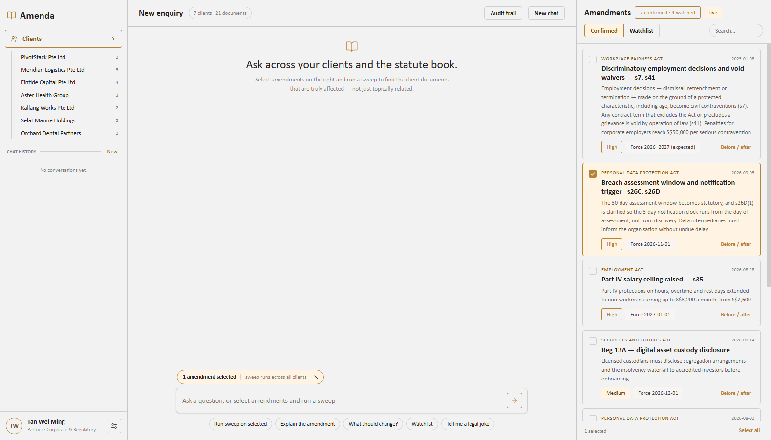
amenda
THE FIRM'S FILE
Seven clients. Twenty-one documents. One statute book.
Amenda sits inside the firm's existing workflow. The right panel tracks bills live from parliament.gov.sg.

Slide 4
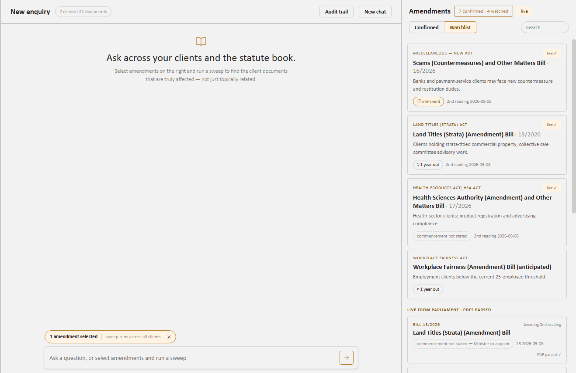
amenda
FEATURE 1 — THE THREE STAGES
First reading, second reading, commencement
Scraped live from Parliament, each bill's PDF parsed for its commencement clause. Where the Minister has given no date, Amenda says so rather than guessing.

Slide 5
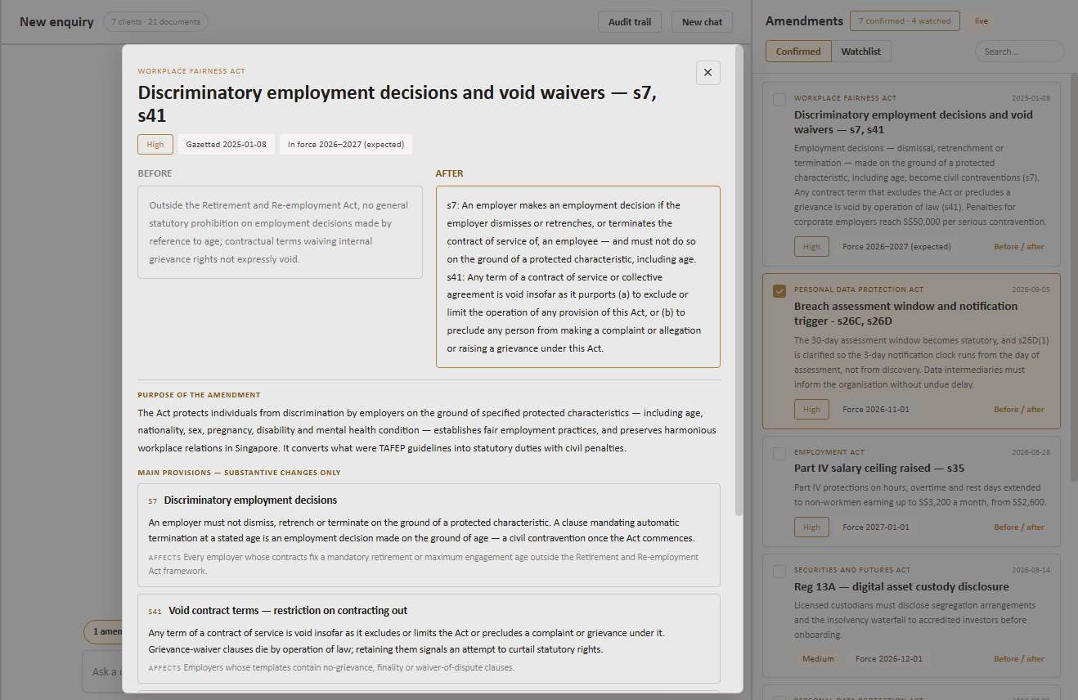
amenda
FEATURE 1 — READING THE BILL
The 200-page bill, reduced to what changed
Purpose and main provisions are drawn only from the Explanatory Statement — definitions and consequential amendments excluded.

Slide 6
amenda
CLAUSE 8.3 — Before (Old Draft)
"This Agreement shall automatically terminate without notice upon the Employee attaining the age of sixty-two (62) years”
CLAUSE 14.1 — Before (Old Draft)
"The Employee hereby waives any right to raise internal disputes or grievances in connection with any decision made by the Employer regarding the Employee's terms of employment or termination thereof."

Slide 7
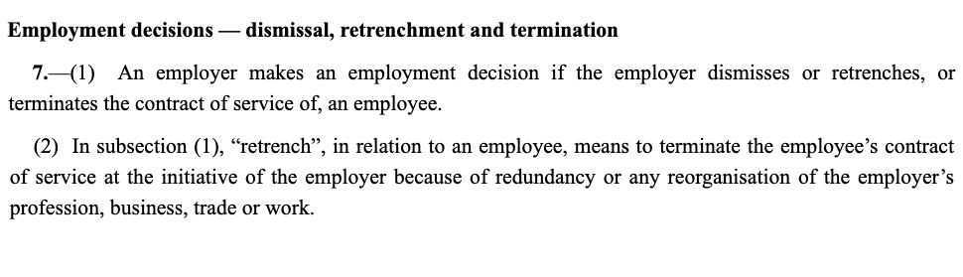
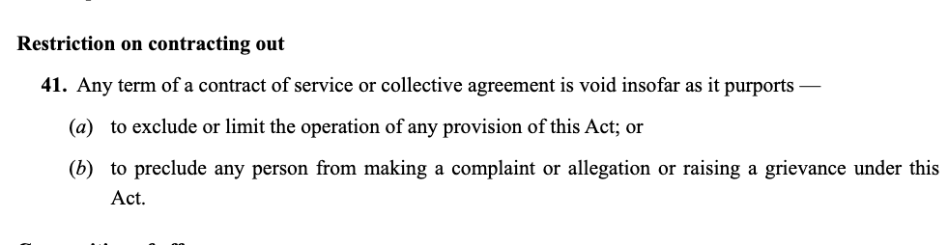
amenda

Slide 8
amenda
HIGH RISK — Clause 8.3 (Automatic Termination at Age 62)
Direct conflict with s.7 WFA — age is a protected characteristic. Mandatory termination tied solely to age constitutes a discriminatory employment decisi
HIGH RISK — Clause 14.1 (Waiver of Grievance Rights)
Directly voided by Clause 41 WFA. Any term preventing an employee from raising a grievance under the Act is rendered void by operation of law.

Slide 9
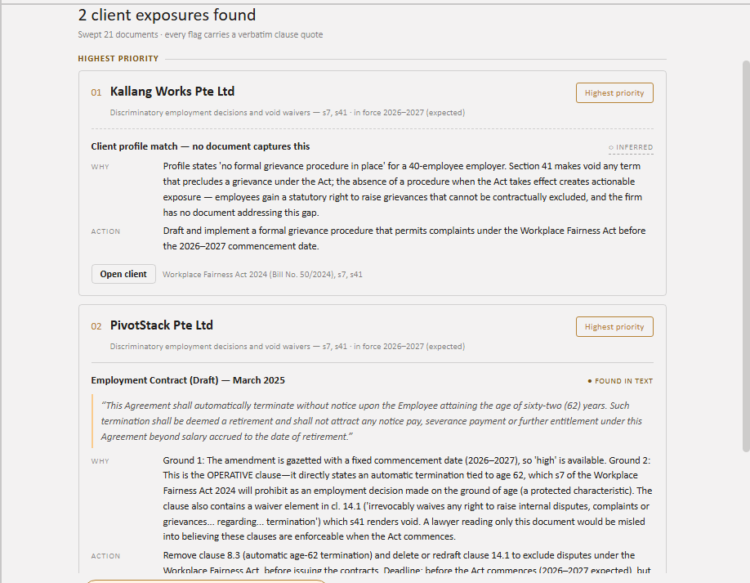
amenda
FEATURE 2 — THE SWEEP
Two exposures, found two different ways
PivotStack is caught in the document — clause 8.3 quoted verbatim. Kallang Works is caught by profile: 40 staff, no grievance procedure, and no document mentioning one.

Slide 10
CLAUSE 8.3 — Amenda's Suggested Replacement ✅
"The Employer may review the Employee's continued engagement upon the Employee attaining the statutory retirement age as prescribed under the Retirement and Re-employment Act (Cap. 274A), and any decision regarding the continuation, variation or termination of employment shall be made on the basis of the Employee's performance, operational requirements of the Company, and other non-discriminatory grounds, in compliance with the Workplace Fairness Act 2024

Slide 11
CLAUSE 14.1 — Amenda's Suggested Replacement ✅
"The Employer shall maintain an internal grievance handling process in accordance with the Workplace Fairness Act 2024. Employees are encouraged to utilise this process to raise concerns regarding their terms of employment. Nothing in this Agreement shall be construed to limit any rights conferred upon the Employee under applicable legislation, including the Workplace Fairness Act 2024."

Slide 12
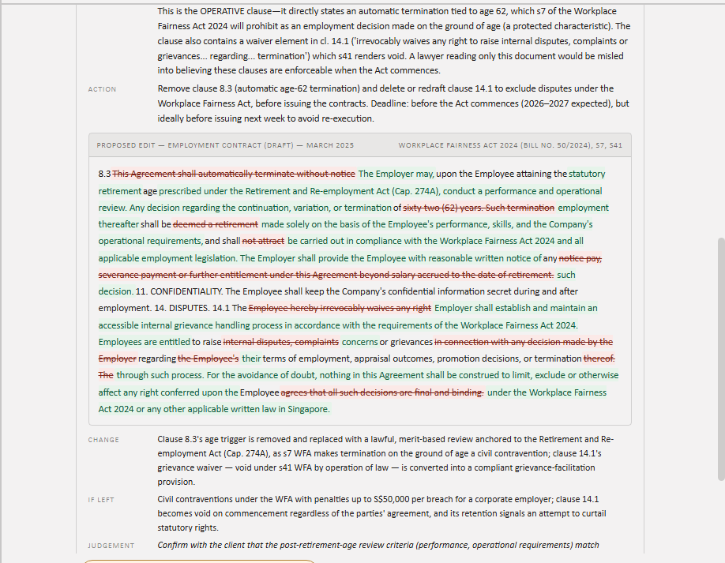
amenda
FEATURE 2 — THE REDLINE
Both clauses, one tracked-changes diff
Red struck out, green inserted. Underneath: what changed, what it costs to leave it, and what still needs the lawyer's judgement.

Slide 13
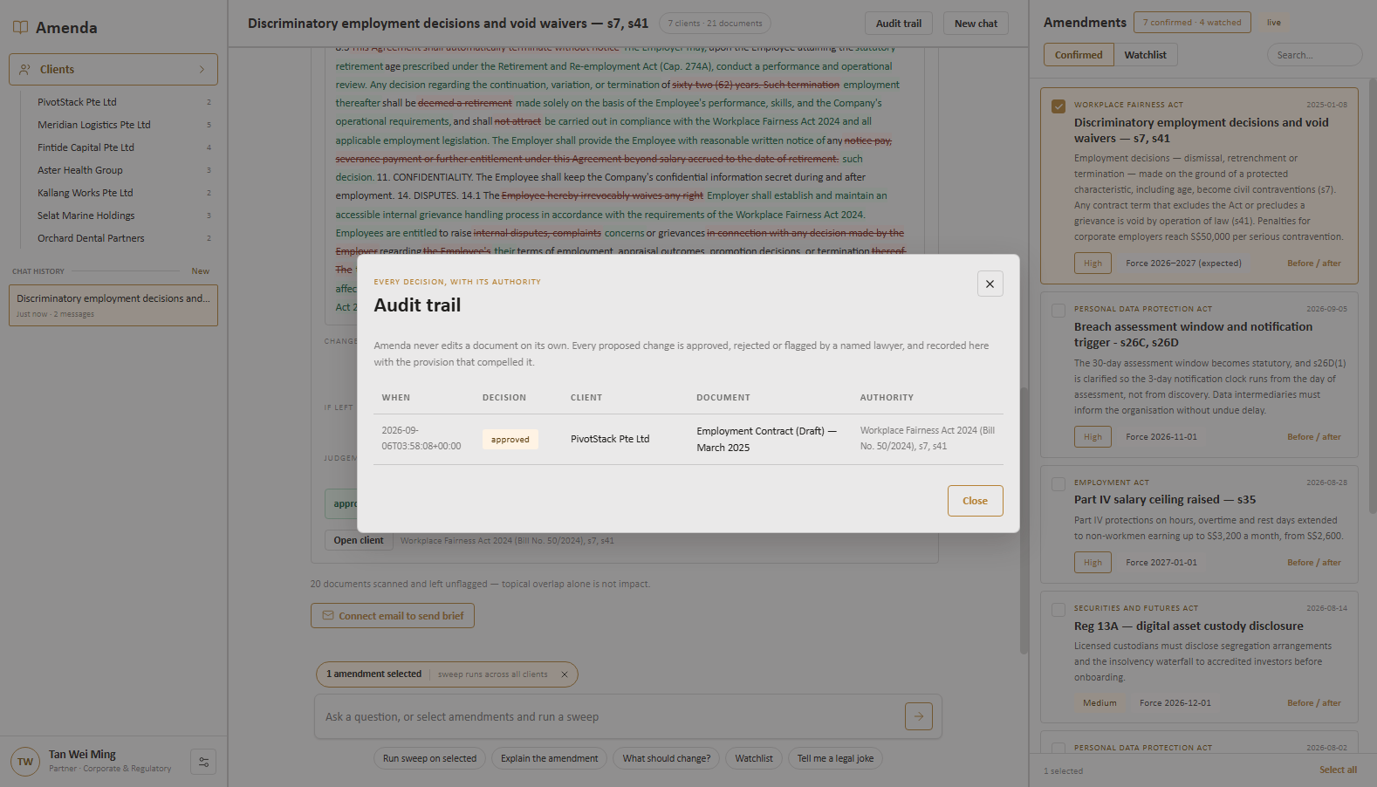
amenda
THE RECORD
Every decision, with its authority
Amenda never edits a document on its own. Each change is approved, rejected or flagged by a named lawyer — and logged with the provision that compelled it.

