Slide 1
Advances in Integrated Assessment Modeling

Slide 2
Schedule
8:00-8:30 Welcome
8:30-9:45 IAMs in the Policy Process (Kopits)
9:45-10:30 Hands-on session 1 (Anthoff)
10:30-10:45 Coffee break
10:45-12:00 IAMs for local pollution problems (Muller)
12:00-1:30 Lunch
1:30-2:15 IAMs in climate economics and the SCC (Anthoff)
2:15-3:30 Hands-on session 2 (Anthoff)
3:30-3:45 Coffee break
3:45-5 Representing Climate Damages in IAMs (Moore)

Slide 3
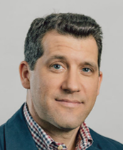
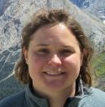
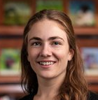
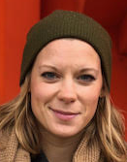
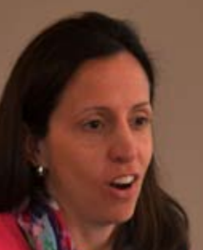
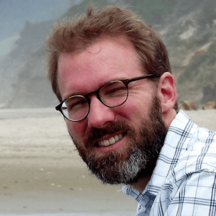
Team
Cora Kingdon
(RFF)
Nicholas Muller
(Carnegie Mellon)
Fran Moore (UC Davis)
Lisa Rennels
(UC Berkeley)
Elizabeth Kopits (EPA)
David Anthoff
(UC Berkeley)

Slide 4
Sponsors and Thanks
Sponsors:
AERE
RFF
Sloan Foundation
Thanks to Max Auffhammer, Daniel Phaneuf and the AERE management team for general help and advice.

Slide 5
Random remarks
Ground rule: please be positive and supportive of each other!
Use the breaks and lunch to meet new folks and chat with the instructor team!

