Slide 1
IAMs in climate economics and the SCC
David Anthoff
Energy and Resources Group
University of California, Berkeley

Slide 2
Outline
What is the SCC?
Definition
Integrated assessment models
What determines the SCC?
Current research issues
Current research efforts

Slide 3
Definition

Slide 6
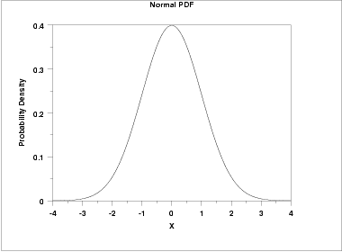
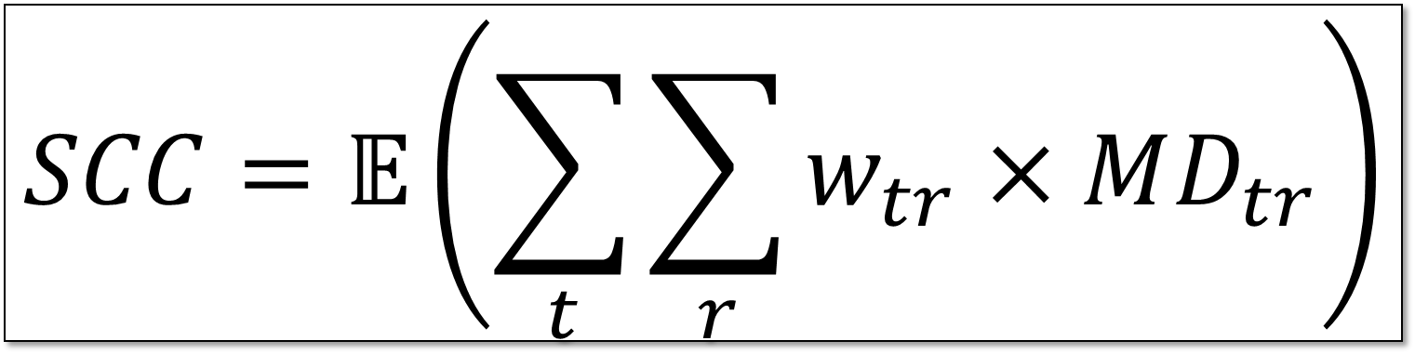
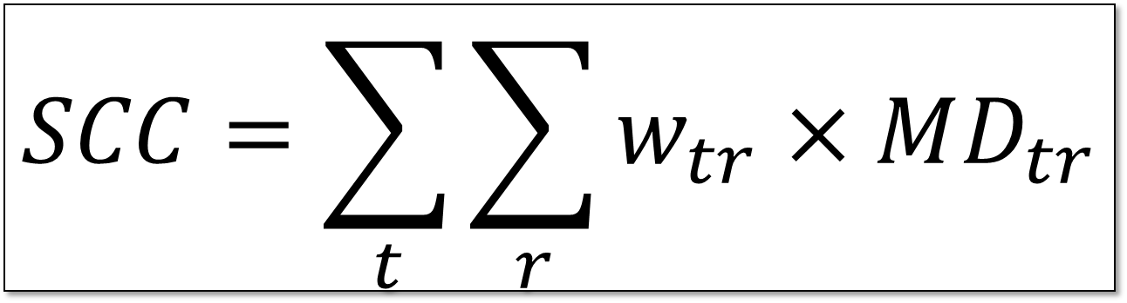
Marginal damage
 | USA | Europe | China | …
2010 | $0.20 | $0.03 | $0.12 | …
2011 | $0.20 | $0.04 | $0.12 | …
2012 | $0.30 | $0.05 | $0.13 | …
2013 | $0.40 | $0.05 | $0.14 | …
2014 | $0.50 | $0.06 | $0.15 | …
2015 | $0.60 | $0.07 | $0.16 | …
2016 | $0.70 | $0.08 | $0.17 | …
2017 | $0.80 | $0.09 | $0.18 | …
…. | … | … | … | …
$$SCC=𝔼\left(\sum_{t}{\sum_{r}{w_{tr}×MD_{tr}}}\right)$$
$$SCC=\sum_{t}{\sum_{r}{w_{tr}×MD_{tr}}}$$

Slide 7
Integrated assessment models

Slide 8
Atmospheric chemistry
Concentrations
Emissions
Climate change
Economy
Physical impact
$ Damage
Impacts
Population
Mortality

Slide 9
Atmospheric chemistry
Concentrations
Emissions
Climate change
Economy
Physical impact
$ Damage
Impacts
Population
Mortality

Slide 10
Atmospheric chemistry
Concentrations
Emissions
Climate change
One sector growth model
Recursive CGE models
Hybrids
Economy
Physical impact
$ Damage
Impacts
Population
Mortality

Slide 11
Atmospheric chemistry
Concentrations
Emissions
Climate change
Simple
CO₂
More complex
CH₄
N₂O
SF₆
Economy
Physical impact
$ Damage
Impacts
Population
Mortality

Slide 12
Atmospheric chemistry
Concentrations
Emissions
Simple
Temperature
More complex
Temperature
Sea-level rise
Biodiversity
Future
Precipitation
Ocean acidification
Climate change
Economy
Physical impact
$ Damage
Impacts
Population
Mortality

Slide 13
Atmospheric chemistry
Concentrations
Emissions
Climate change
Biosphere feedbacks
Economy
Physical impact
$ Damage
Impacts
Population
Mortality

Slide 14

Atmospheric chemistry
Concentrations
Emissions
Climate change
Simple
One aggregate function (e.g. $0.0028388×T^{2}$)
More complex
Damage function per type of impact (e.g. ag, slr, health)
Most complex
Interactions between sectors
Economy
Physical impact
$ Damage
Impacts
Population
Mortality

Slide 15
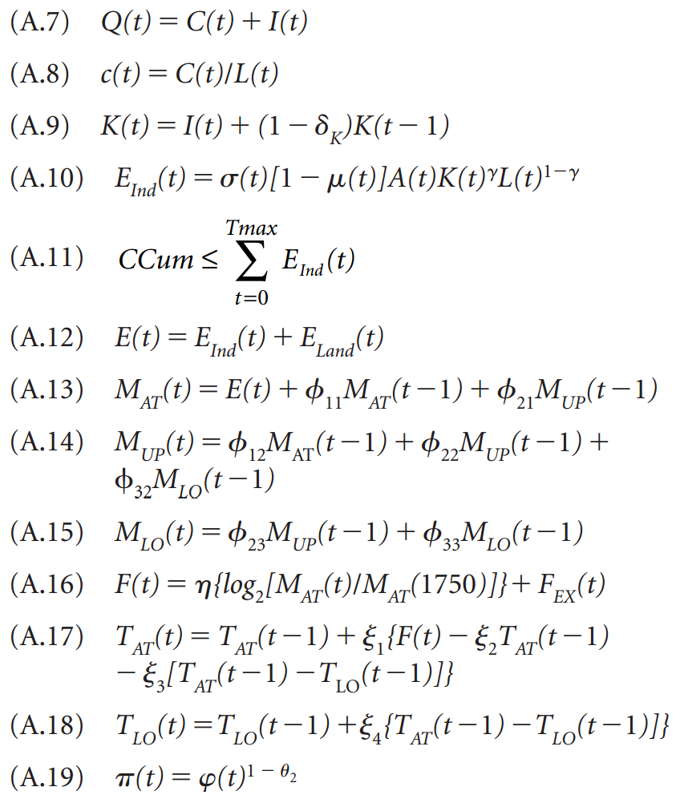
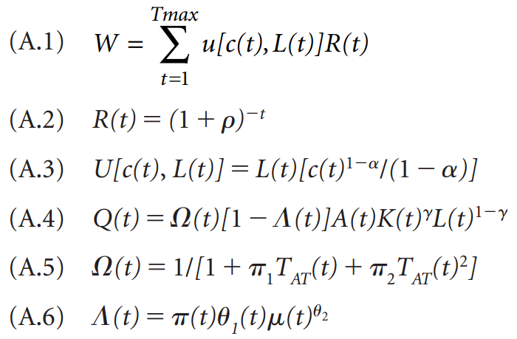
DICE-2007

Slide 16
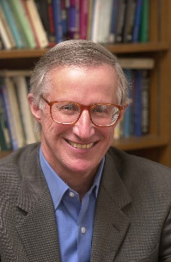


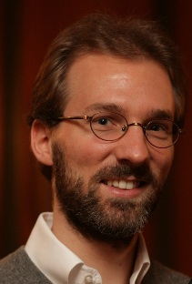
Sources of published SCC estimates
Surveys, “meta-studies”
DICE/RICE Bill Nordhaus
PAGE Chris Hope
FUND Richard Tol & me
Parametric variations
Simplified versions

Slide 17
Outline
What is the SCC?
What determines the SCC?
Model choice
Discount rate
Equity
Damage function
Uncertainty
Current research issues
Current research efforts

Slide 18
Model choice & discount rate
& some other sensitivities

Slide 19
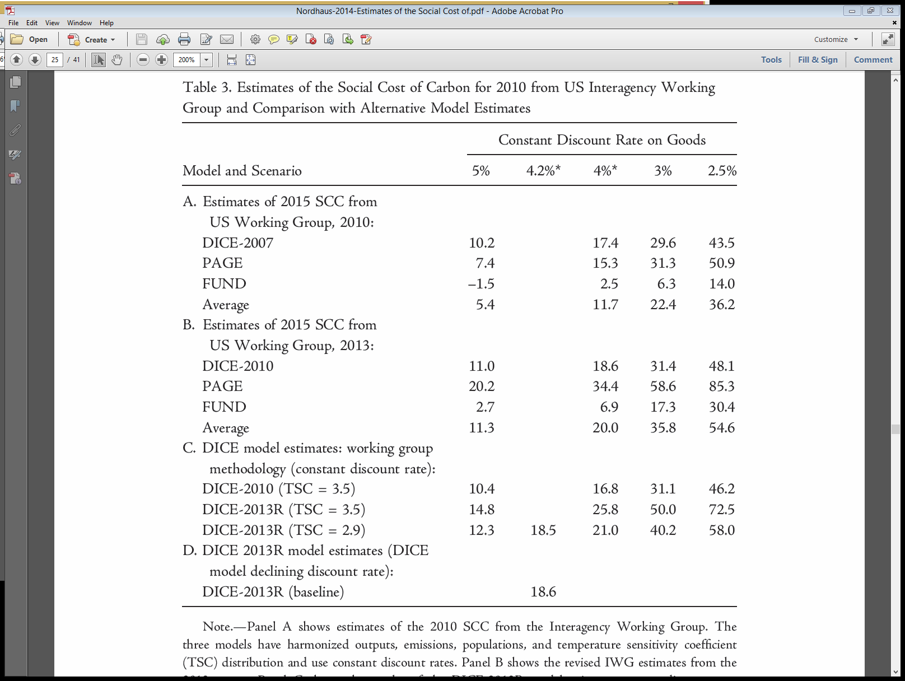
Source: Nordhaus (2014)

Slide 20
Waldhoff et al. (forthcoming)

Slide 21
Discounting

Slide 22
Discounting & aggregation
Opportunity cost approach: we don’t want to waste resources, but try to stay out of distributional judgements (some variant of Kaldor Hicks)
Social Welfare approach: we take an ethical stance, encoded as a particular Social Welfare Function

Slide 23
Opportunity cost approach
We should use the rate of return of other investments as our discount rate (what else could we have done?)
1) So we need a forecast of interest rates
2) And we need to figure out which interest rate is the relevant one
For 1), we could in principle use many different methods, but in the IAM literature with a neo classical growth core, the interest rate is determined endogenously (using the Ramsey rule). Note that the Ramsey rule might appear normative, but it is NOT in this approach
Question 2) has received a lot less attention, but there is a small literature on the climate beta

Slide 24
Social Welfare approach
You start with a Social Welfare Function, and derive your weights/discount factors from that
A particular case of SWF that exhibits aversion to inequality between individuals runs under the term “equity weighting” in the climate literature
Core idea is that of declining marginal welfare of consumption

Slide 25
Damage function

Slide 26

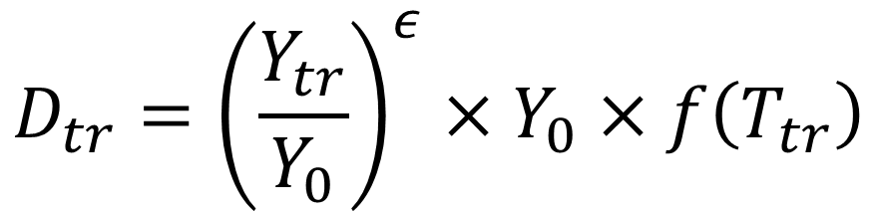

$$f\left(T\right)=αT^{2}$$
$$D_{tr}=Y_{tr}×f\left(T_{tr}\right)$$
$$D_{tr}={\left(\frac{Y_{tr}}{Y_{0}}\right)}^{ε}×Y_{0}×f\left(T_{tr}\right)$$

Slide 27
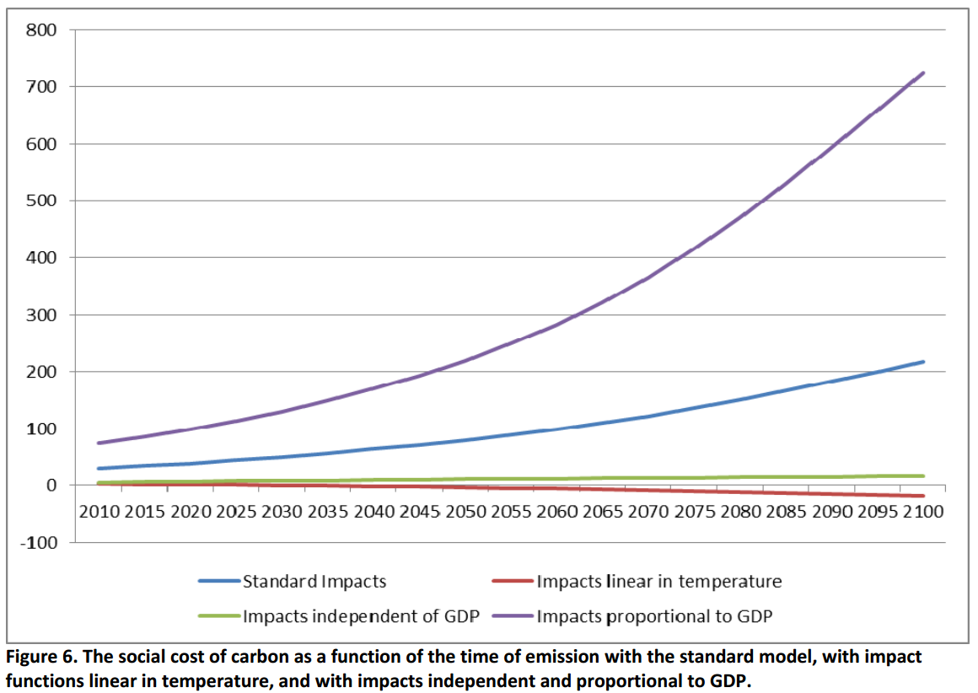
$75/tC
$30/tC
Anthoff et al. (under review)

Slide 28
Uncertainty

Slide 29
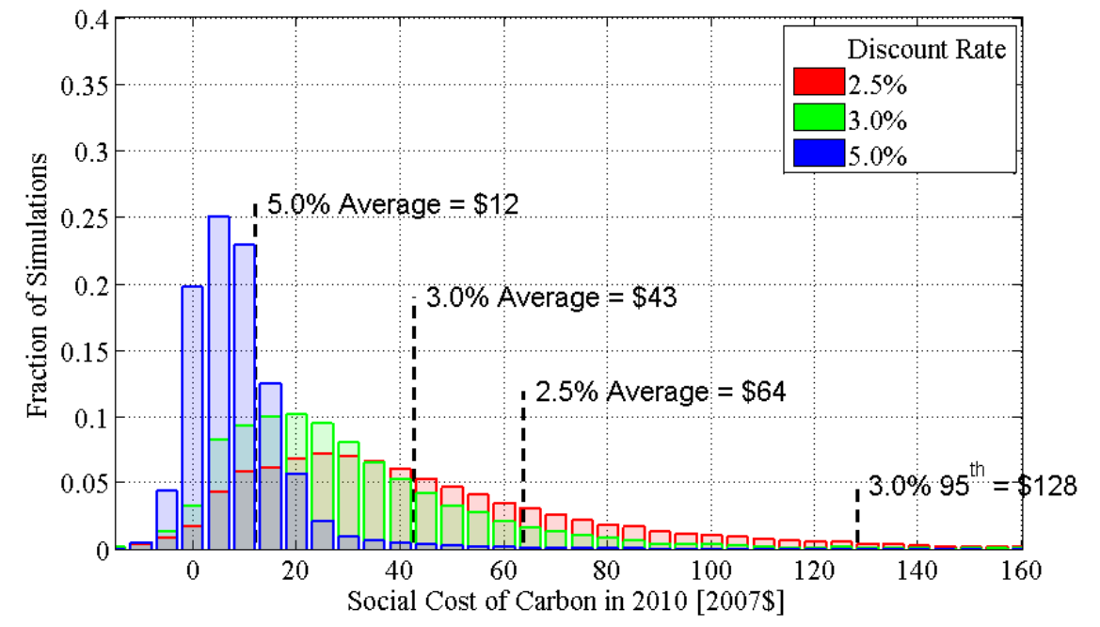

Slide 30
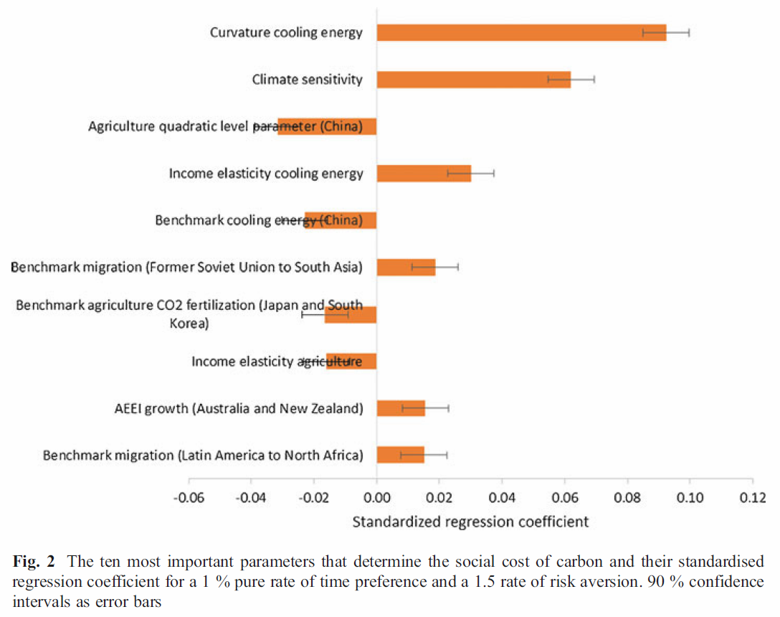
Anthoff & Tol (2013)

Slide 31
Outline
What is the SCC?
How is it used?
What determines the SCC?
Current research issues
Damage function calibration pipeline
Decision under uncertainty
Scenarios vs forecasts
Current research efforts

Slide 32
Damage function calibration pipeline

Slide 33
Damage function pipeline
Road blocks
Lack of welfare impact estimates
Lack of global coverage
Other drivers than climate
Process
Copy & Paste numbers from published studies…
Future
Component based models
Automation of calibration procedures

Slide 34
Decision under uncertainty

Slide 35
Decision making under uncertainty
A relatively new literature (with the exception of Kelly and Kolstad 1999) looks at the climate problem using frameworks from decision making under uncertainty (dynamic programming problems)
Key early work was Kelly and Kolstad (1999), and more recently the groups around Traeger and Judd.
Monte Carlo simulation:
You draw parameter values from distributions, then solve the model. Agents in the model do NOT face uncertainty
Decision making under uncertainty:
Agents in the model make their choices under uncertainty
Computationally not trivial to solve, distinct from the kind of models we are discussing today

Slide 36
Scenarios vs forecasts

Slide 37
Scenarios vs forecasts
Scenarios don’t have likelihoods attached
And yet, they are often used as if they were some form of probalistic forecast (averaging over scenarios implicitly assigns probabilities)
This field has received very, very little attention in the past (but that is changing now)

Slide 38
Outline
What is the SCC?
How is it used?
What determines the SCC?
Current research issues
Damage function calibration pipeline
Decision under uncertainty
Scenarios vs forecasts
Current research efforts

Slide 39
Two large scale efforts underway
Climate Impact Lab (Houser, Greenstone, Hsiang, Kopp et al.)
Develop new cost estimates of climate impacts using modern econometrics
RFF Social Cost of Carbon Initiative (network of partners)
Implement the National Academies recommendations

Slide 40
RFF SCC Initiative I
Provide a modular computational platform for integrated assessment models (Mimi.jl)
Develop probabilistic projections for relevant socio-economic variables, like GDP, population, emissions intensity
Statistical approach spearheaded by Stock, Muller and Watson
Expert elicitation spearheaded by Cooke
Create state-of-the-art natural science components (Berkeley, Penn State and Oxford collaboration)
Integrate existing damage estimates from the literature (and hopefully Impact Lab results once they are out)
Develop a discounting module compatible with the NAS recommendations (Pizer, Newell & Prest)

Slide 41
RFF SCC Initiative II
We see our initiative very much as providing a platform for collaboration
We want other groups to create modules on the Mimi.jl platform
We can provide support and help to other groups (to a certain degree)

Slide 42
Mimi.jl
Modular platform for integrated assessment models
Some goals:
Open source and free
Fast
Easy to use
Decentralized workflow
Transparency in research
Some non-goals:
We don’t aim to be the best platform for every type of IAM

Slide 43
Existing models on Mimi.jl
MimiFUND.jl
MimiDICE2010.jl
MimiDICE2013.jl
MimiRICE2010.jl
MimiPAGE2009.jl
Mimi-SNEASY.jl (private)
Mimi-FAIR.jl (private)
Mimi-MAGICC.jl (CH4 parts, closed)
Mimi-HECTOR.jl (CH4 parts, closed)
Mimi-CIAM.jl (closed)
Mimi-BRICK.jl (closed)
AWASH
PAGE-ICE
Local air pollution (Errickson, closed)
NICE (closed?)
NICER (closed?)

Slide 44
Groups using/collaborating
UC Berkeley (my lab)
RFF
Penn State (Klaus Keller’s lab)
Princeton University (Marc Fleurbaey and Rob Socolow’s group)
FEEM [or whatever their new name is] (planned)
A proposal out of Duke (planned)
LSE (James Rising)

Slide 45
Conclusion
Role in policy
Research state

Slide 46
Thank you!

