Slide 1
The 13th International Conference on
KNOWLEDGE AND SYSTEMS ENGINEERING (KSE 2021)
Leveraging CPLEX to solve the Vehicle Routing Problem with Time Windows (VRPTW)
November 10-12, 2021, Bangkok, Thailand & Online
Authors: Van Manh Tran, Thi Hong Nhan Vu
Presenter: Van Manh Tran
Notes:
1

Slide 2
Contents
2
Introduction
Mathematical formulation
The algorithm flowchart of the VRPTW problem optimization process
Experimental results
Conclusion
Discussion
Notes:
2

Slide 3
Introduction (1/2)
3
The problem of urban traffic has become increasingly urgent when the number of vehicles has increased rapidly while the transport infrastructure has not kept up with the increasing needs of passengers and drivers.
Ridesharing or vehicle sharing are the optimal solutions to save travel time and cost and enhance convenience for passengers and vehicle drivers.
The VRPTW, an expansion of Vehicle Routing Problem (VRP), has been examined in recent literature to find the most effective solutions to address the arrangement of customers with known requests while minimizing the cost on a given set of routes.
We present a model to address the VRPTW applying Mixed-Integer Programming (MIP) to optimize transportation costs and vehicles' numbers.
The time windows constraint is one of the most important components in the VRPTW as it depicts real life.
Notes:
3

Slide 4
Introduction (2/2)
4
The VRPTW aims to create a feasible solution to saving all customers with the minimum cost when solving the enforced constraints. The constraints include:
Each customer only visits once during its time window
Each vehicle should begin and end at the depot
The total needs of all customers in each route should be addressed but not exceed the vehicle capacity
Next, we will develop a Mixed Integer Programming (MIP) model to address the VRPTW to optimize both transportation costs and the number of vehicles.
We use Java language and IBM CPLEX library to perform the experiments with test data.
Notes:
4

Slide 5
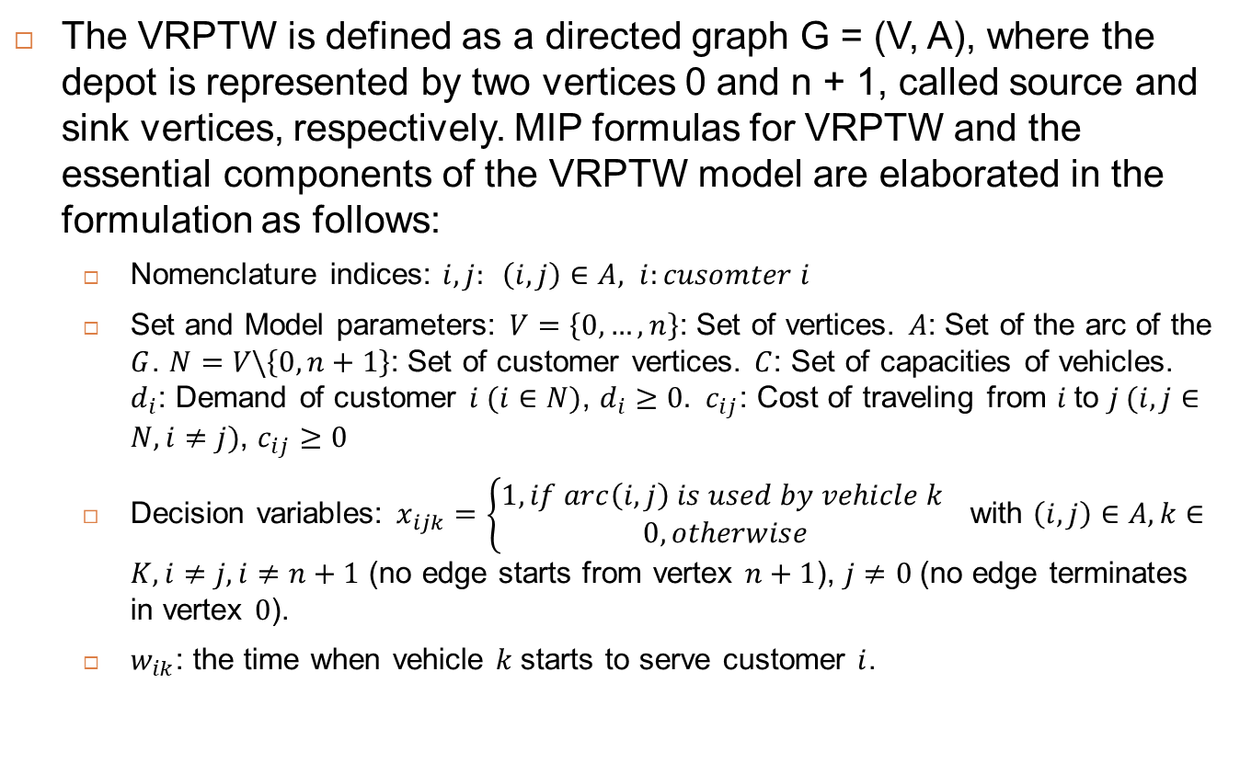
Mathematical formulation (1/3)
5
The VRPTW is defined as a directed graph G = (V, A), where the depot is represented by two vertices 0 and n + 1, called source and sink vertices, respectively. MIP formulas for VRPTW and the essential components of the VRPTW model are elaborated in the formulation as follows:
Nomenclature indices: $i, j: \left(i,j\right)∈A, i:cusomter i$
Set and Model parameters: $V=\left\{0,…,n\right\}$: Set of vertices. $A$: Set of the arc of the $G$. $N=V\backslash \left\{0,n+1\right\}$: Set of customer vertices. $C$: Set of capacities of vehicles. $d_{i}$: Demand of customer $i (i∈N)$, $d_{i}≥0.$ $c_{ij}$: Cost of traveling from $i$to $j (i,j∈N, i≠j)$, $c_{ij}≥0$
Decision variables: $x_{ijk}=\left\{\begin{aligned}1, if arc\left(i,j\right) is used by vehicle k \\ 0, otherwise\end{aligned}\right.$ with $\left(i,j\right)∈A, k∈K, i≠j,i≠n+1$ (no edge starts from vertex $n+1$), $j≠0$(no edge terminates in vertex $0$).
$w_{ik}$: the time when vehicle $k$starts to serve customer $i$.
Notes:
5

Slide 6
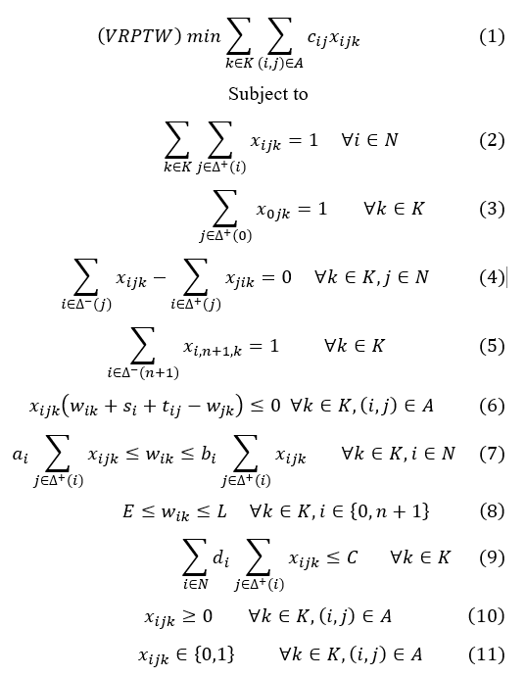
Mathematical formulation (2/3)
6
The objective of this model is to design a set of vehicle tours with the minimum total cost, satisfying:
Every customer is served only one
Each tour begins and ends at the depot
The capacity constraints and time window are guaranteed
The VRPTW can be formally described as the following multithreaded network model with vehicle capacity and time constraints:
Notes:
6

Slide 7
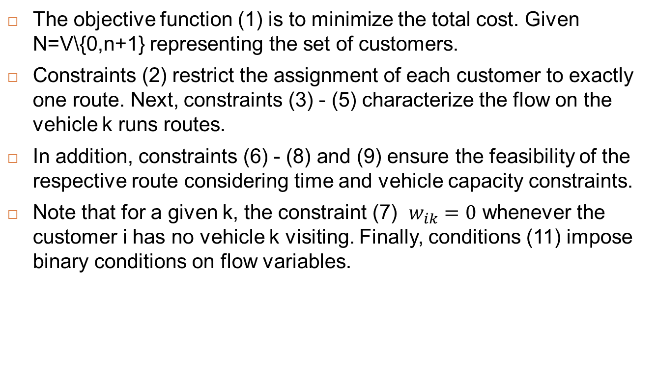
Mathematical formulation (3/3)
7
The objective function (1) is to minimize the total cost. Given N=V\{0,n+1} representing the set of customers.
Constraints (2) restrict the assignment of each customer to exactly one route. Next, constraints (3) - (5) characterize the flow on the vehicle k runs routes.
In addition, constraints (6) - (8) and (9) ensure the feasibility of the respective route considering time and vehicle capacity constraints.
Note that for a given k, the constraint (7) $w_{ik}=0$ whenever the customer i has no vehicle k visiting. Finally, conditions (11) impose binary conditions on flow variables.
Notes:
7

Slide 8
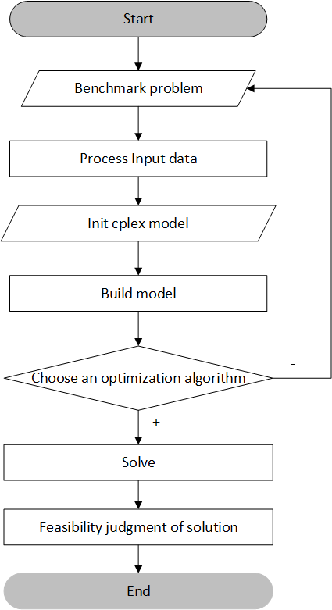
The algorithm flowchart of the VRPTW problem optimization process
8
The first, the benchmark issues were provided as .txt files. Then, these files are passed through an input processing process called Process Input data.
The second, we initialize the CPLEX model based on IBM's Cplex toolkit used for academic purposes.
The third, the model with the criteria stated is developed using methods/algorithms to optimize the model. Currently, two main search algorithms are used, specifically the Branch and Cut algorithm and Dynamic search algorithm.
Next, the feasibility of the solution will be evaluated based on the number of vehicles, vehicle load, time window, and vehicle capacity.
Finally, the total time of all routes will be calculated and optimized.
Notes:
8
d

Slide 9
Experimental results (1/5)
9
The experiment is designed to evaluate the performance of the proposed approach on two well-known standard cases of Solomon (1987).
The algorithm is implemented in IBM CPLEX version 12.9.0 with system configuration parameters, operation system windows 10, Processor: Intel(R) Core (TM) i5-10210U CPU @ 1.60GHz 2.11 GHz, RAM with 12GB RAM.
The data set C101, R101 are tested based on two search algorithms presented above. We do not include all samples in testing for the data set sample of the form RXXXX (specifically, RC101, we only run on 20 customers as the computer capacity does not allow).
Notes:
9

Slide 10
Experimental results (2/5)
10
Using Branch and Cut algorithm
C101 data set:
R101 data set:
No | Problem | No. of Customers | Object cost (distance) | Minimized number of vehicles | CPU time (sec)
1 | C101 | 10 | 58.10 | 1 | 0.15
2 | C101 | 20 | 175.00 | 3 | 0.66
3 | C101 | 30 | 205.70 | 3 | 1.66
4 | C101 | 40 | 343.90 | 5 | 5.02
5 | C101 | 50 | 362.40 | 5 | 18.46
6 | C101 | 60 | 469.00 | 6 | 21.48
7 | C101 | 70 | 607.50 | 7 | 77.85
No | Problem | No. of Customers | Object cost (distance) | Minimized number of vehicles | CPU time (sec)
1 | R101 | 10 | 269.20 | 4 | 0.16
2 | R101 | 20 | 510.30 | 7 | 0.44
3 | R101 | 30 | 680.60 | 10 | 1.10
4 | R101 | 40 | 885.70 | 11 | 23.29
5 | R101 | 50 | 1043.80 | 12 | 10.57
6 | R101 | 60 | 1138.40 | 13 | 26.39
7 | R101 | 70 | 1392.10 | 16 | 305.71
Notes:
10

Slide 11
Experimental results (3/5)
11
Using dynamic search algorithm
C101 data set:
R101 data set:
No | Problem | No. of Customers | Object cost (distance) | Minimized number of vehicles | CPU time (sec)
1 | C101 | 10 | 58.10 | 1 | 0.15
2 | C101 | 20 | 175.00 | 3 | 0.64
3 | C101 | 30 | 205.70 | 3 | 1.66
4 | C101 | 40 | 343.90 | 5 | 4.88
5 | C101 | 50 | 362.40 | 5 | 10.71
6 | C101 | 60 | 469.00 | 6 | 19.82
7 | C101 | 70 | 607.50 | 7 | 54.63
No | Problem | No. of Customers | Object cost (distance) | Minimized number of vehicles | CPU time (sec)
1 | R101 | 10 | 269.20 | 4 | 0.16
2 | R101 | 20 | 510.30 | 7 | 0.45
3 | R101 | 30 | 680.60 | 10 | 1.08
4 | R101 | 40 | 885.70 | 11 | 6.11
5 | R101 | 50 | 1043.80 | 12 | 147.73
6 | R101 | 60 | 1138.40 | 13 | 104.96
7 | R101 | 70 | 1392.10 | 16 | 848.36
Notes:
11

Slide 12
Experimental results (4/5)
12
In the clustered sample data set (C101), the Object cost and Minimized number of vehicles are equal. However, the running time of the algorithm is different.
For example, when the number of customers is from 10 to 30, the running time of the Branch and Cut and dynamic search algorithms is almost the same, but when the number of customers is from 40 to 70, the running time of the Dynamic Search algorithm is shorter.
Where the sample dataset of the sample is random (R101), the object cost and the minimum number of vehicles are the same.
When the number of customers is from 10 to 30, the running time of the Branch and Cut and dynamic search algorithms is not significantly different.
When the number of customers is in the 40s, the Dynamic search algorithm runs faster, but when the number of customers is from 50 to 70, the runtime using the Branch and Cut algorithm is better.
Notes:
12

Slide 13
Experimental results (5/5)
13
In the test [1], the authors just ran with a default algorithm without specifying which algorithm. In this article, two algorithms are used and implementation methods from which to have a better overview of the test dataset as well as in which cases the algorithm is better.
Although our testing on two small data samples, the results demonstrate that if the data of customers are clustered before vehicle routing, the system is more efficient in terms of reducing the cost and the number of vehicles.
It is difficult to compare with recent studies [2] [3] [4] due to different samples. However, this model also shows efficiency in terms of computation time and the number of vehicles.
Notes:
13

Slide 14
Conclusion and future research
14
This paper illustrates an approach to solve VRPTW using MIP to minimize transportation costs and the number of vehicles used simultaneously.
The proposed method has been tested on two well-known test cases of the Solomon benchmark problem. Calculation results show that both the cost and the number of vehicles are optimized at a reasonable time.
Sensitivity analysis for customer nodes was conducted on the model, the findings present that the computation time and the number of vehicles increased when the number of customer nodes increased.
This paper’s findings have widened several directions for our future research.
Further investigation on heuristic techniques and the ways is to integrate with MIP to improve their performance in future research.
Notes:
14

Slide 15
Thank you very much

Slide 16
References
16
[1] B. G. a. E. W. Feiyue Li, "The open vehicle routing problem: Algorithms, large-scale test problems, and computational results," Computers & Operations Research, vol. 34, no. 10, p. 2918 – 2930, 2007
[2] D. Aggarwal and V. Kumar, "Mixed-integer programming for vehicle routing problem with time windows," International Journal of Intelligent Systems Technologies and Applications, vol. 18, no. 4, 2019.
[3] M. D. Z. F. a. S. J. W. Wang C, "A parallel simulated annealing method for the vehicle routing problem with simultaneous pickup–delivery and time windows.," Comput. Ind. Eng, vol. 83, pp. 111-122, 2015.
[4] K. C. B. K. O. a. G. H. O. Polat O, "A perturbation based variable neighborhood search heuristic for solving the Vehicle Routing Problem with Simultaneous Pickup and Delivery with Time Limit. 242: 369–382," Eur. J. Oper. Res. , vol. 242, pp. 369-382, 2015.
Notes:
16

