Slide 1

Motorbike Case Study
David Chung
davidaristotle2012@gmail.com
0627899157
GitHub

Slide 2
Aim
To investigate the type of customers who will buy bikes.
Objectives
To perform Data Wrangling for analysis.
To determine the most significant factors that affect a customer’s decision.
To develop appropriate ML models using Python.
To make suggestions based on the findings.

Slide 3

Data Processing
After cleaning the table, categorical data was converted to a numeric format.

Slide 4
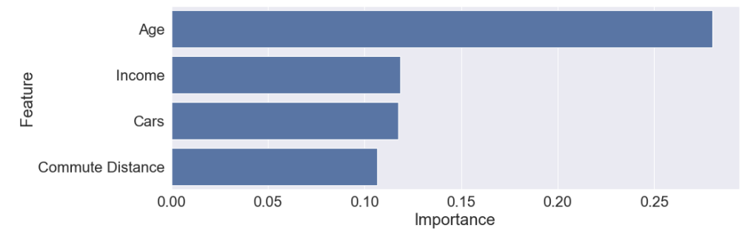
Feature Importance
The importance of each column in determining whether a customer will buy a bike was found using a Random Tree Classifier. (Larger Importance means more significant)

Slide 5
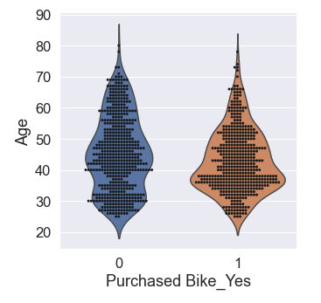
Age
It was found that:
Around 80% of people aged 30-40 have purchased a bike.
For ages 40-60, this is 45%.
For ages 25-30, this is 35%.

Slide 6
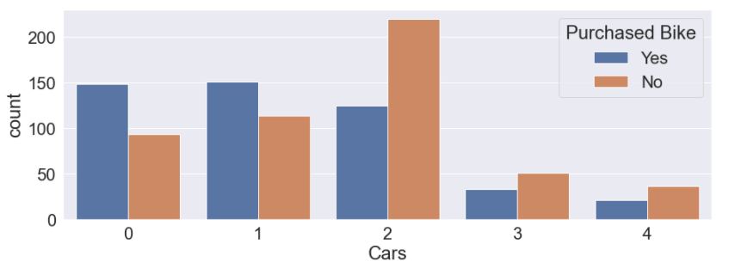
Cars Owned
65% of people across all ages who don’t have a car have bought a motorbike. This is 58% for people with a car.

Slide 7
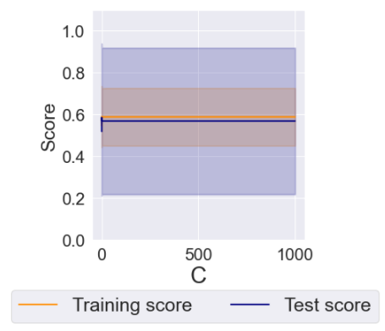
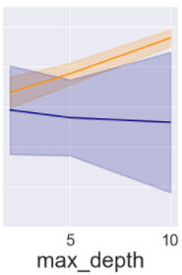
Modelling and Prediction
Logistic Regression, Decision Tree and Random Forests Models were developed. The prediction performance were relatively poor.( 5 fold Cross-Validation was used in both cases)
The logistic regression was underfit. This is probably due to non-linear relationships in the data.
The Decision Tree was severely overfit despite having used the best hyperparameters (obtained from Cross Validation).

Slide 8
Marketing Recommendations
Since bike ownership goes from 35% to 80% from age group 25-30 to 30-40, it can be implied that a lot of people aged 25-30 will be buying bikes in the next few years. (as they change age groups)Therefore, I would recommend aiming for 25-30 year olds.
Facebook could be used as a marketing platform because it has many users in the age range 25-34 (Around 35%). It also offers cheap customisable adds.
Store Location
Research must be done on where 25-30 year olds shop. Especially those without cars. This could include shopping malls, sport centres, etc.

