Slide 1
Chess UML for JS

Slide 2
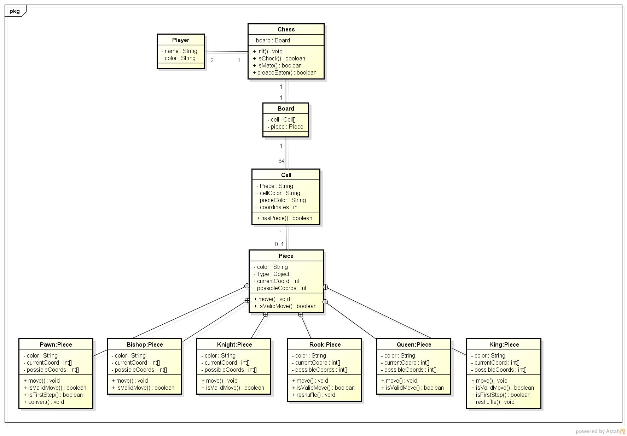

Slide 3
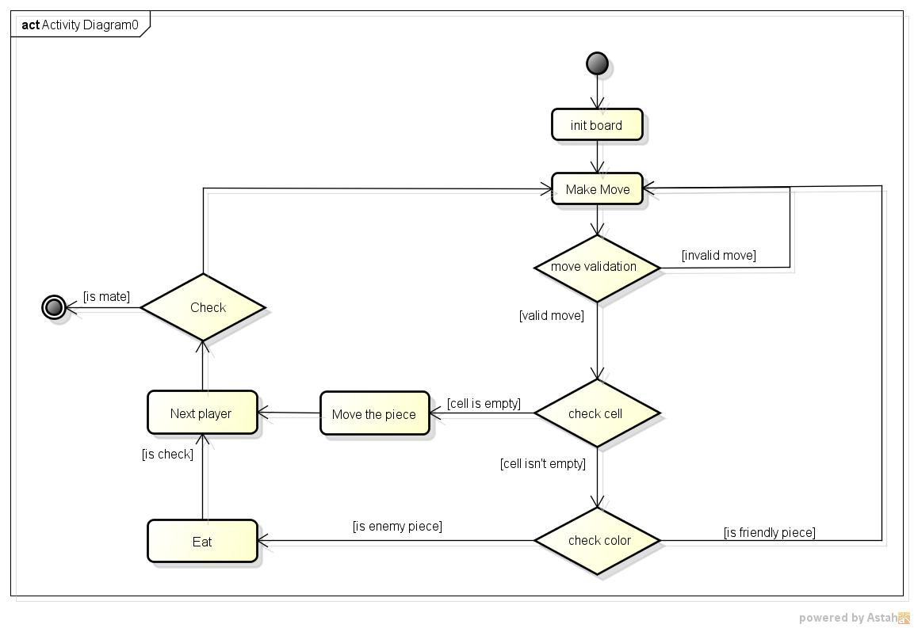

Slide 4
Aggregation and Composition
Chess
Board
Cells
Pieces

Slide 5
States
Chess
White’s turn
Checkmate
Black wins
White moves
Draw
Black moves
Black’s turn
white wins
Checkmate

Slide 6
Use cases
Chess
Play Chess
Player

Slide 7
UI – API
UI request data | API response data
Move(coordinates) | {moved: Boolean, gameEnded: Boolean}
Reshuffle(side) | True, false
Convert(type) | True, false
onGameStart | initBoard(), white’s turn
onDragStart | move()
onMove | getCurrentPosition(), getTargetPosition()
dragCanceled | coordChanged() = false
onDrop | coordChanged() = true
onDrop(moveNotValid) | coordChanged() = false
onDrop(enemyEaten) | removeEnemyPiece()

