Slide 1
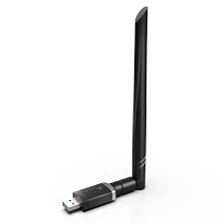
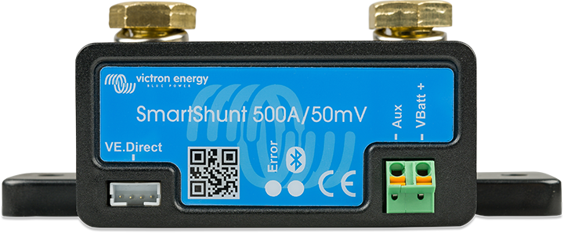
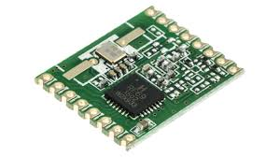
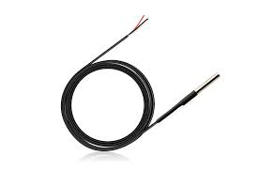
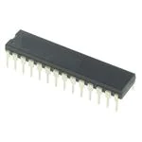
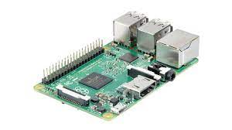
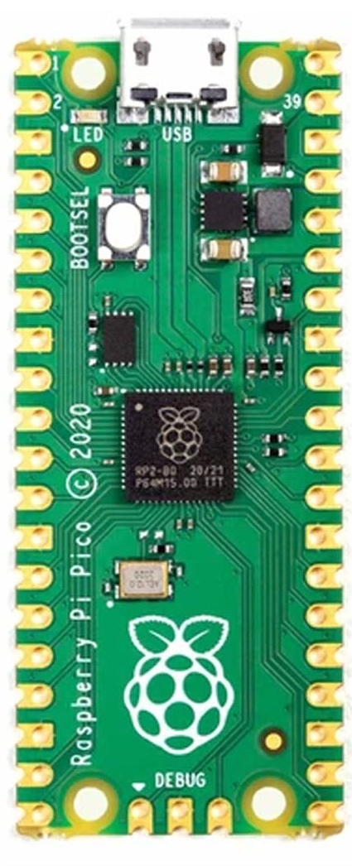
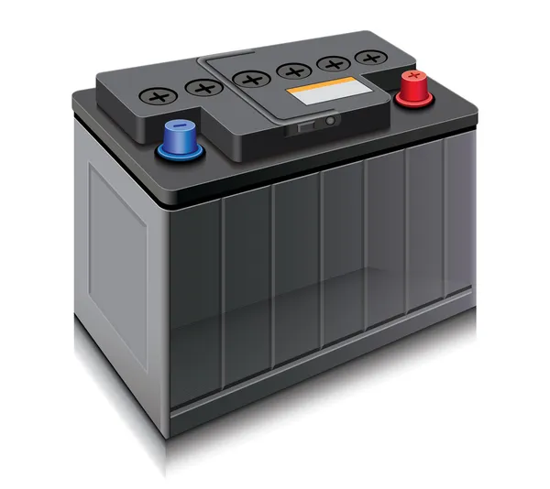
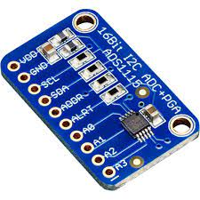


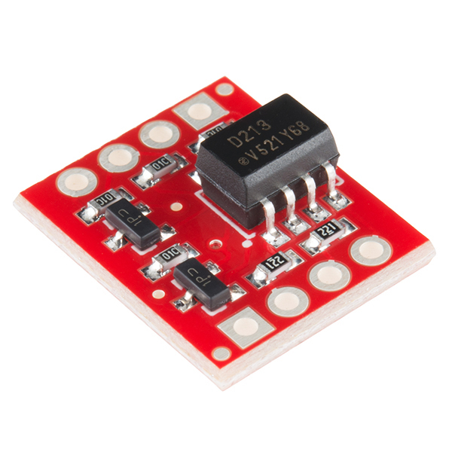
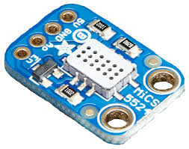
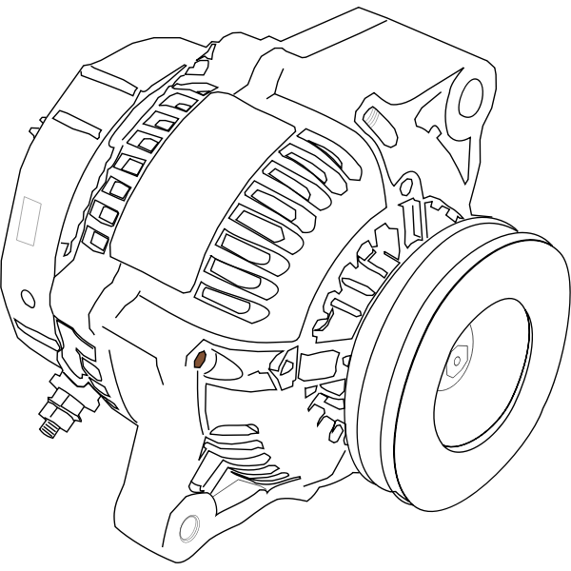
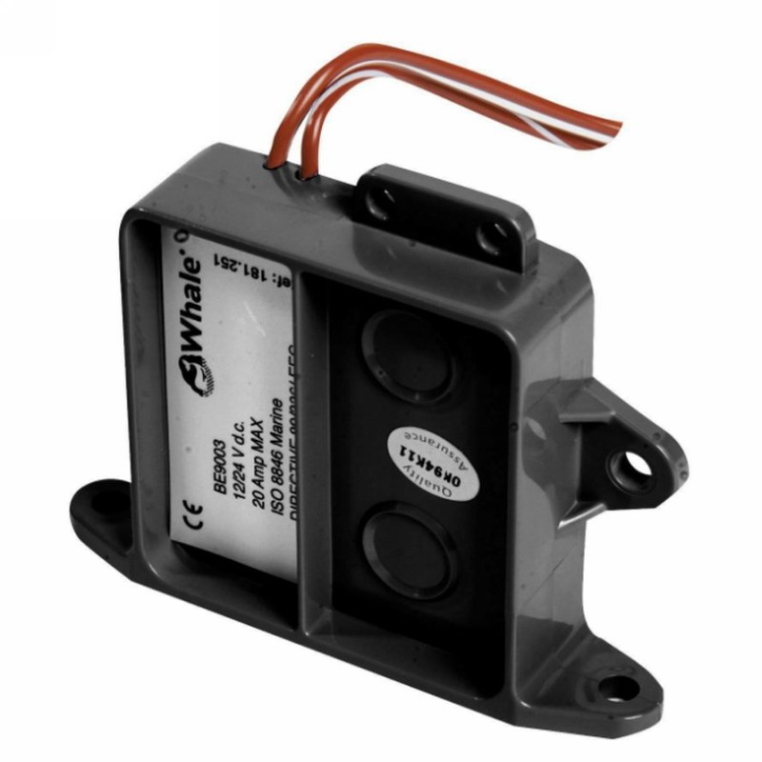
High Level Topology
USB
Smart Shunt for all
loads & chargers
RFM69HCW
RFM69HCW
SPI + Int
Wifi to marina or hotspot
UART
Ethernet
DS18B20
Refrigerator
MFD Chartplotter
Atmega328p
SPI
RFM69HCW
I2C
GPIO
USB
NMEA2K
I2C
Water Tank 1
Sensor
Pi Pico
Pi Model 2 B
Water Tank 2
Sensor
ADS1115
House Bank
1-Wire
NMEA 2000 bridge
Opto-Isolator
GPIO
Shunt for house loads
MiCS5524
VOC Sensor
Engine Bank
Tach Out
DS18B20
Cabin
DS18B20
Engine
DS18B20
Exhaust
All lines colored red have appropriate voltage dividers
Power for Smart Shunt, Pico, and Pi not illustrated
ADS1115
Alternator
Thruster Bank
Bilge pump sensor

