Slide 1
Programming

Slide 2


Different Languages (an analogy)
Me
-speaks English
Someone else
-speaks Arabic
Notes:
In order to explain what programming is, I will start with an analogy.

Slide 3





Translators
Spanish
French
English
French
Me
-speaks English
Someone else
-speaks Arabic
English
German
French
Arabic
Arabic
Farsi
Notes:
Ask class: Given the translators on the screen, how can we translate from English to Arabic?

Slide 4
Translators
Spanish
French
English
French
Me
-speaks English
Someone else
-speaks Arabic
English
German
French
Arabic
Arabic
Farsi
Notes:
Note that we use an intermediate language (French) to communicate between the English and Arabic speakers (the concept of intermediate language will show up again in a bit…)

Slide 5

Talking to Computers
Notes:
We will see similar translation paths in writing instructions for computers, but let’s set up the situation.

Slide 6
Talking to Computers
English
Person:
“Retweet all tweets that mention me.”
Notes:
A person can come up with an English statement of what they want the computer to do.

Slide 7
Talking to Computers
English
?
Binary
“Retweet all tweets that mention me.”
“011010000110010101101100011011000110111100100001”
Notes:
A computer runs instructions that are written in binary

Slide 8
Talking to Computers
English
Computers use binary (0s and 1s) to store:
Information
Instructions
Binary
Computer:
“00101010100010101010010101011101010101101001010101001010001010101001010010101001010010010101010010101001”
Person:
“Retweet all tweets that mention me.”
Notes:
A computer runs instructions that are written in binary

Slide 9
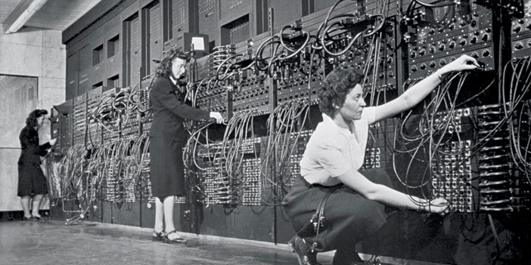
Talking to Computers: First Programmers
The First Programmers
English
Binary
“Retweet all tweets that mention me.”
“011010000110010101101100011011000110111100100001”
Notes:
ENIAC: the first electronic general-purpose computer (1945)
Kay McNulty, Betty Jennings, Betty Snyder, Marlyn Meltzer, Fran Bilas, and Ruth Lichterman
The photo shows, I am guessing, (Ruth Lichterman?), Marlyn Meltzer, Betty Jennings

Slide 10
Talking to Computers: First Programmers
First Programmers
English
Binary
“Retweet all tweets that mention me.”
“011010000110010101101100011011000110111100100001”
Three of the six original programmers on the ENIAC, the first electronic general-purpose computer (1945)
Notes:
ENIAC: the first electronic general-purpose computer (1945)
Kay McNulty, Betty Jennings, Betty Snyder, Marlyn Meltzer, Fran Bilas, and Ruth Lichterman
The photo shows, I am guessing, (Ruth Lichterman?), Marlyn Meltzer, Betty Jennings

Slide 11
Talking to Computers: First Programmers
First Programmers (1940s)
Computer:
“00101010100010101010010101011101010101101001010101001010001010101001010010101001010010010101010010101001”
Person:
“Retweet all tweets that mention me.”
Computers can do two things very quickly:
Arithmetic
2 + 2 = 4
Follow logical steps
When you press this button, then close the program
BUT…
This process is very tedious
Notes:
ENIAC: the first electronic general-purpose computer (1945)
Kay McNulty, Betty Jennings, Betty Snyder, Marlyn Meltzer, Fran Bilas, and Ruth Lichterman
The photo shows, I am guessing, (Ruth Lichterman?), Marlyn Meltzer, Betty Jennings

Slide 12
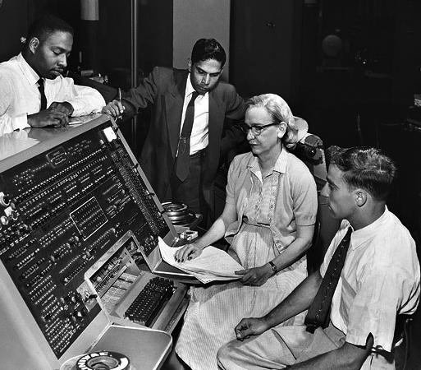
Talking to Computers: A Better Way
What if there were a computer language based on English? (1950s)
Computer:
“00101010100010101010010101011101010101101001010101001010001010101001010010101001010010010101010010101001”
Person:
“Retweet all tweets that mention me.”
Grace Hopper (photo c. 1960)
Notes:
Then in the early 1950s, Grace Hopper proposed creating a programming language based on English with a “compiler” that would turn that code into binary computer instructions.
She proceeded to create her own compiler and later helped design of some of the most important and influential early programming languages.

Slide 13
Talking to Computers: A Better Way
Computer:
“00101010100010101010010101011101010101101001010101001010001010101001010010101001010010010101010010101001”
Person:
“Retweet all tweets that mention me.”
Programmer
Notes:
So instead of what we used to do, with programmers taking what someone wants to happen and figuring out the binary computer code themselves...

Slide 14

Talking to Computers: A Better Way
Programmer
Interpreter / Compiler
Programming Language
(Python, R, Java, etc.)
Binary
English
“011010000110010101101100011011000110111100100001”
“Retweet all tweets that mention me.”
# get my twitter id
my_info = client.get_user(id = "me", user_auth = True)
my_id = my_info.data.id
# get all tweets that mention me
mentions = client.get_users_mentions(id = my_id)
# for each of the tweets that mention me:
for mention in mentions.data:
# retweet the tweet
client.retweet(mention.id)
Notes:
We now use an intermediate “programming language”.
In this class we will take ideas for programs written in English and translate them into Python code. The Python Interpreter will then translate this code into binary instructions, which the computer will then run.

Slide 15
Talking to Computers: A Better Way
Programmer
Interpreter / Compiler
Programming Language
(R, Python, Java, etc.)
Computer:
“00101010100010101010010101011101010101101001010101001010001010101001010010101001010010010101010010101001”
Person:
“Retweet all tweets that mention me.”
# get my twitter id
my_info = client.get_user(id = "me", user_auth = True)
my_id = my_info.data.id
# get all tweets that mention me
mentions = client.get_users_mentions(id = my_id)
# for each of the tweets that mention me:
for mention in mentions.data:
# retweet the tweet
client.retweet(mention.id)
Notes:
We now use an intermediate “programming language”.
In this class we will take ideas for programs written in English and translate them into Python code. The Python Interpreter will then translate this code into binary instructions, which the computer will then run.

Slide 16
Talking to Computers: A Better Way
Programmer
Interpreter / Compiler
Programming Language
(R, Python, Java, etc.)
Computer:
“00101010100010101010010101011101010101101001010101001010001010101001010010101001010010010101010010101001”
Person:
“Retweet all tweets that mention me.”
Programmer must do three things
Break down problem into steps for a computer
Write those steps down in a programming language
Run compiler / interpreter

