Slide 1
Discussion Section 5
HW4 questions
HW5: modeling translation start sites (TSSs)

Slide 2
HW5: create a motif model for TSSs
Due 11:59pm on Sunday, Feb. 11th
Assignment:
Parse a Genbank file (gbff format) with sequence info and annotated CDS locations
Write your own code to parse the file! Do not use a third-party Genbank file parser.
Using the CDS information, compute a site weight matrix for a 21bp motif centered at the translation start site
Using the weight matrix, compute scores for annotated CDS translation start sites and for non-annotated positions

Slide 3
Genbank flat file format (.gbff)
Feature list
Each locus has entries for gene, mRNA, and CDS
CDS features are coding sequences (these are the entries we care about)
‘complement’ indicates the reverse complement
ORIGIN
Located after the feature list, at the end of the file
Contains the genome sequence

Slide 4
Genbank flat file format (.gbff)
FEATURES Location/Qualifiers
source 1..2895605
/organism="Plasmodium falciparum 3D7"
/mol_type="genomic DNA"
/isolate="3D7"
/db_xref="taxon:36329"
/chromosome="13"
gene 21467..28890
/gene="VAR"
/locus_tag="MAL13P1.1"
/db_xref="GeneID:813647"
mRNA join(<21467..26641,27577..>28890)
/gene="VAR"
/locus_tag="MAL13P1.1"
/transcript_id="XM_001349702.1"
/db_xref="GI:124512763"
/db_xref="GeneID:813647"
CDS join(21467..26641,27577..28890)
/gene="VAR"
/locus_tag="MAL13P1.1"
/codon_start=1
/product="erythrocyte membrane protein 1, PfEMP1"
/protein_id="XP_001349738.1"
/db_xref="GI:124512764"
/db_xref="GOA:Q8IEV1"
/db_xref="InterPro:IPR008602"
/db_xref="UniProtKB/TrEMBL:Q8IEV1"
/db_xref="GeneID:813647"
/translation="MGPPGITGTQGETAKHMFDRIGKQVYETVKNEAENYISELEGKL SQATLLGERVSSLKTCQLVEDYRSKANGDVKRYPCANRSPVRFSDESRSQCTYNRIKD…"
.
.
.
ORIGIN
1 taaaccctga accctaaacc ctaaaccctg aaccctaaac cctaaaccct aaacctaaac
61 ctaaaccctg aaccctaaac cctgaaccct gaaccctaaa ccctaaaccc tgaaccctaa…

Slide 5
Some more CDS examples
CDS 96094..97215
/locus_tag="PTSG_00022"
/codon_start=1
/product="hypothetical protein"
/protein_id="EGD72006.1"
/db_xref="GI:326426436"
/translation="MVVAAGSGGASRPTNAPSCPLCPGGSVGGAVLMVVPLLVCIALL
AGCLSVSSLWRRNKRQRHAPQYASTCASGRAKPNKRAAPRVQPDLRLPHQQQQPQHPQ...“
CDS join(10183..10943,11138..11246,11408..11525,11697..11815,
12006..12056,12284..12445,12661..12792,12989..13135,
13293..13400,13597..13661,13848..13957,14104..14208,
14364..14440,14606..14773,14909..15013)
/locus_tag="PTSG_00005"
/codon_start=1
/product="hypothetical protein"
/protein_id="EGD71989.1"
/db_xref="GI:326426419"
/translation="MMMMMMMMRPCCSLPSTWWLVVVVLAAACCAATPTAAAVPAAAP
AEAADPSVVNVGQFVVSLDEDGVLSAVRNPAQMPNPHLAWHSTGEILEVAASKMYLHG...“
CDS complement(join(15291..15934,16108..16234,16358..16394,
16582..16790,17086..17196,17376..17456,17810..17877,
18020..18060,18199..18256,18556..18598,18767..19187,
19334..19410,19552..19631,19795..19917,20098..20183,
20449..20577,20789..20904,21261..21449,21667..21787,
21936..22108,22453..22549,22808..22934,23895..23970,
24140..24246,24389..27209))
/locus_tag="PTSG_11525"
/codon_start=1
/product="hypothetical protein"
/protein_id="EGD71990.1"
/db_xref="GI:326426420"
/translation="MWRSWRHGEVGSGVAGGENGKDAQQASSNSHGSHGSHGSNHPNG
NHGGSSDNVGSSHDERSSSDREQERGQVQRRKRRHARMHEKHASNHAASSVARPSRLT...“

Slide 6
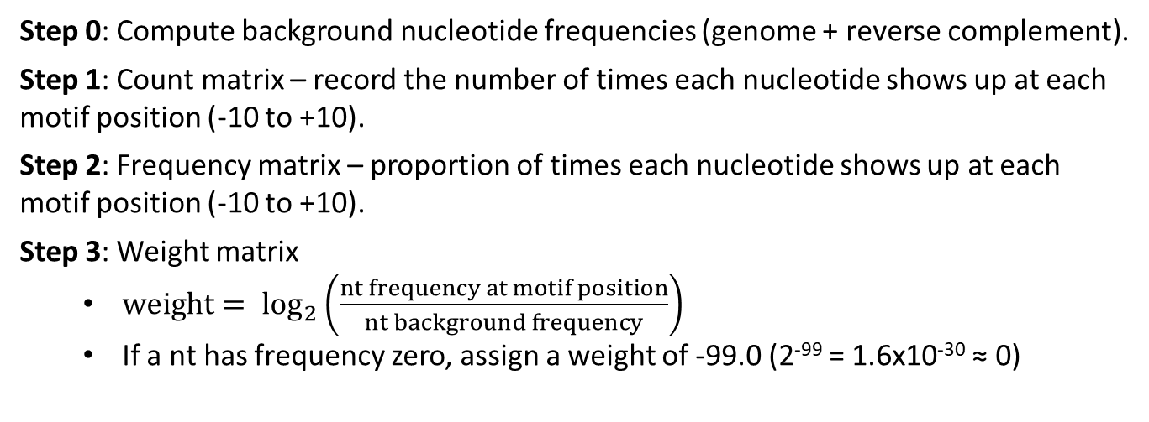
Computing a TSS site weight matrix
-10
0
+10
+10
0
-10
5’
3’
3’
5’
Step 0: Compute background nucleotide frequencies (genome + reverse complement).
Step 1: Count matrix – record the number of times each nucleotide shows up at each motif position (-10 to +10).
Step 2: Frequency matrix – proportion of times each nucleotide shows up at each motif position (-10 to +10).
Step 3: Weight matrix
${weight= log}_{2}\left(\frac{nt frequency at motif position}{nt background frequency}\right)$
If a nt has frequency zero, assign a weight of -99.0 (2⁻⁹⁹ = 1.6x10⁻³⁰ ≈ 0)

Slide 7
Computing site scores
-10
0
+10
+10
0
-10
5’
3’
3’
5’
Score for a position = sum of the weights for each nucleotide in the 21bp motif centered at that position
Scores for a position are strand-specific (different for forward vs. reverse)
Compute scores for all possible positions (both strands)

Slide 8
Noncontiguous CDSs
Positions downstream of the translation start site could be noncontiguous
join(1000…10008, 1200…1500)
How would you construct the TSS motif?

Slide 9
Reporting score histograms
Score Histogram All:
-5 101880
-4 76413
-3 54704
-2 38081
-1 27202
0 21440
1 18671
2 18825
3 19072
4 18675
5 17308
6 14429
7 10595
8 6915
9 3886
10 1850
11 699
12 225
13 46
14 4
lt-50 6132782
Two histograms:
All genomic positions
Positions that are annotated CDS TSSs
Group scores into bins of size 1 (round down to nearest integer)
Format – two columns:
Score bin
Number of sites with that score
Print all bins with at least one count
Put all scores less than -50 into one bin

Slide 10
Position list
List of non-CDS positions with a motif score >= 10
Format – three columns:
1-indexed genome position (on forward strand)
Strand indicator (0 for forward, 1 for reverse)
Score (to four decimal places)
Position List:
1899 0 10.1167
2274 0 10.1923
2502 0 10.1098
4646 0 10.5886
5252 0 10.5534
6127 0 11.0669
7250 1 10.0453
11016 1 10.1616 ...

Slide 11
HW5 output summary
Nucleotide histogram
Background nt frequencies (based on both strands)
Count matrix (-10 to +10 nucleotides)
Frequency matrix (-10 to +10 nucleotides)
Weight matrix (-10 to +10 nucleotides)
Maximum score
Score histogram for annotated CDS TSSs
Score histogram for all positions
List of non-CDS positions with score >=10

Slide 12
HW5 Tips
Looking only for ‘CDS’ features
Only consider positions where location is certain (no < or >)
Positions downstream of the translation start site could be noncontiguous
join(1000…10008, 1200…1500)
Also watch out for multi-line joins (c.f. examples 2 & 3 in slide 5)
Precision matters! (use doubles over floats)
Make sure outputs make sense (ATG…)

