Slide 1


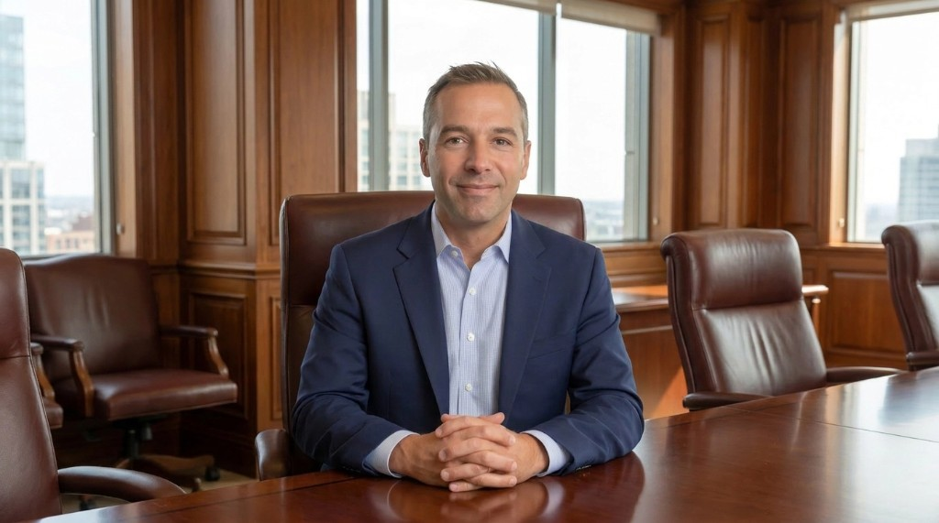
ANGEL
PLATFORM
PROOF
PILOTS
ANGEL / PRE-SEED
AI digital workers for client work.
ParlayVU turns meetings, source material, approvals, and follow-up into an operating system for expert firms.
LEAD ORCHESTRATOR
Nathan Ellis
$100k-$300k raise
Teams/M365 beachhead
RamAir proof
Coordinates strategy, agent routing, approval gates, and final delivery.
VU is your brand. Parlay your VU.
Agentic client-work operating system
01/12

Slide 2
PROBLEM
PLATFORM
PROOF
PILOTS
PROBLEM
FILES
Client work leaks margin after every call.
FOLLOW-UP
source material
client-ready next steps
NOTES
transcripts, recaps
Generic AI drafts assets. Expert firms still need the whole workflow coordinated.
Meetings
CONTENT
Memory
posts, pages, emails
Approvals
Outputs
CLIENT CALL
TASKS
owners, deadlines
REPORTING
APPROVALS
dashboards, updates
claims, sends, deploys
The buyer pain is not one prompt. It is memory, routing, governance, and repeatable delivery.
Agentic client-work operating system
02/12

Slide 3
SOLUTION
PLATFORM
PROOF
PILOTS
SOLUTION
Nathan runs the client workflow from Teams.
A front-door orchestrator routes work to specialist agents, grounds it in project memory, and keeps approvals visible.
1
Brief Intake
2
Agent Routing
3
Asset Factory
4
Launch Loop
audience, source, constraints
right specialist, visible handoff
notes, sites, emails, dashboards
approve, deploy, refine
Human approval gates govern client-facing sends, publishing, deployments, claims, and commitments.
Agentic client-work operating system
03/12

Slide 4
PRODUCT
PLATFORM
PROOF
PILOTS
PRODUCT
A Microsoft-native client-work OS.
FRONT DOORS
Teams messages | M365 Files | Word | email/task surfaces | web/demo UI
Teams and Microsoft 365 are the launch surface customers already use, not the company’s ceiling.
ORCHESTRATION
Nathan | FastAPI/LangGraph | specialist agent registry | readiness checks
MEMORY + GOVERNANCE
clients | projects | source assets | approval states | agent events
OUTPUT SYSTEMS
meeting notes | approval packets | campaign sites | dashboards | follow-up
Working proof: routing, memory scaffold, Files outputs, approvals
Roadmap: native Teams audio/video media bridge
Agentic client-work operating system
04/12

Slide 5
PROOF
PLATFORM
PROOF
PILOTS
WHAT EXISTS NOW
The demo proves the operating loop.
NATHAN ROUTING
M365 FILES
APPROVALS
Teams-style messages against project memory
meeting notes as .md and .docx
endpoints and Teams-ready cards
Current proof is specific: workflow infrastructure, seeded pilot artifacts, and approval-aware outputs.
RAMAIR WORKSPACE
AVATAR VALIDATION
READINESS CHECKS
channel model, artifacts, dashboard starter
provider-hosted Tavus path; native Teams A/V remains roadmap
LLM, memory, M365, Teams, avatar, approvals
Credibility boundary: do not imply mature SaaS traction or production native Teams media until pilots and media bridge validation prove it.
Agentic client-work operating system
05/12

Slide 6

CASE STUDY
PLATFORM
PROOF
PILOTS
PARLAYVU IN THE FIELD
RamAir turns one weekly podcast into a content engine.
OUTPUT
OUTPUT
OUTPUT
YouTube + site
Short clips
Social posts
The first client story shows the repeatable pattern: source material becomes governed outputs across channels.
OUTPUT
OUTPUT
OUTPUT
Transcript insights
Case studies
Sell sheets
RAMAIR / RAMAIR.CO
Straight from the Hart
Podcast source material becomes a coordinated workspace and distribution cadence.
Use as pilot proof of a workflow pattern, not broad SaaS traction.
Agentic client-work operating system
06/12

Slide 7
MARKET
PLATFORM
PROOF
PILOTS
MARKET + MODEL
Start where expertise becomes deliverables.
IDEAL EARLY CUSTOMER
INITIAL PROMISE
REVENUE PATH
Boutique agencies, consultants, coaches, professional services firms, and expert-led businesses already using Microsoft 365.
Turn client meetings and source material into approved deliverables, updates, and follow-up inside the tools the firm already uses.
Pilot setup fee plus monthly subscription by clients/projects, agent seats, integrations, outputs, and premium workflow modules.
Founder-led pilots reveal the repeatable workspace subscription modules.
Ann Arbor/Michigan is the launch network and credibility base, not the market ceiling.
Agentic client-work operating system
07/12

Slide 8
GTM
PLATFORM
PROOF
PILOTS
GO TO MARKET
Founder-led pilots create the first playbook.
1
2
3
4
5
Sell one concrete workflow, measure the outputs, then template the repeatable pieces.
INTRODUCTIONS
RAMAIR-STYLE PILOT
PROOF METRICS
TEMPLATES
REFERRALS
angels, operators, agencies
one workflow, visible outputs
time saved, output cadence
notes, packets, dashboards
adjacent firms, same pain
3-5 pilots are enough to convert a services-assisted motion into a productized client-workspace package.
Agentic client-work operating system
08/12

Slide 9
DIFFERENTIATION
PLATFORM
PROOF
PILOTS
DIFFERENTIATION
Not another blank chat box.
GENERIC AI
drafts content, but loses workflow context
PARLAYVU
ParlayVU combines memory, governance, and outputs in the Microsoft workflow where client work already happens.
Coordinates client work across memory, agents, approvals, and outputs.
CONTENT TOOLS
help make assets, not client operations
Teams/M365 is the wedge. The durable value is governed agentic workflow.
Agentic client-work operating system
09/12

Slide 10
ROADMAP
PLATFORM
PROOF
PILOTS
ROADMAP
90 days to pilot-ready product.
30 DAYS
60 DAYS
90 DAYS
LATER
Sequence core workflow hardening before making bigger native media claims.
Polish RamAir workspace, notes, approvals, readiness, demo script
Package onboarding templates and run 3-5 qualified pilot conversations
Paid pilots or LOIs, measurable outputs, pricing and module clarity
Validate native Teams roster/media bridge after Graph and provider terms
Agentic client-work operating system
10/12

Slide 11
ASK
PLATFORM
PROOF
PILOTS
ASK
Raising $100k-$300k to turn proof into revenue.
Product hardening
Pilot delivery
M365 / Teams integration
$100k–$300k
Angel / pre-seed raise
Capital plus pilot/customer introductions are equally valuable at this stage.
Avatar validation
Design + pitch assets
Founder-led GTM
Target: RamAir polished, 3-5 qualified pilots active, first paid pilots or signed LOIs within 90 days of funding.
Agentic client-work operating system
11/12

Slide 12
START
PLATFORM
PROOF
PILOTS
VU is your brand. Parlay your VU.
Investor asks
ParlayVU turns every client interaction into approved work, reusable memory, and distribution-ready output.
Small checks Pilot introductions Microsoft 365 operator/customer intros
Book a strategy call
Agentic client-work operating system
12/12

