Slide 1
Peer-to-Peer Network Interface Simulation
David Baschung - Augustin Martignoni
Concurrent and Distributed Computing
Semester Project SA 2020

Slide 2
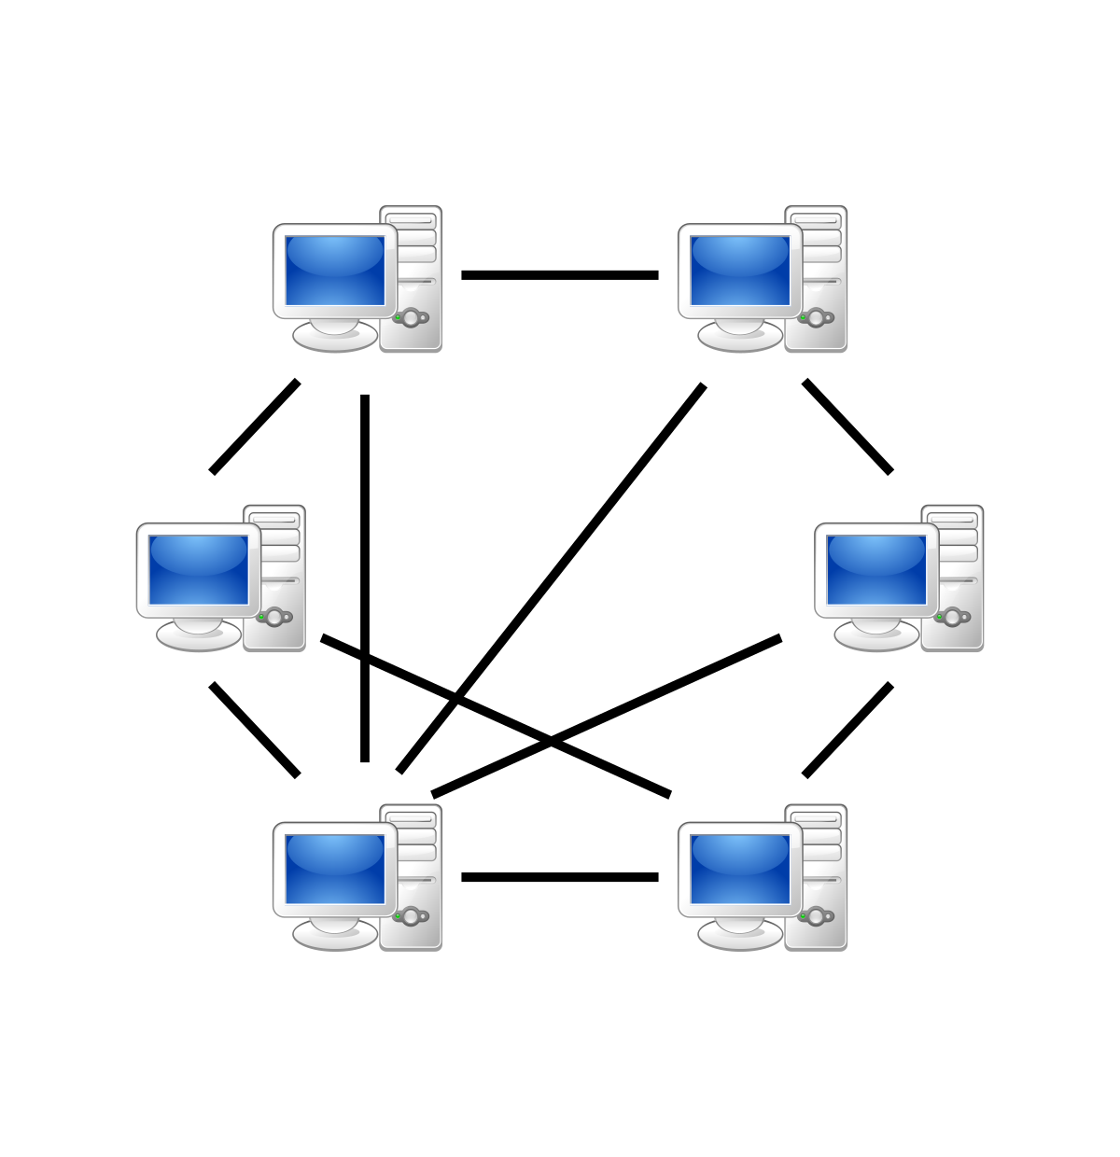
Context
Peer-to-Peer download Network
Nodes have neighbours and costs
Nodes have files
Tracker server sometimes
Notes:
Slide présentée par Augustin
P2P : distribtued, sparsely and directly connected, : minimizes latency. No server, no client ⬄ Seeder, Leechers
Neighbours & Costs : difficulty for finding destination
Files : Data. Sharing file names is difficult
Tracker for address+files. Implemented in our project.

Slide 3
Goals
Simulation, built network with given nodes
Interface for individual node usage
Download files from multiple sources in the network
Notes:
Slide présentée par Augustin
Simulation : Build network, host nodes, give neighbouring costs. Nodes of the network are processes and are listed in the tracker.
Nodes can be used to download from other nodes in the network, (back-end dev).
Multiple Sources : several paths for the same file

Slide 4

Implementation – Network creation
Tracker as initial process, launches nodes
Tracker and nodes are loops
Tracker primitives :
Return current network
Print network
Notes:
Slide présentée par David
Tracker inits Nodes in deployNetwork+deployNode+addNodeToNetwork, gives Neighbouring and Costs attributes. Predefined list for custom network.
Loops : each can send messages to each other
Primitives : no functions, asynchronous system.
Current network : asked at beginning of download/upload. Gets latest updated network (in case add/remove nodes)

Slide 5

Implementation – Node actions
Nodes loops messages
Nodes primitives :
Download from one or multiple sources
Upload
Declare/add/remove files
Notes:
Slide présentée par David
- Node is a loop and asynchronous, Download and upload at the same time,
Download from one source : sends download orders recursively on one path, until source. Order : File+Path to upload back to the requester
Upload (for source), uploads back on the given path. Like download but path inverted. Also, Nodes on the path don’t save the File, only transmit as parameter.
Declare files (for tracking), ofc add (rem)

Slide 6
Evaluation
Successfully downloads from multiple sources
Failed for shortest path discovery
Further development :
Real files, cut it in pieces
Node Failure Management
Notes:
Slide présentée par David
Downloads from multiple sources instead of several paths for same source
Shortest paths : was blocking nodes, we removed it. Paths must be entered during download.
- Real files : filenames yet.
- Failure mgmt : during a download, removing and re-adding crashed nodes, updating neighbours costs list

Slide 7
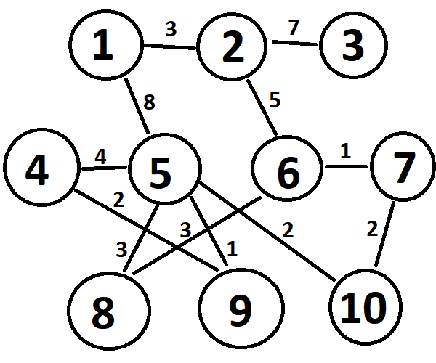
Demonstration
Notes:
Slide présentée par David

Slide 8
Questions

